Slide 1

THIS PRESENTATION INCLUDES :
CLASSIFICATION OF FUSES
low voltage fuses
High voltage fuses
Working of fuse
Merits and demerits of fuse
Presentation by
parineeta g p
Poorvik achary
Pradyumna shettigar
Pavan kulkarni

Slide 2
CLASSIFICATION OF FUSES
Fuses may be classified as follows
Low Voltage Fuses
High Voltage Fuses
(a)Low Voltage Fuses:
In order to limit the damage caused by fault currents of high value, the arc should be prevented from re-striking after passing through the zero value of the AC cycle. This is done by means of a semi-enclosed or enclosed fuse where the element is shrouded, so that the gases produced on melting of the fuse are cooled; moreover, shrouding also prevents the scattering of molten metal.

Slide 3
Semi-enclosed rewirable fuses: These fuses have one or more strands of fuse wire stretched between terminal blocks and are mounted on a moulded or porcelain handle. The use of these type of fuses is limited to power points where low values of fault currents are to be handled. Fuses of this type are made upto about 500 amperes rated current, but their low breaking capacity makes them unsuitable for power system applications.
Enclosed Fuses: Enclosed fuses have the element surrounded by an asbestos tube or by incombustible powder. The latter are called cartridge fuses; the fusible elements are usually made of silver, which has a low ohmic loss and is immune to oxidation. These are surrounded by filling powder having good are extinguishing properties, and are all encased in a ceramic body of high strength.

Slide 4
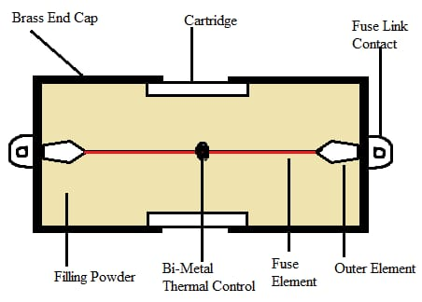
H.R.C Fuses: Modern cartridge fuses have a high rupturing capacity, are non-deteriorating, have a consistent fusing current, so that they can be graded to operate in correct sequence. The fusing factor for such type of fuses may lie
The space within the body surrounding the elements is completely filled with incombustible powder, usually quartz, which has excellent are extinguishing properties.
The operation of the fuse is performed with the following steps:
Melting of the fuse element
Vaporization of the element
Fusion of silver vapour and filling powder
Extinction of arc due to fusion.

Slide 5
(b) High Voltage Fuses
High voltage fuse elements should be enclosed in a strong casing as the fuse may melt with explosive violence.
The element may be immersed in oil or carbon tetrachloride so as to extinguish the arc.
One type of high voltage fuse is specially designed to fuse at a current which is a little higher than its current rating, i.e., it has a low fusing factor, which enables it to be employed in place of a circuit breaker, together with an over-load trip for protection against overload as well as short-circuit.

Slide 6
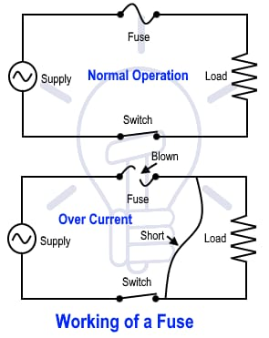
WORKING OF A FUSE

Slide 7
The Electric Fuse works on the basis of the heating effect of the Electric Current.​
It is composed of a non-flammable thin metallic wire with a low melting point.​
If a high amount of Electricity is passed from the Electric Fuse, there is a production of heat which causes the Fuse to melt which leads to the opening of the Circuit and the blockage of Current.​
Once a Fuse melts, it can be changed or replaced with a new Fuse.​
A Fuse acts as a circuit breaker and breaks the circuit in case any fault occurs in the circuit. It acts as a protector of Electric appliances and also as a safety measure for humans. The figure below represents a Fuse operation, Fuse barrel and Fuse link.​

Slide 8
Merits of Fuses :
The capability of clearing high values of short circuit.
High speed operation.
Consistent performance.
Low cost as compared to other types of circuit interruptors.
Demerits :
Replacement is necessary after every operation.
The fuse assemblies are by nature prone to high temperature rise. Though this is not a disadvantage in the fuse, it is likely to affect associated switches etc. unless proper steps are taken to prevent it.
Fuses might have slower response times compared to some electronic protection devices, which could be crucial in certain applications.

Slide 9
THANK YOU

