Slide 1
Why ZEN (instead of ZEB)? View from WP4: Energy flexible neighborhoods
Igor Satrori, SINTEF Byggforsk
ZEN PhD course, 01.01.2018
Notes:
Bildet illustrerer:
· bredden i SINTEFs ekspertise, fra havrom til verdensrom.
· hvilke områder og bransjer vi jobber innen for å realisere visjonen Teknologi for et bedre samfunn.
Bildestilen er basert på stikkordene fremtidsrettet, teknologi og norsk natur (naturressurser). SINTEFs visuelle univers er utviklet for SINTEF av Headspin Productions AS.

Slide 2
Why ZEN (instead of ZEB)?
What is the effect of ZEB/ZEN on the overall decarbonisation of society?
…or at least of the energy system?

Slide 3
3 things to consider
Energy efficiency
Onsite (nearby) energy generation
Energy flexibility

Slide 4
Energy efficiency
Energy demand
If the cake gets half the size, the % of renewables "automatically" becomes the double
[OK, it is not really that simple, but…] Are we emphasizing enough the role of energy efficiency?
Energy demand / 2

Slide 5
Energy efficiency
The "elephant in the room" is the existing building stock

Slide 6
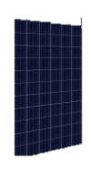

Onsite (nearby) energy generation
As long as it is (instantaneously) self-consumed it is the same as energy efficiency from the grid's viewpoint (it reduces demand)
But there is a difference: it (often) comes with some export
This can help increase the % of renewables in the grid/market – without claiming more land use – but might happen when it is not convenient
How do we deal with it?

Slide 7
Onsite (nearby) energy generation
After all:
Solar technology (on the building's envelope) is just a construction material that happens to produces some energy
CHP (Combined Heat and Power) is just a particular type of heating system

Slide 8
Energy flexibility
Many energy uses in buildings are flexible, i.e. can be shifted back and forth a few hours without affecting the users
E.g. heating/cooling (exploiting the buildings' thermal mass), hot water tanks, EV charging
Using both physical and virtual storage (Demand Response), electric and thermal
Unlike instantaneous self-consumption it differs from energy efficiency because it has losses

Slide 9
Energy flexibility
Energy flexibility is about demanding (and evt. supplying) energy when it is convenient for the system
There are two main goals with energy flexibility:
Market goal: better match demand with supply of fluctuating renewables
→ follow the sun, follow the wind
Grid goal: avoid congestion problems in the grids ("shave peaks")
→ flatten the load profile
So controlling the flexibility options makes sense at aggregated level
But:
What do we know about it?
How can we characterize it?
How can we use it?
These are the main topics or research in WP4

Slide 10
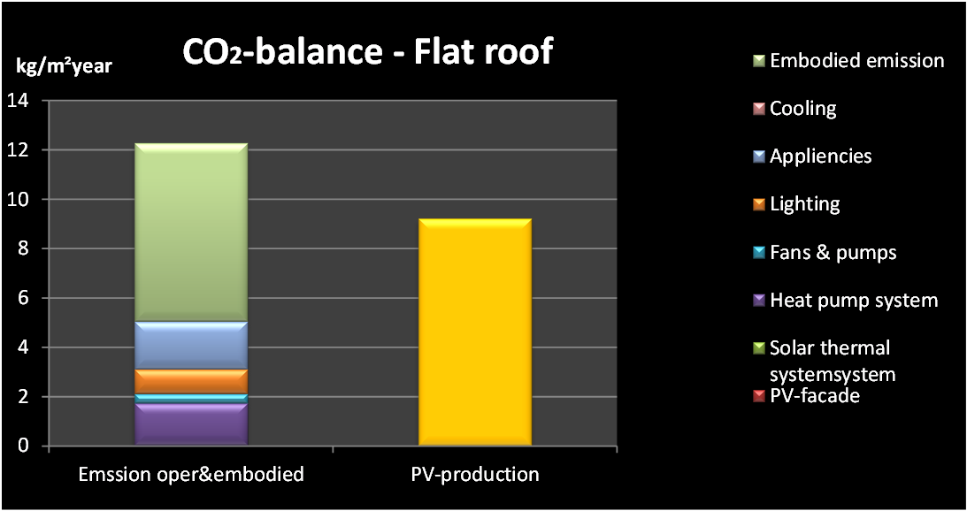
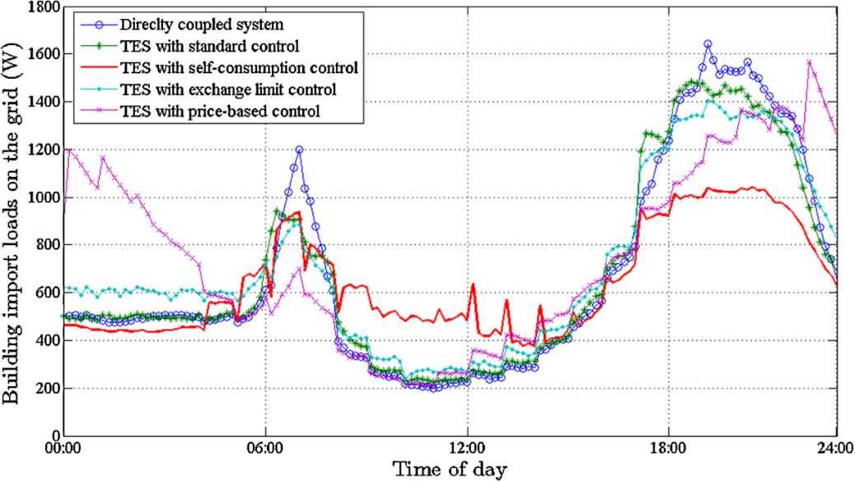
In summary
from ZEB…
How much ?
…to ZEN
How much ?
Can you spot the difference?

