Slide 1
(KPI for) Neighbourhood energy systems
Igor Sartori, SINTEF Byggforsk
ZEN PhD course, 02.02.2018
Notes:
Bildet illustrerer:
· bredden i SINTEFs ekspertise, fra havrom til verdensrom.
· hvilke områder og bransjer vi jobber innen for å realisere visjonen Teknologi for et bedre samfunn.
Bildestilen er basert på stikkordene fremtidsrettet, teknologi og norsk natur (naturressurser). SINTEFs visuelle univers er utviklet for SINTEF av Headspin Productions AS.

Slide 2

Definition of "neighborhood"
In the ZEN research centre, a neighbourhood is defined as a group of interconnected buildings (new, retrofitted, or a combination of both) and infrastructure (e.g. energy, water, sewage, roads, communication and data lines) located within a confined geographical area and with a defined physical boundary to the electric and thermal grids (e.g. transformer and substation).

Slide 3
ZEN definition
A zero emission neighbourhood aims to reduce its greenhouse gas (GHG) emissions towards zero within its life cycle. To achieve this the neighbourhood must:
Become highly energy efficient and smartly powered by local renewable energy sources.
Manage energy flows in the built environment and with the surrounding energy system in a flexible way to facilitate the transition towards a decarbonised energy system.
Design and construct buildings, infrastructure, components and materials in the neighbourhood to consider zero or low GHG emissions from the whole life cycle; from extraction of raw materials, production, transport, installation, use, maintenance, repair, replacement, deconstruction, waste treatment, reuse, recovery and final disposal.
Plan, design and operate with respect to economic sustainability, and with a focus on minimising life cycle costs.
Achieve sustainable transport patterns through the overall design of the neighbourhood and implementation of sustainable smart mobility systems both locally and regionally.
Plan and localise amenities in the neighbourhood to produce good spatial qualities that consider reduction of emissions also through their relationship with the larger region and promote sustainable behaviour. Sustainable behaviour includes behaviour that results in reduced waste and resource use with a view to stimulate a circular economy.
Development of the area is characterised by innovative processes based on new forms of cooperation between the involved partners leading to innovative solutions.

Slide 4
KPI categories
Emissions
Energy
Power
Economy
Mobility
Spatial qualities
Innovation
7 categories of KPI – Key Performance Indicators
Here we focus on the two most relevant for WP4:
Energy
Power

Slide 5
Emissions
Energy
Power
Economy
Mobility
Spatial qualities
Innovation

Slide 6
Energy
Core KPI | Unit
Energy efficiency in buildings | Annual totals
Energy needs | kWh/m²
Energy carriers | Annual totals Monthly profiles
Energy use | kWh
Energy generation | kWh
Delivered energy | kWh
Exported energy | kWh
Self-consumption | %
Self-generation | %
Color coded carpet plot | kWh
KPI calculated with an hourly resolution
KPI in the energy efficiency in buildings sub-category are calculated on the building assessment boundary
KPI in the energy carriers sub-category are calculated on the neighbourhood assessment boundary

Slide 7
Building assessment boundary
typically includes building energy use for: heating, cooling, ventilation, domestic hot water, de-/humidification, lighting, and may include plug loads
must be harmonised between ISO 52000 and NS/TS 3031
Source: NS/TS 3031

Slide 8
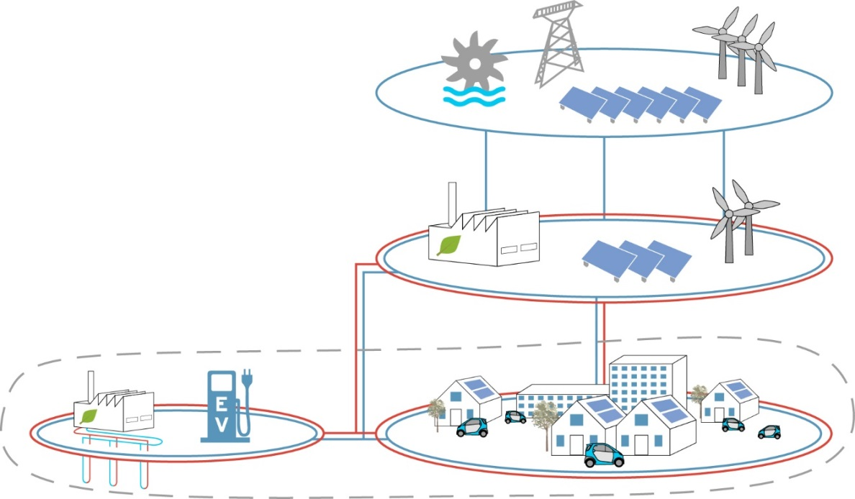

Neighborhood assessment boundary
Typically an expansion of the building assessment boundary, and includes energy use for:
people transport inside buildings (e.g. elevators, escalators)
dataservers, refrigeration and other industrial processes inside buildings
outdoor lighting, snow melting
charging of electric vehicles
local energy generation
In other words it includes all energy flows in the neighborhood.

Slide 9
Energy efficiency in buildings: energy needs
The energy needs, both net and gross, are calculated according to the NS/TS 3031 and are presented both as a total and split per energy service.
Source: NS/TS 3031

Slide 10
Energy carriers: use & generation
For each energy carrier, energy use and generation can be compared on a graph showing their monthly values; this gives a visual impression of the seasonal mismatch between the two quantities

Slide 11
Energy carriers: delivered & exported
Calculated on the hourly mismatch between energy use and energy generation. Annual totals reported.
Source: NS/TS 3031

Slide 12
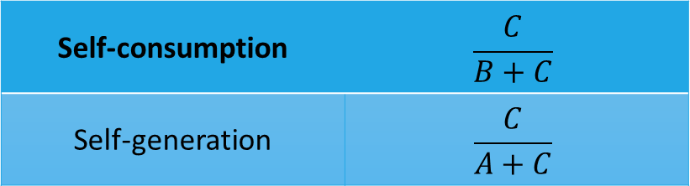
Energy carriers: self-cosumption & self-generation
tell about the mismatch between energy locally generated and used in the neighborhood
express two complementary aspects
numerically, will have the same value only when the total annual energy generation is equal to the total annual energy use
Source: adapted from Luthander et al. (2015)
Self-consumption | $$\frac{C}{B+C}$$
Self-generation | $$\frac{C}{A+C}$$

Slide 13
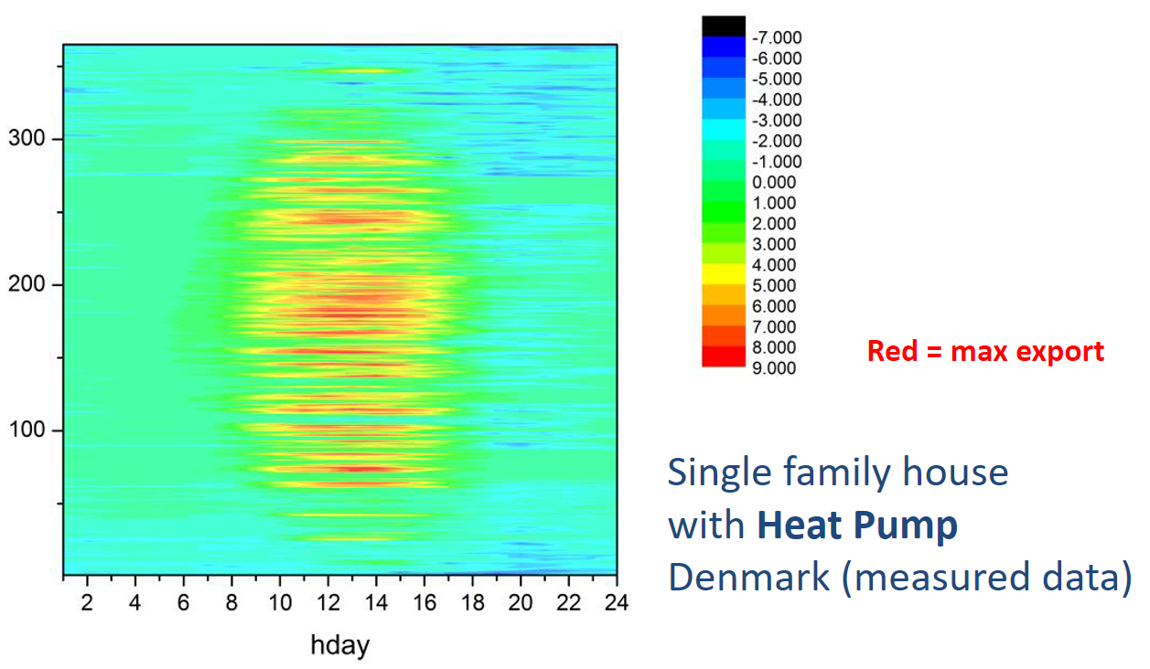
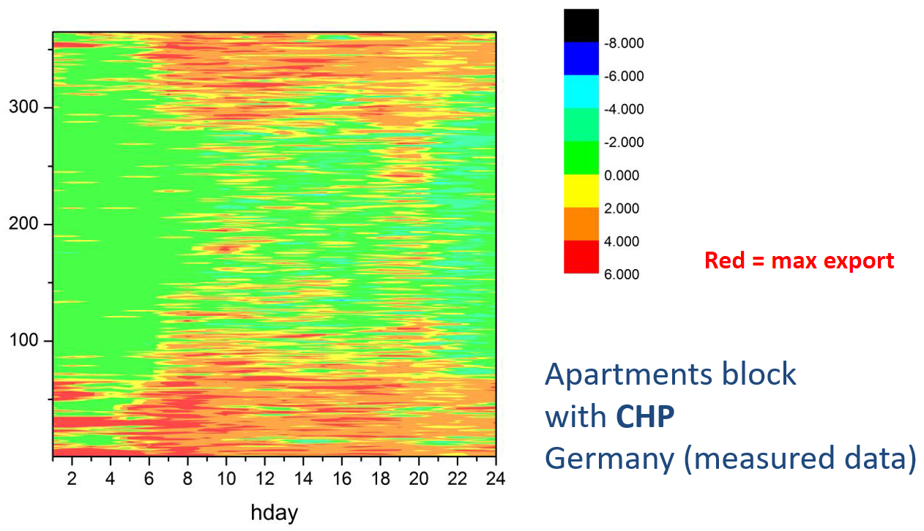
Color-coded carpet plots a convenient graphical visualization
Source: Salom et al. (2013)

Slide 14
Emissions
Energy
Power
Economy
Mobility
Spatial qualities
Innovation

Slide 15
Power
Core KPI | Unit
Power performance | Hourly values Yearly profiles
Net load yearly profile | kW
Net load duration curve | kW
Peak load | kW
Peak export | kW
Utilization factor | %
Power flexibility | Hourly values Daily profiles
Net load daily profile | kW
KPI to be defined | -
KPI calculated with an hourly or sub-hourly resolution (15 min, 1 min)
KPI calculated on the neighbourhood assessment boundary

Slide 16
Power performance: net load yearly profile & duration curve
the value of the net load yearly profile is to give a sense of the energy flows throughout the year, much as the color-coded carpet plot.
the value of the net load duration curve is to provide useful information for the design and operation of the energy system.

Slide 17

Power performance: peak load & peak export + utilization factor
Peak load
Delivered energy
Exported energy
$$E=Delivered+Exported$$
$$P=max\left(Peak load;\left|Peak export\right|\right)$$
$$Utilization factor=\frac{E}{P∗8760h}≅18\%$$
Peak export

Slide 18
Power flexibility: net load daily profiles
focus on typical days:
summer/winter + weekdays/weekends
evaluate the effect of short term load shifting and storage solutions in response to signals from smart grids:
price signals
CO₂ content
grid congestion (peak hours)
flexibility may be controlled in different ways, in order to serve different purposes

Slide 19
Example: PV-battery with different charging
Fast charging of battery
Limiting peak export
Source: adapted from Luthander et al. (2015)

Slide 20
Power flexibility: KPI to be defined
…work in progress, both in the ZEN centre and in the IEA EBC Annex 67 "Energy flexible buildings"
Promising approach:
Characterize the "step response function" to a generic penalty signal
Calculate "flexibility indexes" based on specific penalty functions
e.g. price, CO₂, sun-tracking, wind-tracking, peak shaving

Slide 21
YOU
T
H
A
N
K
For your attention!

Slide 22
Literature
Wiik et al. (2018) Zero Emission Neighbourhoods in Smart Cities: Definition, Key Performance Indicators and Assessment Criteria, Version 1.0. ZEN report.
Wiik et al. (2018) A ZEN Guideline for the ZEN Pilot Areas, Version 1.0. ZEN report.
ISO 52000-1 (2017) Energy performance of buildings - Overarching EPB assessment. Part 1: General framework and procedures
NS/TS 3130 (2016) Bygningers energiytelse - Beregning av energibehov og energiforsyning. Teknisk spesifikasjon.
Luthander, R., Widén, J., Nilsson, D. and Palm, J. (2015) Photovoltaic self-consumption in buildings: A review, Applied Energy, (142) 80-94.
Salom, J., Marszal, A.J., Widén, J., Candanedo, J. and Lindberg, K.B. (2014) Analysis of load match and grid interaction indicators in net zero energy buildings with simulated and monitored data, Applied Energy, (136) 119-131
Salom, J., Marszal, A. J., Candanedo, J., Widén, J., Lindberg, K. B. and Sartori, I. (2013) Analysis of Load Match and Grid Interaction Indicators in Net Zero Energy Buildings with High-Resolution Data, subtask A report in IEA SHC Task40 / EBC Annex 52 Towards Net Zero Energy Solar Buildings.
Junker et al. (2018) Characterizing the Energy Flexibility of Buildings and Districts. Submitted to Applied Energy.

