Slide 1
Deconstructing the Rankings:
Visualizing Biases in Global University Rankings
Data Visualisation [G0R05a] - Intermediate Presentation
Team: Renlong Yin, Lei Pei, Victor Kao, Szabó Gergely, Kawtar Darkaoui, Deborah Adelakun

Slide 2
The Problem & Target Audience
Target Audience: Prospective international Master's/PhD students.
The Problem: Students often rely blindly on QS Rankings, which heavily favor historical 'prestige' and established Western brands.
The Solution: We compare QS (Reputation) against THE (Research Output) to find the 'Hidden Gems'.
Goal: Help students find universities with world-class research infrastructure that are currently undervalued by general reputation.

Slide 3
The Data Sources
Times Higher Education (THE) 2016-2026: Provides longitudinal data on research environment, quality, and industry impact.
QS World Rankings 2026: Provides data on Employer and Academic Reputation.
World Bank Open Data API: Live GDP and economic data to analyze the socio-economic drivers of ranking success.
Data Feasibility: We are utilizing robust Kaggle datasets and official APIs rather than scraping, ensuring high data reliability.

Slide 4
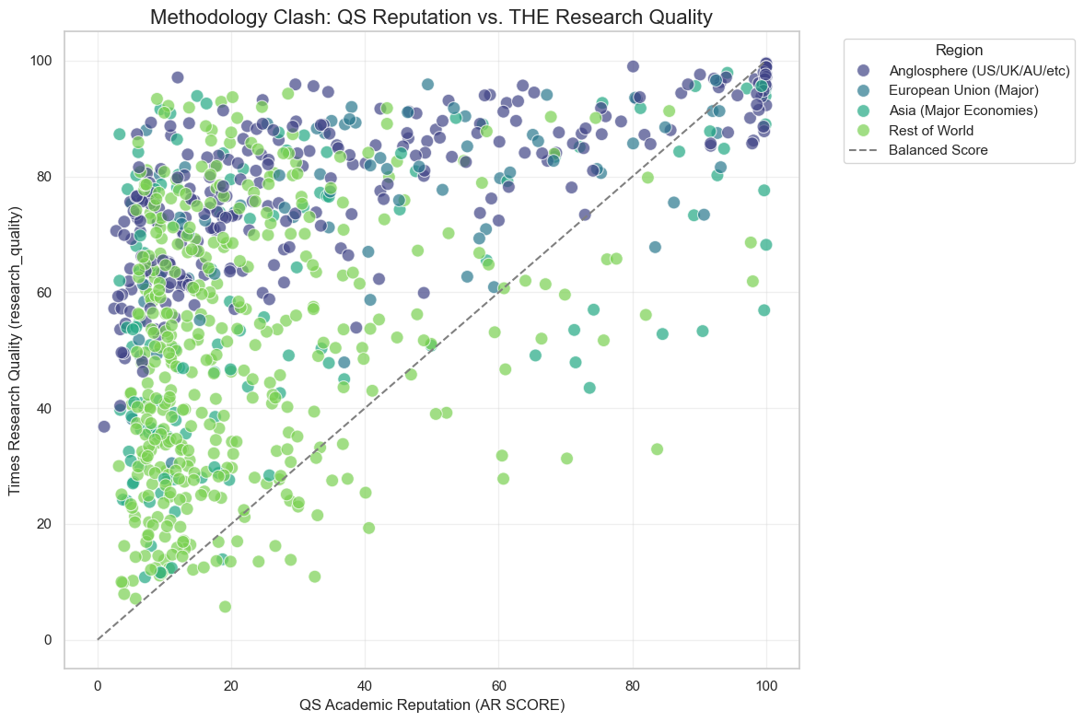
Proof of Concept: Methodology Clash
Our initial data exploration confirms our hypothesis.
We identified a massive 'Prestige vs. Performance' gap.
A dense cluster of Asian and European technical universities show elite 'Industry Impact' (THE) but very poor 'Employer Reputation' (QS).
--> See graph to the right.

Slide 5
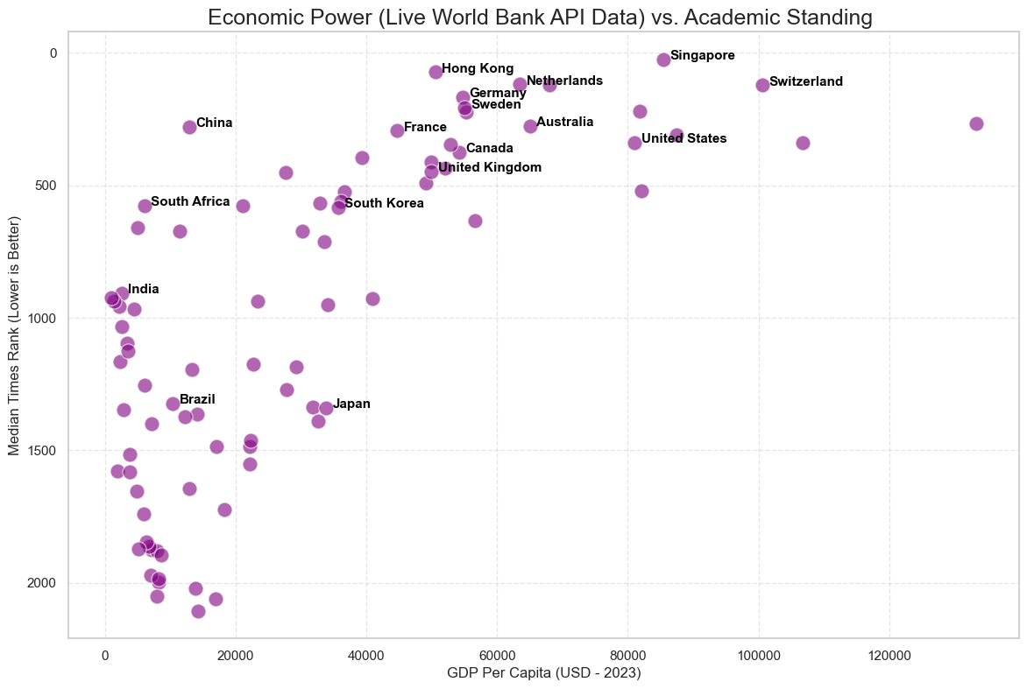
Our Planned Interactive Web Dashboard
Data Augmentation: We integrated live World Bank API data to compare a country's wealth against its median university rank.,
General Trend: National wealth strongly correlates with elite academic performance (e.g., US, Switzerland, Singapore).,
Key Insight: China is a massive outlier. It achieves top-tier rankings despite a significantly lower GDP per capita than its Western rivals.,
--> See graph to the right.

Slide 6
Questions for Feedback
1. Visual Clutter: Our dataset has over 800 universities. To avoid violating Gestalt principles in our Scatter Plot, do you recommend semantic zooming or forcing the user to filter by region first?
2. Narrative Flow: Since we pivoted to a student-focused narrative, would a 'Scrollytelling' approach be better than a static dashboard?
3. Encodings: What is the best way to visually encode the 'Gap' between a university's QS rank and THE rank?

