Slide 1


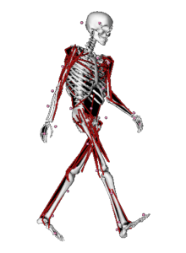

Ultrasound
MOCAP
Subject-specific MSM
MRS
Physiological coördination
+
Generic MSM
EMG

Slide 2
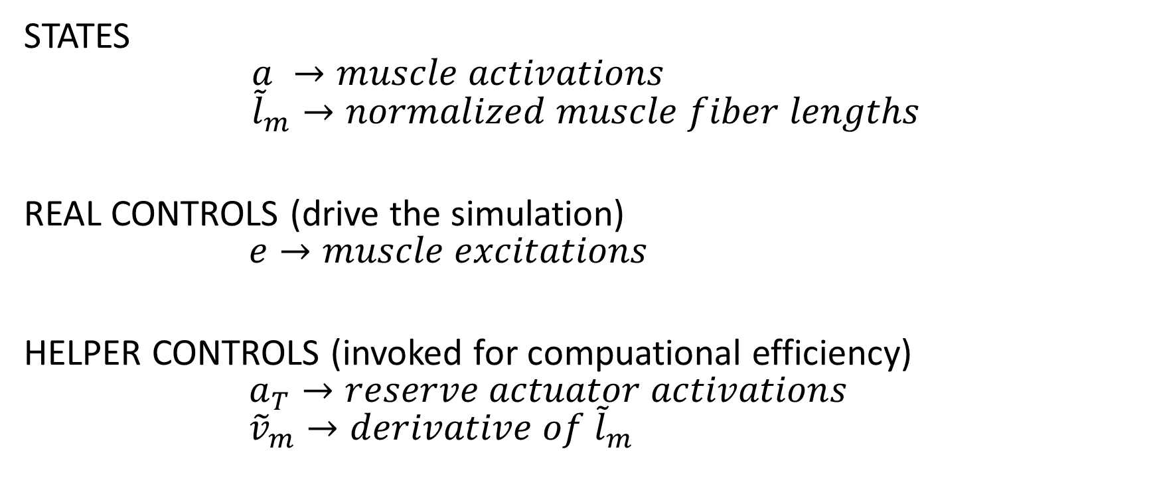
States and controls
STATES $$a →muscle activations \\ {\tilde{l}}_{m}→normalized muscle fiber lengths$$
REAL CONTROLS (drive the simulation) $$e→muscle excitations$$
HELPER CONTROLS (invoked for compuational efficiency) $$a_{T}→reserve actuator activations \\ {\tilde{v}}_{m}→derivative of {\tilde{l}}_{m}$$

Slide 3
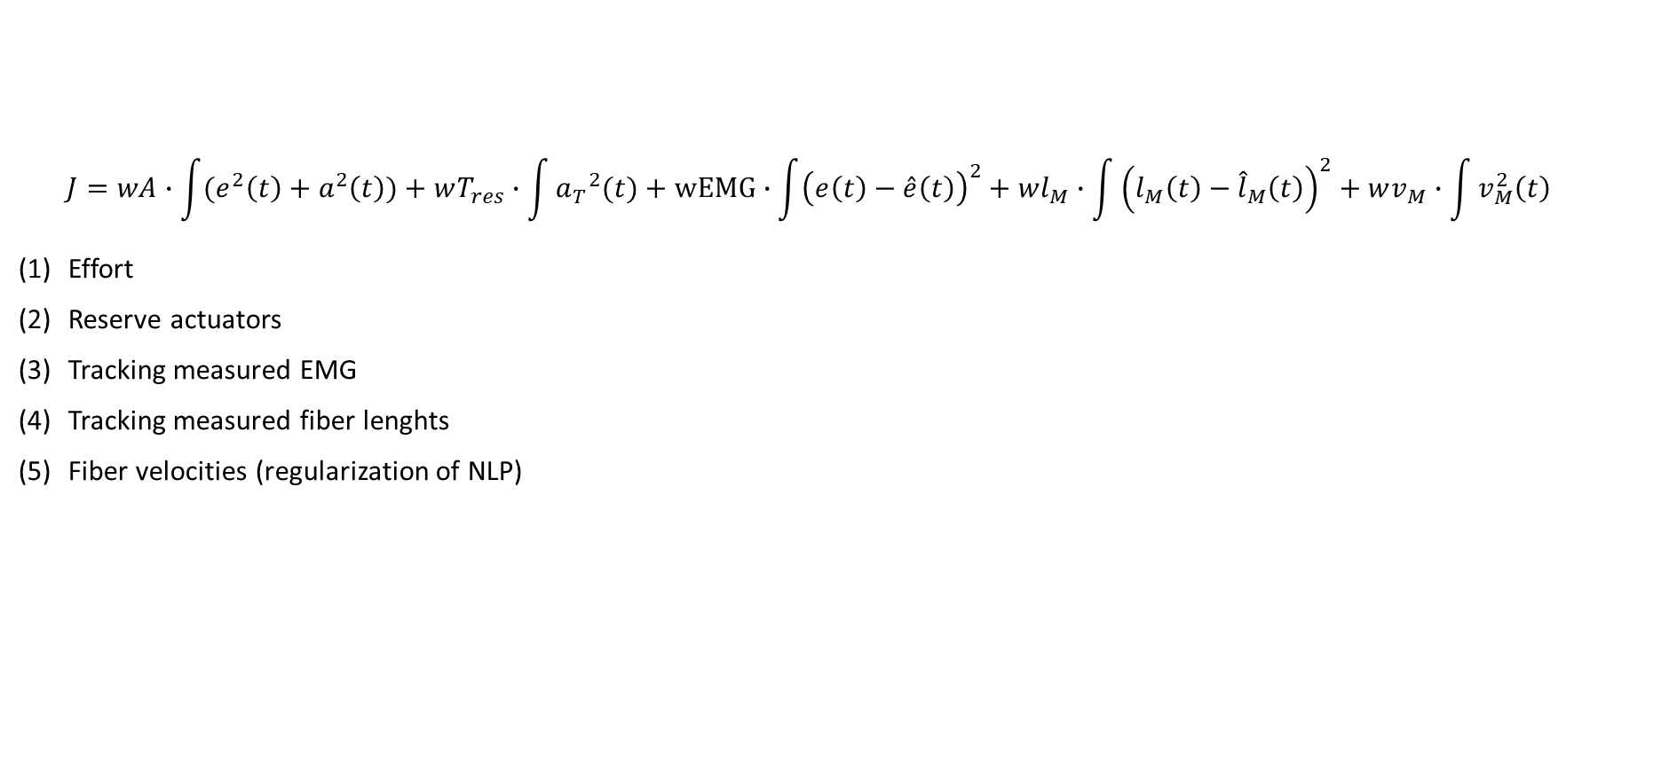
Cost function
$$J=wA∙\int{(e^{2}\left(t\right)+a^{2}\left(t\right))}+wT_{res}∙\int{{a_{T}}^{2}(t)}+wEMG∙\int{{\left(e\left(t\right)−\hat{e}\left(t\right)\right)}^{2}}+wl_{M}∙\int{{\left(l_{M}\left(t\right)−{\hat{l}}_{M}\left(t\right)\right)}^{2}}+wv_{M}∙\int{v_{M}^{2}\left(t\right)}$$
Effort
Reserve actuators
Tracking measured EMG
Tracking measured fiber lenghts
Fiber velocities (regularization of NLP)

Slide 4
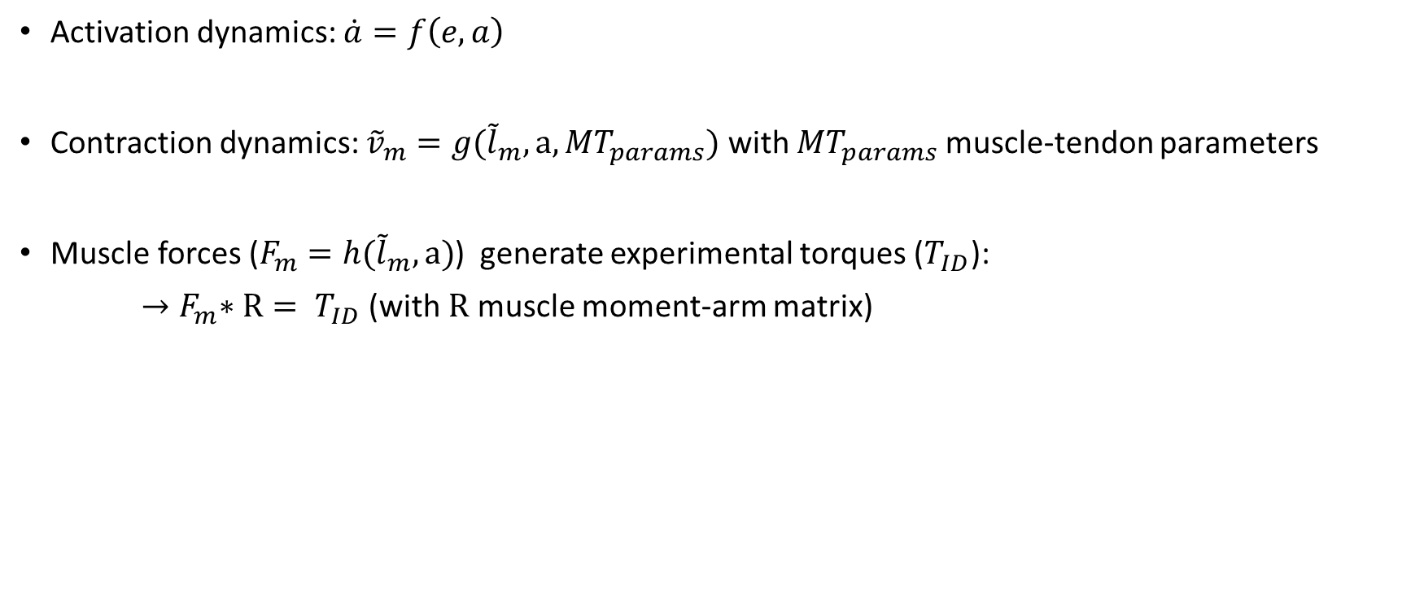
Constraints
Activation dynamics: $\dot{a}=f\left(e,a\right)$
Contraction dynamics: ${\tilde{v}}_{m}=g({\tilde{l}}_{m},a, {MT}_{params})$ with ${MT}_{params}$ muscle-tendon parameters
Muscle forces ($F_{m}=h({\tilde{l}}_{m},a)$) generate experimental torques ($T_{ID}$):
${→F}_{m}∗R= T_{ID}$ (with $R$ muscle moment-arm matrix)

Slide 5
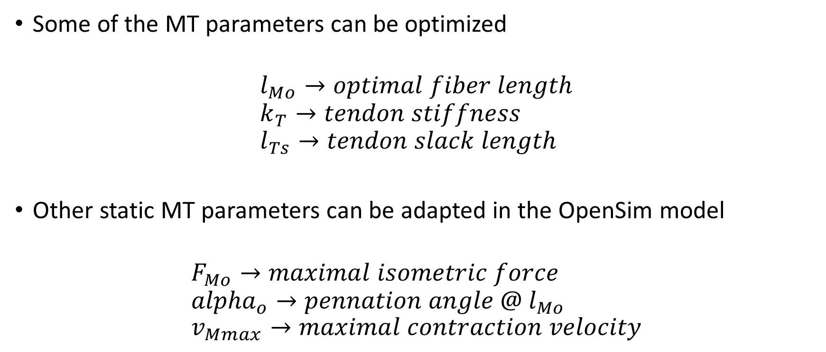
Muscle-tendon parameters to optimize
Some of the MT parameters can be optimized
$$l_{Mo}→optimal fiber length \\ k_{T}→tendon stiffness \\ l_{Ts}→tendon slack length$$
Other static MT parameters can be adapted in the OpenSim model
$$F_{Mo}→maximal isometric force \\ {alpha}_{o}→pennation angle @ l_{Mo} \\ v_{Mmax}→maximal contraction velocity$$

