Slide 1


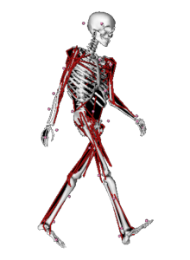


Ultrasound
MOCAP
Personalized MSM
and
muscle coordination
MRS
Muscle redundancy solver
Generic MSM
EMG
Notes:
Tom, zou je voor het skeletje rechts gekleurde spieren kunnen gebruiken? Dan zie je dat dit niet enkel een model is maar ook spiercoordinatie.
Misschien osim-symbool bij het skeletje zetten?

Slide 2
Functionalities
Input:
Processed motion capture data
Musculoskeletal model
EMG
Muscle fiber-lengths (ultra-sound)
Solve muscle redundancy problem
Estimate muscle-tendon parameters
Perform EMG-driven simulations
optional
Notes:
Hier zou ik een overzichtje geven van wat je met de nieuwe MRS kan doen.
Solve muscle redundancy problem
Based on mocap
EMG-constraints
Parameter estimation based on optimizing fit with EMG and/or measured fiber lengths.

Slide 3

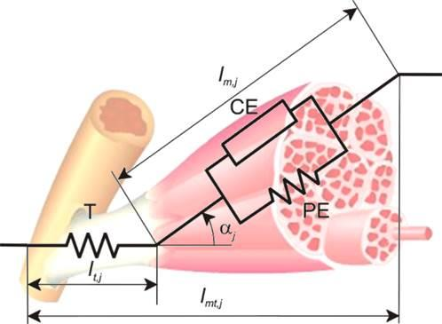
Muscle redundancy solver
minimize muscle excitations squared
subject to
muscle
excitations
muscle
forces
MuscULO-skeletal Geometry
joint torques
= measured (inverse dynamics)
joint torques
Muscle dynamics
?
kinematics
Notes:
Ik zou het hier en daar nog wat visueler maken. Zie ook opmerkingen bij specifieke slides.

Slide 4
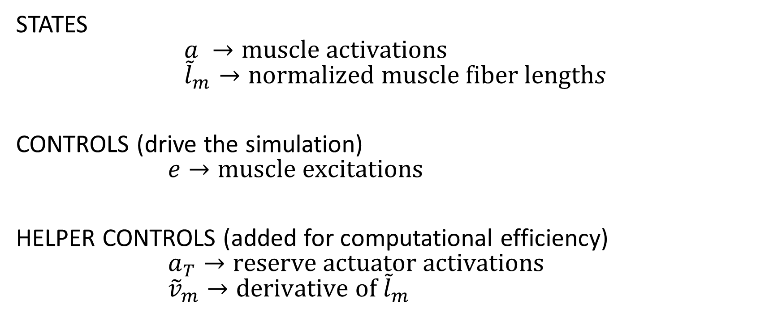
States and controls
STATES $$a →muscle activations \\ {\tilde{l}}_{m}→normalized muscle fiber lengths$$
CONTROLS (drive the simulation) $$e→muscle excitations$$
HELPER CONTROLS (added for computational efficiency) $$a_{T}→reserve actuator activations \\ {\tilde{v}}_{m}→derivative of {\tilde{l}}_{m}$$
Notes:
Hier block diagram/schema van muscle dynamics?

Slide 5
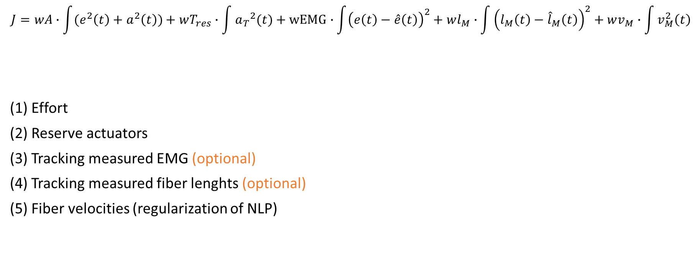
Cost function
$$J=wA∙\int{(e^{2}\left(t\right)+a^{2}\left(t\right))}+wT_{res}∙\int{{a_{T}}^{2}(t)}+wEMG∙\int{{\left(e\left(t\right)−\hat{e}\left(t\right)\right)}^{2}}+wl_{M}∙\int{{\left(l_{M}\left(t\right)−{\hat{l}}_{M}\left(t\right)\right)}^{2}}+wv_{M}∙\int{v_{M}^{2}\left(t\right)}$$
Effort
Reserve actuators
Tracking measured EMG (optional)
Tracking measured fiber lenghts (optional)
Fiber velocities (regularization of NLP)
(1)
(2)
(3)
(4)
(5)
Notes:
Nummertjes nog met accolade onder verschillende termen zetten?
Hier block diagram van inverse approach?

Slide 6
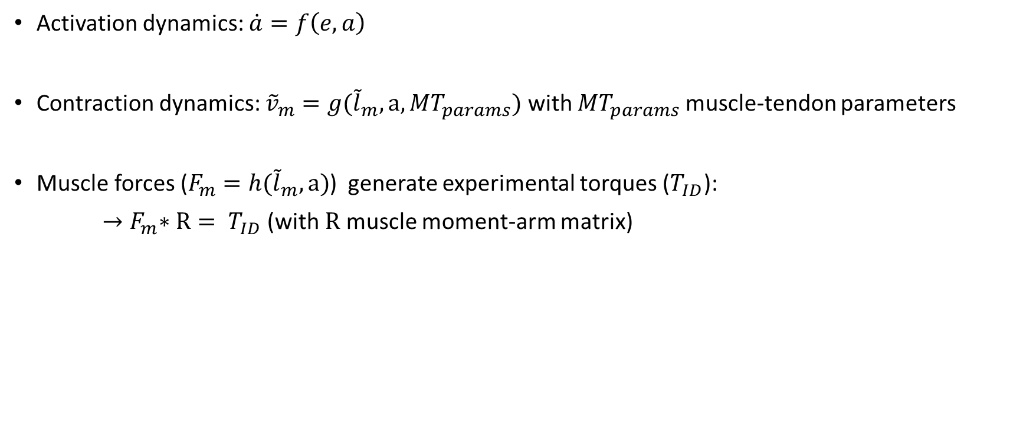
Constraints
Activation dynamics: $\dot{a}=f\left(e,a\right)$
Contraction dynamics: ${\tilde{v}}_{m}=g({\tilde{l}}_{m},a, {MT}_{params})$ with ${MT}_{params}$ muscle-tendon parameters
Muscle forces ($F_{m}=h({\tilde{l}}_{m},a)$) generate experimental torques ($T_{ID}$):
${→F}_{m}∗R= T_{ID}$ (with $R$ muscle moment-arm matrix)
Notes:
Ik vind dit wel goed lettertype. Heb nu het gevoel dat het nogal verandert van slide tot slide.

Slide 7
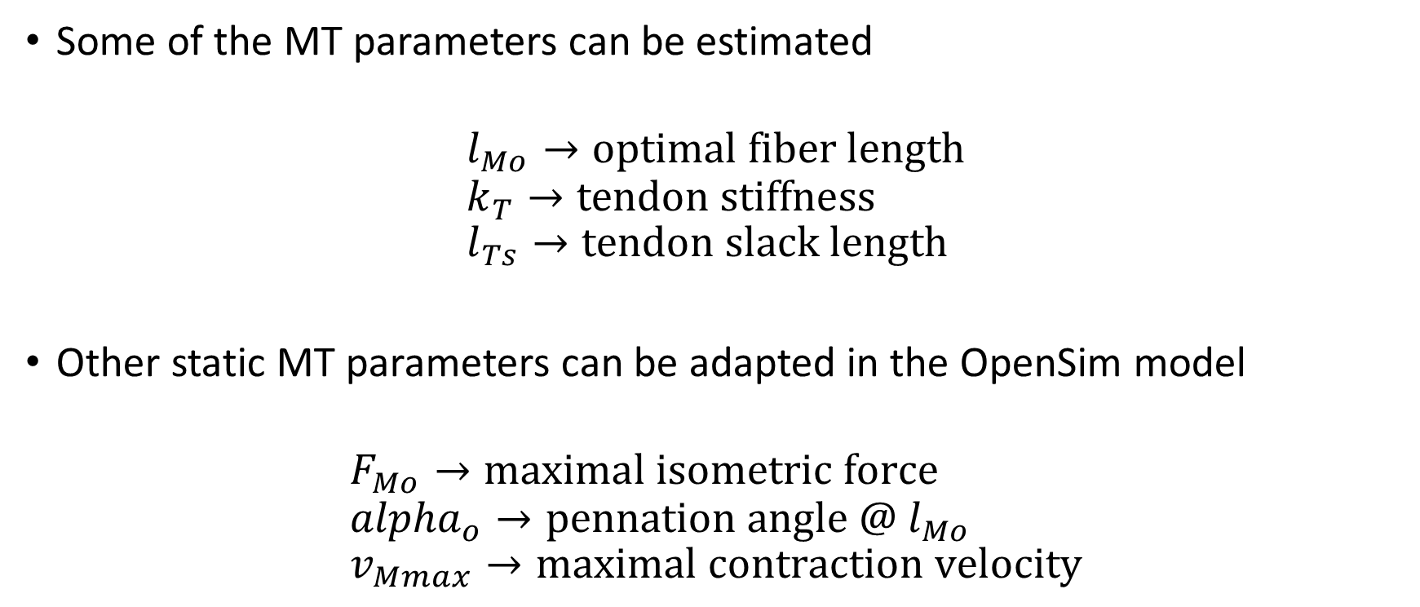
Muscle-tendon parameter estimation
Some of the MT parameters can be estimated
$$l_{Mo}→optimal fiber length \\ k_{T}→tendon stiffness \\ l_{Ts}→tendon slack length$$
Other static MT parameters can be adapted in the OpenSim model
$$F_{Mo}→maximal isometric force \\ {alpha}_{o}→pennation angle @ l_{Mo} \\ v_{Mmax}→maximal contraction velocity$$
Notes:
Ik mis misschien nog een slide met input data.

Slide 8
Note on overfitting
Musculoskeletal models typically have many parameters and it might therefore be possible to fit experimental data (EMG and ultrasound-based fiber length) without accurately estimating the underlying MT-parameters.
Validation of the personalized model is important.
Verify that you obtain physiologically plausible muscle activations with the MRS based on the personalized model. If not, decrease the number of parameters you are estimating and/or the weight on the data tracking terms in the cost function.
Verify that you obtain physiologically plausible muscle activations for other movements.

Slide 9
References

