Slide 1
BANK CUSTOMER CHURN
Analysis & Dashboard Project
SQL · Power BI · Exploratory Data Analysis
Dataset: 10,000 bank customers | 14 attributes | Overall churn rate: 20.4%

Slide 2
Project Overview
A bank wants to understand why customers leave (churn) so it can take action to retain them. This project explores customer data, identifies churn drivers using SQL, and visualizes findings in an interactive Power BI dashboard.
G
Goal
Identify the key factors driving customer churn and quantify their impact
D
Data
10,000 customer records with demographics, account & product details
T
Tools
PostgreSQL for analysis queries, Power BI for the interactive dashboard
O
Outcome
Actionable insights to support targeted retention strategies
2

Slide 3
Headline Numbers
10,000
2,037
20.37%
$2.86B
Total Customers
Churned Customers
Overall Churn Rate
Balance Lost to Churn
1 in 5 customers leaves the bank — and Germany, female customers, and inactive members churn at far higher-than-average rates (details ahead).
3

Slide 4
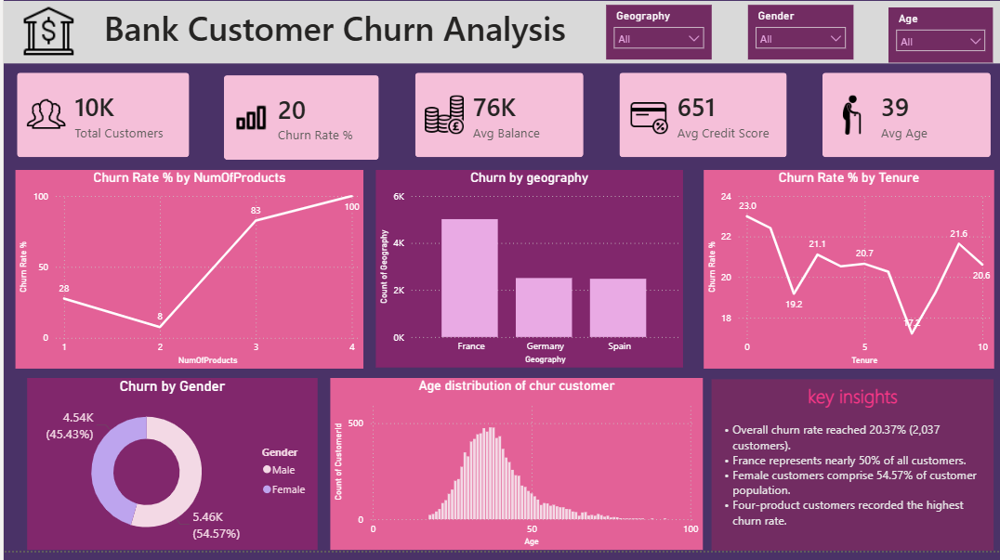
Churn by Gender
Targeted products, personalized offers, and retention strategies focused on this age segment can improve customer engagement and reduce churn risk while maximizing long-term customer value.
4

Slide 5
Engagement & Product Holding
Customers holding 3–4 products experience significantly higher churn rates than customers with fewer products, indicating potential dissatisfaction with bundled offerings.
The bank should evaluate its cross-selling strategy and address customer pain points to improve retention among multi-product customers.
5

Slide 6
Age, Balance & Credit Score Patterns
Age Groups
Balance Segments
Credit Score & Cards
Senior customers (50+) churn at the highest rate
Adult customers (30-50) show moderate churn
Young customers (<30) churn least
High balance (>100K) customers churn more
Medium balance (50K-100K) churn moderately
1,683 customers with zero balance still churned
Churned customers have slightly lower average credit scores
Owning a credit card has minimal effect on churn rate
Credit score alone is a weak churn predictor
6

Slide 7
SQL-Driven Analysis
16 SQL queries against PostgreSQL power every metric in this project — from simple counts to segmented churn-rate comparisons.
Overview
Demographics
Engagement
Financial
Deep Dives
Total & churned customers
Overall churn rate
Churn by geography
Churn by gender
Age-wise & age-group churn
Active member vs churn
Credit card holders vs churn
Balance segment analysis
Number of products impact
Credit score vs churn
Top 10 high-balance churners
Zero-balance churned customers
Geography + gender risk matrix
Total balance lost to churn
7

Slide 8
Power BI Dashboard
The SQL findings feed an interactive Power BI dashboard, allowing stakeholders to filter and drill into churn drivers by geography, demographics, account activity and product holdings in real time.
CHURN OVERVIEW
10,000
20.4%
32.4%
Customers
Churn Rate
Germany Churn
KPI cards: total customers, churn rate, lost balance
Geography & gender churn comparison visuals
Age group and balance segment breakdowns
Activity status & number-of-products impact views
Interactive filters/slicers for drill-down analysis
8

Slide 9
Key Takeaways & Recommendations
✓
Geography matters
Germany's churn rate is 2x France/Spain — investigate local service quality, competition, or pricing.
✓
Engagement drives loyalty
Inactive members are far more likely to leave — proactive engagement campaigns could reduce churn.
✓
Product overload risk
Customers with 3-4 products churn at 80-100% — review cross-sell practices and bundle quality.
✓
Targeted retention for women & seniors
Female and older customers churn more — tailor retention offers to these segments.
Tech stack: PostgreSQL (SQL analysis) · Power BI (interactive dashboard)
9

