Slide 1
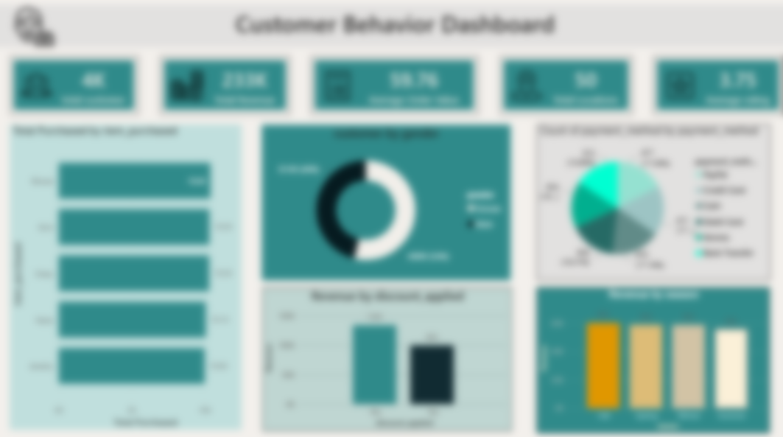
Customer Behavior
Analysis Dashboard
End-to-end data analytics project: CSV → Python → PostgreSQL → Power BI
3,900
$233K
3.75 ★
50 States
Customers
Revenue
Avg Rating
Locations
Tools: Python | PostgreSQL | Power BI | DAX

Slide 2
Project Overview
Business Problem
Objective
The retailer had around 3,900 customer records but had no clear understanding of customer buying behavior, website/session trends, or how discounts were affecting sales. This made it difficult to make data-driven decisions.
Build an end-to-end analytics solution—from raw CSV data to an interactive Power BI dashboard—that answers key business questions related to revenue trends, customer behavior, and seasonality, covering 13 important KPIs and insights.
Raw CSV
Dataset
Python
Cleaning
PostgreSQL
DB + Queries
Power BI
Dashboard
Business
Insights
→
→
→
→
End-to-end pipeline
Dataset: 3,900 rows × 16 columns
• Age
• Location
• Gender
• Season
• Item Purchased
• Review Rating
• Category
• Discount Applied
• Purchase Amount
• Payment Method

Slide 3
Python Data Cleaning
01
Load & Inspect
Read CSV with pandas. Check shape (3,900 × 16), dtypes, and null counts.
02
Handle Nulls
Verified zero nulls across all 16 columns — dataset was clean.
03
Standardise Types
Cast Purchase Amount to float, Review Rating to float, Age to int.
04
Feature Engineering
Created age_group bins: 18-25, 26-35, 36-50, 50+ for segmentation.
05
Export to PostgreSQL
Used SQLAlchemy to push clean DataFrame to a PostgreSQL table named 'customer'.

Slide 4
PostgreSQL — 13 Business Queries
Q1
Gender revenue split
Q8
Discount usage % by product
GROUP BY + SUM
ROUND + CASE
Q2
High spenders with discount
Q9
Category % of total revenue
WHERE + Subquery
SUM OVER()
Q3
Top 5 products by rating
Q10
Highest spending customer
AVG + ORDER BY
ORDER DESC LIMIT 1
Q4
Top 5 most purchased items
Q11
Seasonal revenue analysis
COUNT + GROUP BY
GROUP BY season
Q5
Revenue by category
Q12
Revenue rank by category
SUM + GROUP BY
RANK() OVER()
Q6
Revenue by age group
Q13
Running revenue per customer
CASE + Bins
SUM OVER PARTITION
Q7
Top 5 states by revenue
LIMIT 5

Slide 5
Key Business Insights
Male customers drive 68% of revenue
Fall is the top revenue season
Male: $157,890 vs Female: $75,191 — targeting male shoppers with loyalty programs could amplify revenue.
Fall: $60,018 → Spring: $58,679 → Winter: $58,607 → Summer: $55,777. Plan inventory & promotions for Q3-Q4.
Clothing dominates at 45% of revenue
50+ age group are the biggest spenders
Clothing $104K (45%) → Accessories $74K (32%) → Footwear $36K (15%) → Outerwear $19K (8%).
Customers aged 50+ contribute $88,480 (38%) of total revenue — a premium segment to target.
Montana, Illinois & California lead by state
Discounts reduce revenue, not boost it
Top 3 states: Montana $5,784 | Illinois $5,617 | California $5,605 — high-potential markets.
Non-discounted orders generated $133,670 vs $99,411 with discounts. Discount strategy needs review.

Slide 6
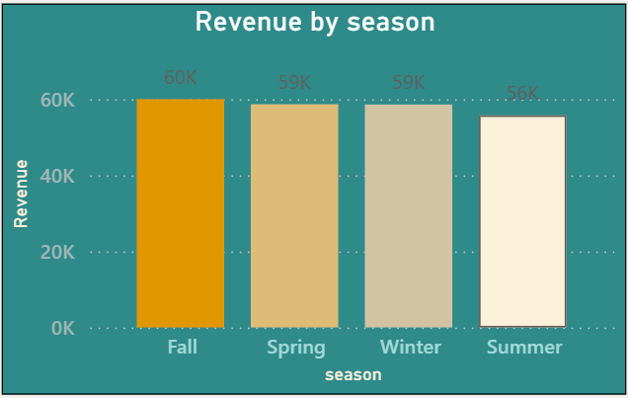
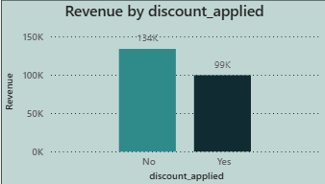
Revenue Analysis

Slide 7
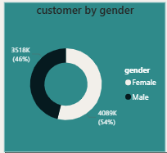
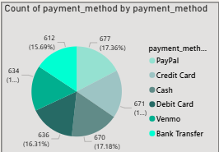
Customer Segmentation
50+ ($88K)
PayPal (677)
Top spender age
Top payment

Slide 8
Power BI Dashboard
3,900
$233K
$59.76
3.75★
50
Total customers
Total revenue
Avg order value
Avg rating
Locations
Dashboard Visuals
Donut chart
Column chart
Bar chart
Gender split
Revenue by discount
Top items purchased
Male 68% vs Female 32%
Non-discount earns +34% more
Blouse, Pants & Jewelry lead
Pie chart
Column chart
Payment methods
Revenue by season
PayPal is #1 (677 customers)
Fall peaks at $60,018

Slide 9
Business Recommendations
1
Rethink discounting strategy
Discounts are not lifting revenue. Shift from blanket discounts to loyalty points or bundle offers that maintain margin.
2
Double down on Fall/Spring marketing
Fall ($60K) and Spring ($58.7K) drive the most revenue. Increase ad spend and stock in Q2-Q3 preparation.
3
Target 50+ segment with premium products
The 50+ age group contributes 38% of revenue. Create curated collections and personalised outreach for this segment.
4
Expand in Montana, Illinois & California
Top 3 revenue states — prioritise physical stores, pop-ups, or local campaigns in these markets.
5
Optimise Clothing & Accessories
Together they are 77% of revenue. Deeper inventory analysis (colour, size, style) would unlock further growth.

Slide 10
Project by
Abhishek Kumar
Data Analyst | Power BI | SQL | Python
Python (pandas, SQLAlchemy)
PostgreSQL — 13 analytical queries incl. window functions
Power BI — DAX measures, interactive dashboard
Business storytelling & data-driven recommendations
GitHub : https://github.com/KUMARabhishek2005/Customer-Behavior-Analysis-Dashboard
LinkedIn: https://www.linkedin.com/posts/abhishek-kumar-2a746a247_powerbi-sql-postgresql-ugcPost-7468193832061485057-j7Be/?utm_source=share&utm_medium=member_desktop&rcm=ACoAAD0dSx8BG4yGkSsXdkMCPaNxmJEc667Q35c

