Slide 1


RAPIDO RIDE ANALYTICS
Business Intelligence & Data-Driven
Decision Making
Solving operational challenges using SQL · Excel · Power BI
--by Abhishek kumar
Data Analytics Project | Technologies: SQL • Excel • Power BI

Slide 2
THE BUSINESS PROBLEM
High Cancellation Rate
Poor Location Insights
No visibility into why customers & drivers cancel rides, making it impossible to take corrective action.
Top pickup/drop locations unknown — leading to driver unavailability in high-demand zones.
Revenue Leakage
Operational Inefficiency
No tracking of daily revenue trends or vehicle-type contribution, causing missed revenue opportunities.
Long vehicle & customer turnaround times (VTAT/CTAT) go undetected without data monitoring.

Slide 3
TECHNOLOGY STACK
Three Tools. One Unified Analytics Pipeline.
SQL
Excel
Power BI
Data Cleaning & Pivot
Interactive Dashboard
MySQL
20 analytical queries covering cancellation rates, revenue aggregation, top customers, VTAT/CTAT analysis, pickup-drop pairs, and window functions for ranking.
Raw CSV data cleaned, structured and summarised using pivot tables, conditional formatting, and formulas for operational KPI tracking.
End-to-end interactive dashboard with slicers, DAX measures, custom visuals and drill-through capabilities for business stakeholder reporting.
Data cleaning & formatting
Pivot tables for trends
Conditional formatting
KPI summary sheets
Interactive visuals & slicers
DAX measures & KPIs
Drill-through reports
Multi-page dashboard
Data extraction & filtering
Aggregations & GROUP BY
Window functions (RANK)
Cancellation rate calculation

Slide 4
SQL ANALYSIS — KEY QUERIES
20 business queries answered with MySQL
Q1–3
Booking Status
Q4–5
Customer & Driver
Success rides, cancellations by customer & driver
Top 5 customers, driver cancellation by reason
Q6–8
Ratings & Value
Q9–10
Revenue & Incomplete
Max/min driver ratings, payment > ₹500, avg customer ratings
Total booking value, incomplete ride details
Q13
Cancellation Rate %
Q16
Top Cancel Reason
17.8% customer | 10.2% driver cancel rates
Most common customer cancellation reason identified
Q17
Day-wise Revenue
Q19
Revenue Rank
Daily ride count + revenue trend for the month
Vehicle types ranked by revenue via RANK() window fn

Slide 5
KEY INSIGHTS
What the Data Revealed
28%
₹7M+
4.1★
15 min
Customer Cancellation Rate
Total Revenue (Success)
Avg Customer Rating
Avg VTAT Breach Rides
Main reason: Driver not moving
Tracked across all vehicle types
Highest: Prime Sedan & Bike
Rides with wait time > 10 mins
Additional Findings from SQL Analysis
Top 5 pickup locations drive 42% of all successful bookings — High concentration in 3 zones
Prime Sedan generates highest average booking value (₹380 avg) vs Auto (₹145 avg)
Peak booking hour: 8 AM – 10 AM slot accounts for the most rides across all vehicle types
Customers cancelling more than completing rides identified — targeted retention needed

Slide 6
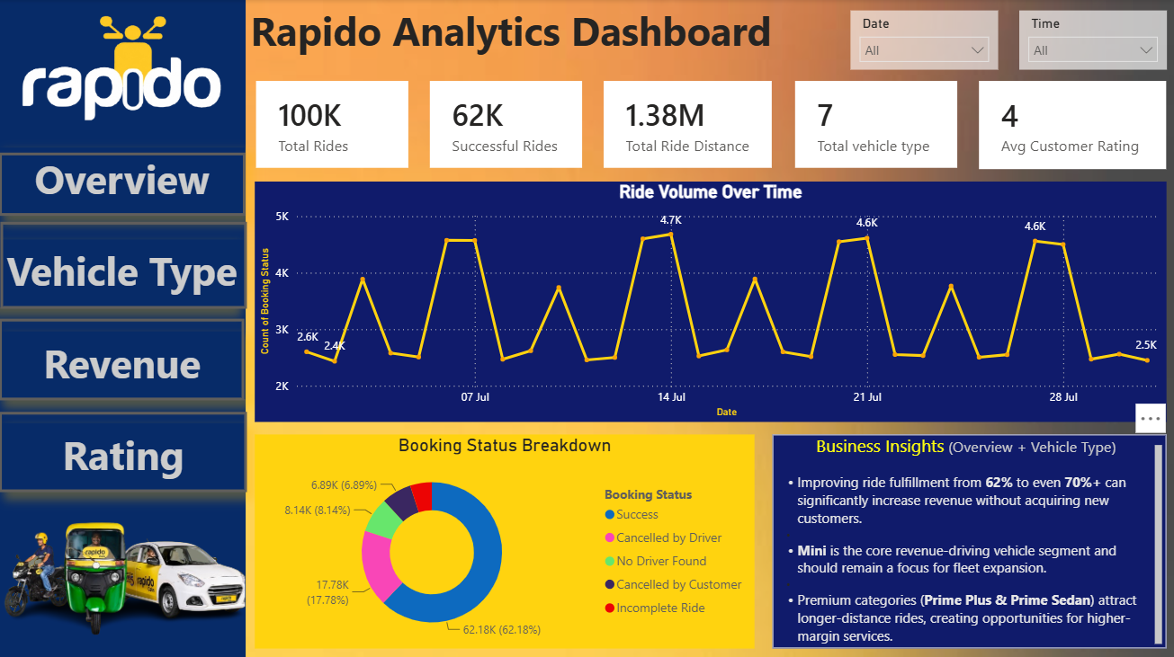
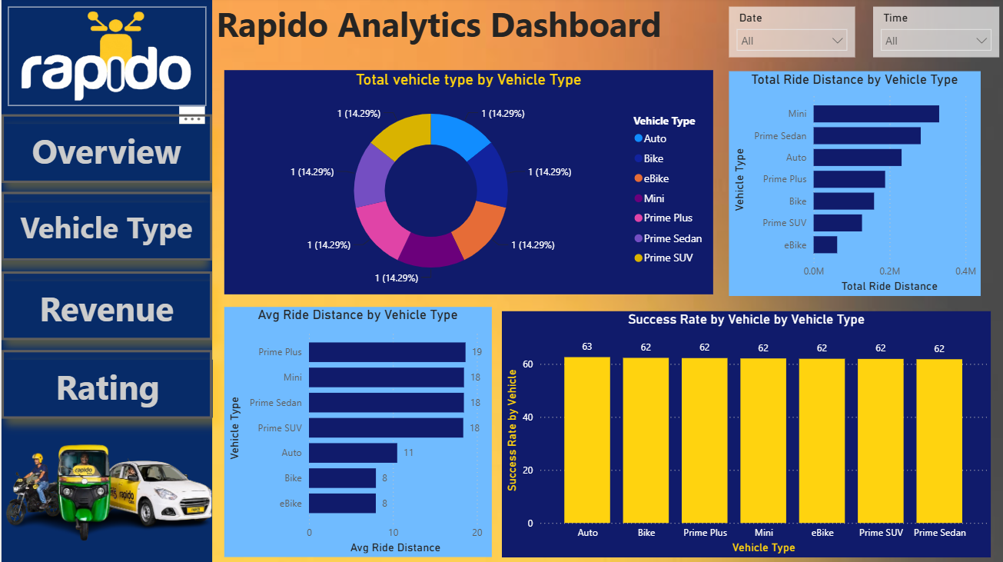
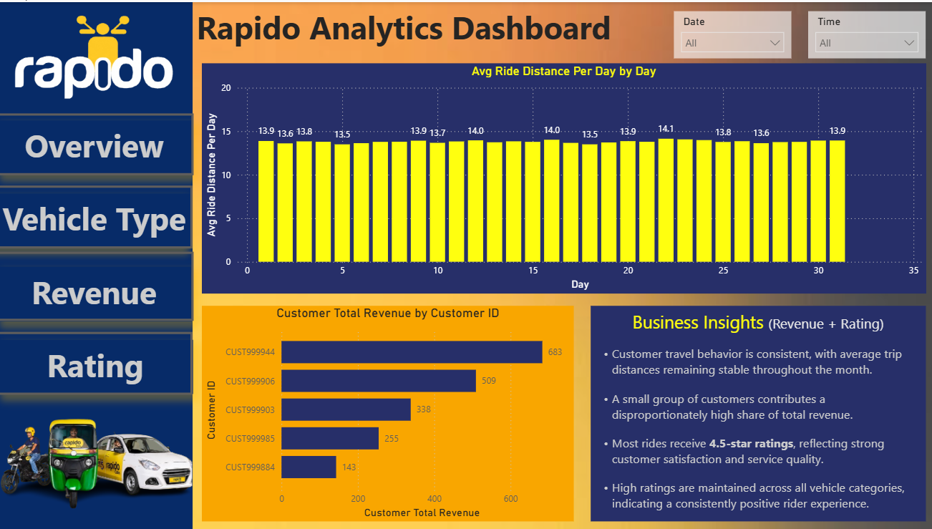
POWER BI DASHBOARD OVERVIEW
Dashboard includes → Booking Status Overview • Revenue by Vehicle Type • Cancellation Trends • Top Locations Map • Day-wise Ride Count

Slide 7
HOW WE SOLVED IT
SQL
Data Extraction & Analysis
01
Wrote 20+ optimised SQL queries to extract meaningful business answers from raw ride data — cancellation analysis, revenue breakdown, top users, location demand, VTAT/CTAT monitoring and window function rankings.
Excel
Data Cleaning & Pivot Reports
02
Imported the CSV into Excel, cleaned nulls, formatted columns, and built pivot tables to cross-tabulate vehicle type vs revenue, daily ride volumes, and rating distributions for quick team reporting.
Power BI
Interactive Dashboard
03
Designed a multi-page Power BI dashboard with DAX measures, date slicers, drill-through pages and card KPIs so stakeholders can monitor rides, revenue, cancellations and ratings in real time.

Slide 8




CONCLUSION
Data-Driven Operations
for Rapido's Growth
SQL uncovered hidden patterns in cancellations, ratings, and revenue that were invisible without structured querying.
Excel bridged raw data and business reporting, giving teams a lightweight yet powerful analytical layer.
Power BI transformed static numbers into a live, interactive operations dashboard for management decisions.
Rapido Analytics Project • SQL • Excel • Power BI

