Slide 1

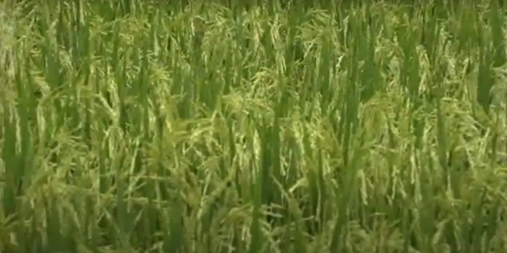
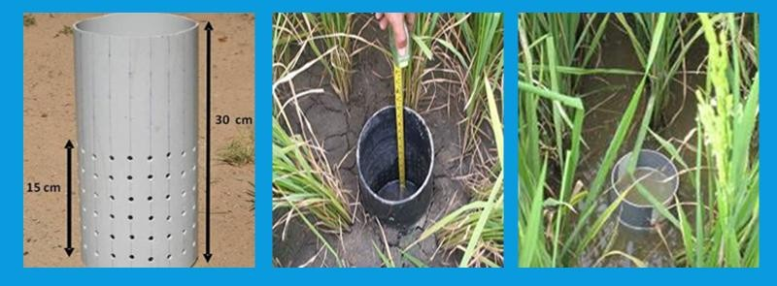
Progressive Community and Development Foundation Trust_CCX & Aurigraph Co, Sustainable Rice Production in Karnataka.

Slide 2

To Reduce Greenhouse Gas (Methane) Emission, Improve Water Management as well as Productivity and Paddy Yield by Following AWD Irrigation Method
GOAL
Rice farms that change the water regime during the cultivation period from continuously to intermittent flooded conditions and/or a shortened period of flooded conditions
Alternate Wetting and Drying method (AWD)
Rice farms that change their rice cultivation practice from transplanted to direct-seeded rice (DSR).
ACTIVITIES INVOLVED

Slide 3
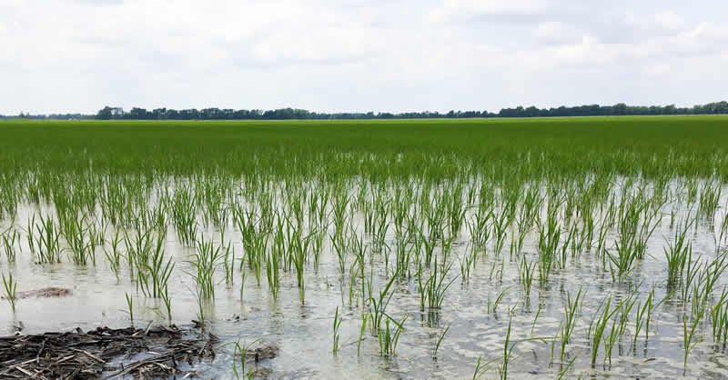
The Objectives of Maintaining Water in the Rice Field
To Control the Weed
Dissolve the Fertilizer
Maintain the Temperature in the Field
Rice is a Semi- Aquatic Plant
Generally Rice is tolerant to submergence situation.
The Excessive Submergence Causes Impaired Growth & Development

Slide 4
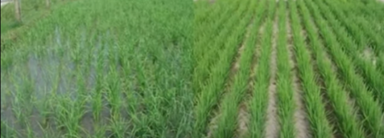
Alternate
Wetting
Drying
Alternate Wetting and Drying (AWD)

Slide 5
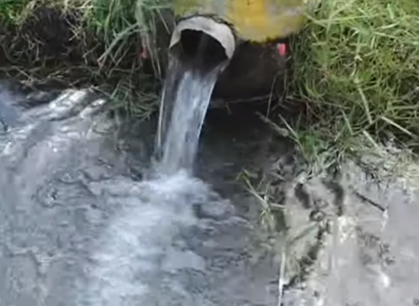
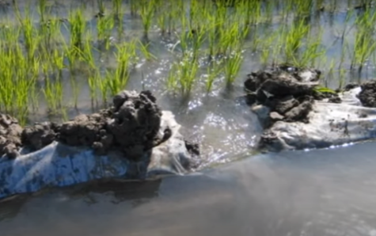
AWD Technique is a Water Saving Technology to Reduce the Irrigation water Consumption in Rice Field Without Decreasing the Yield by Alternate Pump in and Drain out the Water from Rice Field.

Slide 6
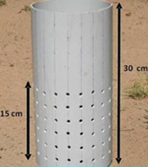

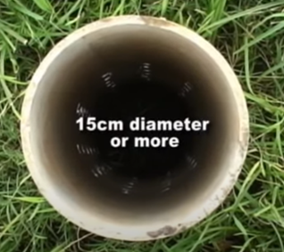
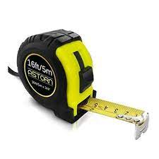
Equipments Required
PVC Tube/ Pani Pipe ( 30 cm Length, 15 cm Diameter
Measuring Scale/ Tape

Slide 7
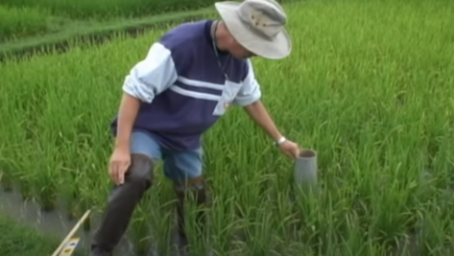
Install the Tube at one (1) mt Distance from the Bond of Rice Field

Slide 8
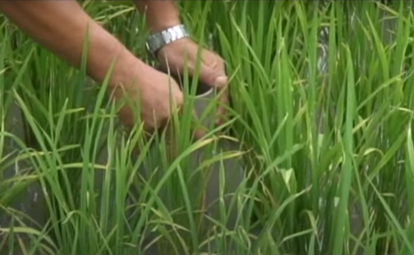
Insert the Tube (50% i.e. 15 cm) inside the Soil by Putting Pressure Using Both The Hands

Slide 9
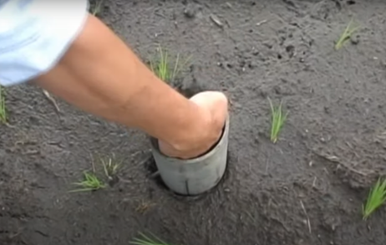
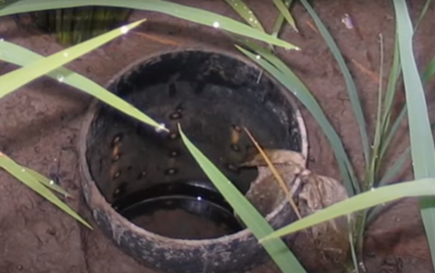
Take out the Soil from Inside the Tube
So That
Water Present Below the Soil Surface Can Easily Enter into the Tube Through the Pores

Slide 10
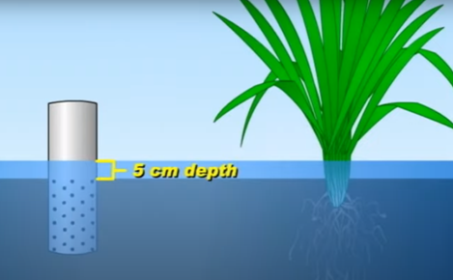
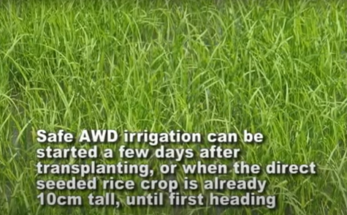
Initiation of Wetting/ Pumping Water 5cm Above Soil Surface

Slide 11
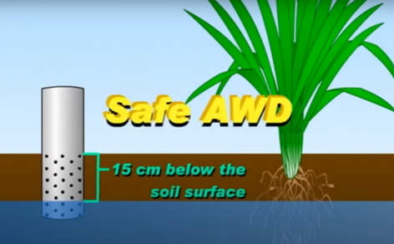
Initiation of Drying/ Draining of Water 15cm Below the Soil Surface

Slide 12
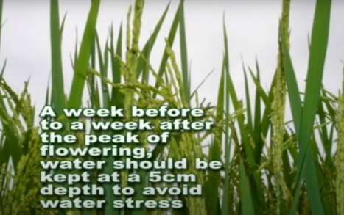
Water Pumping at Flower Initiation

Slide 13
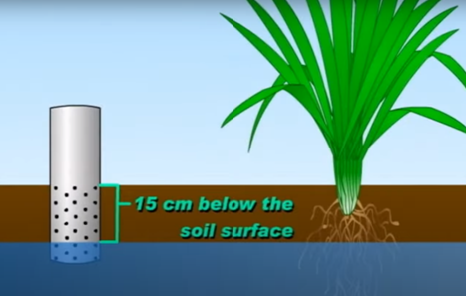
Drying of Water 15cm Below the Soil Surface

Slide 14
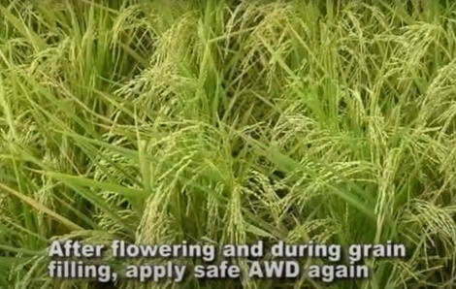
Water Maintenance 5cm Above the Soil Surface

Slide 15
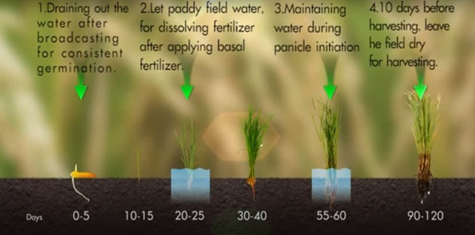
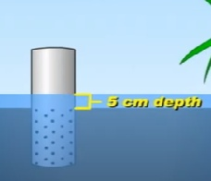
Whole AWD- At a Glance

Slide 16
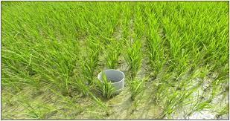
Benefits of AWD Water Management
1. Reduce 55% Maximum Water Consumption.
2. Reduce 30% Fuel & Labor Cost for Water Pumping
3. Reduce Pest and Disease epidemic
4. Increase Vigorous Root System
5. Increase Soil Fertility
6. Reduce 30% Maximum Greenhouse Gas Emission

Slide 17
Way Forward
Environmental Benefit:
Greenhouse Gas ( Methane) Avoidance
Water Conservation
Economical Benefit:
Contribute in Better Water Utilization
Earning Carbon Revenue from the Global Carbon Market.
Social Benefit:
Reducing Usage of Water in the Rice Cultivation
Technological:
Promotion of AWD & DSR with Adjusted Water Management.

Slide 18
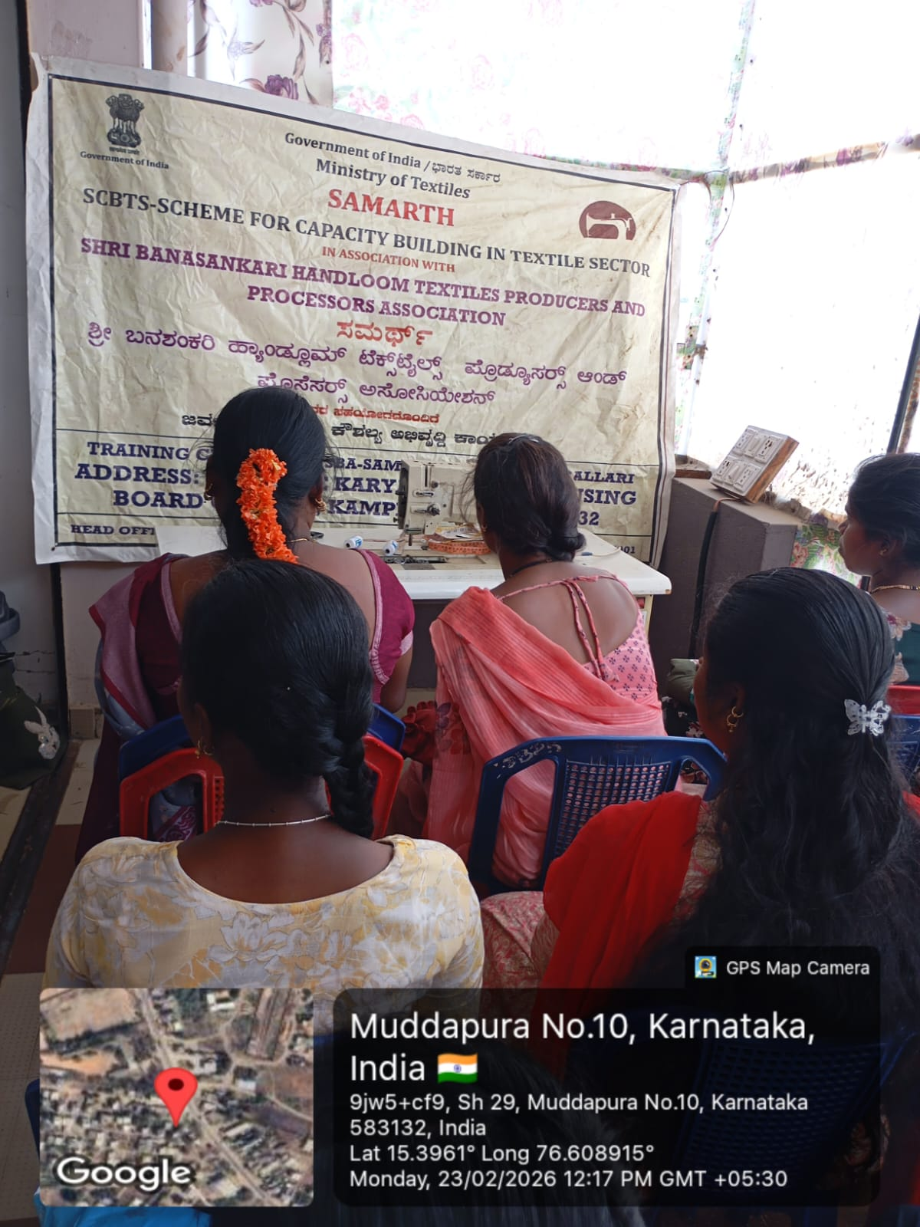
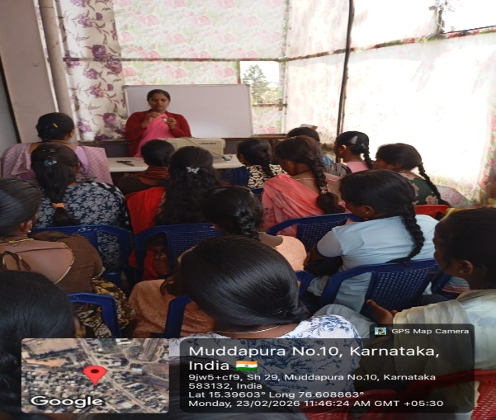
Progressive Community and Development Foundation_P M Samarth Tailering Trainings In Karnataka.

Slide 19
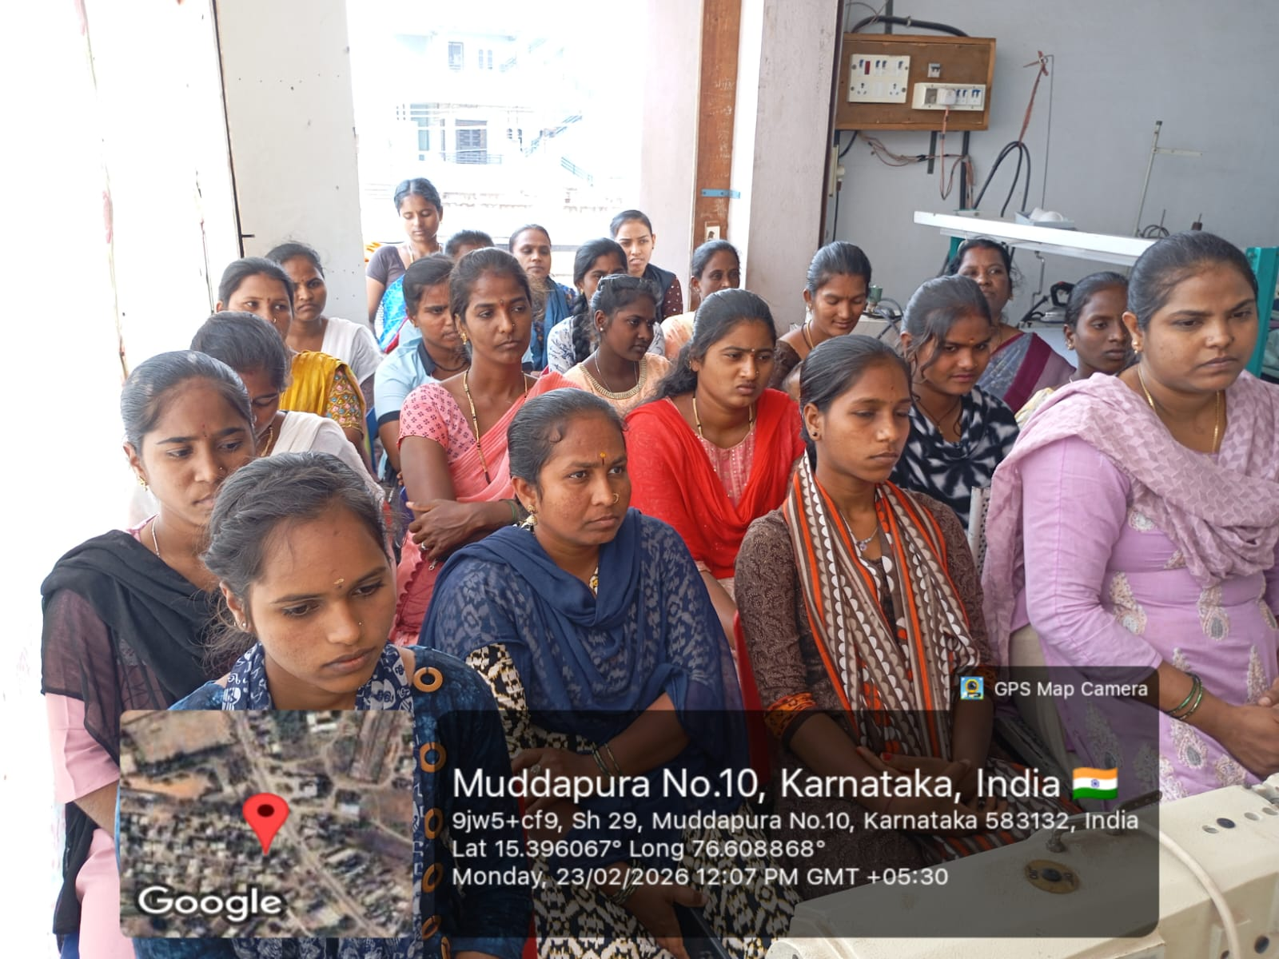
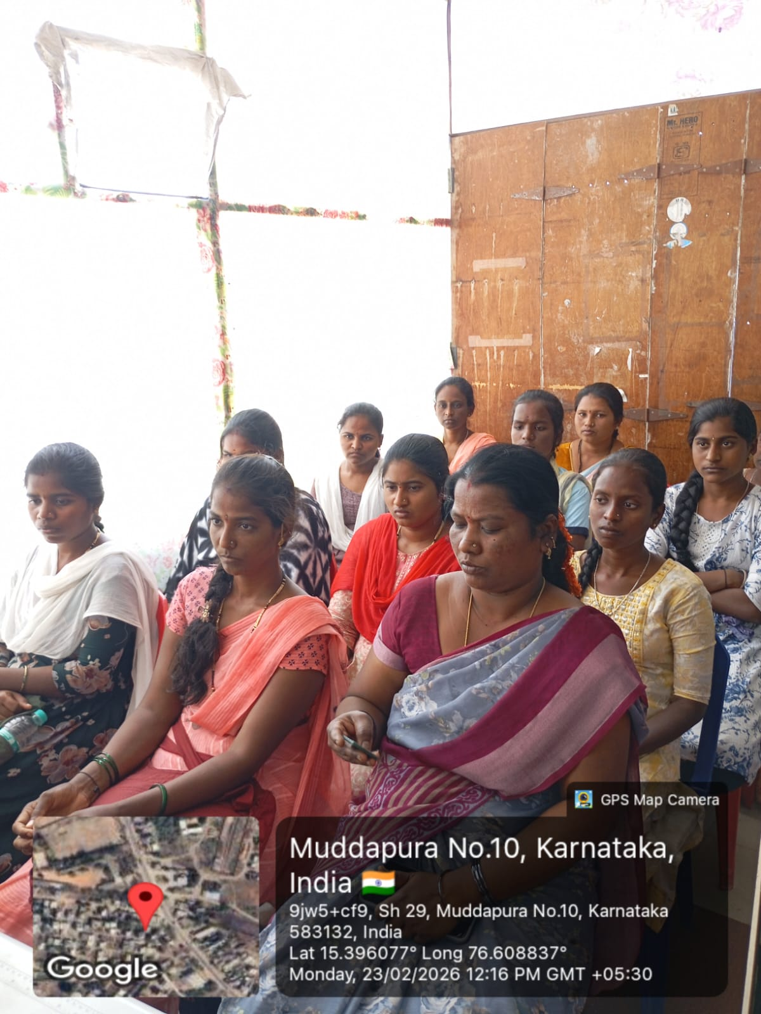
Tailering Training Students Theory Classes

Slide 20
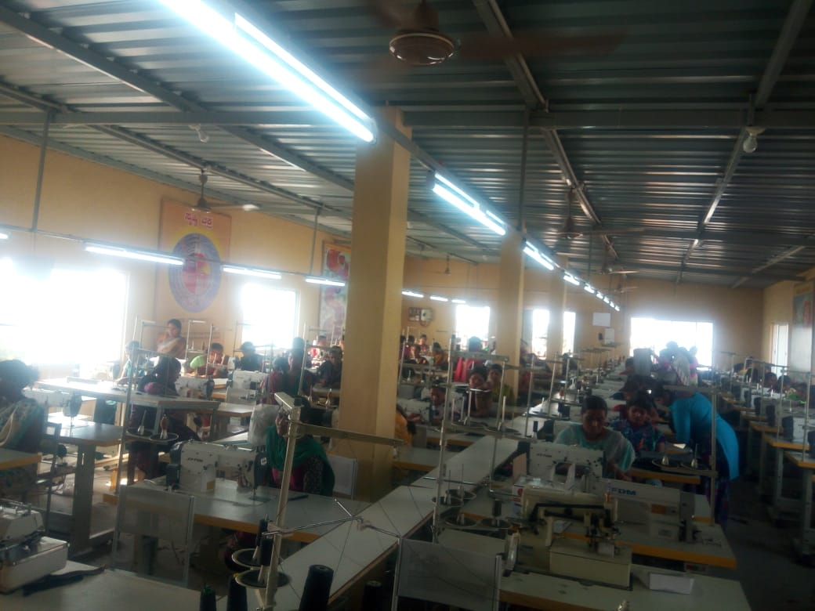
Tailering Training Students Practical Classes

Slide 21
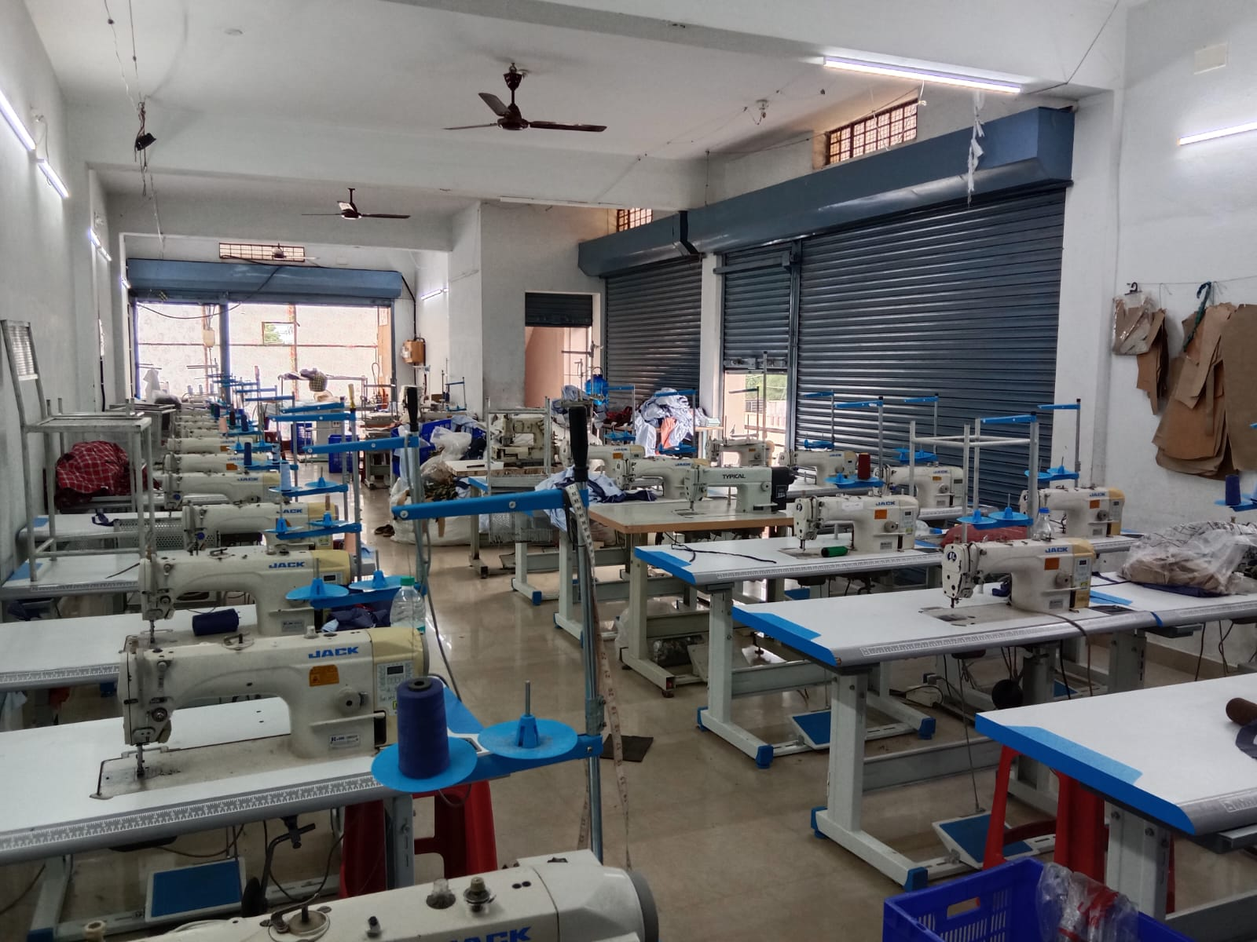
Tailering Training Students Practical Classes Room

Slide 22
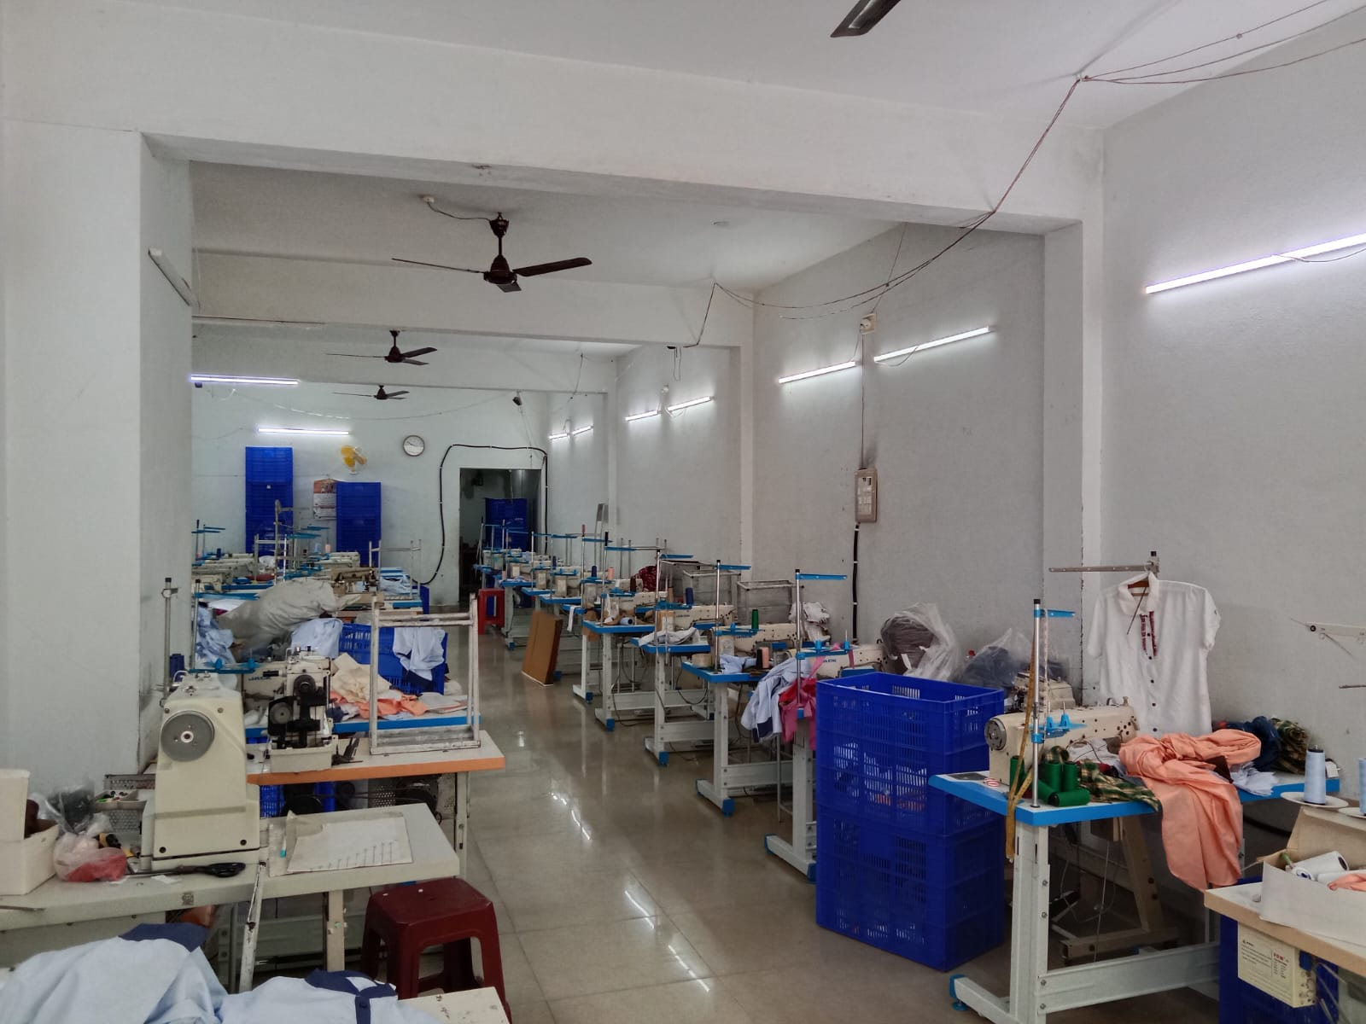
Tailering Training Students Practical Classes Room

Slide 23
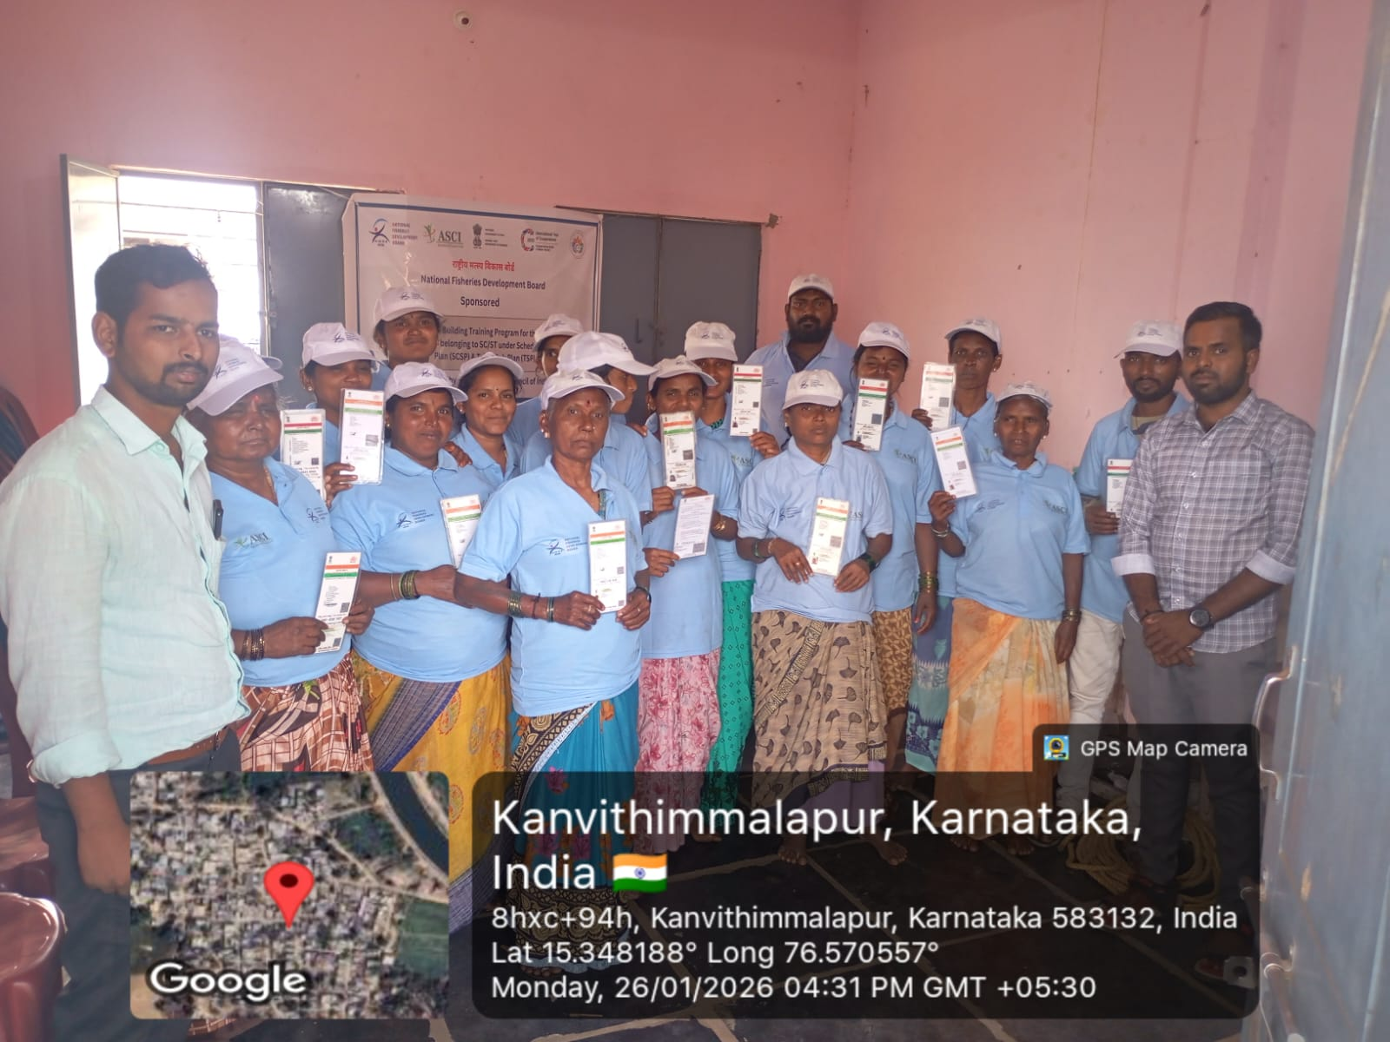
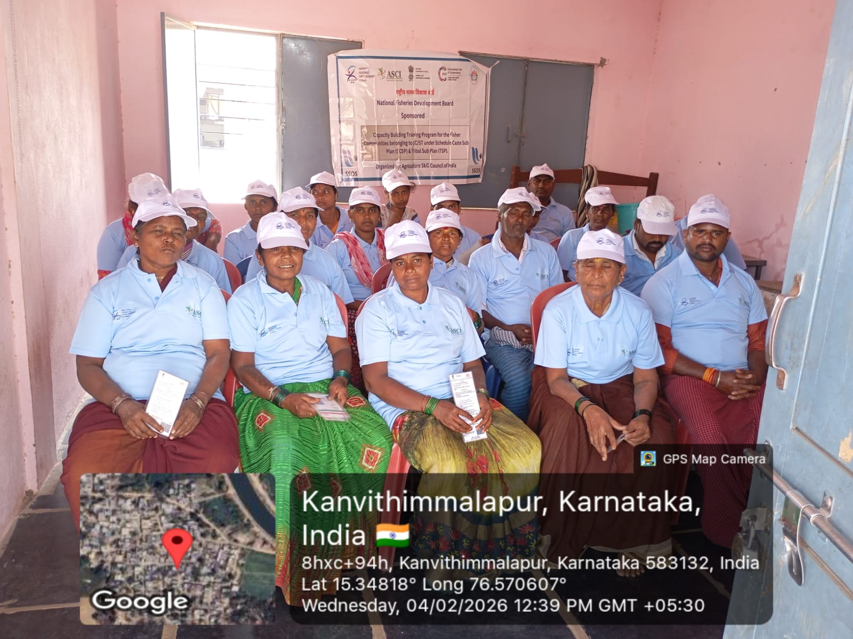
Progressive Community and Development Foundation Fish Farming Trainings_ASCI in Karnataka. (Skill India Development Programs)

Slide 24
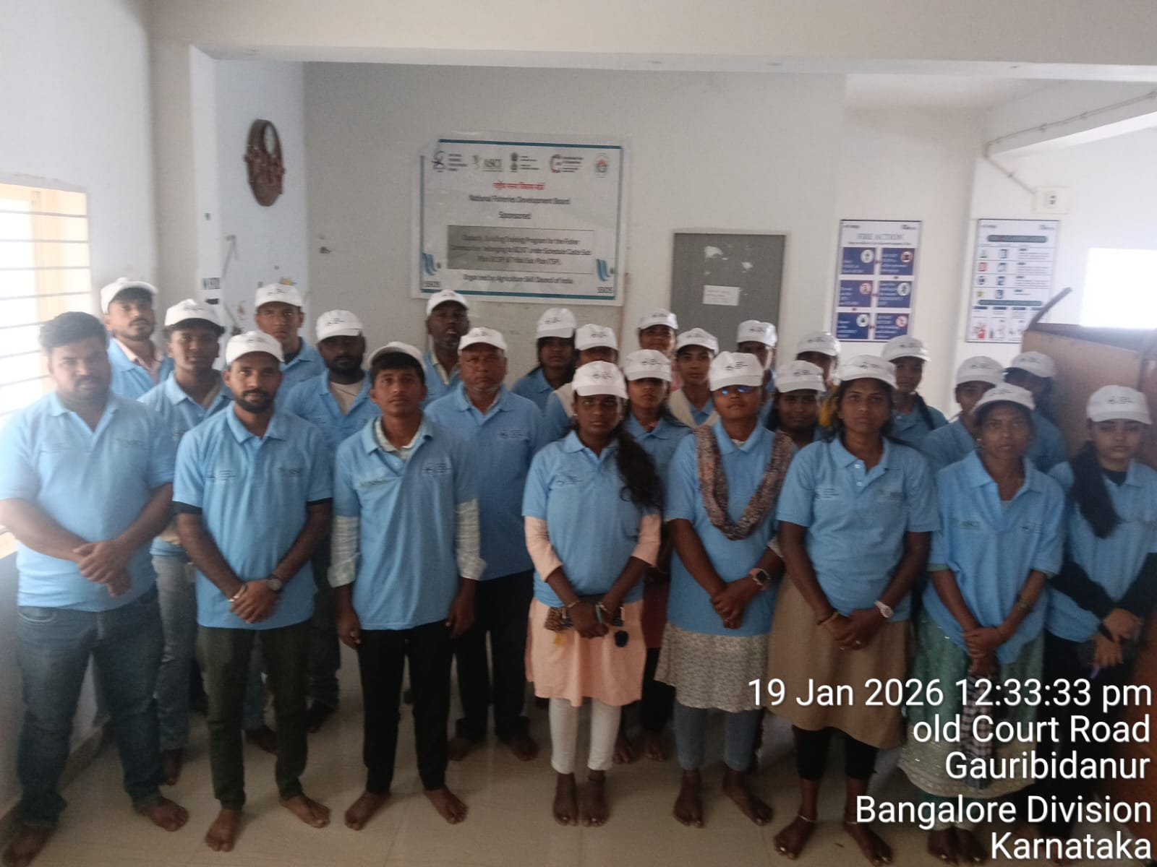
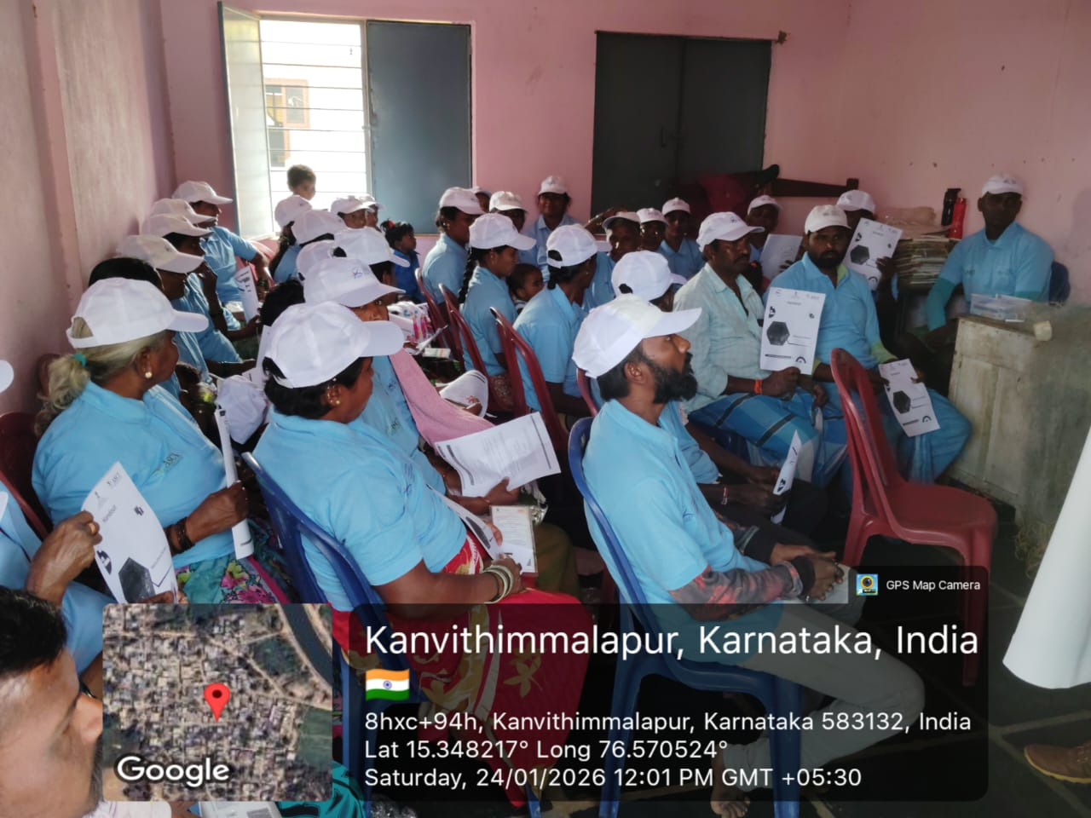
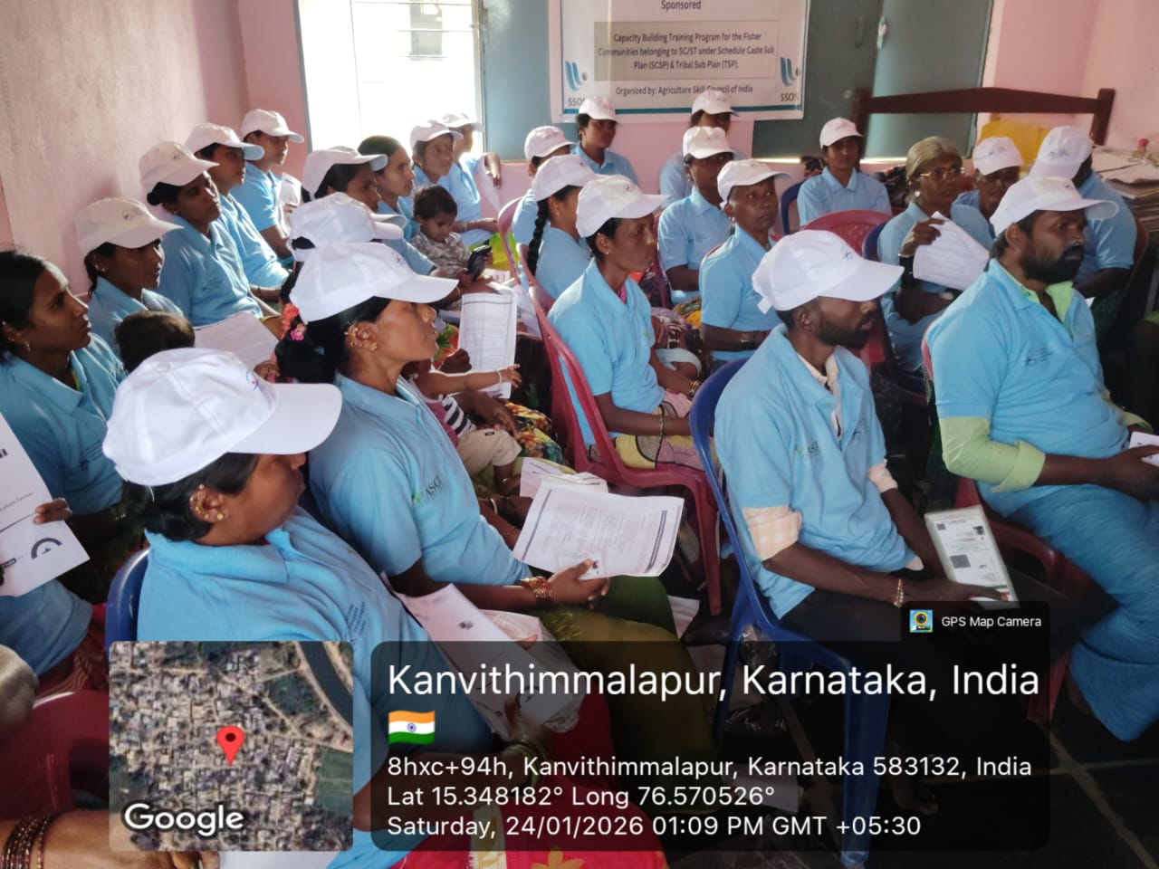
Fish Farming Trainings under ASCI

Slide 25
Thanks

