Slide 1
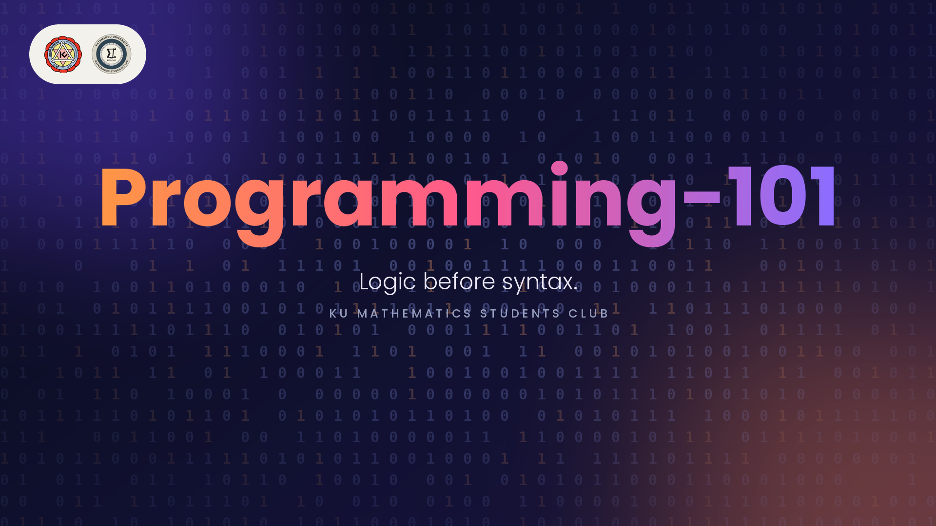

Slide 2
Who was the first programmer in history?
Programming 101
2

Slide 3

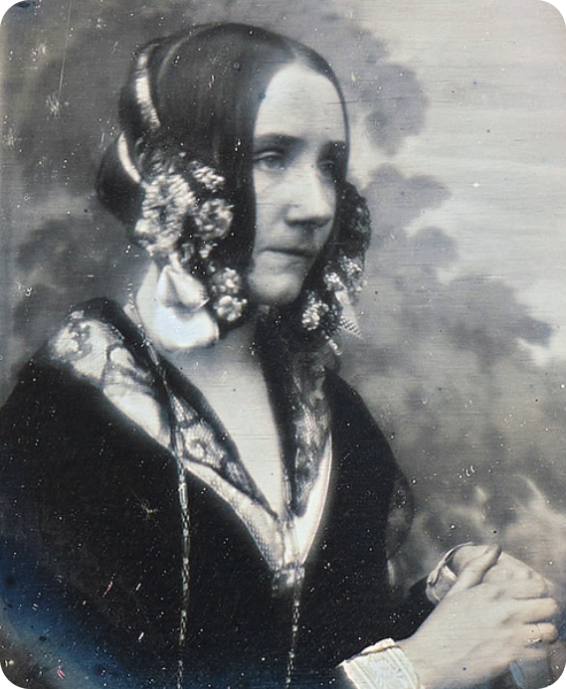
Ada Lovelace
Mathematician. Author of the first published algorithm.
1834
Analytical Engine
Babbage designs a general-purpose mechanical computer.
1842
Menabrea’s paper
An article describing how the engine would work.
1843
Ada’s Notes A–G
She translates it, then adds notes three times longer.
1843
Note G
A step-by-step algorithm for Bernoulli numbers.
A program for a machine that didn’t exist.
About 100 years before the first electronic computers.
Ada Lovelace, 1815–1852
She also saw that machines could work on symbols, not just numbers. Music included.
Programming 101
3

Slide 4
Are coding and programming the same?
Not quite.
Coding is one step inside programming.
PROGRAMMING
1
Understand the problem
What exactly needs solving?
2
Design the logic
Steps, decisions, data.
3
Write the code
Express it in a language.
4
Test and debug
Does it really work? Fix it.
CODING
Ada’s Note G was all design and logic, with no programming language yet to write it in.
Programming 101
4

Slide 5

Today’s roadmap
From thinking to building
1
THINK
1 · THINK
Algorithms
Solve it in plain steps before you touch any code.
Programming 101
5

Slide 6

Today’s roadmap
From thinking to building
1
2
THINK
STORE
2 · STORE
Data, variables, types
Where information lives, and what kind of thing it is.
Programming 101
6

Slide 7

Today’s roadmap
From thinking to building
1
3
2
THINK
STORE
DECIDE
3 · DECIDE
Operators, logic, control flow
Combine values, choose a path, repeat a task.
Programming 101
7

Slide 8

Today’s roadmap
From thinking to building
1
3
2
4
THINK
STORE
DECIDE
REUSE
4 · REUSE
Functions and recursion
Name a piece of logic once, use it anywhere.
Programming 101
8

Slide 9

Today’s roadmap
From thinking to building
1
3
5
2
4
THINK
STORE
DECIDE
REUSE
ORGANIZE
5 · ORGANIZE
Data structures
Shape your data so it is easy to work with.
Programming 101
9

Slide 10

Today’s roadmap
From thinking to building
1
3
5
2
4
6
THINK
STORE
DECIDE
REUSE
ORGANIZE
TRUST
6 · TRUST
Errors, debugging, testing
Find what broke, then prove it works.
Programming 101
10

Slide 11

Today’s roadmap
From thinking to building
1
3
5
7
2
4
6
THINK
STORE
DECIDE
REUSE
ORGANIZE
TRUST
IMPROVE
7 · IMPROVE
Paradigms, efficiency, tools
Make it work well, not just work.
Programming 101
11

Slide 12

Today’s roadmap
From thinking to building
1
3
5
7
2
4
6
8
THINK
STORE
DECIDE
REUSE
ORGANIZE
TRUST
IMPROVE
BUILD
8 · BUILD
Putting it all together
One small project, from idea to finish.
Programming 101
12

Slide 13
Today’s roadmap
From thinking to building
1
3
5
7
2
4
6
8
THINK
STORE
DECIDE
REUSE
ORGANIZE
TRUST
IMPROVE
BUILD
No specific language today.
Languages are accents; the thinking is shared.
Programming 101
13

Slide 14

Warm-up
Before we write a single line
How do you tell a robot to make a cup of chiya?
It does exactly what you say. Nothing more.
Programming 101
14

Slide 15
Think
So what is programming?
Algorithms
the steps you design
+ Data Structures
the information they work on
= Programs
what a machine can run
Programming is not typing code. It is designing the steps and the data.
Wirth, N. (1976). Algorithms + Data Structures = Programs. Prentice-Hall.
Programming 101
16

Slide 16
Think
Algorithms
What is an algorithm?
Algorithm
A finite list of clear, precise steps that turns input into output.
Problem
What to solve: the input you get, the output you need.
Program
One way of writing the algorithm for a machine.
Correct
Gives the right output for every valid input.
Efficient
Uses little time and little memory.
Representation
Pseudocode, a flowchart, or plain steps.
The algorithm is the idea. The program is one way to write it down.
Programming 101
46

Slide 17
Think
What makes a good algorithm
Five properties of an algorithm
Input
What it starts with.
Output
What it must produce.
Finite
It must end.
Effective
Every step is doable.
Precise
Every step is exact. No guessing.
A person fills in the gaps. A machine can’t.
“Add sugar” is a wish. “Add 1 teaspoon” is a step.
Knuth, D. E. (1997). The Art of Computer Programming, Vol. 1: Fundamental Algorithms (3rd ed.), §1.1. Addison-Wesley. Knuth calls “precise” definiteness.
Programming 101
17

Slide 18
Think
Problem solving
Pólya’s four steps
Step | Ask yourself | chiyaaa
1. Understand | What is given? What is wanted? | Given: water, tea. Wanted: one cup.
2. Plan | Have I solved something similar? | Like boiling noodles, plus milk.
3. Carry out | Follow the plan, checking each step. | Cook, taste along the way.
4. Look back | Does it work? Can it be better? | Too sweet? Adjust next time.
Pólya, G. (1945). How to Solve It. Princeton University Press.
Programming 101
48

Slide 19
Think
Computational thinking
The four pillars
Pillar | Meaning | Chiyaa
Decomposition | Break a big problem into small parts. | Boil, brew, sweeten, serve.
Pattern recognition | Spot what repeats. | Every cup follows the same steps.
Abstraction | Ignore details that do not matter. | The colour of the pot.
Algorithm design | Write the steps precisely. | The exact recipe.
Wing, J. M. (2006). Computational thinking. Communications of the ACM, 49(3), 33–35.
Programming 101
49

Slide 20
Store
Data and variables
Where does the robot keep the 200 ml?
water
sugar
boiling
200
ml
1
teaspoon
no
changes to yes
A variable is a named box. The name says what it is. The value says how much.
Programming 101
18

Slide 21
Store
Why the name?
Why is it called a variable?
variable, from Latin variabilis: able to change.
runs address 0x1000, the same box every time
45
start
49
runs ← runs + 4
50
runs ← runs + 1
56
runs ← runs + 6
Name stays. Address stays. Value varies.
A constant never changes: boilingPoint = 100.
Programming 101
20

Slide 22
Store
Memory location
Where does a variable live?
Memory
A long row of cells. Each cell has a number, its address.
MEMORY (RAM)
0x1000
45
← runs
Address
Where a value is stored, like a house number.
0x1004
2
← wickets
0x1008
51
← balls
Name
The label we use, so we never remember addresses.
0x100C
120
← target
Addresses shown are illustrative.
A variable is a named location in memory.
Humans use the name. The machine uses the address.
Programming 101
19

Slide 23
Store
Types
Every value has a type
Number
200
Do maths with it.
200 + 100 = 300
Text
“ginger”
Letters and words.
Join them, not add them.
True / False
yes
Only two answers.
Is the water boiling?
The type decides what you can do.
As numbers, 200 + 100 = 300. As text, “200” + “100” = “200100”.
Programming 101
19

Slide 24
Store
Kinds of data
Data comes in kinds
Kind | Meaning | Example
Quantitative, discrete | Counted, whole numbers | 3 cups
Quantitative, continuous | Measured, any value in a range | 98.6 °C
Qualitative, nominal | Categories with no order | Assam, Darjeeling
Qualitative, ordinal | Categories with an order | small, medium, large
The kind of data decides how you store it and what you can do with it.
Programming 101
28

Slide 25
Store
How data is organised
Structured, semi-structured, unstructured
Form | Shape | Example
Structured | Fixed rows and columns | A guest list table
Semi-structured | Labelled fields, flexible shape | An order with optional extras
Unstructured | No fixed shape | A photo or voice note of the chai
Most real-world data is unstructured. Programs first give it a shape.
Programming 101
29

Slide 26
Store
Data types
Primitive data types
Type | Holds | Example | Examples
Integer | Whole numbers | 3, −7 | Number of cups
Float | Decimal numbers | 98.6 | Temperature
Character | One symbol | ‘S’ | Size code
String | Text | “ginger” | Tea name
Boolean | True or false | true | Is it boiling?
Null | No value | null | Milk not chosen yet
Programming 101
30

Slide 27
How many different values can a byte holds?

Slide 28
Store
Numbers
Numbers inside the machine
Bit
0 or 1. Everything a computer stores is bits.
Byte
8 bits. It holds 2⁸ = 256 different values.
n bits
2ⁿ different values. More bits, bigger range.
Signed 8-bit
−128 to 127. Go past the end and it overflows.
Integer
Exact whole numbers. Use it for counting.
Float
Approximate decimals. 0.1 + 0.2 is not exactly 0.3.
Programming 101
31

Slide 29
Store
Text
Text inside the machine
Character
One symbol, stored as a number. A is 65.
String
A sequence of characters. Counting positions usually starts at 0.
ASCII
128 characters. English letters, digits, punctuation.
Unicode
One code for every script, including नमस्ते
UTF-8
Unicode stored in 1 to 4 bytes per character.
Same text, different encoding, different bytes.
Programming 101
32

Slide 30
Store
Four different things
False, zero, empty and null
Value | Means | Example
false | A real answer: no | boiling = false
0 | A number: zero | sugar = 0
“” (empty) | Text with no characters | note = “”
null | No value at all | milk = null
Four different things. A precise programmer never mixes them up.
Programming 101
33

Slide 31
Store
Composite types
Composite data types
Type | Ordered | Duplicates | Access by | Chai
Array / list | Yes | Yes | Position | Guests
Tuple | Yes | Yes | Position, fixed | (200 ml, 100 ml)
Set | No | No | Membership | Tea types tried
Dictionary | No | Keys unique | Key | Order → sugar
Record / struct | Fields | — | Field name | One guest’s order
Pick the structure whose rules match the rules of your data.
Programming 101
34

Slide 32
Store
Variables in theory
Anatomy of a variable
Name
The label you choose, such as water
Type
The kind of value it can hold
Value
What is stored right now
Address
Where it lives in memory
Scope
The part of the program that can see it
Lifetime
How long it exists while the program runs
Constant
A name whose value never changes, like boilingPoint = 100
Programming 101
36

Slide 33
Store
Why types matter
Why do we need different types?
01000001
read as an integer
65
read as a character
A
Meaning
The type tells the machine how to read the bits.
Operations
Numbers add. Text joins. Booleans decide.
Safety
Wrong-type mistakes are caught, not silently accepted.
Each type has its own operators.
DECIDE →
Programming 101
23

Slide 34
Decide
Operators and logic
Three kinds of operators
Arithmetic
200 + 100
Gives a number: 300
Comparison
heat ≥ 100
Gives true or false
Logic
boiling AND milk added
True only if both are true
Every decision boils down to true or false.
Operators are how the robot asks its questions.
Programming 101
20

Slide 35
Decide
Control flow
Three moves build every program
Sequence
Step 1, then 2, then 3
Do things in order.
Choose
IF boiling
Add the tea. Otherwise keep heating.
Repeat
WHILE not boiling
Wait 10 seconds, check again.
In order, choose, repeat.
Everything else is a mix of these three.
Programming 101
21

Slide 36
Decide
What is an operator?
Operators and operands
Operator
A symbol that performs an action, such as +
Operand
A value the operator works on
Expression
Operands and operators that produce a value: 200 + 100
Unary
One operand: −5
Binary
Two operands: 3 + 4
Ternary
Three operands: condition ? a : b
Notation
Infix 3 + 4, prefix + 3 4, postfix 3 4 +
Programming 101
37

Slide 37
Decide
Families of operators
Eight families of operators
Family | Examples | Gives back
Arithmetic | + − × ÷ % power | A number
Assignment | = += −= ×= | Stores a value
Comparison | == != < > <= >= | True or false
Logical | AND OR NOT XOR | True or false
Bitwise | & | ^ ~ << >> | A number
String | join, repeat | Text
Membership, identity | in, is | True or false
Conditional | condition ? a : b | Either value
Programming 101
38

Slide 38
Decide
Arithmetic
Arithmetic operators
Operator | Name | Example | Result
+ | Add | 7 + 2 | 9
− | Subtract | 7 − 2 | 5
× | Multiply | 7 × 2 | 14
÷ | Divide | 7 ÷ 2 | 3.5
div | Integer divide | 7 div 2 | 3
mod (%) | Remainder | 7 mod 2 | 1
power | Exponent | 2 power 3 | 8
7 cups shared by 2 guests: 3 each (div), 1 left over (mod).
Programming 101
39

Slide 39
Decide
Assignment
Assignment operators
Operator | Meaning | Same as | If sugar is 1
= | Store a value | — | sugar = 1
+= | Add, then store | sugar = sugar + 1 | sugar += 1 → 2
−= | Subtract, then store | sugar = sugar − 1 | sugar −= 1 → 0
×= | Multiply, then store | sugar = sugar × 2 | sugar ×= 2 → 2
÷= | Divide, then store | sugar = sugar ÷ 2 | sugar ÷= 2 → 0.5
%= | Remainder, then store | sugar = sugar mod 2 | sugar %= 2 → 1
One = stores a value. Asking “are these equal?” needs ==.
Programming 101
40

Slide 40
Decide
Comparison
Comparison operators
Operator | Meaning | Example (heat = 90) | Result
== | Equal to | heat == 100 | false
!= | Not equal to | heat != 100 | true
< | Less than | heat < 100 | true
> | Greater than | heat > 100 | false
<= | Less than or equal | heat <= 90 | true
>= | Greater than or equal | heat >= 100 | false
Floats: compare with a tolerance, not ==.
Programming 101
41

Slide 41
Decide
Logical
Logical operators and truth tables
A | B | A AND B | A OR B | A XOR B
true | true | true | true | false
true | false | false | true | true
false | true | false | true | true
false | false | false | false | false
NOT
Flips the value. NOT true is false.
Short-circuit
If A is false, A AND B never checks B. If A is true, A OR B never checks B.
AND needs both. OR needs one. XOR needs exactly one.
Programming 101
42

Slide 42
Decide
Bitwise
Bitwise operators
Operator | Name | 5 = 0101, 3 = 0011 | Result
& | AND | 0101 & 0011 | 0001 (1)
| | OR | 0101 | 0011 | 0111 (7)
^ | XOR | 0101 ^ 0011 | 0110 (6)
~ | NOT | ~0101 (4 bits) | 1010 (10)
<< | Shift left | 0101 << 1 | 1010 (10)
>> | Shift right | 0101 >> 1 | 0010 (2)
Bitwise works on the bits of a number. Logical works on true and false.
Programming 101
43

Slide 43
Decide
Precedence
Which operator goes first?
Order | Operators | Example
1 | Parentheses ( ) | (2 + 3) × 4 = 20
2 | Power | 2 power 3 = 8
3 | Unary + and − | −5
4 | × ÷ mod | 6 ÷ 2 × 3 = 9
5 | + − | 2 + 3 × 4 = 14
6 | Comparison | 1 + 1 == 2
7 | NOT, then AND, then OR | NOT a AND b
8 | Assignment | x = 5
Same level runs left to right, except power and assignment. Unsure? Add parentheses.
Programming 101
44

Slide 44
Decide
Other operators
Other operators you will meet
Join
“mas” + “ala” gives “masala”
Repeat
“ha” × 3 gives “hahaha” in some languages
Membership
“ginger” in ingredients gives true
Identity
Do two names point at the same object?
Conditional
boiling ? “add tea” : “keep heating”
Index, access
guests[0], order.sugar
Call
makeChai(3)
Programming 101
45

Slide 45
Decide
Control flow
Four ways to control the order
Structure | Idea | Keywords | Chiya Analogy
Sequence | One step after another | none | Boil, then add tea
Selection | Choose a path | if, else, switch | If boiling, add tea
Iteration | Repeat | while, for | Wait while not boiling
Jump | Leave or skip | break, continue, return | Stop if no milk
Sequence, selection and iteration are enough to express any algorithm.
Programming 101
50

Slide 46
Decide
Control flow
Selection statements
Form | Meaning | Chai
if | Run only when the condition is true | if boiling: add tea
if … else | Choose one of two paths | else keep heating
else if chain | Test in order, first match wins | no sugar / one / two
nested if | A decision inside a decision | if milk: if fresh: add
switch / case | Pick a branch by exact value | case size: small, large
Conditions are checked top to bottom. The first true one wins.
Programming 101
51

Slide 47
Decide
Control flow
Loops and jumps
while
Check first, repeat while the condition holds.
do … while
Run once, then check. Runs at least once.
for
Repeat a set number of times with a counter.
for each
Visit every item in a collection.
break
Leave the loop now.
continue
Skip to the next round.
return
Leave the function and hand back a value.
Programming 101
52

Slide 48
Reuse
Functions
Write it once. Use it anywhere.
INPUT
cups, sugar
what you hand over
FUNCTION
makeChiya
the steps, written once
OUTPUT
hot chiya
what you get back
A function is a named recipe.
Call makeChai(3) and skip rewriting the steps.
Programming 101
22

Slide 49
Reuse
Recursion
A problem that holds a smaller copy of itself
makeCups(3)
make 1 cup, then makeCups(2)
makeCups(2)
make 1 cup, then makeCups(1)
makeCups(1)
make 1 cup, then makeCups(0)
makeCups(0)
Stop. Nothing left to make.
Every recursion needs a place to stop.
Programmers call it the base case.
Programming 101
23

Slide 50
Reuse
Functions
Functions in theory
Function
A named block of code that does one job.
Definition
Writing the function once.
Call
Using it. The block runs.
Parameter
A placeholder name in the definition.
Argument
The real value passed in a call.
Return value
What the function hands back.
Pure function
Same input, same output, no side effects.
Programming 101
53

Slide 51
Reuse
Functions
Scope and the call stack
Local variable
Exists only inside the function that made it.
Global variable
Visible everywhere. Easy to misuse.
Call stack
Active calls, last in, first out.
Stack frame
One call’s parameters, locals and return spot.
Returning
The top frame is removed, control goes back.
Stack overflow
Too many nested calls fill the stack.
Programming 101
54

Slide 52
Reuse
Recursion
Recursion in theory
Recursion
A function that calls itself on a smaller problem.
Base case
Input simple enough to answer directly.
Recursive case
Shrink the problem and call yourself.
Progress
Each call must move toward the base case.
Classic uses
Factorial, Fibonacci, trees, divide and conquer.
Danger
No base case: the calls never end.
Programming 101
55

Slide 53
Reuse
Recursion
Factorial in action: 3! = 6
Call | Waits for | Returns
fact(3) | 3 × fact(2) | 6
fact(2) | 2 × fact(1) | 2
fact(1) | Base case: the answer is 1 | 1
Calls stack up on the way down. Answers multiply on the way back up.
Programming 101
56

Slide 54
Organize
Data structures
Shape your data to fit the problem
List
Asha, Bikash, Sita
Many values, in order.
Record
name: Asha, sugar: 2
One thing, several named parts.
List of records
the whole class order
A list where every item is a record.
Choose the right shape and the steps get easy.
Algorithms + data structures = programs.
Programming 101
24

Slide 55
Organize
Data structures
Why data structures?
Data structure
A way of arranging data so operations are fast and simple.
Operations
Insert, delete, search, traverse, update.
Trade-off
Every structure is fast at some things and slow at others.
Abstract type
What it does, not how it is built.
Implementation
How it is really stored in memory.
Choice
Depends on which operation you do most.
The right structure can turn a slow program into a fast one.
Programming 101
58

Slide 56
Organize
Data structures
Linear structures
Structure | Rule | Chai
Array | Fixed slots, access by index | A shelf of numbered cups
Linked list | Nodes point to the next node | A chain of guests
Stack | Last in, first out | A pile of clean cups
Queue | First in, first out | Guests waiting for chai
Programming 101
59

Slide 57
Organize
Data structures
Non-linear structures
Structure | Rule | Chai
Tree | Parent and children, one root | Menu: drinks → hot → chai
Graph | Nodes joined by edges | Map of tea shops and roads
Hash table | Key to value through a hash function | Guest name → order
Heap | Biggest or smallest always comes first | Most urgent order first
Programming 101
60

Slide 58
Organize
Data structures
Choosing a structure
If you need | Use
Fast lookup by key | Hash table / dictionary
Items in order, add at the end | Array / list
First come, first served | Queue
Undo the last action | Stack
Parent and child relations | Tree
Things connected to each other | Graph
Ask first: what will I do most, search, add, or remove?
Programming 101
61

Slide 59
Trust
Errors, debugging, testing
Chiya gone wrong: three kinds of error
Syntax error
“Pour mlik”
The robot cannot read the step.
Runtime error
Add milk, none left
The robot stops half way.
Logic error
Too sweet
Runs fine, wrong chai.
Debugging: find the step, fix it, test again.
Test the edges: 0 cups, no sugar, 100 cups.
Programming 101
25

Slide 60
Trust
Errors
Kinds of error
Error | Found | Cause | Chai
Syntax | Before running | Breaks the language’s rules | “Pour mlik”
Runtime | While running | An impossible action | Add milk, none left
Logic | Only by testing | Wrong idea, program runs | Sugar × 10 by mistake
Logic errors are the hardest. Nothing complains. The answer is just wrong.
Programming 101
62

Slide 61
Trust
Debugging
The debugging process
1. Reproduce
Make the bug happen every time.
2. Isolate
Shrink it to the smallest failing case.
3. Find the cause
Make a guess, then check it. Do not assume.
4. Fix
Change one thing at a time.
5. Verify
Run the failing case again, then everything else.
6. Prevent
Add a test so it never returns.
Programming 101
63

Slide 62
Trust
Debugging
Debugging techniques
Read the message
Errors and stack traces name the place and reason.
Print or log
Show values while the program runs.
Breakpoint
Pause the program and inspect variables.
Step through
Run one line at a time and watch.
Bisect
Halve the code or history to find where it broke.
Rubber duck
Explain the code aloud, line by line.
Programming 101
64

Slide 63
Improve
Paradigms, efficiency, tools
Working is the start
Efficiency
Crush ginger while water heats
Same chai, less time.
Paradigms
Same chiya, new mindset
Steps, objects, or small functions chained.
Tools
Kettle, timer, notebook
Editor, debugger, version control.
Good means faster, clearer, easier to change.
Programming 101
26

Slide 64
Improve
Efficiency
Time and space
Time complexity
How running time grows as the input grows.
Space complexity
How memory use grows as the input grows.
Input size n
The number of items the algorithm handles.
Worst case
The slowest possible run. Gives a guarantee.
Average case
The typical run.
Trade-off
You can often save time by spending memory.
Programming 101
67

Slide 65
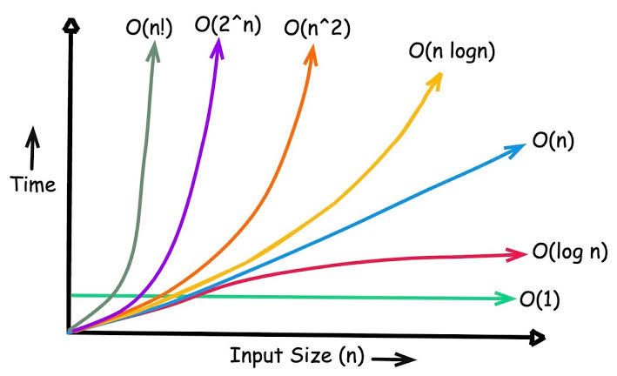

Slide 66
Improve
Efficiency
Big-O notation
Class | Name | Chai
O(1) | Constant | Read the label on the tea box
O(log n) | Logarithmic | Find a name in a sorted list by halving
O(n) | Linear | Serve n guests one by one
O(n log n) | Linearithmic | Sort the orders
O(n²) | Quadratic | Every guest compares with every guest
O(2ⁿ) | Exponential | Try every combination of extras
Big-O describes how cost grows, not how many seconds it takes.
Programming 101
68

Slide 67
Improve
Algorithms
Common strategies
Strategy | Idea | Example
Brute force | Try everything | Test every password
Divide and conquer | Split, solve, combine | Merge sort
Greedy | Take the best choice now | Give change with fewest coins
Dynamic programming | Save answers to sub-problems | Fibonacci with a table
Search | Find an item | Linear or binary search
Sort | Put items in order | Bubble, merge, quick sort
Programming 101
69

Slide 68
Improve
Paradigms
Programming paradigms
Paradigm | Idea | Chai
Imperative | Commands that change state | Do step 1, then step 2
Object-oriented | Objects with data and behaviour | A Cup object you can fill
Functional | Pure functions, no shared state | Ingredients in, chai out
Declarative | Say what, not how | “All orders with ginger”
Event-driven | React to events | Guest arrives, start boiling
A paradigm is a style of thinking. Most languages mix several.
Programming 101
70

Slide 69
Improve
Tools
Tools of the trade
Editor / IDE
Where you write and run code.
Compiler
Translates the whole program to machine code first.
Interpreter
Runs the program line by line.
Debugger
Pauses and inspects a running program.
Version control
Records every change so you can go back (Git).
Package manager
Installs code other people wrote.
Terminal
Type commands instead of clicking.
Programming 101
71

Slide 70
Improve
Code quality
Good code habits
Clear names
waterMl beats w.
Small functions
One function, one job.
Named values
Name 100 as boilingPoint.
Why comments
The code already shows what.
DRY
Do not repeat yourself. Reuse.
Refactor
Improve the structure, keep the behaviour.
Programming 101
72

Slide 71
Build
Putting it all together
Your turn: chiya for the whole class
THINK
Steps for one cup
STORE
water, sugar, boiling
DECIDE
IF boiling, add tea
REUSE
makeChai() per guest
ORGANIZE
List of guest orders
TRUST
Taste it, fix it
IMPROVE
Heat and crush together
Design the chiya program for our class.
Use every stop. Pen and paper first.
Programming 101
27

Slide 72
Build
Life cycle
From idea to working program
Phase | Question | Chiya for the class
Requirements | What must it do? | Chiya for 30 students
Design | How will it work? | Steps, data, functions
Implementation | Write it. | Code the design
Testing | Does it work? | 0 cups, no sugar, 100 cups
Deployment | Put it in use. | Serve the class
Maintenance | Fix and improve. | Add a ginger option
Real projects loop through these phases many times.
Programming 101
73

Slide 73
Build
Putting it together
The chiya program in pseudocode
FUNCTION makeChai(cups, sugar)
water ← 200 × cups
milk ← 100 × cups
boiling ← false
WHILE NOT boiling
heat(water)
IF temperature ≥ 100 THEN
boiling ← true
ADD tea, sugar, milk
WAIT 2 minutes
RETURN strain(mixture)
guests ← [Asha, Bikash, Sita]
FOR EACH guest IN guests
SERVE makeChai(1, guest.sugar)
Store
variables and types
Decide
WHILE and IF
Reuse
makeChai
Organize
the guests list
Trust
test 0 cups, no sugar
Programming 101
74

Slide 74
Build
Keep going
Further reading
Pólya
How to Solve It (1945). Princeton University Press.
Wirth
Algorithms + Data Structures = Programs (1976). Prentice-Hall.
Knuth
The Art of Computer Programming, Vol. 1 (1997). Addison-Wesley.
Abelson, Sussman
Structure and Interpretation of Computer Programs, 2nd ed. (1996). MIT Press.
Cormen et al.
Introduction to Algorithms, 4th ed. (2022). MIT Press.
Programming 101
75

Slide 76


