Slide 1
Name : Kunal Prakash mote Batch Code : PECM93 Project Name : Compatibility Testing using two mobile Browsers. Website : ebay.com Two Browsers :- 1) Chrome 2) Firefox

Slide 2
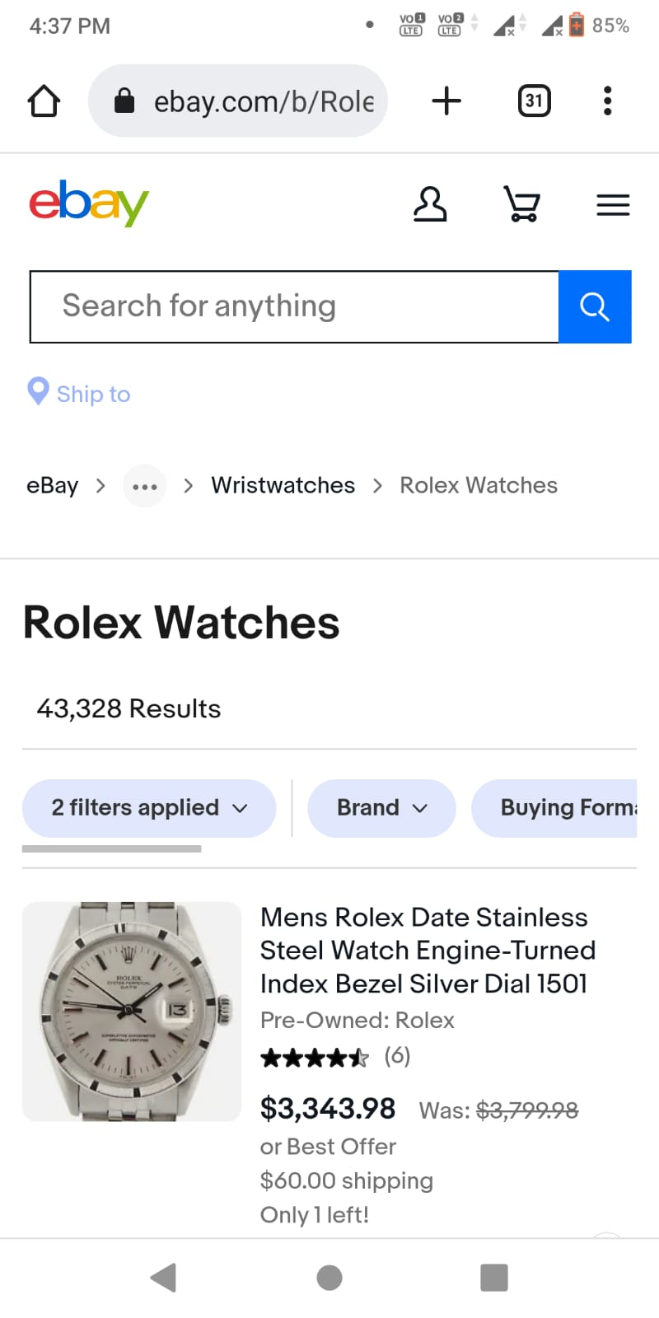
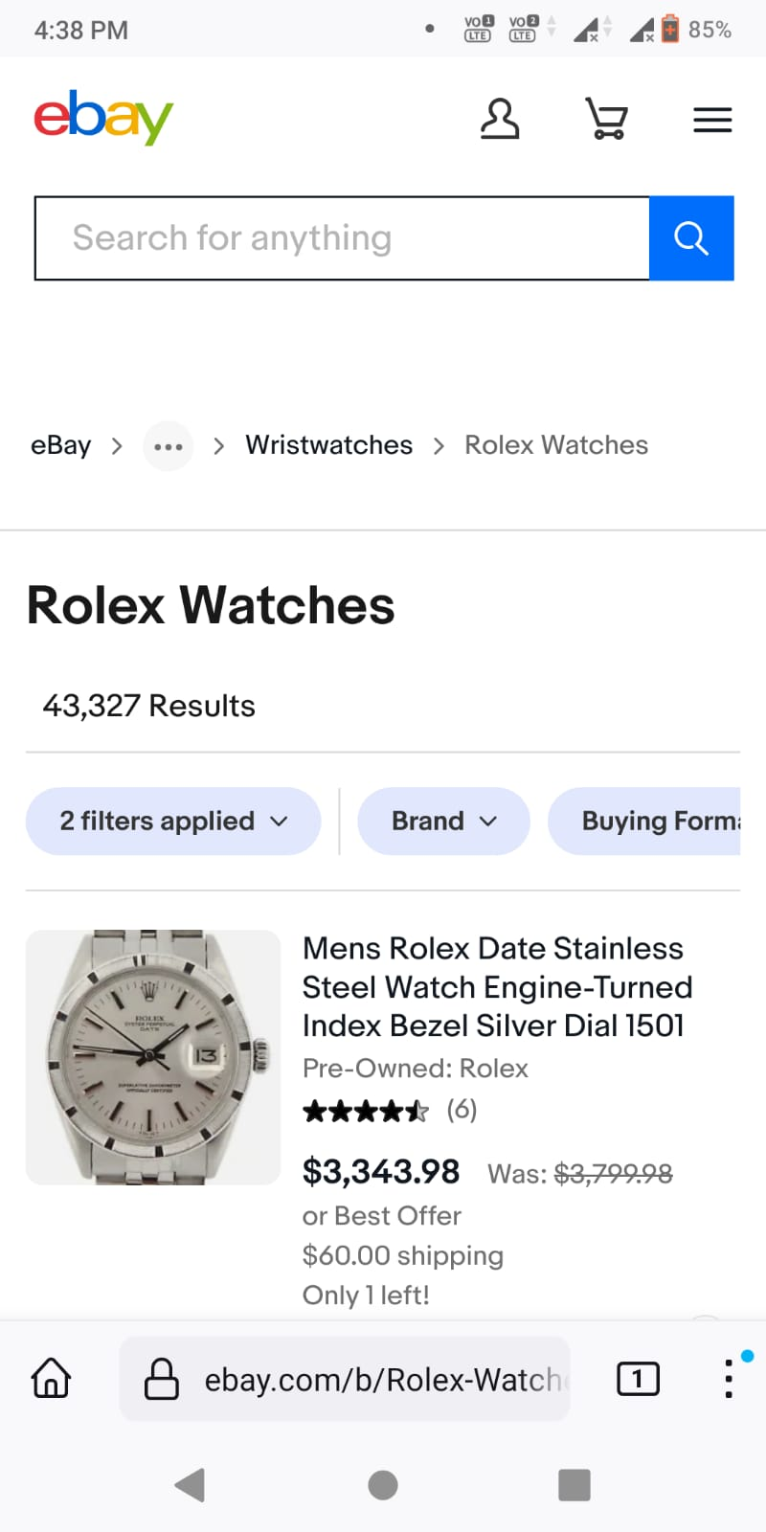
website : ebay.com Bug : In chrome there is icon of ship to, In Firefox there is not icon of ship to
Browser : Chrome
Version 109.05414.85
Browser :Firefox
version : 108.02-20230104165113

Slide 3
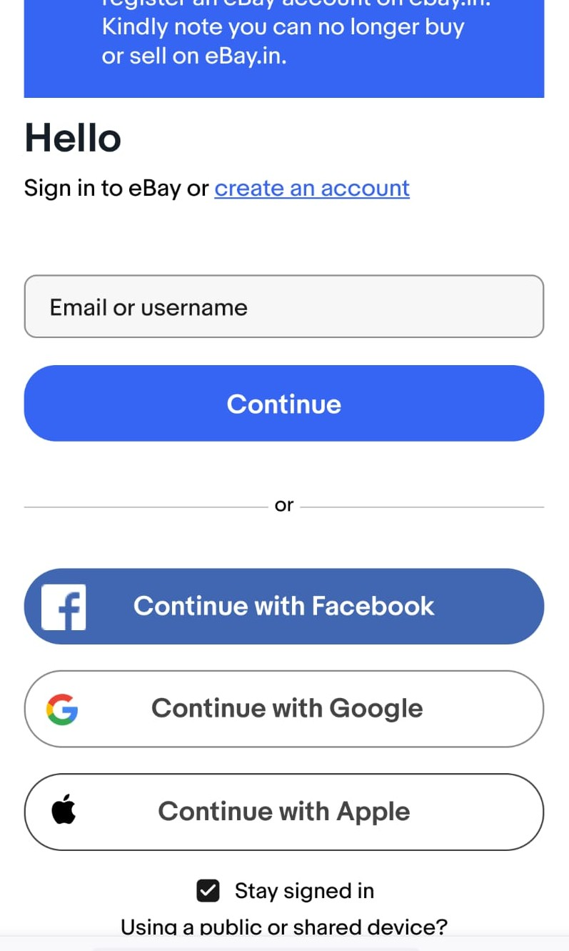
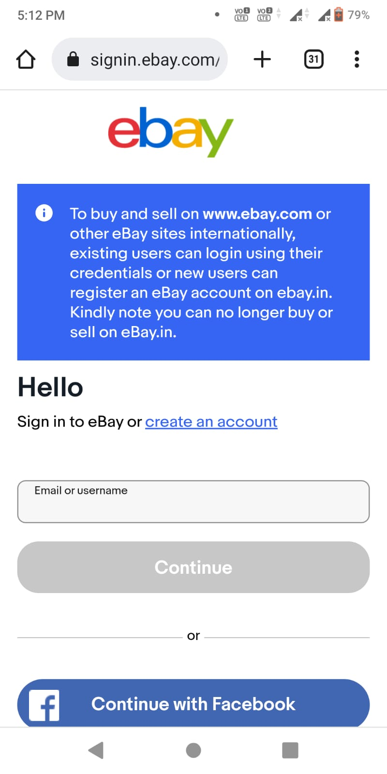
Bug : in chrome email or username textfield is very small
Browser : Chrome
Version 109.05414.85
Browser :Firefox
version : 108.02-20230104165113

Slide 4
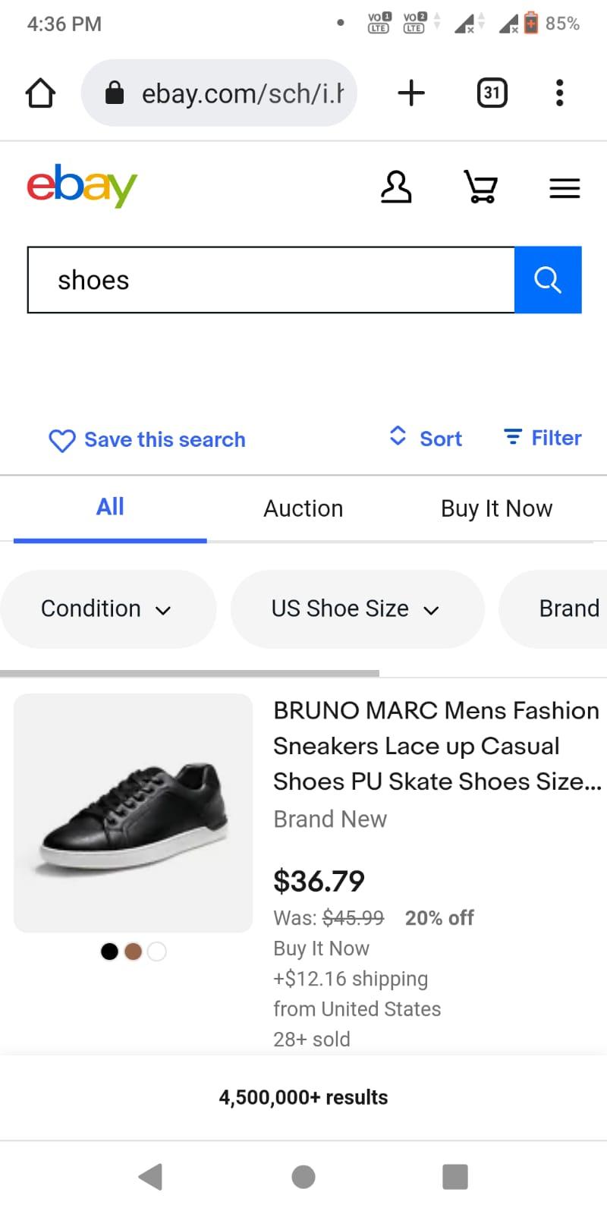
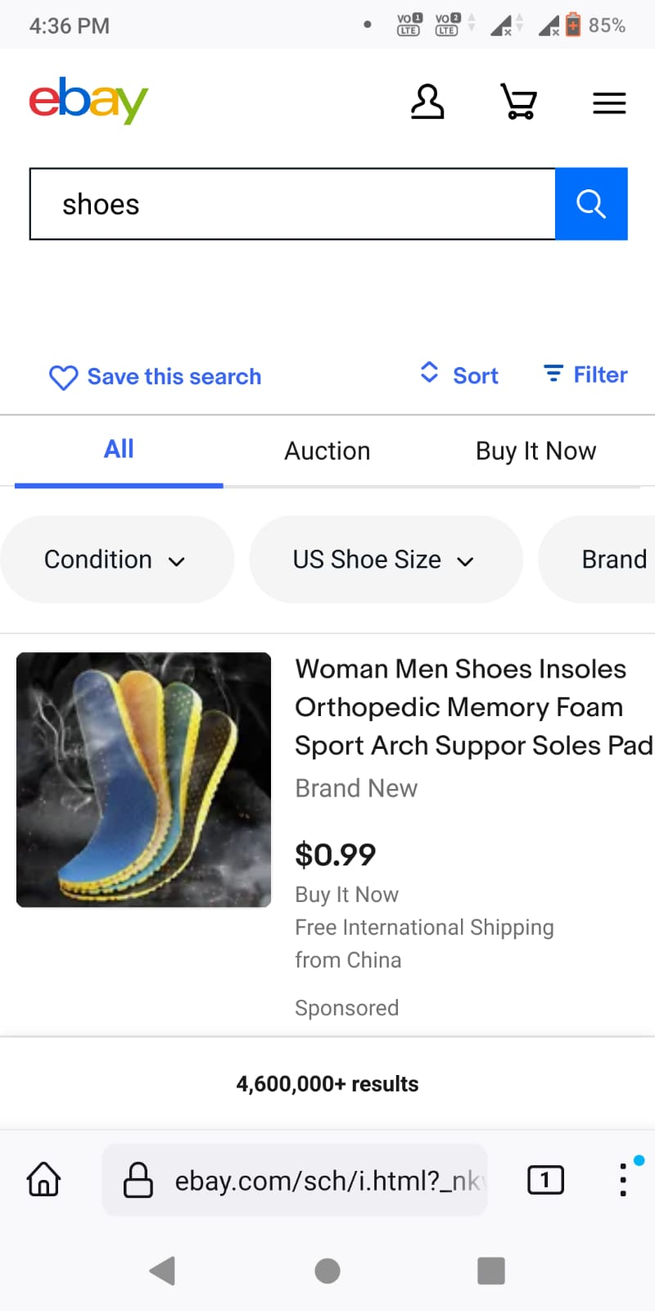
bug : When I search shoes I saw difference between the shoes on chrome and firefox.
Browser : Chrome
Version 109.05414.85
Browser :Firefox
version : 108.02-20230104165113

Slide 5
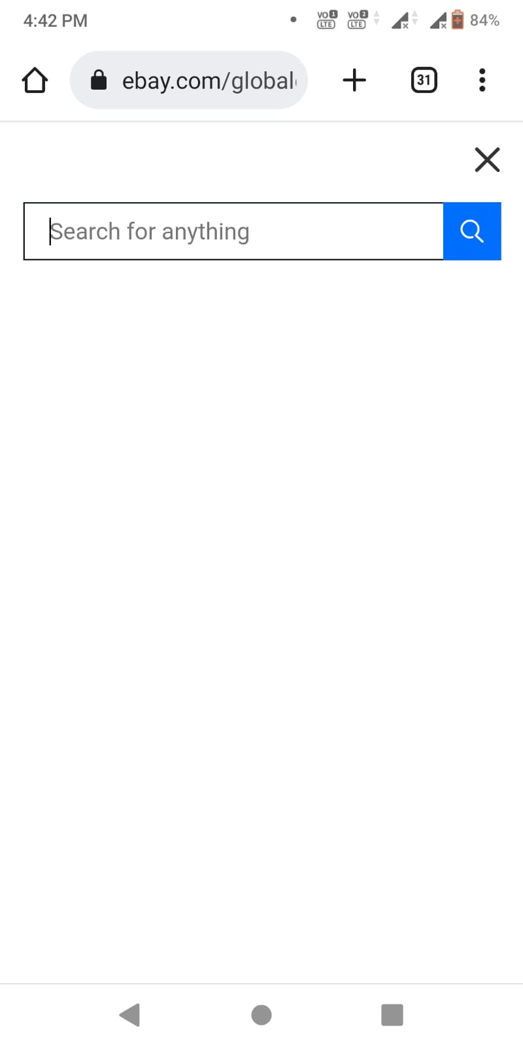
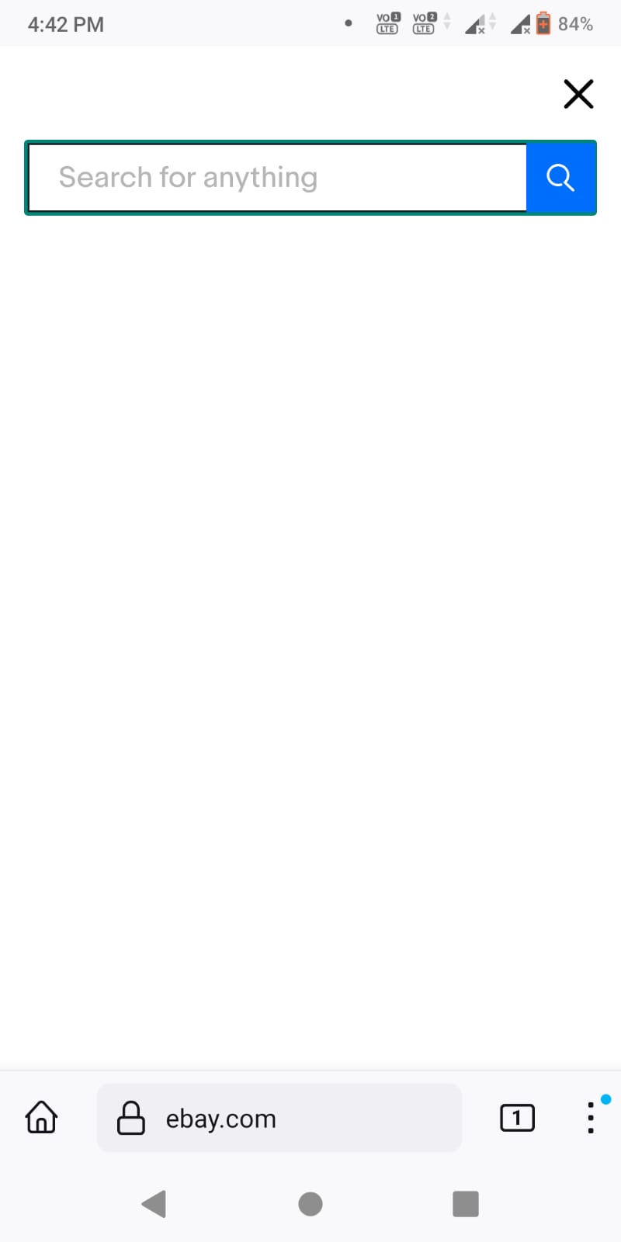
Bug : When click on search field of chrome there is no change in colour after clicking on search bar. When in click on search field of firefox there is change in colour.
Browser : Chrome
Version 109.05414.85
Browser :Firefox
version : 108.02-20230104165113

Slide 6
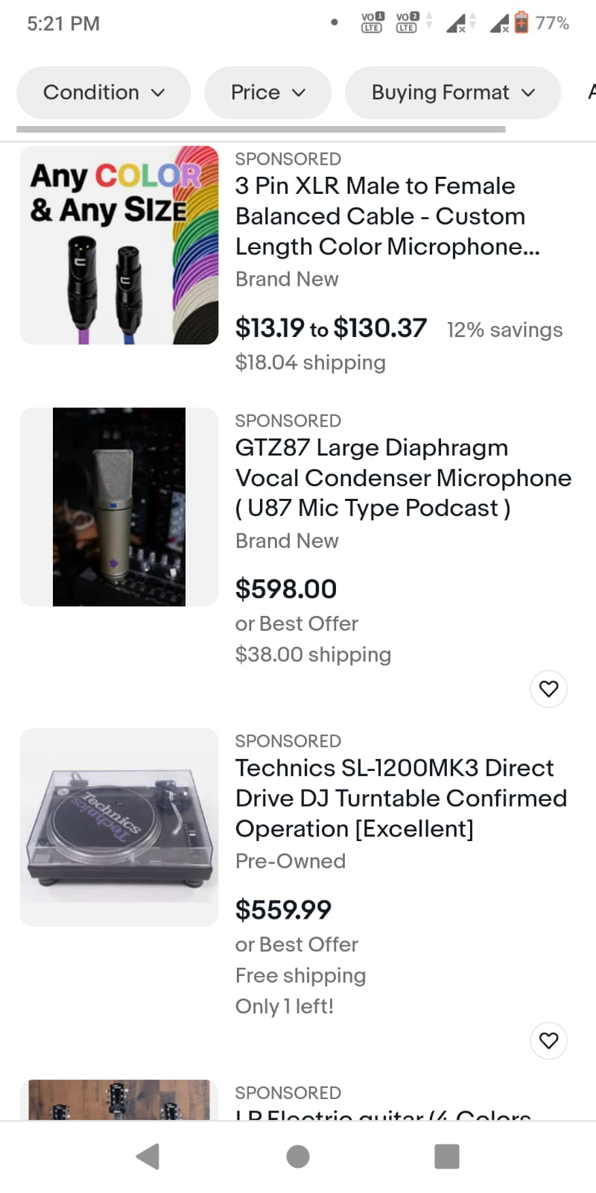
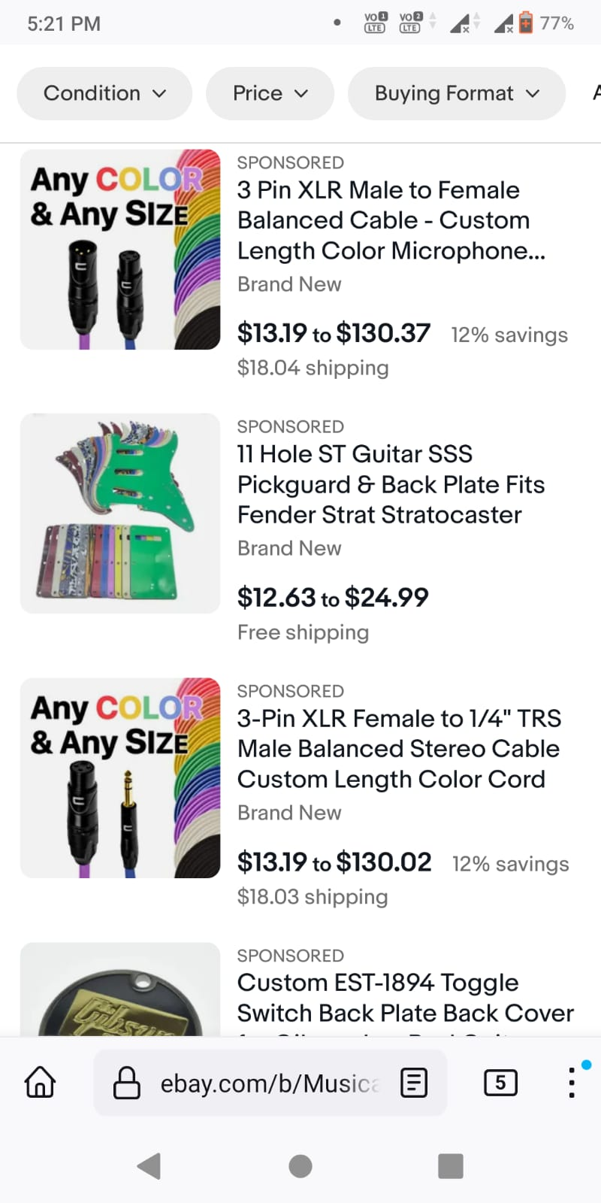
Bug: In chrome browser when I search for a product I saw different brand product, but when I search in firefox I saw the some products are repeated product of same brand.
Browser : Chrome
Version 109.05414.85
Browser :Firefox
version : 108.02-20230104165113

Slide 7
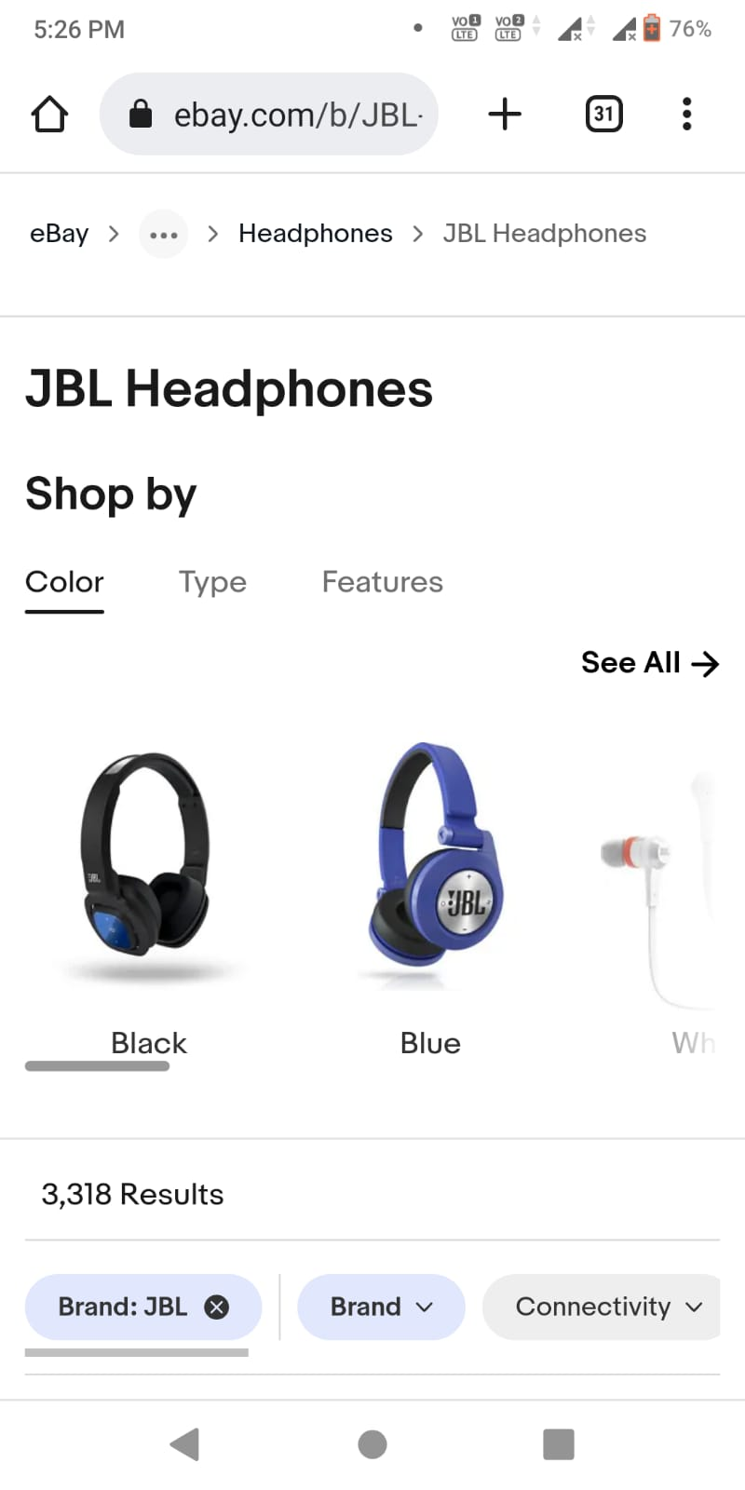
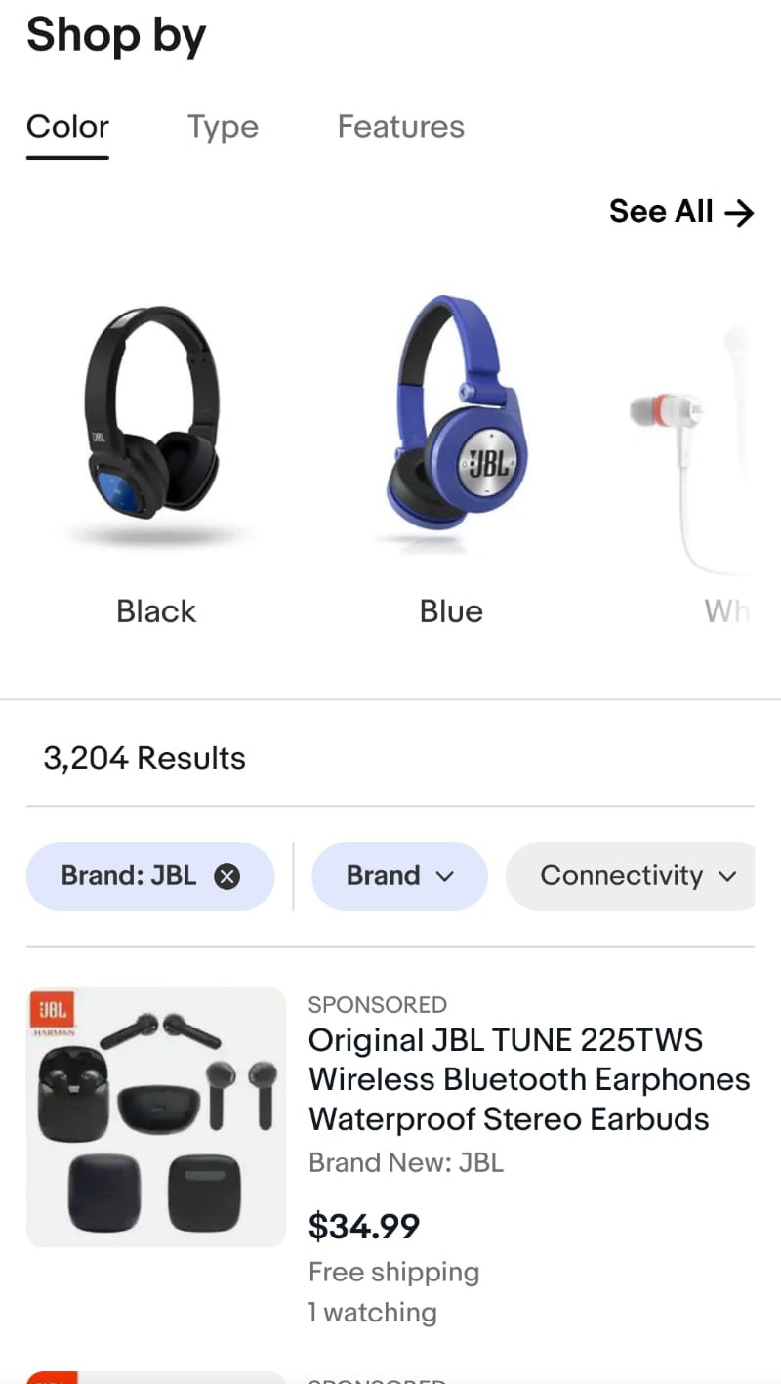
Bug: When I search for the JBL Headphone I saw different result in chrome and Firefox.
Browser : Chrome
Version 109.05414.85
Browser :Firefox
version : 108.02-20230104165113

Slide 8
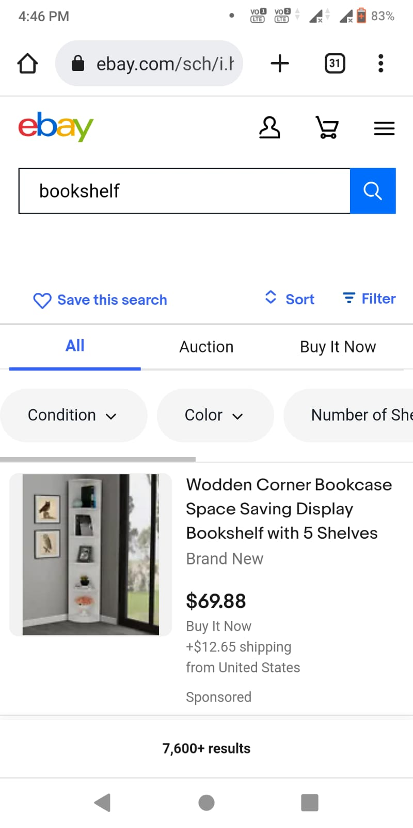
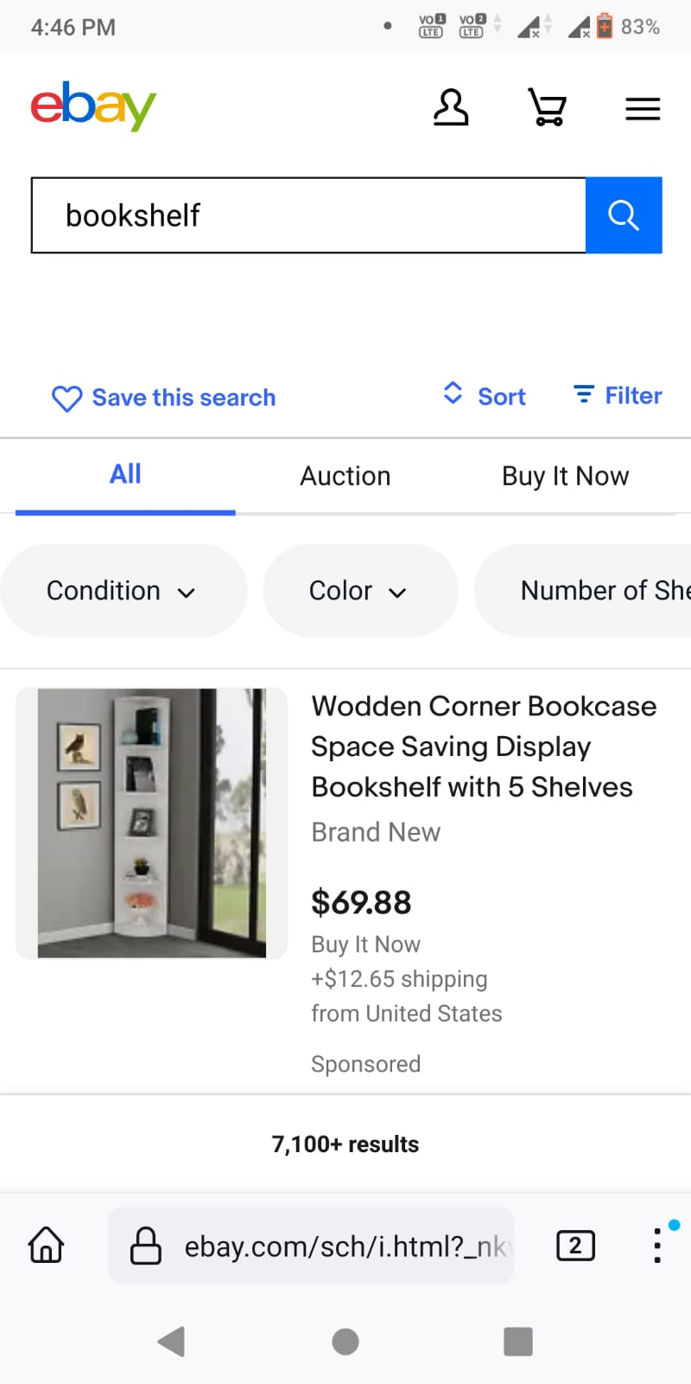
Bug: When I search for bookshelf I saw different result in chrome and firefox
Browser : Chrome
Version 109.05414.85
Browser :Firefox
version : 108.02-20230104165113

