Slide 1
RealTimeFinder.io

Slide 2
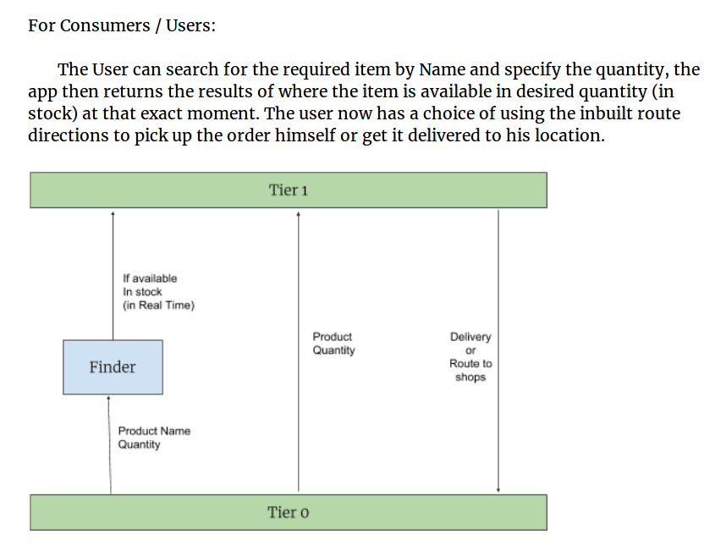

Slide 3
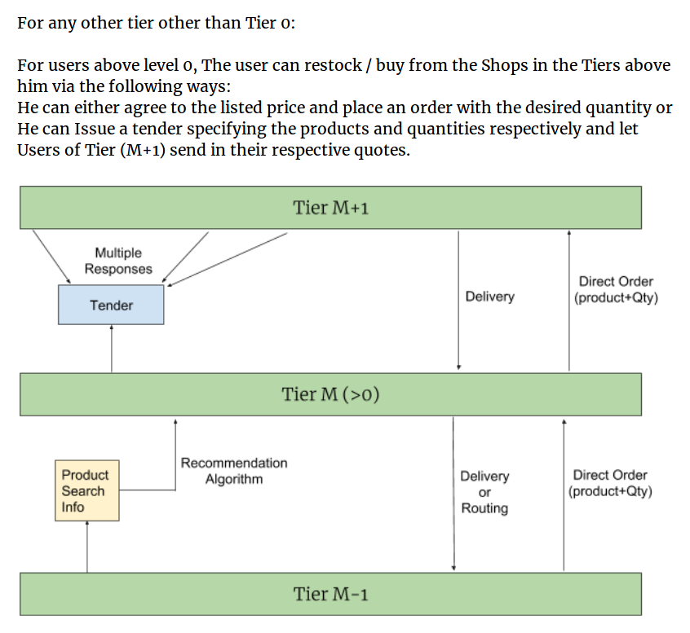

Slide 4
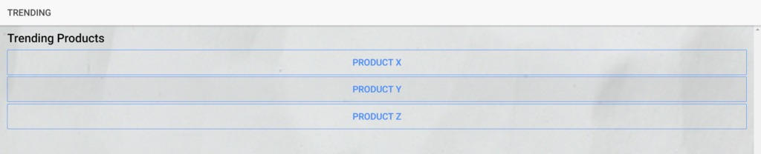
The Recommendation algorithm:
For Users of any Tier other than Tier 0, there exists a recommendation algorithm which uses past usage data from all users and recommends shopkeepers to keep certain products to increase their sales.
Shopkeepers can also visit the trending area to see which products are trending and accordingly keep those in their inventory. Any user also can check the popularity graph or “trend” of a certain product of the past 90 days via the statistics section.

Slide 5
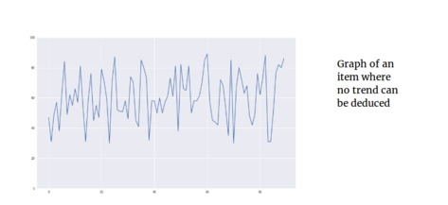
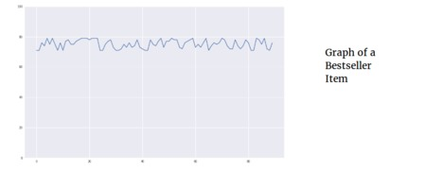
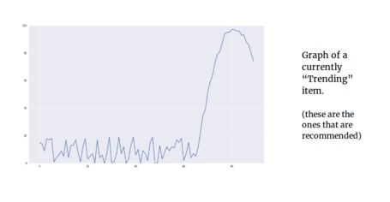

Slide 6
The UX:
The application has an inbuilt feature to handle inventory and sales records for stores where they can handle sales transactions. The application automatically extracts data from that and updates online databases to use for further queries by end consumers.

