Slide 1
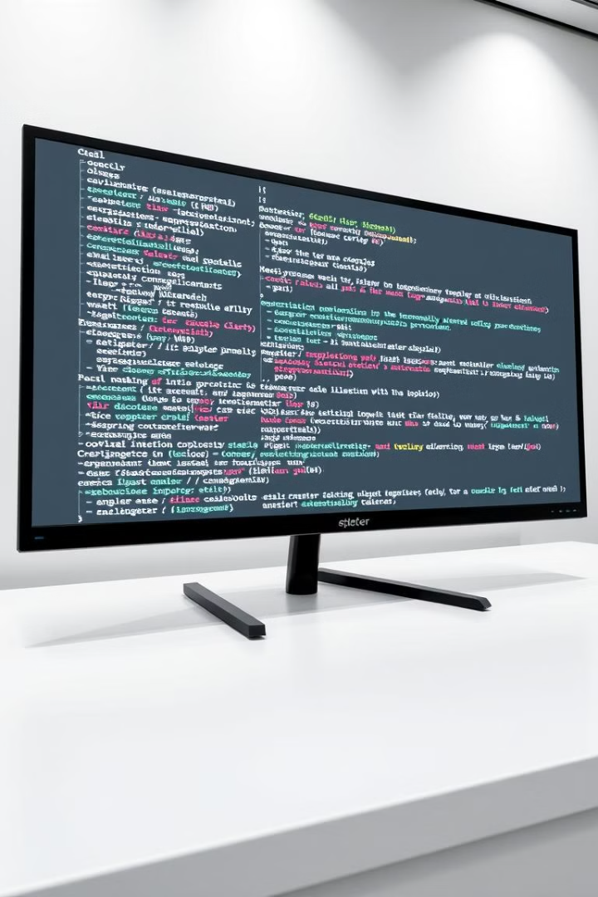

Building an AI Pipeline for Image Segmentation and Object Analysis using pixellib in Python
This presentation will guide you through the process of building an AI pipeline using pixellib in Python for image segmentation and object analysis. Pixellib is a powerful library that simplifies AI development and allows you to easily implement sophisticated image processing tasks.
by Kunal Tanwar

Slide 2

Introduction to pixellib and its capabilities
Pixellib is a user-friendly Python library designed for image segmentation and object detection. It offers a range of pre-trained models for tasks such as instance segmentation, semantic segmentation, and object detection.
1
Easy Integration
2
Pre-Trained Models
Pixellib makes it easy to integrate AI capabilities into your Python projects, simplifying the development process.
Pixellib provides access to pre-trained models, saving you time and effort in training models from scratch.
3
Versatile Applications
4
Flexible Framework
Pixellib's capabilities extend to various applications, such as image analysis, autonomous driving, and medical imaging.
Pixellib provides a flexible framework that allows you to customize and experiment with different AI models.

Slide 3

Setting up the development environment
Setting up your development environment is crucial for successful AI development. You need to install Python, the pixellib library, and other necessary dependencies.
1
Install Python
Python is a versatile programming language essential for AI development. Ensure you have the latest version of Python installed.
2
Install pixellib
Use pip, the package installer for Python, to install the pixellib library. This library simplifies the process of implementing image segmentation and object detection.
3
Install Dependencies
Install additional dependencies required by pixellib, such as TensorFlow or PyTorch, based on the specific model you're using.
4
Test Installation
Test the installation by importing the pixellib library into your Python script and running a simple example.

Slide 4
Implementing image segmentation and object detection
Once your development environment is set up, you can start implementing image segmentation and object detection using pixellib.
Image Segmentation
Object Detection
Custom Training
Image segmentation involves dividing an image into multiple segments or regions based on specific criteria. Pixellib can be used for semantic segmentation and instance segmentation.
Object detection aims to identify and locate objects within an image. Pixellib provides pre-trained models for object detection, which can be used to identify objects like cars, people, and animals.
You can also train your own custom models for segmentation and object detection using pixellib. This allows you to build models that are tailored to specific tasks and datasets.
Prepare a labeled dataset
Load an image
Load an image
Train a model using pixellib
Instantiate a segmentation model
Instantiate an object detection model
Evaluate the performance of the trained model
Run segmentation on the image
Run object detection on the image
Visualize the results
Visualize the detected objects
Fine-tune the model for optimal results

Slide 5
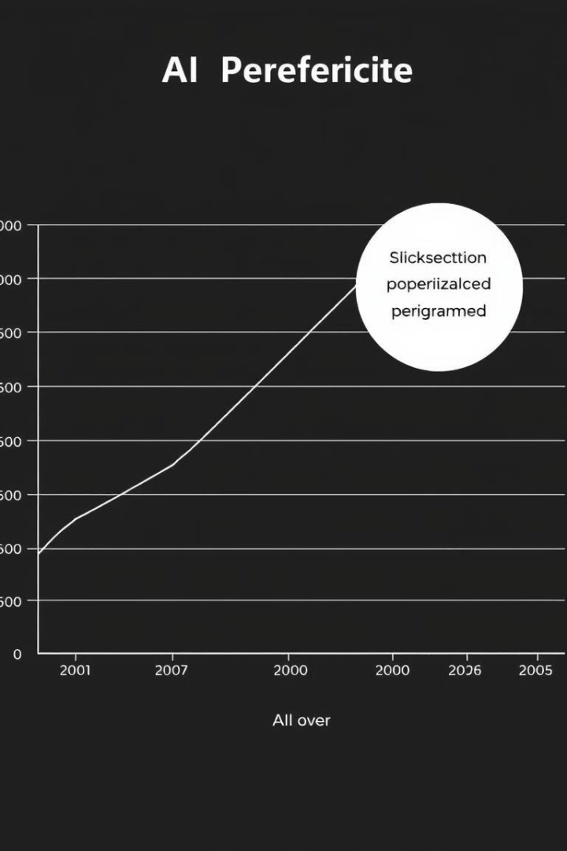




Optimizing the pipeline and handling real-world scenarios
Optimizing your pipeline and handling real-world scenarios are crucial for deploying your AI model in practical applications.
Performance Optimization
Analyze the performance of your model using metrics like accuracy, precision, and recall. Adjust hyperparameters and experiment with different models to improve performance.
Handling Real-World Data
Train your model on a diverse dataset that represents real-world scenarios. Consider factors like lighting conditions, image quality, and object variations.
Data Augmentation
Use techniques like data augmentation to expand your training dataset and enhance the robustness of your model.
Deployment
Deploy your AI model using frameworks like Flask or Django to create a web application or integrate it into other systems.

