Slide 1
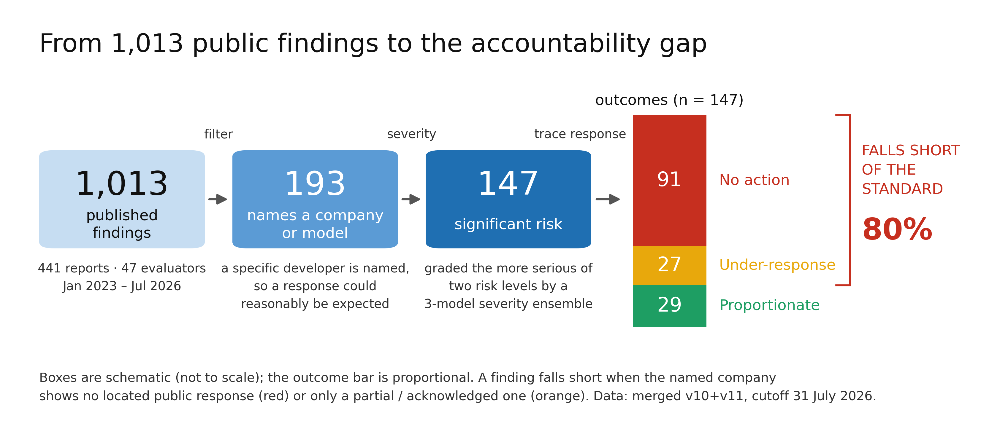
EVALUATING THE EVALUATORS
80% of significant-risk findings
draw no proportionate response
Of 147 findings that name a company and were graded the more serious of two risk levels, 118 drew no response proportionate to what they found.
1,013 findings · 441 reports · 47 evaluators · Jan 2023 – Jul 2026
Notes:
0:00–0:50 — Open on the claim and let the funnel sit there. Do NOT explain tiers yet: the audience needs to want the method before you give it to them.
The number: 118 of 147. 91 drew nothing at all, 27 drew something too weak.

Slide 2
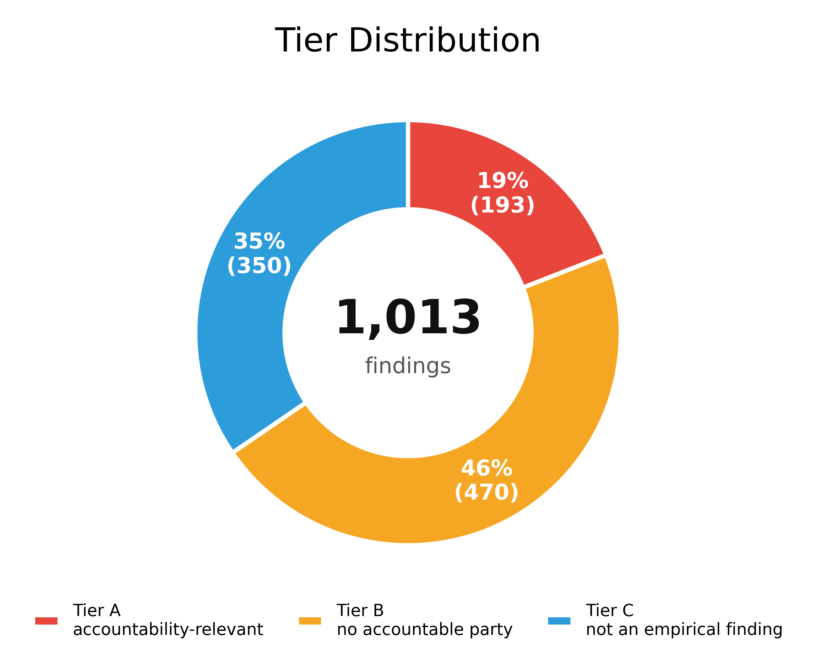
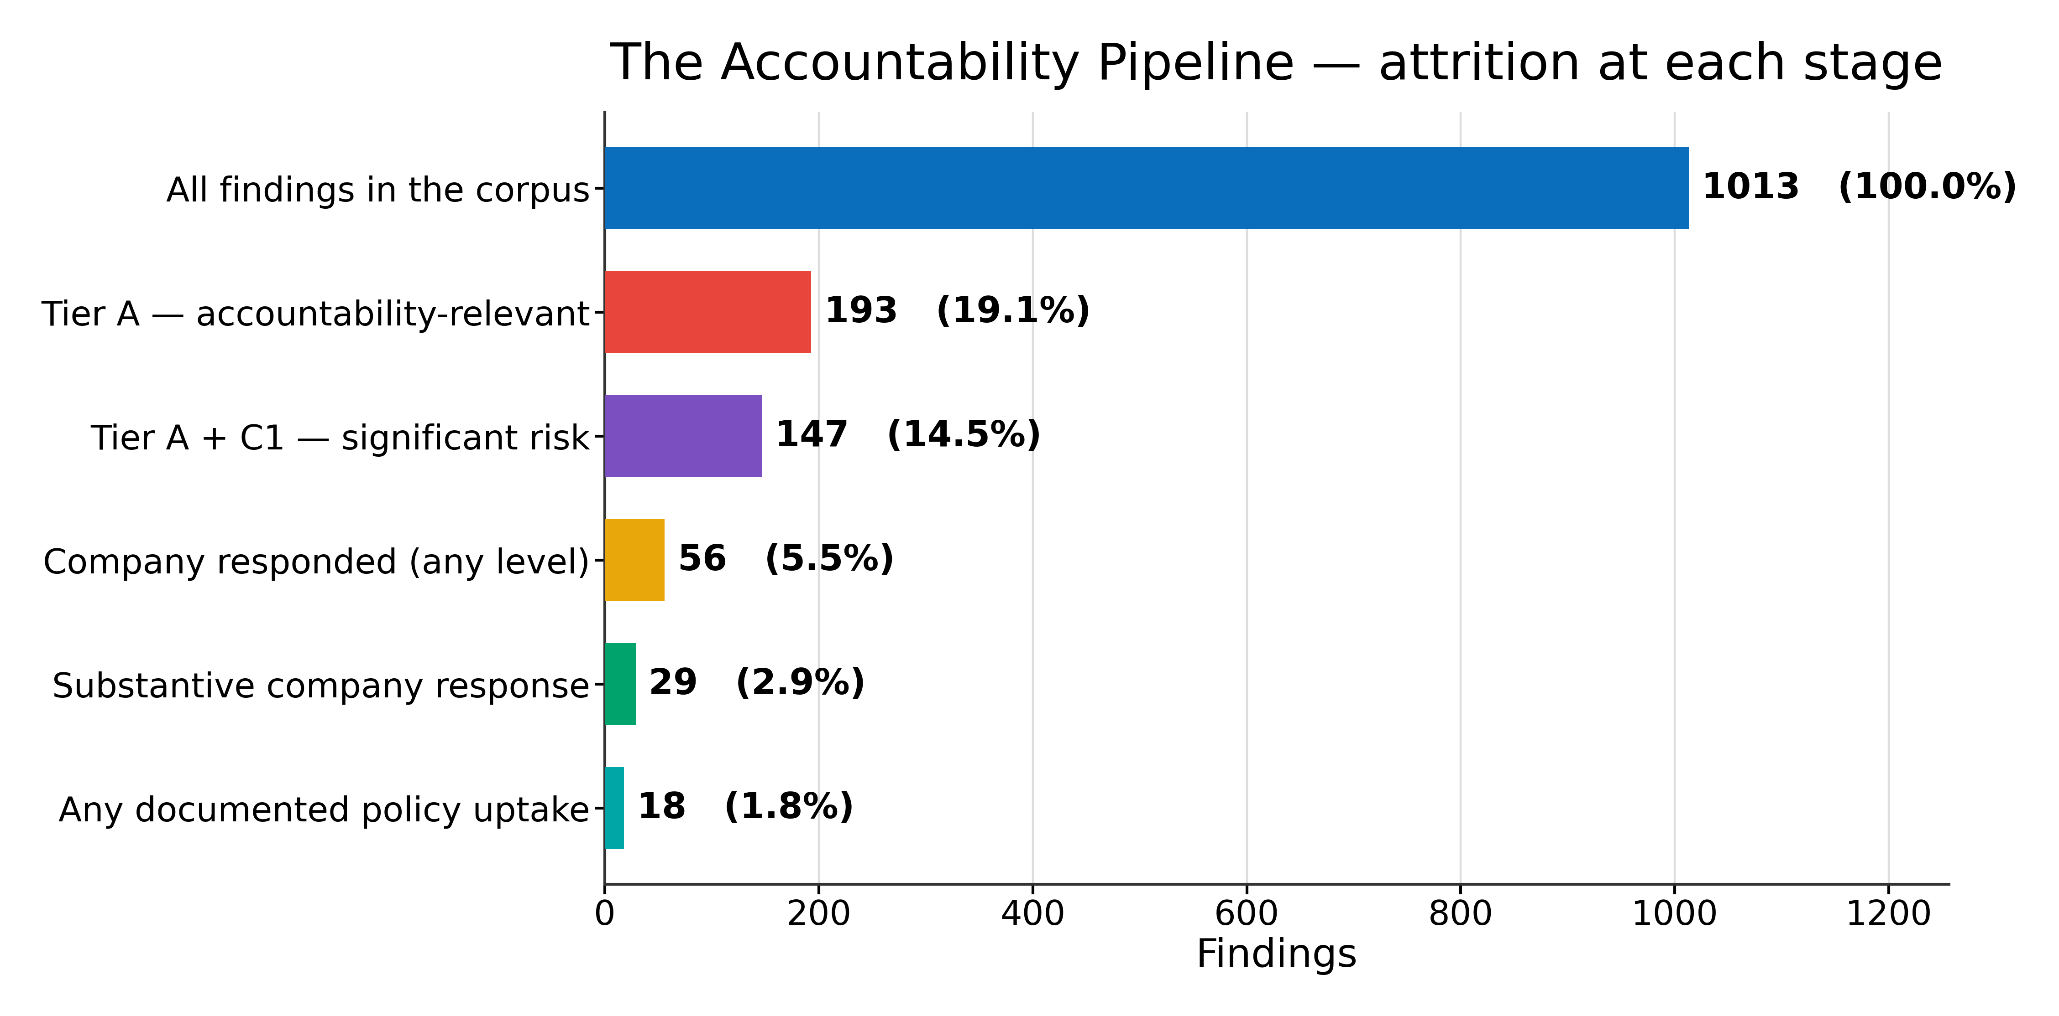
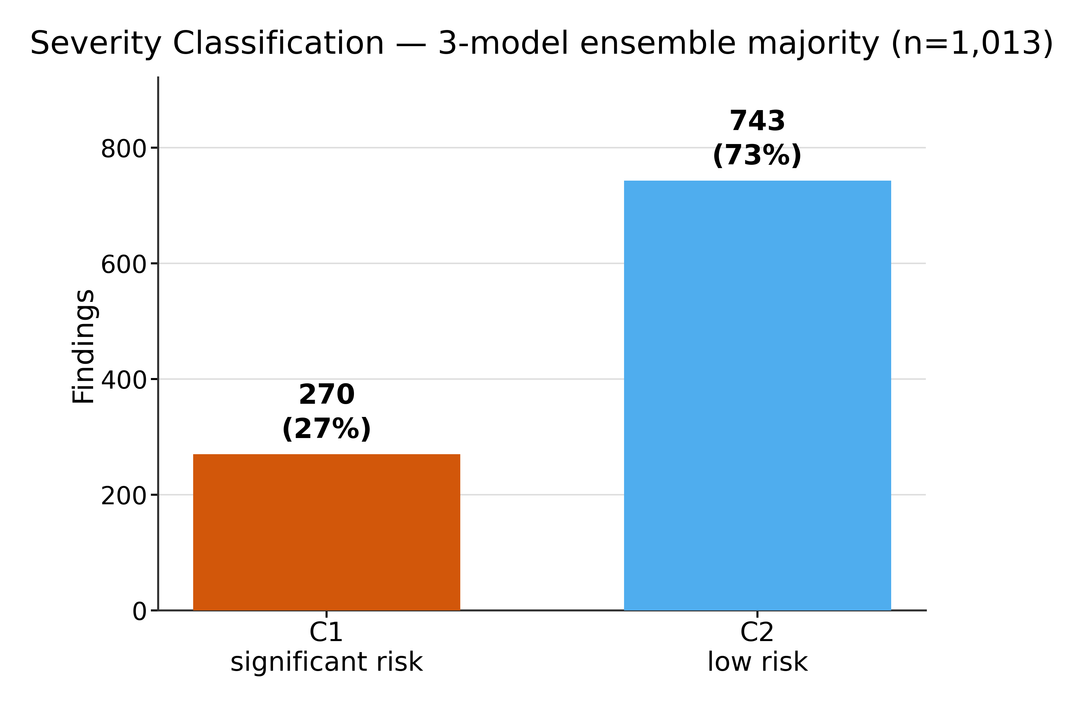
2
0:50 · 1:10
What earns a finding a place in the denominator
1,013 findings → 193 where both the evaluation and a company action are traceable → 147 graded significant risk by a three-model severity ensemble. Two filters, both pre-registered, neither applied by hand.
Notes:
0:50–2:00 — The credibility slide; the denominator is the whole argument.
Say out loud what is EXCLUDED: reassuring nulls, benchmark scores with no dangerous threshold crossed, comparative rankings, anonymised models. That kills the 'you picked the bad cases' objection.
Severity is a 3-model ensemble majority, not our judgement — that kills 'you graded these yourself'.

Slide 3
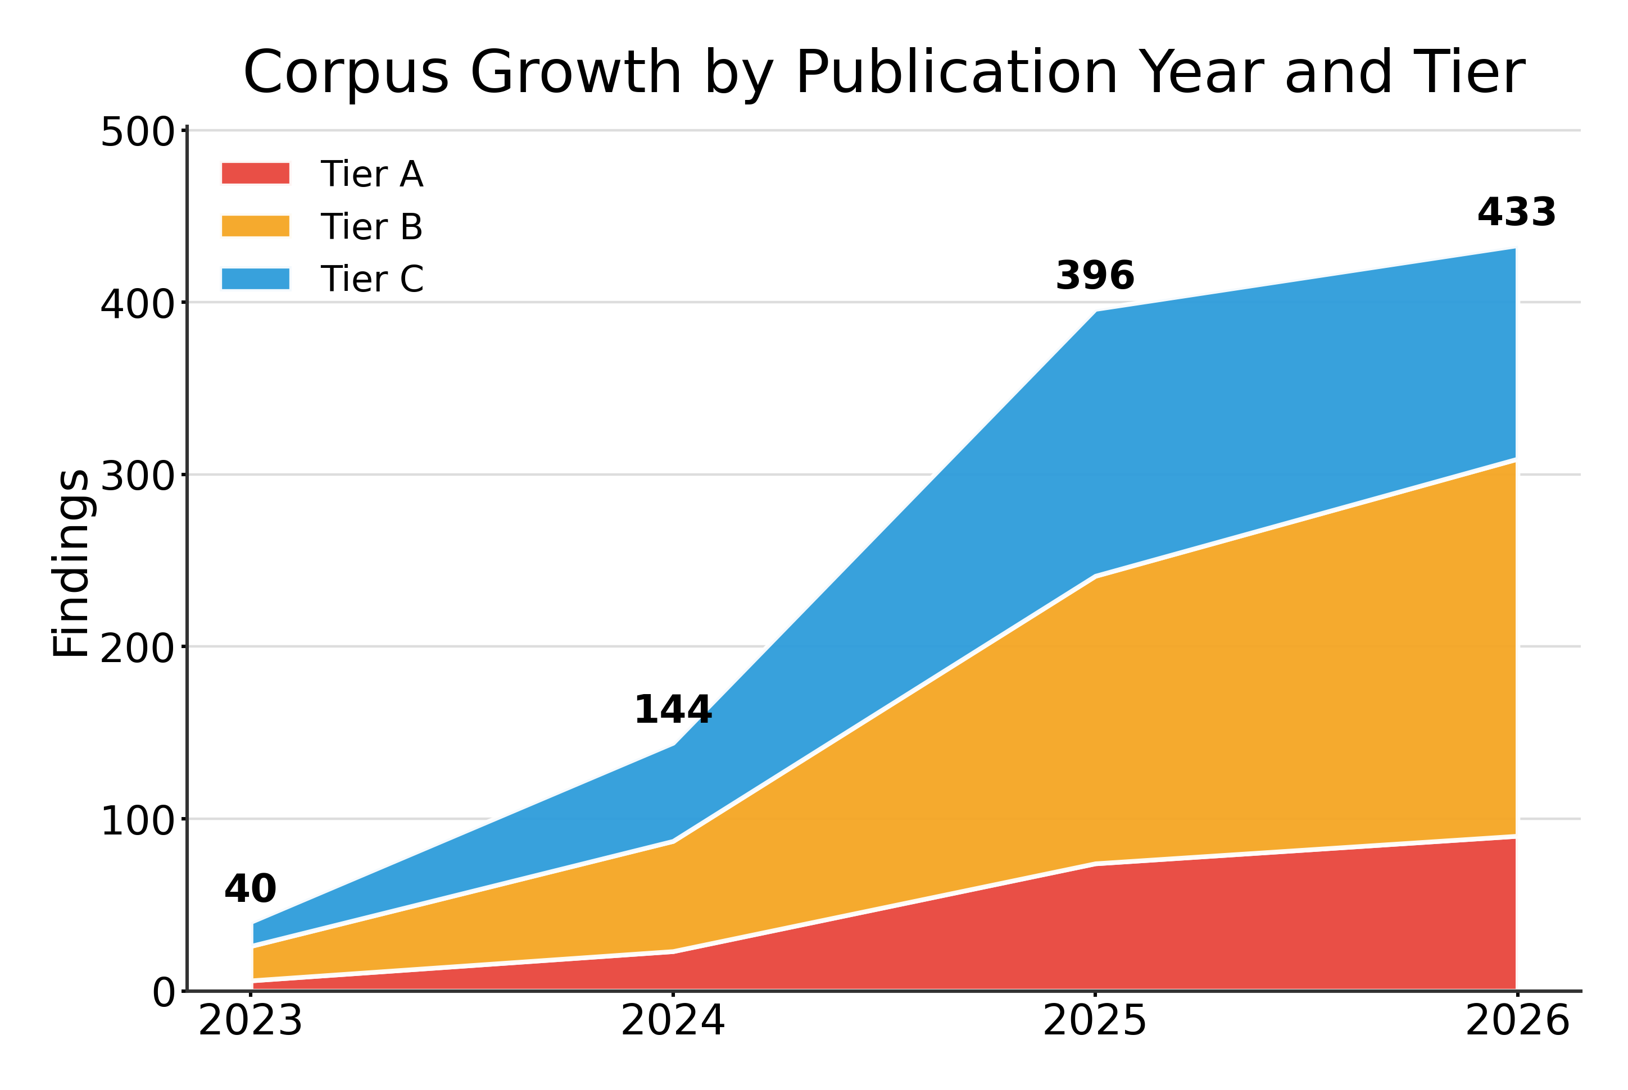
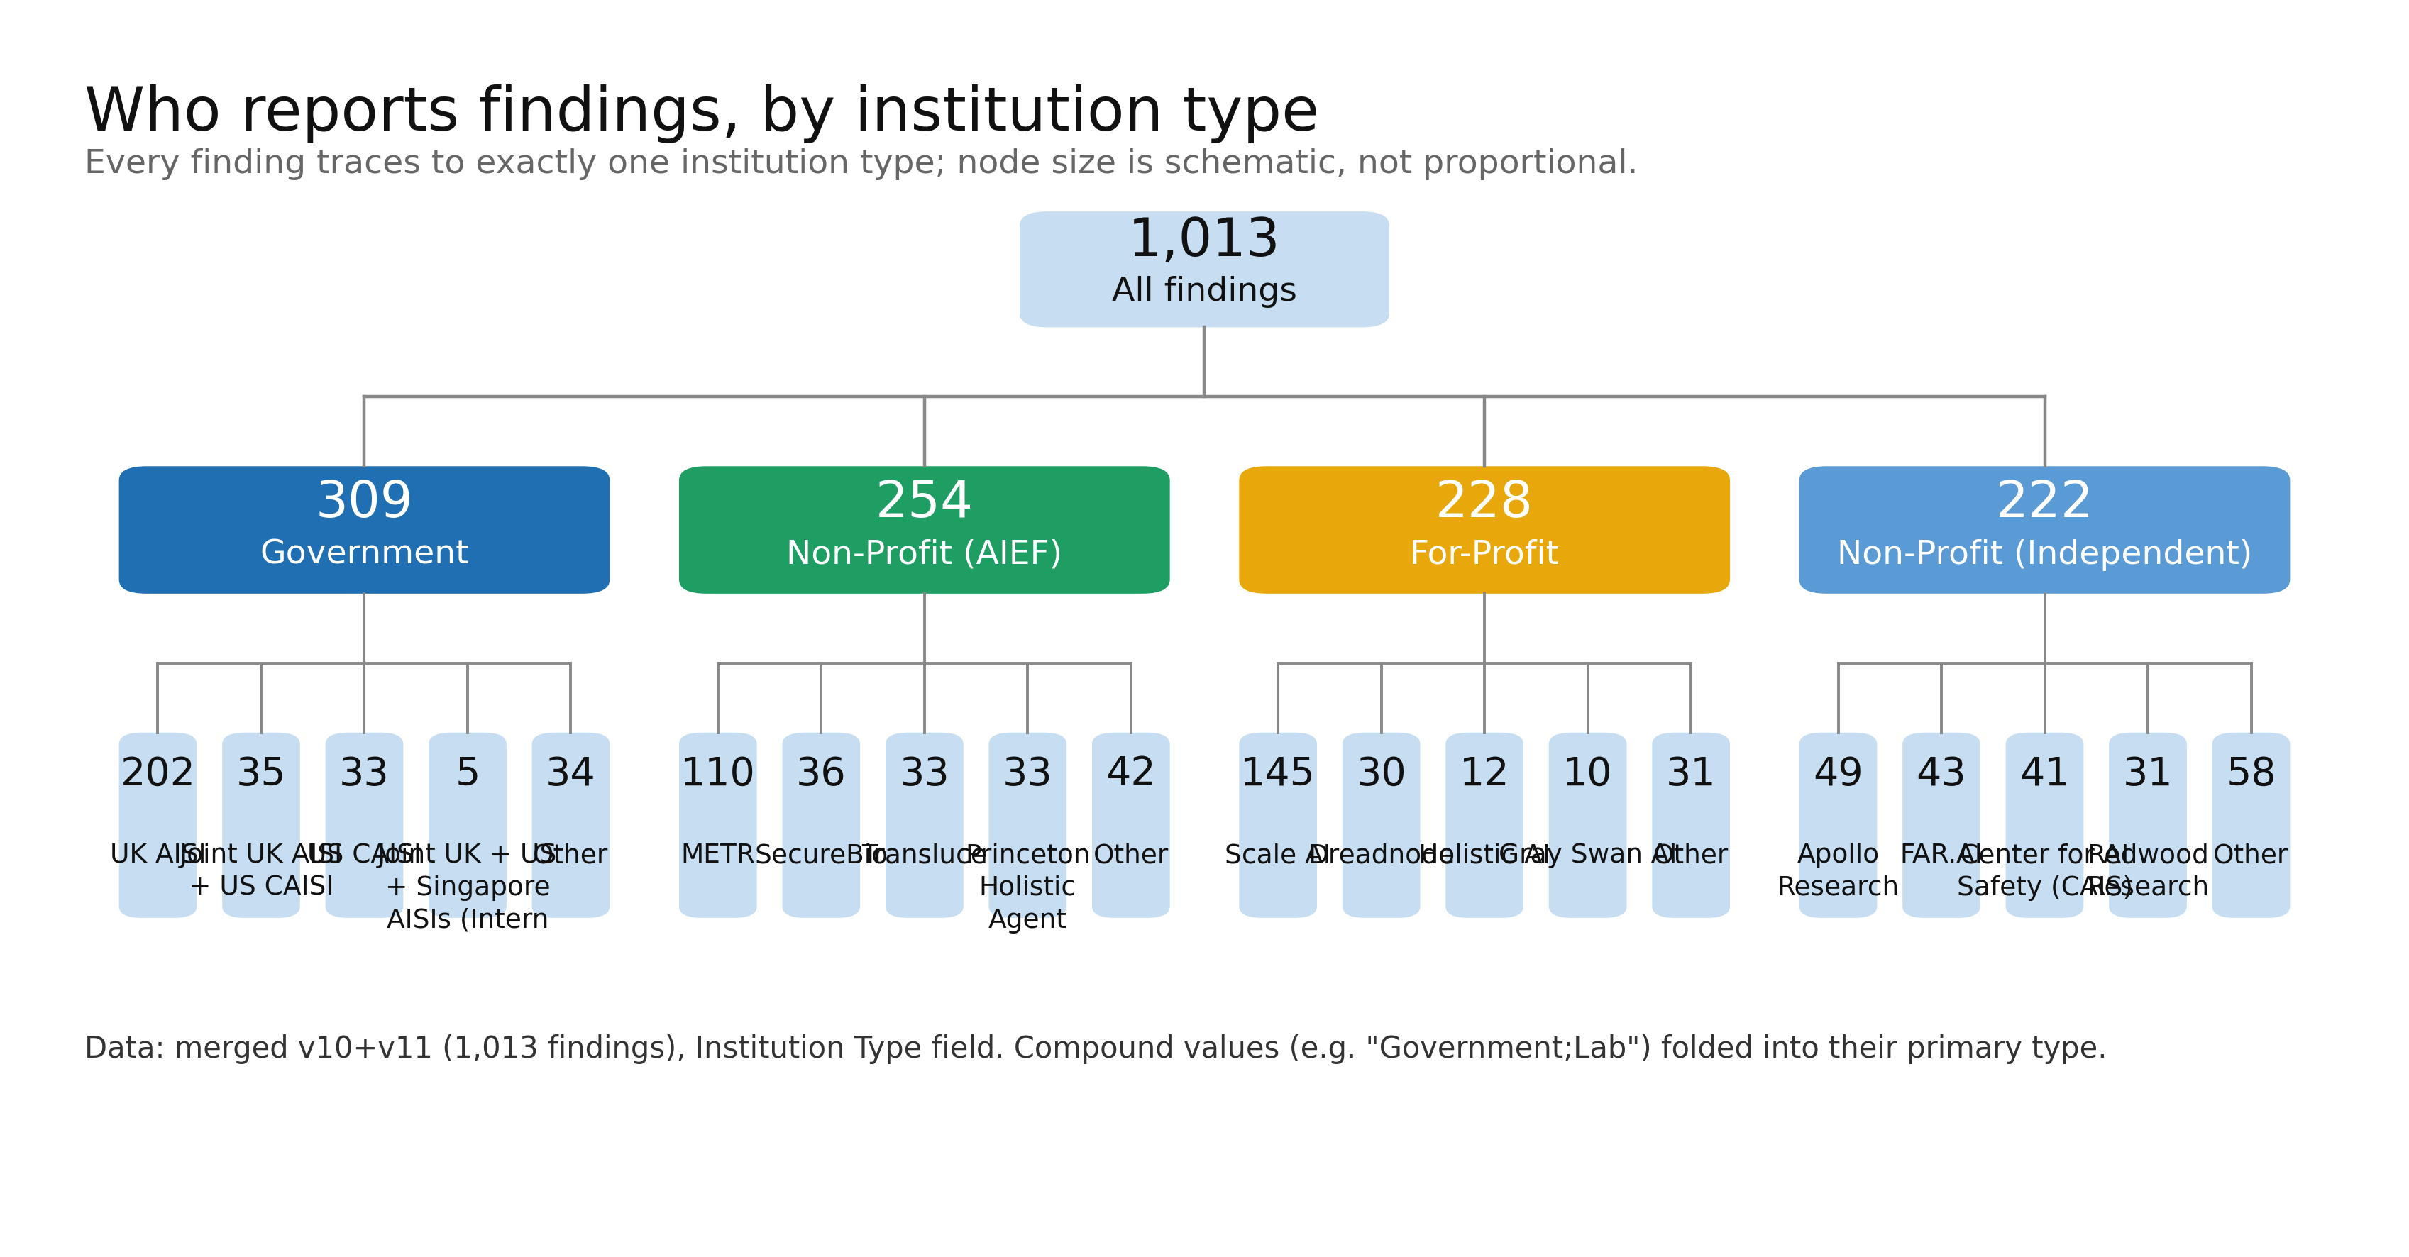
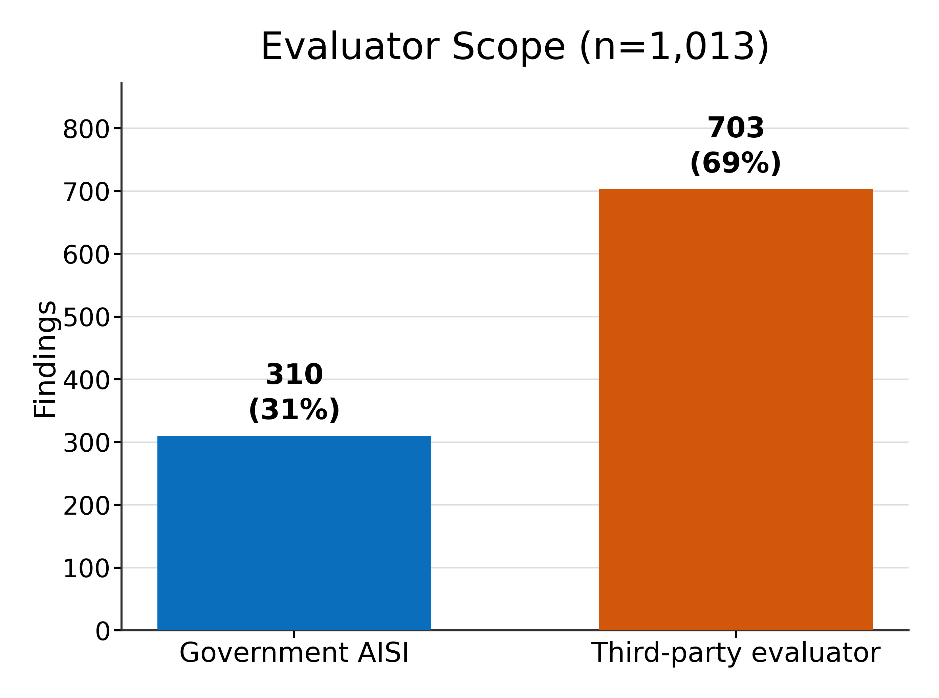
3
2:00 · 1:15
Scrutiny is scaling. That is not the bottleneck.
47 institutions, 441 reports — 310 findings from government AI safety institutes, 703 from third-party evaluators — and the volume rises steeply through 2025–26.
Notes:
2:00–3:15 — Tree runs left-to-right so institution names stay readable.
KEY POINT: the headline holds on the government-only subset too — 41/54 = 75.9% fall short — so it is not an artifact of pooling AISIs with independent labs.
Then land the setup: scrutiny is growing, and the next slide shows response is not growing with it.

Slide 4
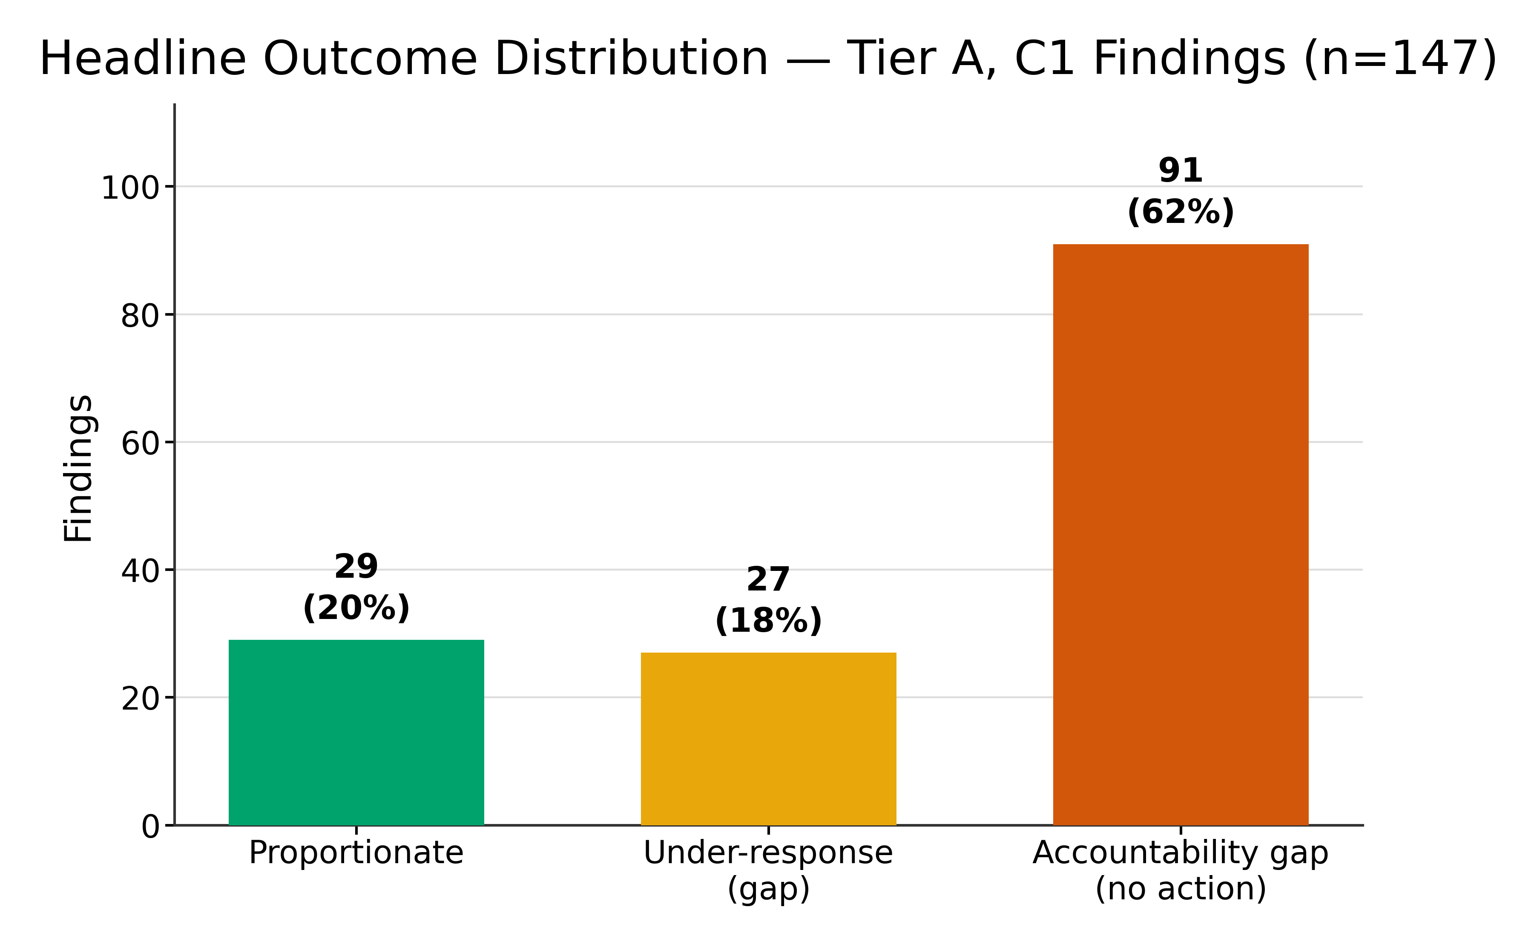
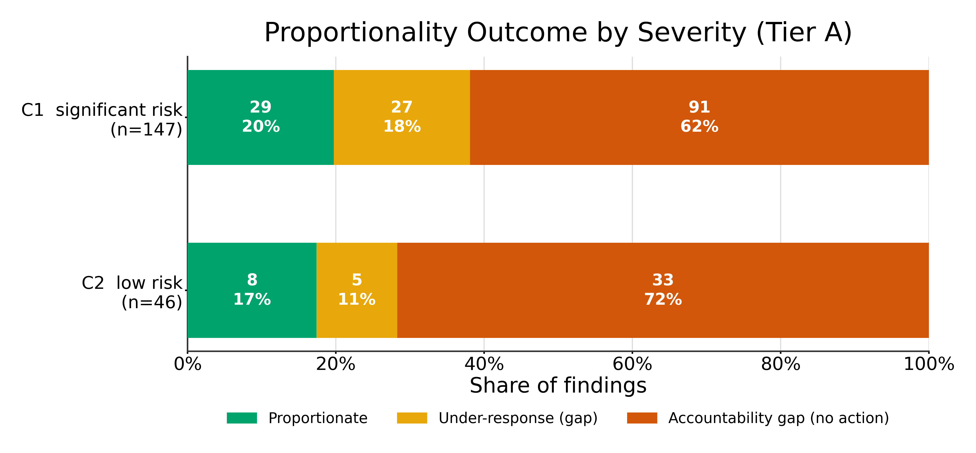
4
3:15 · 1:30
Most significant-risk findings go unanswered
91 no action · 27 under-response · 29 proportionate. 80.3% fall short of a response proportionate to the severity — 91 drew nothing at all, 27 drew something too weak.
Notes:
3:15–4:45 — Your longest slide. Take the full 90 seconds; do not rush it.
Define 'proportionate' out loud from the severity x response matrix, and note it is SEVERITY-RELATIVE: for a significant-risk finding only a substantive response qualifies, whereas for the lower severity a partial one does.
Say plainly: this measures the CONTENT of the public response. It does not establish that the action was implemented, or that it reduced the risk.

Slide 5
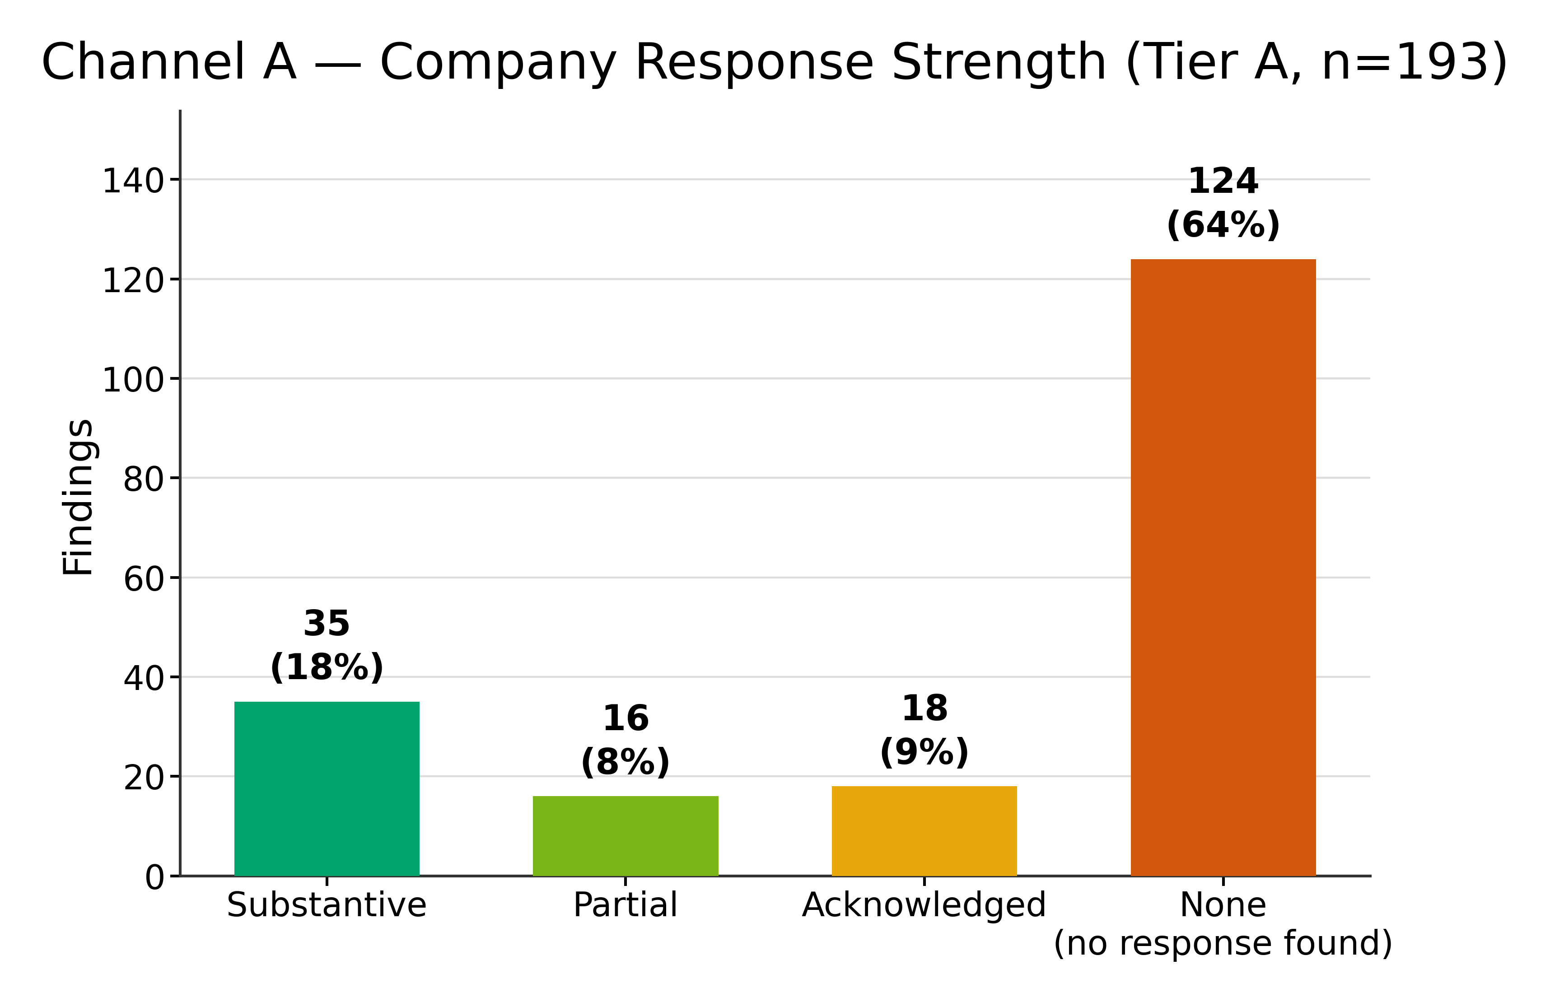
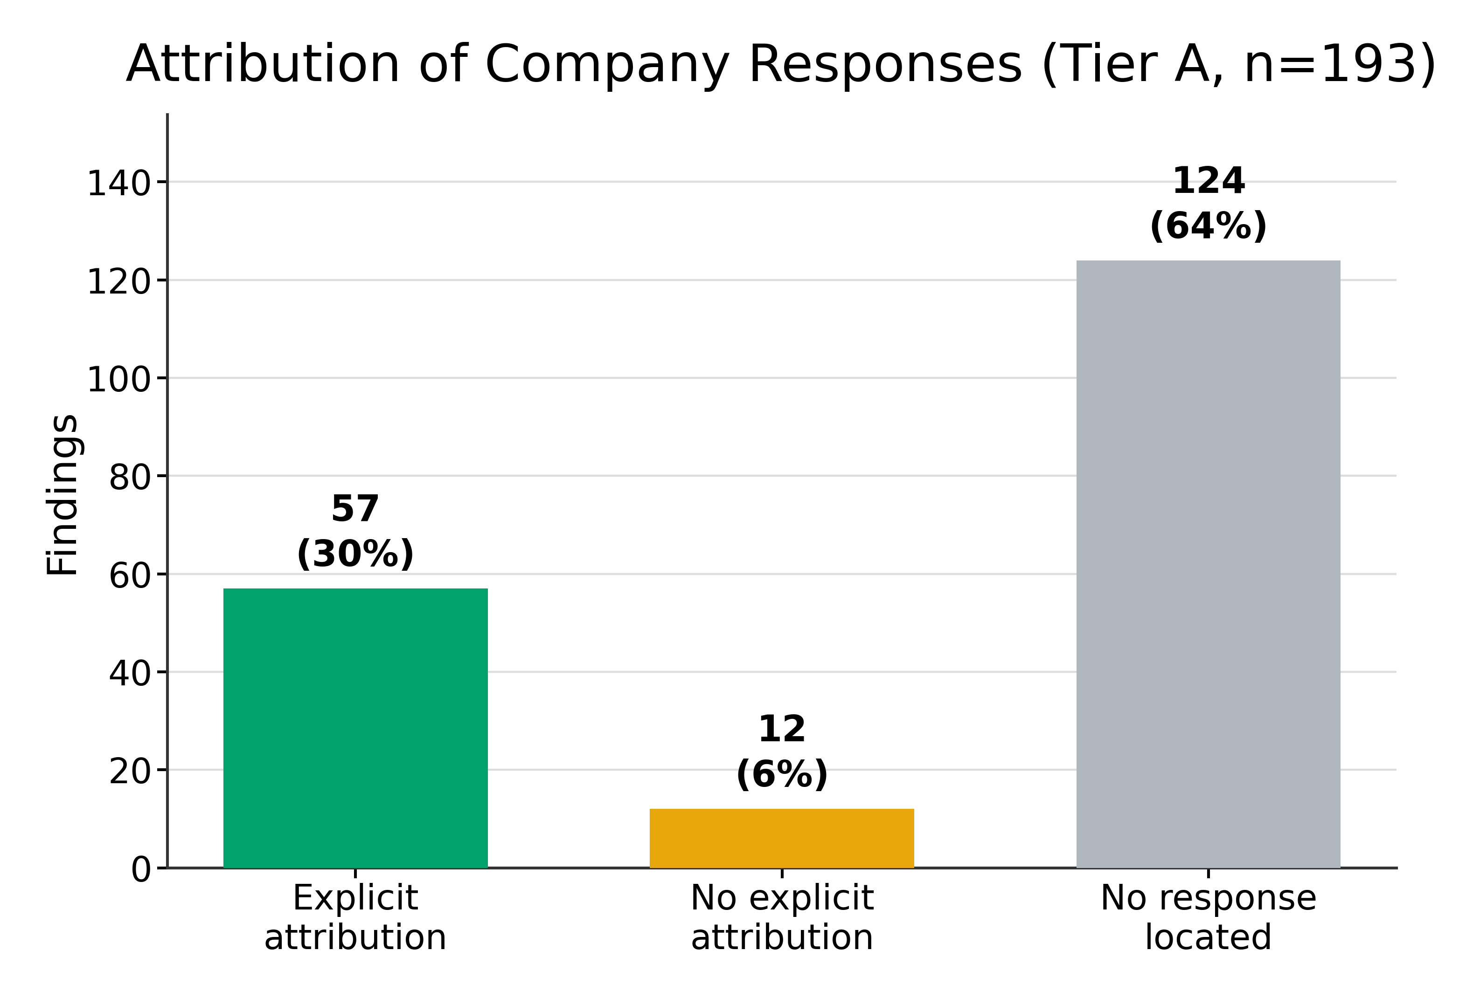
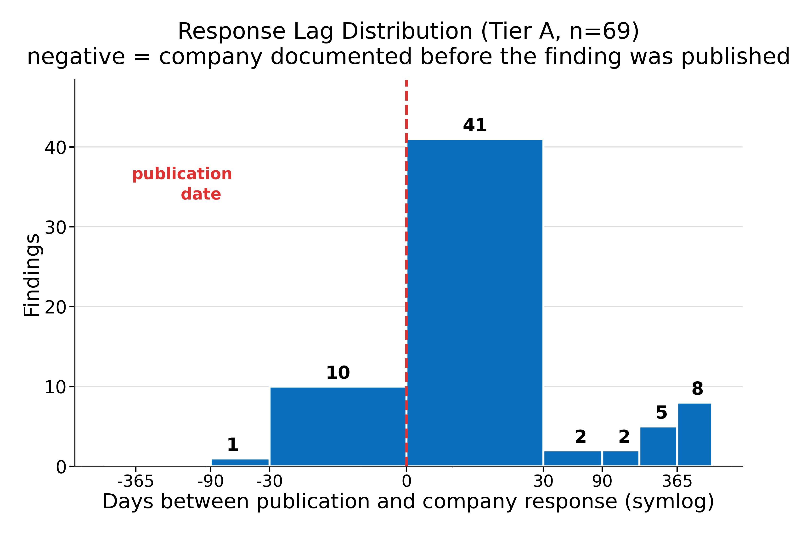
5
4:45 · 1:10
When companies do respond, what does it look like?
35 substantive, 16 partial, 18 acknowledged. 57 responses cite the evaluator explicitly, 12 act without saying why. Median lag: 0 days.
Notes:
4:45–5:55 — The zero-day median is a FINDING, not a data error.
Responses cluster in the launch system card, because that is where pre-deployment evaluations get answered. A response arriving after a finding is published is the rare case.
The 12 'acted without saying why' rows are why Attribution is a separate column from Action Level — the dataset stops conflating silence with inaction.

Slide 6
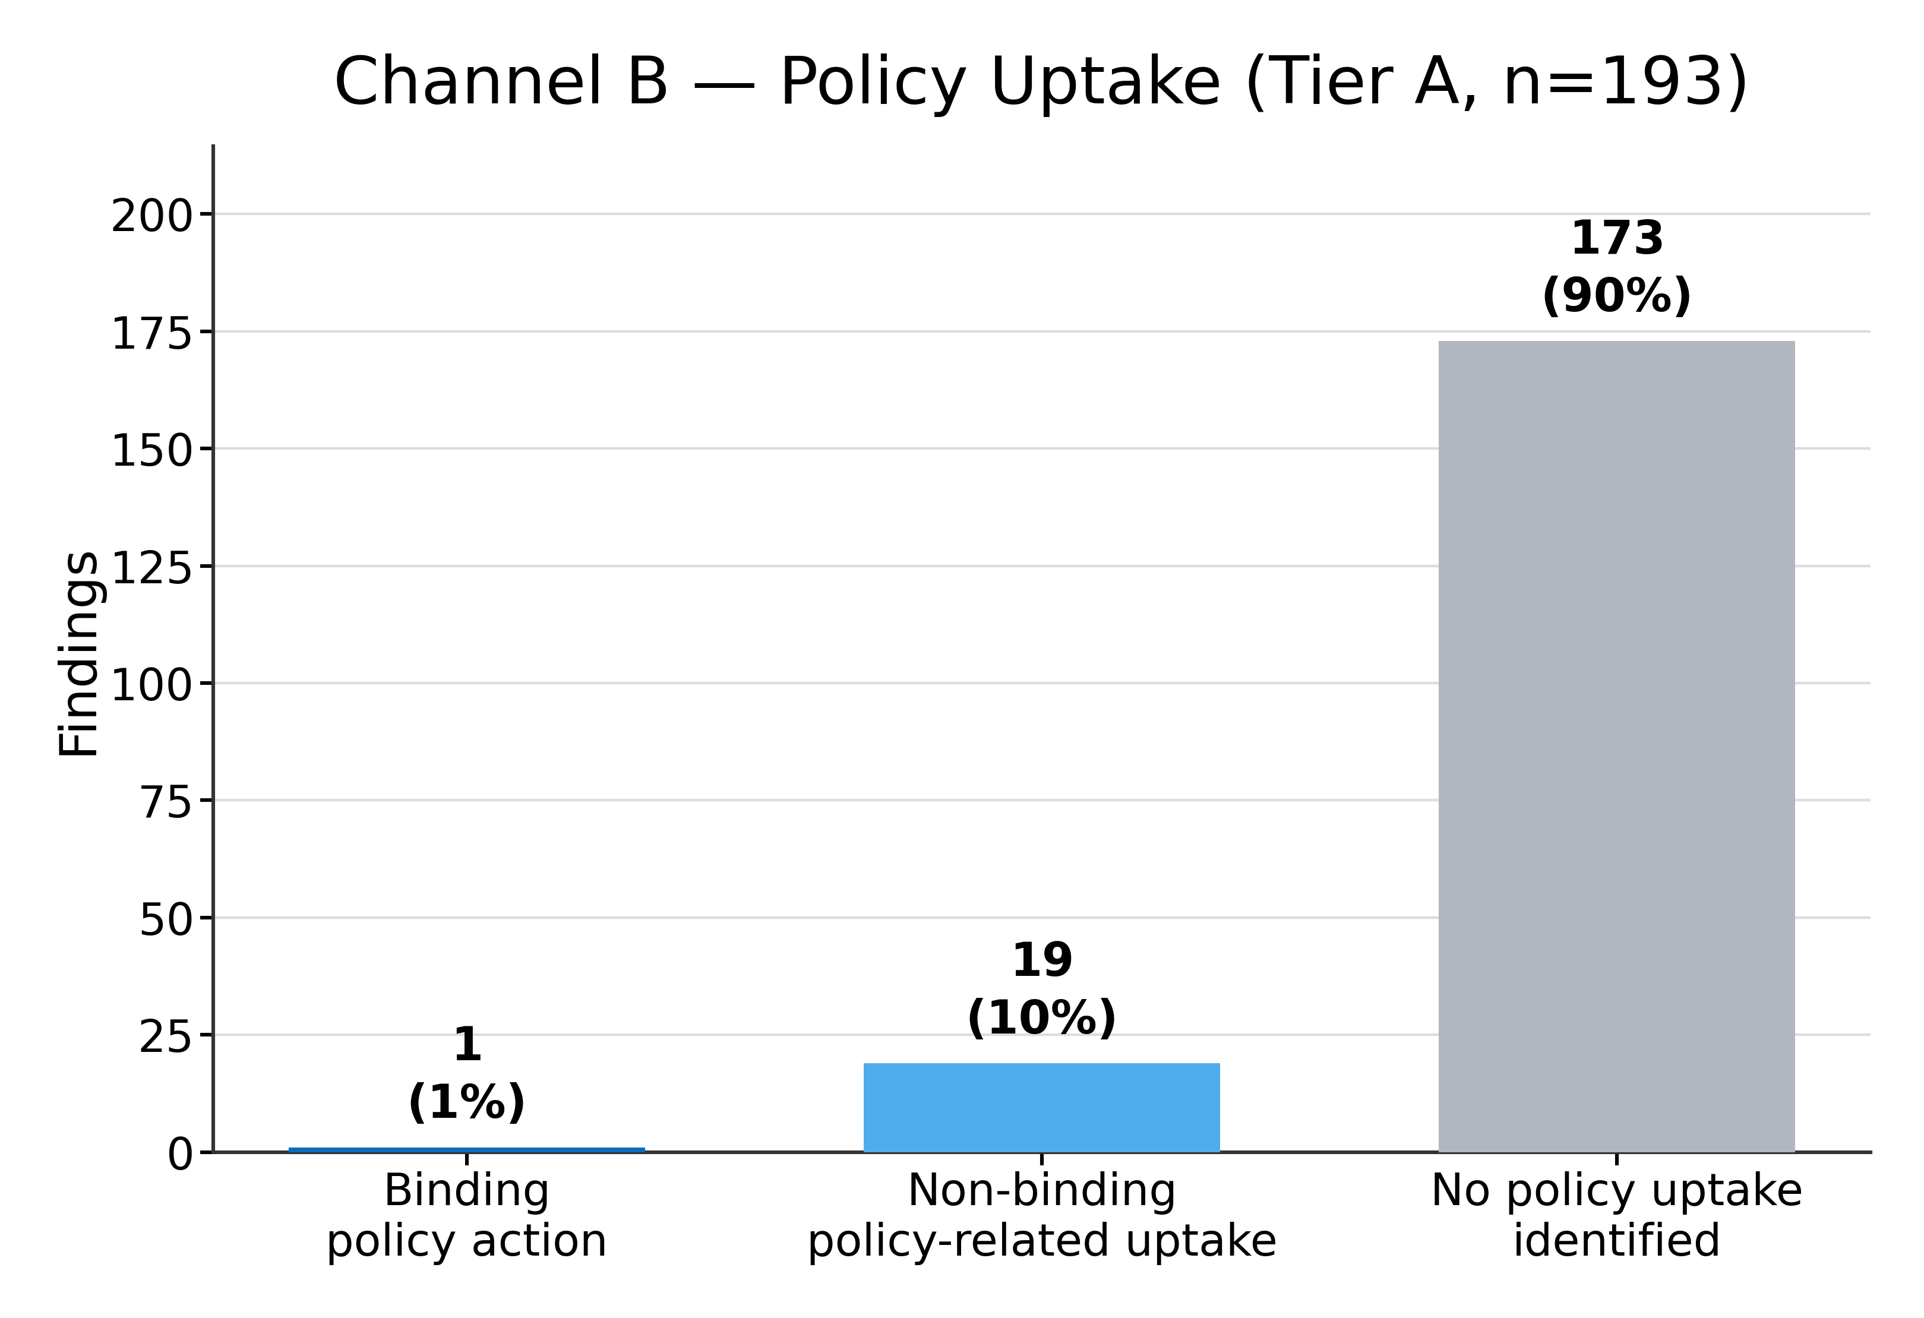
6
5:55 · 0:45
Almost nothing reaches binding policy
173 no policy uptake · 19 non-binding uptake · ONE binding policy action across the entire corpus.
Notes:
5:55–6:40 — CHECK BEFORE PRESENTING: it is ONE binding action, not two.
It is the June 2026 Commerce export-control order taking Fable 5 and Mythos 5 offline globally. The second candidate was re-sourced and downgraded: voluntary compliance at ONCD/OSTP request is not an enforceable instrument.
This is the weakest link in the whole pipeline. Findings reach companies sometimes; they reach binding policy essentially never.

Slide 7
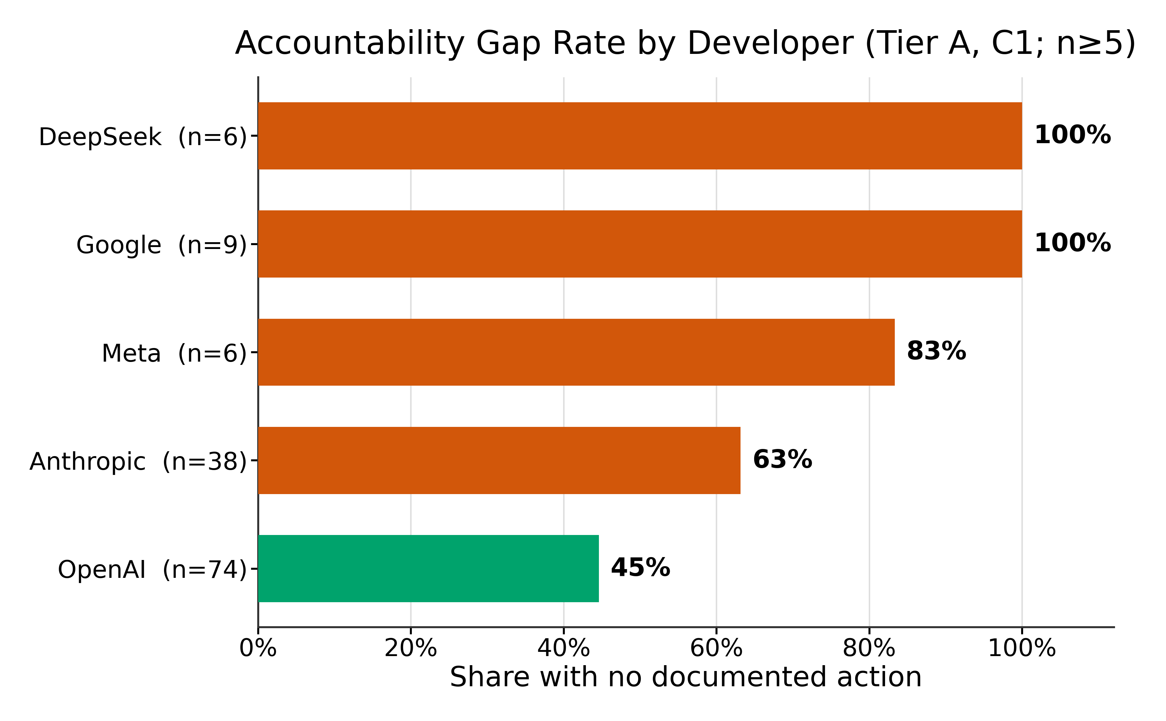
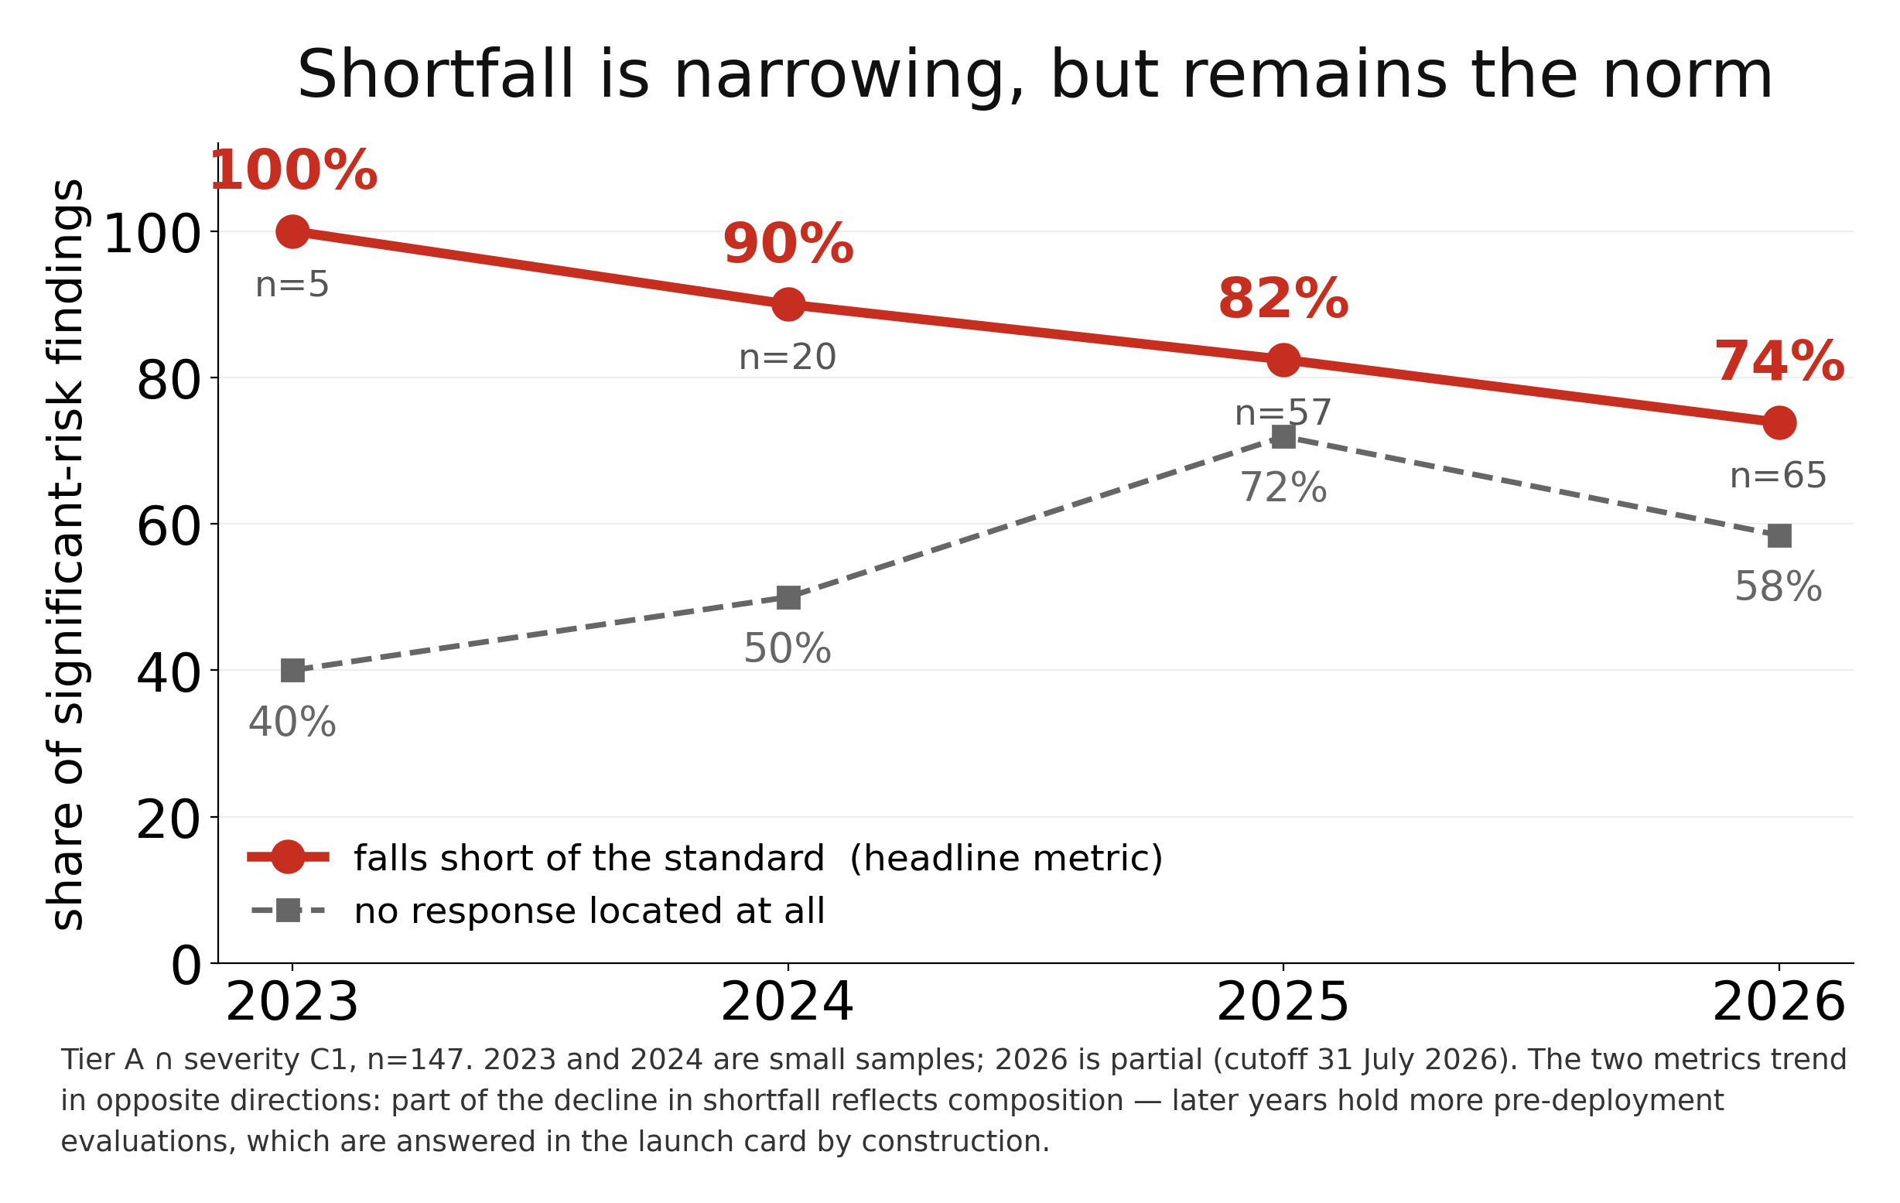
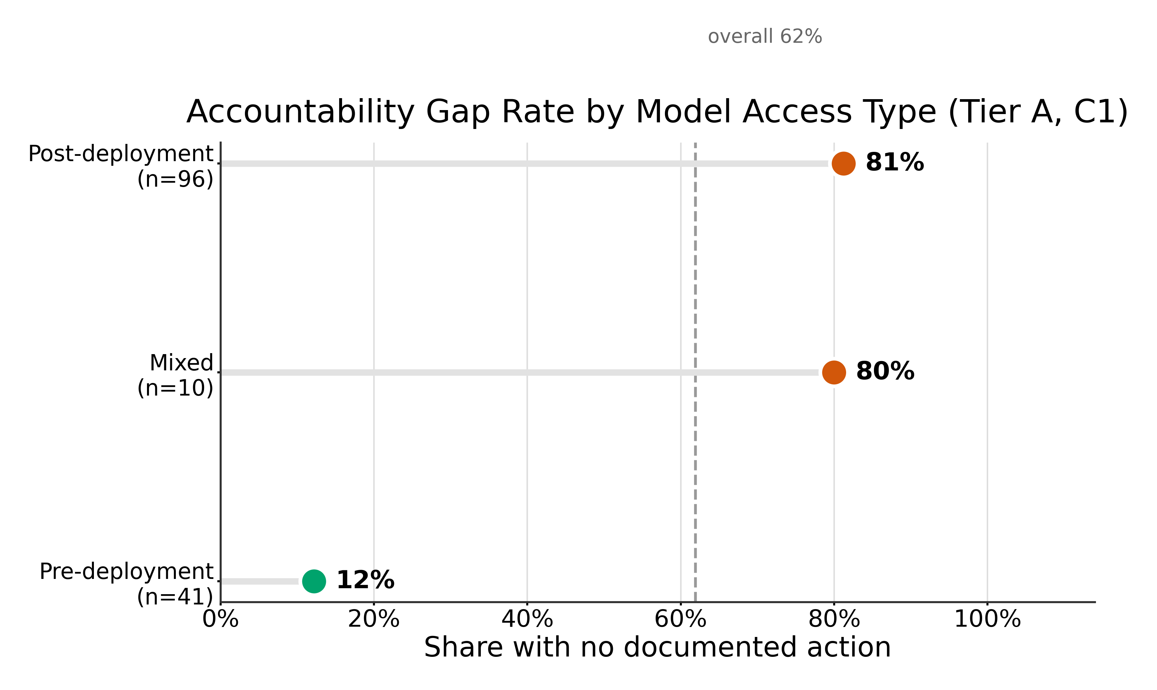
7
6:40 · 1:30
Unevenly distributed, and narrowing slowly
Shortfall varies sharply by developer and by evaluator access. Over time it declines: 100% → 90% → 82% → 74% — still roughly three in four.
Notes:
6:40–8:10 — On the headline metric the trend is DOWNWARD. Do not claim it is getting worse. The honest line: the shortfall is narrowing but remains the norm.
Caveats first: 2023 is n=5, 2024 n=20, and 2026 is partial (cutoff 31 July). Fig 19 covers developers with n>=5 and the smallest bars are fragile.
Some of the decline is composition, not behaviour change — later years hold more pre-deployment evaluations, which are answered in the launch card by construction.
NOTE: the left chart is on the headline metric (falls short). The two right-hand charts plot the no-action rate, which is the lower number — say which you are quoting.

Slide 8
8
8:10 · 1:50
Why you should believe it, and what would change it
All 69 rows with a documented response were re-verified against the source document; 9 were recoded, in both directions. The weak link is not detection — it is that nobody is obliged to answer.
A response register would be cheap, and would make this measurable by default.
Notes:
8:10–10:00 — Corrections went BOTH ways (under-coded and over-coded), which is the evidence the review is not tuned to produce a bigger number.
Every negative coding is backed by a completed, dated five-source search battery — an absence is only claimed where the search was exhausted.
State the live limitation: the two corpus halves differ in Channel A search depth, so 80.3% is an upper bound.
Then the ask, once: a response register. Close on the hero you opened with, so the number lands twice. Then stop talking.

Slide 9
Held in reserve — for Q&A
Nine figures kept off the running order, each mapped to the question it answers.
If asked… | Show this figure
"Don't they answer before launch?" | 05_pre_vs_post_deployment_response_rate.png
"Is the gap worse in some risk domains?" | 22_domain_x_outcome_heatmap.png
"Do they at least answer the serious ones?" | 21_severity_x_action_heatmap.png
"Is this just one company?" | 02_findings_per_model_developer.png
"Do big evaluators get better treatment?" | 24_evaluator_volume_vs_gap.png
"What do evaluators actually test?" | 11_domain_distribution.png
"Who publishes the most?" | 01_findings_per_institution.png
"Do evaluators get real access?" | 03_findings_per_access_type.png
Simpler alternative to slide 3's growth chart | 06_findings_per_year.png
Notes:
Not presented. Keep this slide in the file so the figures are one click away in Q&A.
05_pre_vs_post is the one you are most likely to need.

