Slide 1
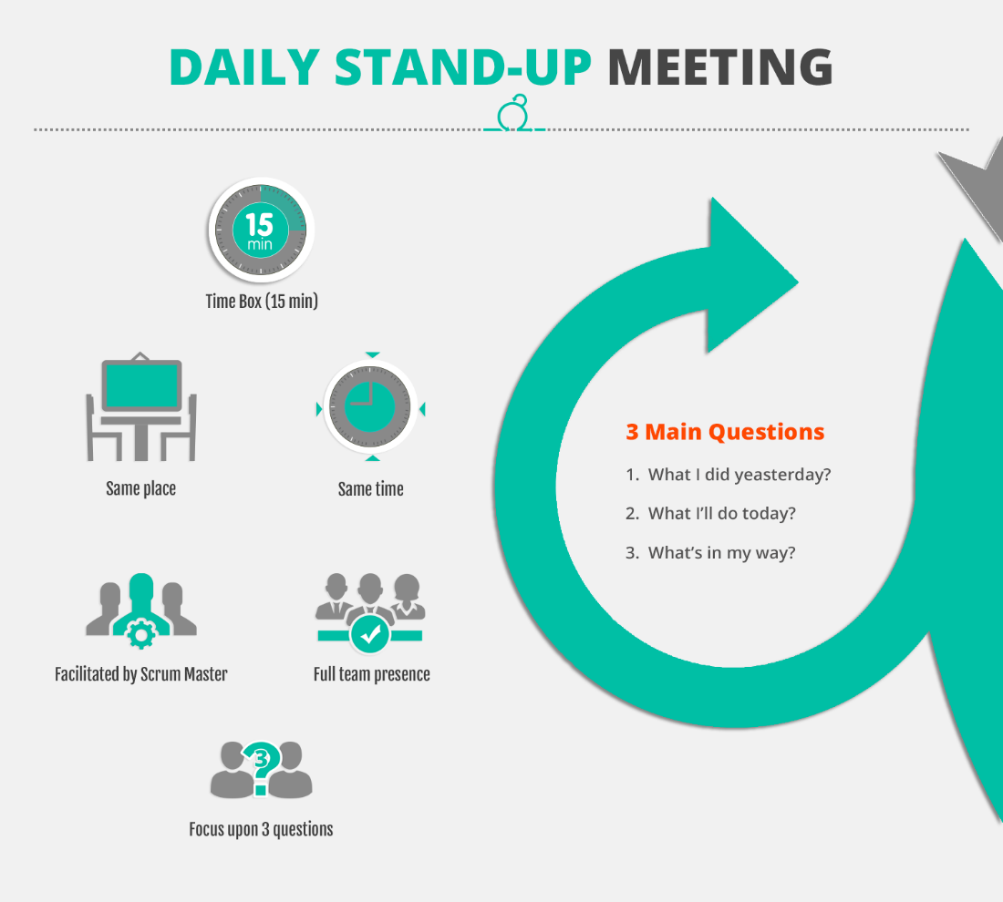

Slide 2
Key benefits
The team stays in sync with how the project is going.
There is an opportunity for swift course correction if needed.
By consistently committing and delivering, trust is built among team members.
Action can be taken with those who are consistently unable to make their commitments (not always pleasant, but usually necessary).

