Slide 1
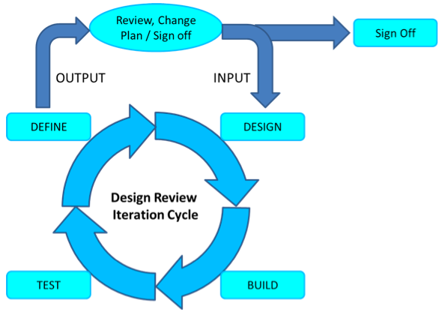

Slide 2
Why Iteration review is important
The purpose of the iteration review is to measure the team’s progress by showing working stories to the Product Owner and other stakeholders to get their feedback.
The iteration review serves three important functions:
It brings closure to the iteration time box, to which many individuals have contributed to provide new value to the business.
It gives teams an opportunity to show the contributions they have made to the business and to take some satisfaction and pride in their work and progress.
It allows stakeholders to see working stories and provide feedback to improve the product

