Slide 1
Team 2025113

Slide 2







Exploratory Data Analysis
Feature
Engineering
Performance
Indicators
AGENDA
Model
Pipeline
Dashboard
Summary

Slide 3










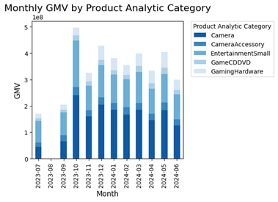
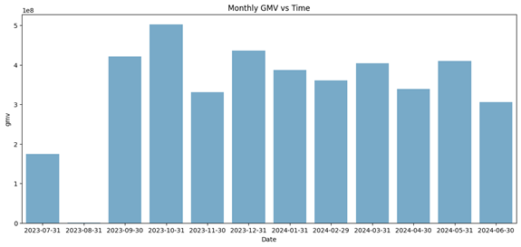
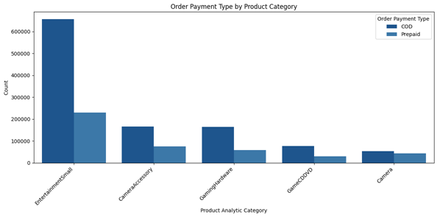
EXPLORATORY DATA ANALYSIS
FEATURE ENGINEERING
PERFORMANCE
INDICATORS
EXPLORATORY DATA ANALYSIS
MODEL PIPELINE
DATASET DESCRIPTION
FEATURE ENGINEERING
KEY PERFORMANCE INDICATOR
MARKETING MIX MODEL
LINEAR PROGRAMMING
DASHBOARD
DATASET DESCRIPTION
UNIVARIATE ANALYSIS
The customer dataset includes 20,611 unique products across 74 verticals, 14 subcategories, and 5 categories. In a year, 123,360 unique customers made purchases. It is imbalanced in both Total Investment and product categories.
The stacked bar chart shows Monthly GMV by Product Category, highlighting sales trends. Camera and Entertainment Small categories consistently lead in GMV, indicating a strong market presence.
The chart shows that Cash on Delivery (COD) is the preferred payment method across all product categories, indicating strong customer preference, especially in high-selling categories.
The bar chart depicts monthly Gross Merchandise Value (GMV) fluctuations, with October 2023 showing the highest GMV and August 2023 reflecting a lower value due to fewer data points

Slide 4
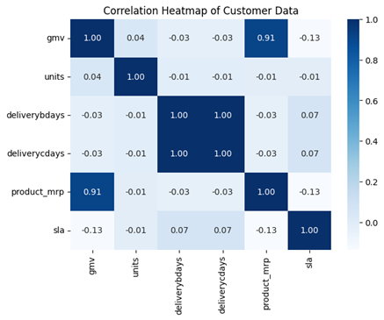
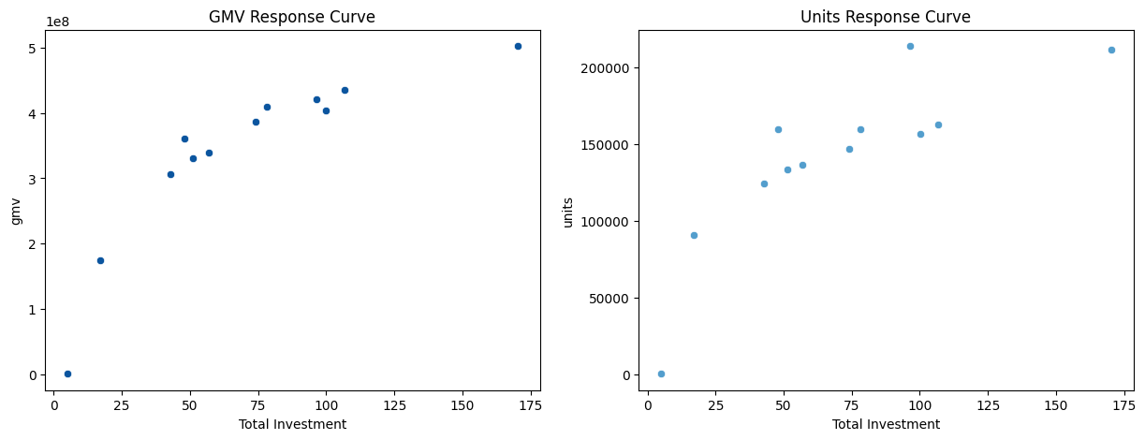
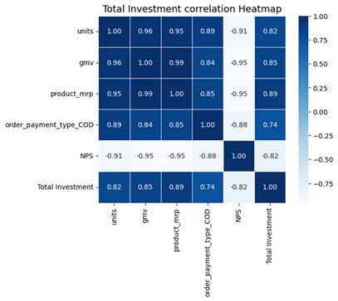
EXPLORATORY DATA ANALYSIS
FEATURE ENGINEERING
PERFORMANCE
INDICATORS
EXPLORATORY DATA ANALYSIS
MODEL PIPELINE
BIVARIATE ANALYSIS
PEARSON’S CORRELATION
The scatter plot shows a positive correlation between Total Investment and both GMV and Units, but with diminishing returns beyond a certain investment level.
The heatmap shows strong positive correlations: GMV with product MRP (0.91), and delivery days (1.00).
DISTRIBUTION ANALYSIS
The heatmap reveals a strong positive correlation between GMV and units (0.96), and a strong negative correlation between NPS and all other variables.
Kolmogorov-Smirnov tests confirmed the normality of all key variables (P > 0.05), supporting model validity and robust statistical analysis, particularly important in small samples.

Slide 5





EXPLORATORY DATA ANALYSIS
FEATURE ENGINEERING
PERFORMANCE
INDICATORS
FEATURE ENGINEERING
MODEL PIPELINE
Sale Price :
The sale price represents the Gross Merchandise Value per unit, which is the actual selling price of a product after applying discounts or promotional adjustments.
Payday Week :
The Payday Week feature identifies whether an order was placed in a week, including a typical payday.Paydays were assumed to be on the 1st and 15th of each month.
Discount Percentage :
In marketing, the discount percentage refers to the reduction in price offered on a product or service.
Orders Delay :
The Order Delays feature represents the difference in time taken for an order to be delivered and the expected time of delivery
Product Type :
The Product Type feature categorizes products into two segments based on their Gross Merchandise Value: Luxury and Mass Market

Slide 6

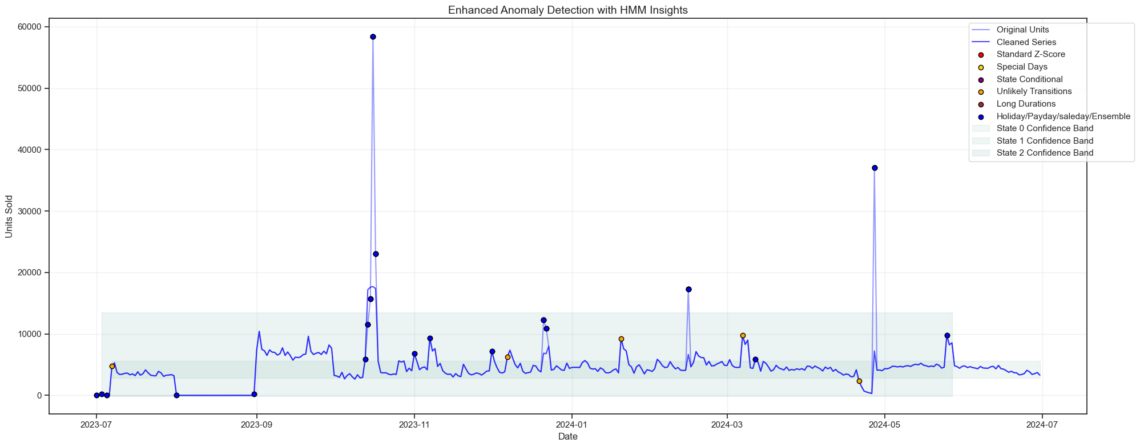
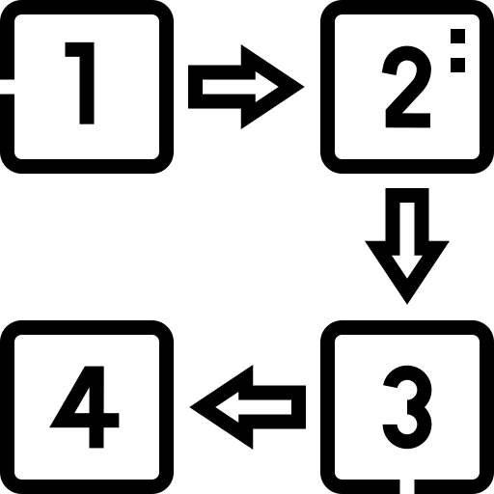


EXPLORATORY DATA ANALYSIS
FEATURE ENGINEERING
PERFORMANCE
INDICATORS
ANOMALY DETECTION
MODEL PIPELINE
Hidden Markov Model (HMM)
Initially the Z score method and Isolation Forest method used for anomaly detection wasn’t very fruitful in identifying the anomalies, majorly because of the high sales during thanksgiving and mother’s day were labelled as global anomalies. We had to adopt a better anomaly detection algorithm leading to the choice of HMM for this task.
Why HMM?
HMMs capture sequential patterns and dependencies in time series data, learning "normal" behavior from historical observations.
HMMs provide accuracy with a low false alarm rate, making them particularly useful for distinguishing between normal and anomalous behavior in noisy or uncertain environments.
HMM allows for probabilistic state transitions, making it useful for forecasting future trends.
Spikes in daily sales observed near holidays, paydays, and sale days, with notable increases in October, May, and February, indicating heightened consumer activity during these periods.

Slide 7
EXPLORATORY DATA ANALYSIS
FEATURE ENGINEERING
PERFORMANCE
INDICATORS
PERFORMANCE INDICATORS
MODEL PIPELINE
Monthly Sales Growth (MSG)
Percentage increase or decrease in sales revenue from one month to the next
Sales by
Payment Type
Distribution between payment options of Cash on Delivery (COD) and Prepaid transactions
Key Performance Indicators
Marketing Return on Investment (MROI)
MROI measures the financial return generated from marketing expenditures
Special Day
Performance Index (SDPI)
Metric which quantifies how sales on special days perform relative to forecasts
Delivery Performance Index (DPI)
Measures how effectively a business fulfills its order delivery commitments
Cost Per Acquisition (CPA)
Measures the average expense required to acquire a new customer
Key Risk Indicators
Order Delay
Distribution between payment options of Cash on Delivery (COD) and Prepaid transactions
Net Promoter Score (NPS)
Measures customer loyalty and helps businesses assess customer sentiments

Slide 8

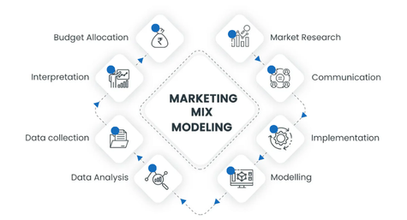
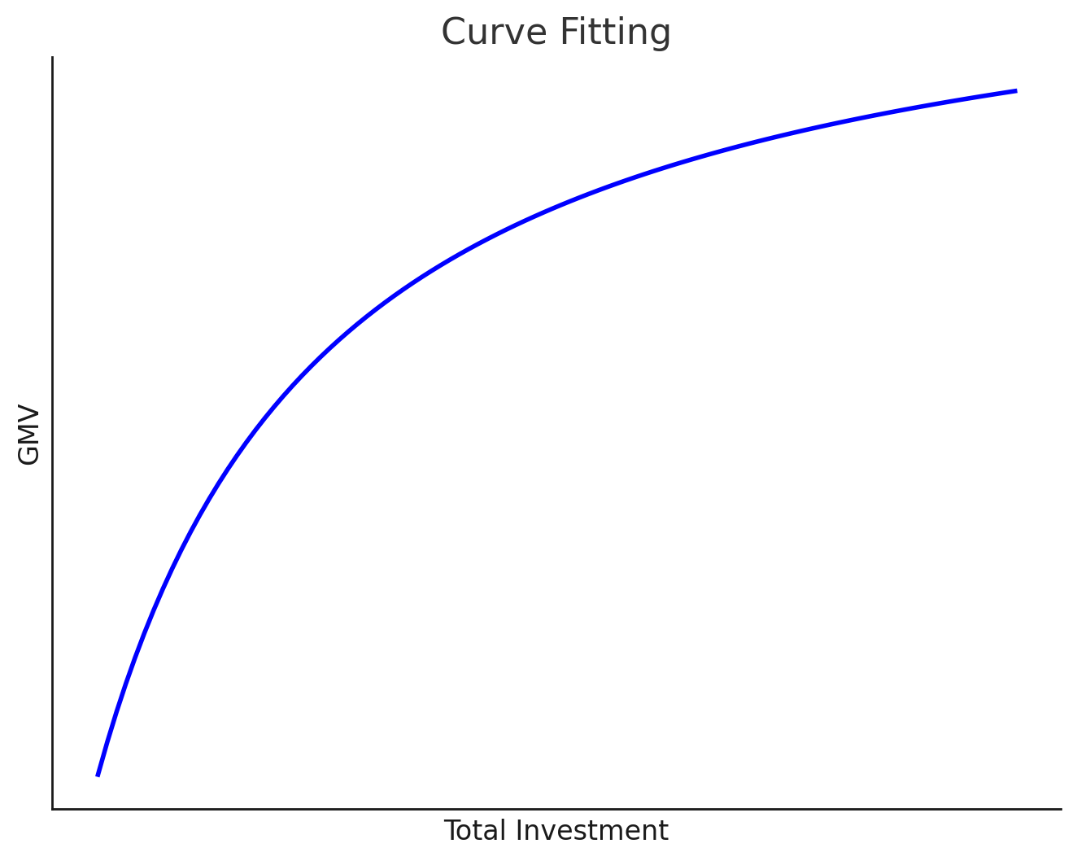
FEATURE ENGINEERING
EXPLORATORY DATA ANALYSIS
PERFORMANCE INDICATORS
PERFORMANCE
INDICATORS
MODEL PIPELINE
MODEL PIPELINE
FEATURE ENGINEERING
MODEL
PIPELINE
DASHBOARD
Marketing Mix Modeling
Model measures marketing impact on sales, revenue, and engagement.
Optimizes budget by identifying effective channels.
Identifies key channels driving sales.
Michaelis-Menten model
Michaelis-Menten to model used diminishing GMV-Investment relationship.
Equation: y = αx/{1 + x} (GMV vs. Investment).
Data processed into features, KPIs, KRIs.
Five product groups, each modeled with Michaelis-Menten.
Weights computed and used in LPP solver with SDPI.
Key features converted to JSON for dashboard integration.

Slide 9
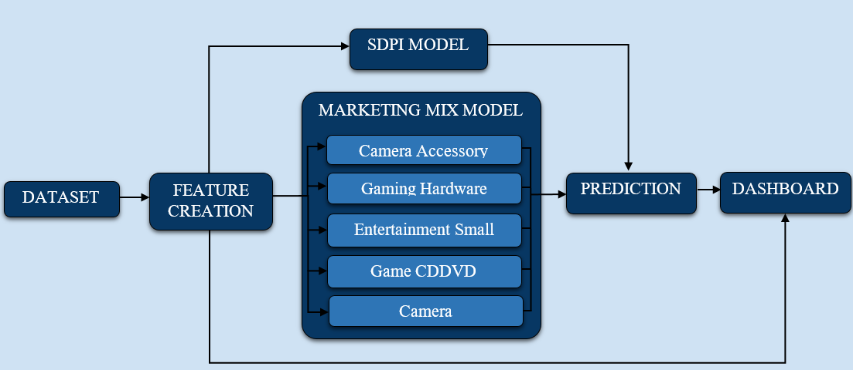
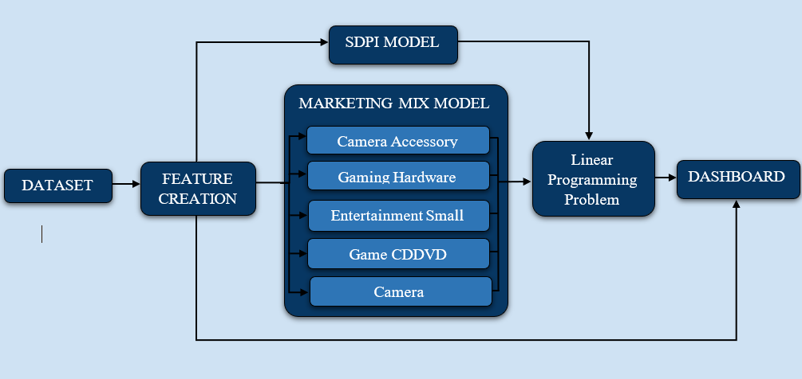

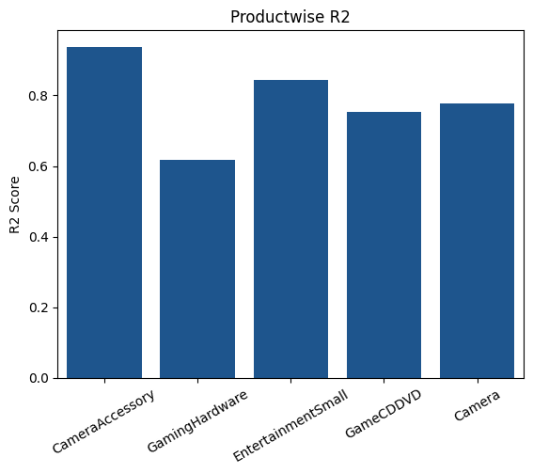


MODEL PIPELINE
FEATURE ENGINEERING
PERFORMANCE INDICATORS
MODEL
PIPELINE
DASHBOARD
Extracted features are passed into five Michaelis-Menten models, each for a specific category
Computed weights from these models are fed into a Linear Programming Problem (LPP) solver
The final budget allocation is the optimized solution of the LPP

Slide 10



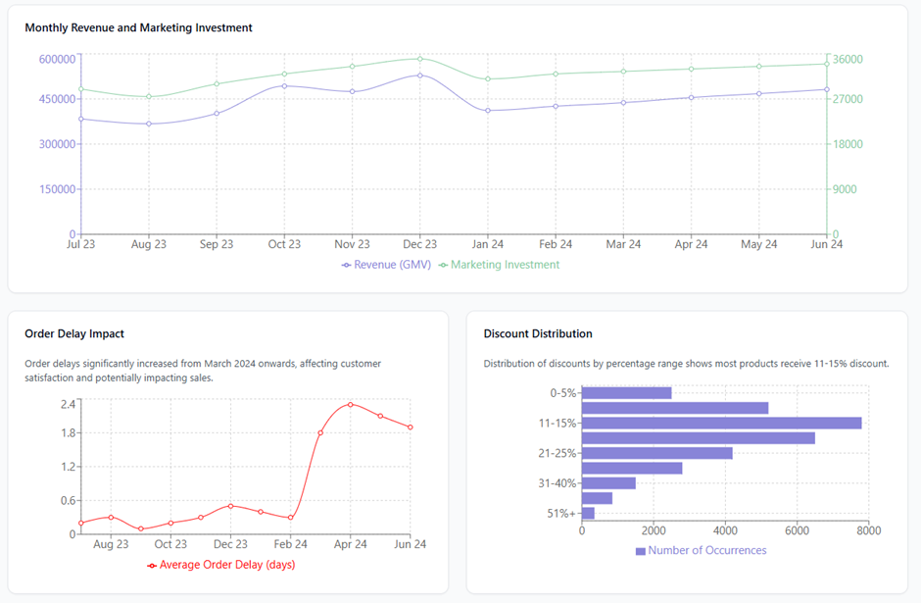




PERFORMANCE INDICATORS
MODEL PIPELINE
SUMMARY
DASHBOARD
DASHBOARD
IMPORTANT TABS
Performance Overview: Monitors monthly revenue, marketing spend, order delays, and discounts.
Marketing ROI Analysis: Tracks ROI with response curves, channel-specific metrics, and investment filters.
Budget Allocation: Optimizes and displays budget distribution and its impact.
Product Categories: Analyzes sales trends and insights by category.
KPI & KRI Monitoring: Visualizes and provides insights on key performance and risk indicators.

Slide 11





PERFORMANCE INDICATORS
MODEL PIPELINE
SUMMARY
SUMMARY
DASHBOARD
Exploratory Data
Analysis
Feature
Engineering
KPI
Formation
Model
Building
Dashboard
Building
Performed univariate and bivariate analysis and found a marginal curve relation between GMV and Total Investment
Engineered Features like sales price, discount percentage and identified key variables influencing sales patterns, pricing strategies, and customer purchasing behavior.
Analyzed performance using financial, operational, and risk indicators. KRIs like CPA, order delays, and NPS provided insights into cost efficiency, logistics, and customer loyalty.
Built a Marketing Mix Model using the Michaelis-Menten regression to optimize budget allocation. Categorized data into five groups, modeled diminishing returns, and optimized via an LPP solver.
Developed a React.js dashboard with a Node.js backend for performance tracking, marketing ROI analysis, budget allocation, product insights, and KPI/KRI monitoring through interactive visualizations.

Slide 12

Thank You!

Slide 13
ANNEXURE

Slide 14






ADDITIONAL HELPFUL INFORMATION
TV Marketing -- Gross Rating Points (GRPs): The basic measurement unit that quantifies ad impressions as a percentage of a target market. Studies track the rate of delivery of a television commercial's sales effectiveness per GRP.
Content Marketing – Site Interaction Data: How users engage with different content types, including time spent on page and scroll depth.
Digital Marketing – Engagement Metrics: Click-through rates (CTR), bounce rates, and exit rates that indicate content relevance.
Online Marketing (Cross-Channel) – Budget Analytics: Cost per visitor, revenue per visitor, and other financial metrics across online channels.
Sponsorship Marketing – Audience Reach Data: Raw numbers of people exposed to a brand through sponsored events across TV broadcasts, social media, and live attendance.
Affiliate Marketing – Raw Clicks: The total number of times an affiliate link is clicked, providing a fundamental count of user interactions.

Slide 15





ALTERNATIVE APPROACH
Causal Impact Analysis: Using Causal Inference to analyze which marketing levers drive revenue we conduct hypothesis to validate the impact of each marketing channel.
Customer Segmentation & Personalized Marketing: Customers are segregated by value, discount sensitivity, and preferred channels using RFM analysis and clustering. A/B testing is used to optimize marketing for the best impact.
Price Elasticity & Dynamic Pricing: Using elasticity models to see how price changes impact demand and apply dynamic pricing to adjust rates based on competition, demand, and stock levels for maximum profitability.
Marketing Mix Modeling using Bayesian Regression: We can use Bayesian regression to see how TV ads, digital marketing, and discounts drive sales by accounting for carryover effects from past ads to optimize spending for the best ROI.
Reinforcement Learning for Dynamic Budget Allocation: Using AI-driven budget optimization with Multi-Armed Bandit or Deep Q-Networks, we adjust spending in real-time based on what works best. to maximize ROI while staying within budget and avoiding overspending on less effective channels.

Slide 16

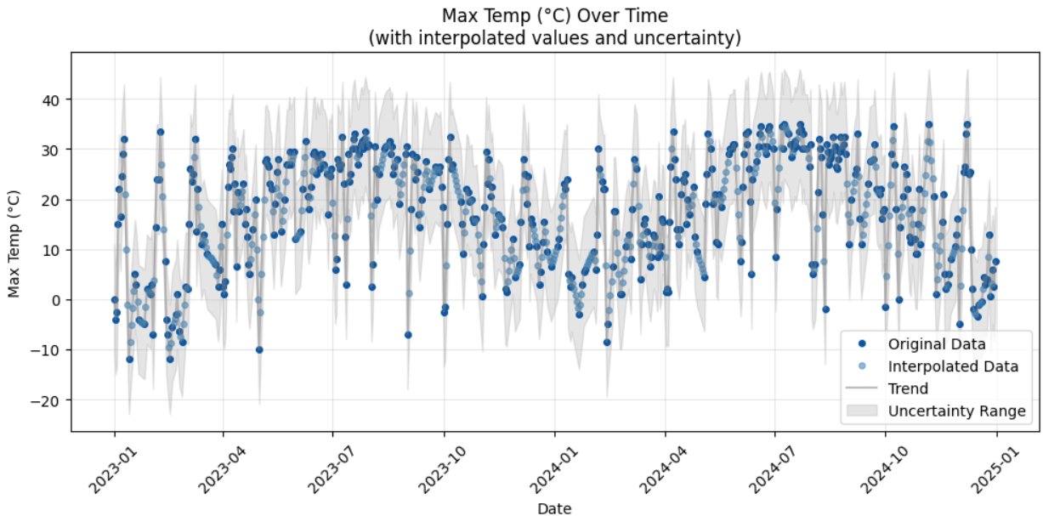
Interpolation Weather Data
Missing weather data (NaNs) and datetime entries.
Interpolation:
Linear (≤3 days) & Time (with noise) for gaps.
Precipitation: Linear (≤2 days), weekly median (longer).
Degree Days:
HDD/CDD calculated based on 18°C base, imputed for missing values.
Stationarity:
ADF test (Max: -4.88, Min: -3.94, Mean: -4.63) confirmed stationarity.
Observation: Weather dataset predominantly complete, with some missing values (NaNs).
Analysis: 400 rows complete; 320 rows contained missing values.
Inference: Minor data gaps, suggesting potential sensor issues or collection inconsistencies.

Slide 17

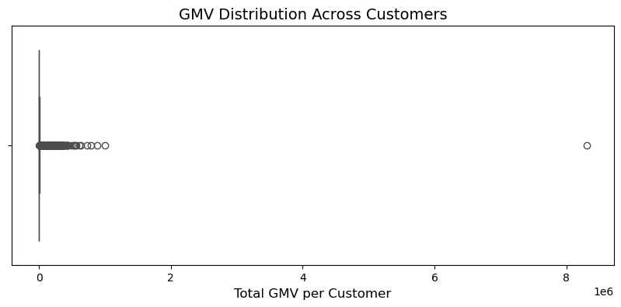
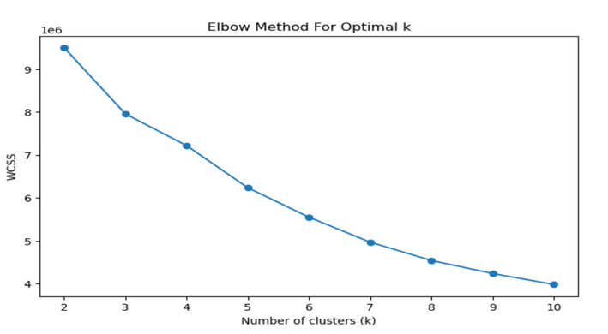
Clustering
Customer Segmentation via Clustering Analysis
Problem:
Attempted to segment customers based on daily Gross Merchandise Value (GMV) using K-Means clustering.
Initial boxplot revealed a highly skewed GMV distribution with significant outliers, notably one customer with ~8 million GMV.
This outlier distorted the clustering results and required exclusion for further analysis.
Methodology:
Applied the Elbow Method to determine the optimal number of clusters (K) for K-Means.
Plotted Within-Cluster Sum of Squares (WCSS) against the number of clusters (K).
Results:
The WCSS plot displayed a gradual decrease without a distinct "elbow" point.
This indicates a lack of clear clustering structure in the data.
Determining an optimal K value was challenging due to the ambiguous results.

Slide 18
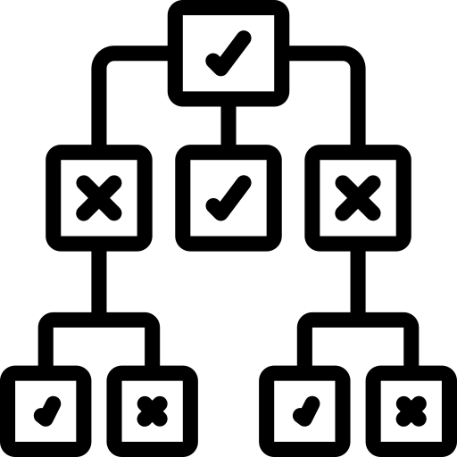


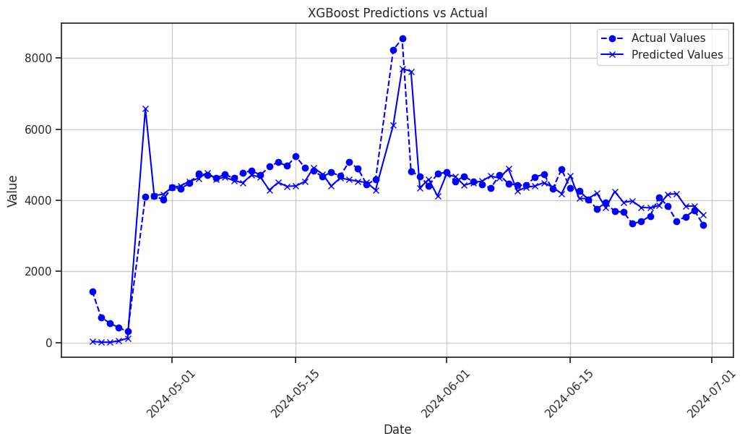
XGBoost
Anomaly Prediction using XGBoost Regressor
Why XGBoost?
XGBoost Regressor is a machine-learning algorithm designed for regression tasks. It builds on the principles of gradient boosting, creating an ensemble of decision trees that work together to make accurate predictions. XGBoost incorporates several innovative features, including regularization to prevent overfitting, efficient handling of sparse data, and optimized tree-building techniques.
Suitable for Large Datasets
Works well for Autoregressive
features
R2 Score : 0.75

