Slide 1
ICV module
Users
VM requirements
User Interface
VM information
Inference
Engine
import
Trained Model
Flask APIs
User-level
cGroups
Optimal CPU quota

Slide 2
netperf_client.sh
input.py
input.csv
# inferencing 결과를 대신할 임의의 인풋 생성
# 500개 데이터 : range(1, 100000, 200)
# input.csv : 500행 * 1열
while read quota
do
$quota > cgroup
# cgroup 수정 불가 : write error (file system full?)
# 쉘스크립트 상에서 명령어 변경
$ sed -i "1s/.*/$quota/g"
/sys/fs/cgroup/…/emulator/cpu.cfs_quota_us
ssh server8@netperf
bash command
output
output_full.txt
output.py
# 넷퍼프 실행결과에서 network throughput 추출
# [ cpu quota, network throughput ] 형태로 저장
# output.csv : 500행 * 2열
done < input.csv
output.csv
그래프 그리기

Slide 3
ICV module
Users
VM requirements
User Interface
VM information
Inference Engine
model loading
model.pkl
Model
Training
Flask server
Client
User-level
model
html
button
API
(Flask)
Data (SLO)
ajax
html ver
Optimal CPU quota
cGroups

Slide 4
ICV module
Model training
model.pkl
Inference Engine
Model loading
Flask server
Client
User-level
model
html
button
API
(Flask)
VM requirements
ajax
html ver
Optimal CPU quota
cGroups

Slide 5
ICV module
Users
VM requirements
User Interface
VM information
Inference Engine
model loading
model.pkl
Model
Training
Flask server
User-level
model
API
(Flask)
Data (SLO)
Client
Optimal CPU quota
cGroups

Slide 6
app.py
- app : Flask
- serve : get_model_api
client.html
+ load_model() : pkl
+ api() : int
+ index() : String
+ url_error() : String
+ server_error() : String
- callAPI : button
- input : input text
+ api_call() : void
@app route && @app handler
ajax( {‘POST’, JSON.stringify(input)} )
serve.py
+ get_model_api() : model_api
+ model_api() : int
response = model.predict(request)

Slide 7
model.py
app.py
- dataset : csv
- workbook : csv
- app : Flask
- serve : get_model_api
- data : csv
- model : pkl
thread_quota, pkt_size, bandwidth_tx, pps_tx, cpu_usage
rmsle, pred_y, test_y
+ data_preprocessing() : void
+ fit() : void
+ test() : void
+ evaluate() : void
+ save() : void
+ load_model() : void
+ api() : int
output = serve(data)
serve.py
+ get_model_api() : model_api
+ model_api() : int
output = model.predict(input)

Slide 8
model.py
app.py
cgroup.sh
- dataset : csv
- workbook : csv
- app : Flask
- serve : get_model_api
- model : pkl
- quota : int
thread_quota, pkt_size, bandwidth_tx, pps_tx, cpu_usage
rmsle, pred_y, test_y
+ cgset() : void
+ data_preprocessing() : void
+ fit() : void
+ test() : void
+ evaluate() : void
+ save() : void
+ load_model() : void
+ api() : int
+ index() : String
+ url_error() : String
+ server_error() : String
# output=serve(data)
serve.py
+ get_model_api() : model_api
+ model_api() : int
output = model.predict(input)
client.html
- callAPI : button
- input : input text
+ api_call() : void
ajax( {‘POST’, JSON.stringify(input)} )

Slide 9
ICV module
Client
html
Flask API
button
SLO
ajax
SLO
Inference Engine
inference
vCPU usage
cGroups
SLO
vCPU usage
inference
I/O thread
CPU usage
Optimal CPU quota
cGroups

Slide 10
Client
Flask API
Model 1
cGroups
SLO
SLO, pkt size, pps, vcpu usage
I/O thread
CPU usage
Client
Flask API
Model 1
Model 2
cGroups
SLO
SLO
vCPU usage
I/O thread
CPU usage

Slide 11
m1
m2
cGroups
m1_input.csv
SLO
m2_input.csv
pkt_size
SLO
vCPU usage
cgroup_input.csv
I/O CPU (quota)
pkt_size
SLO
pps
vCPU usage

Slide 12
ICV module
Model loading
Trained Models
model_vCPU.pkl
model_IOCPU.pkl
Inference Engine
Flask server
Client
API
(Flask)
ajax
html
Data
(Bandwidth,
Packet size)
button
vCPU
usage
bandwidth,
packet size
model1
(vCPU)
bandwidth,
packet size,
vCPU usage
model2
(SLO)
I/O thread
CPU usage
Optimal CPU quota
cGroups

Slide 13
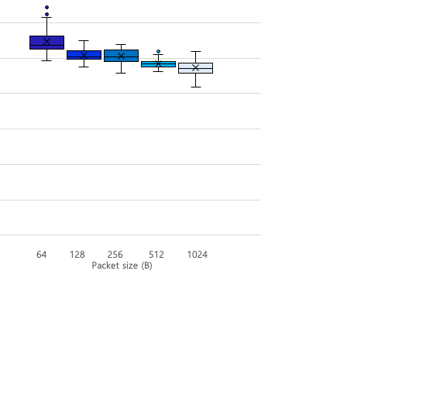
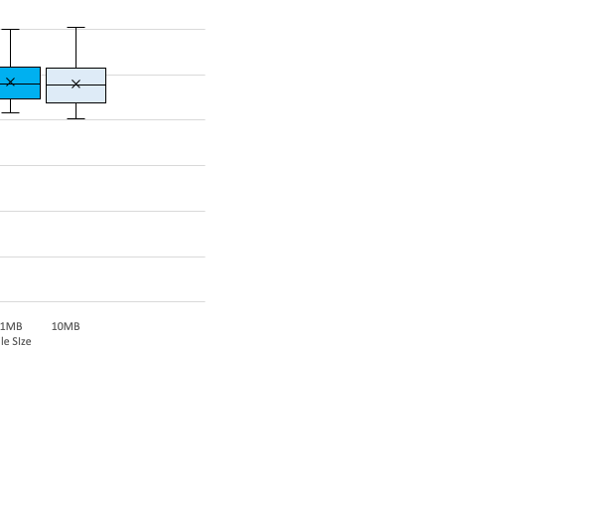

Slide 14
Web Server
KVM
ab
1st physical machine
2nd physical machine
10GbE switch

