Slide 1

01
Introduction to NN, CNN and GNN (24113) & Analog System Design (24AIM114)
FOOD ADULTERATION DETECTION
TEAM MEMBERS:
K. Varshitha (CB.AI.U4AIM24122)
Nikitha Sree TY (CB.AI.U4AIM24132)
R. Ashwika (CB.AI.U4AIM24138)
V. Sevita Naidu (CB.AI.U4AIM24150)
TEAM -6

Slide 2
TEAM -6
02
INTRODUCTION
Food Adulteration refers to adding of substandard substances to the original food which are harmful and can lead to health risks. Generally done for economic benefits. Foreign substances are generally known as “Adulterants”.
Day-to-Day-Life Food Adulterations that we observe:
Lead Chromate in turmeric
Sugar Syrup in honey
Artificial Colors in spices
Animal Fat in ghee
.

Slide 3
TEAM -6
03
PROBLEM STATEMENT
Adulterants sometimes can be carcinogenic. Consumption of adulterated food may lead to serious health issues like cancer, neurological disorders, reproductive issues, gastro-intestinal issues etc.,
Traditional methods involves both home remedies and laboratory analysis it involves very highly scaled spectrometers which are of high cost and large in size, which would difficult for the experts to carry everywhere during inspection; during performing these methods it can also lead to spoilage/ wastage of food item.

Slide 4
LITERATURE REVIEW
04

Slide 5
05

Slide 6
www.reallygreatsite.com
TEAM -6
06
RESEARCH GAPS
Integration of AS7263 NIR sensor with Neural Networks.
Existing systems are not portable
User-friendly
OBJECTIVES
Aims to develop a portable, low cost, user friendly real-time food adulteration detection system .
2. To identify harmful adulterants in the food using NIR (Near Infrared Spectral Sensor) to analyze food samples.
3. Develops a Forward Neural Network(FNN) based classification model as it is useful and easy for classification problems.
4. To develop a system which have better accuracy than home remedies.

Slide 7
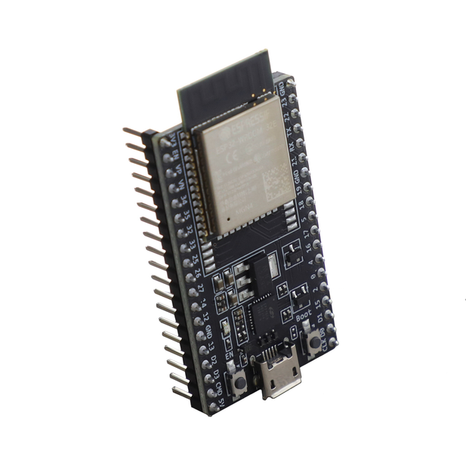
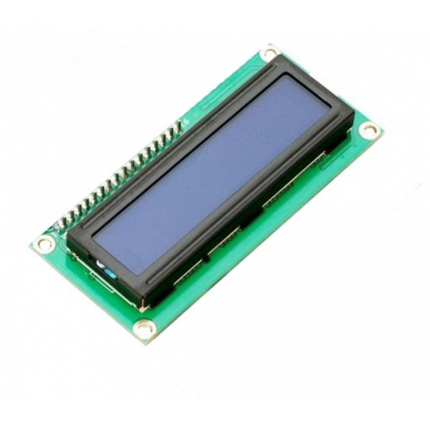
TEAM -6
07
COMPONENTS USED
TCS34725 Sensor
Arduino UNO
LCD Display
Resistors
Jumping Wires
Bread Board

Slide 8
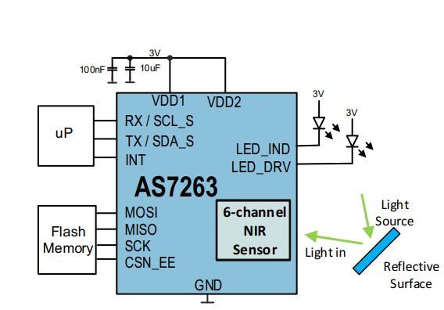
TEAM -6
08
ABOUT THE SENSOR
AS7263
NIR spectral sensor
6 wavelength channels (610 nm, 680nm, 730nm, 760 nm, 810nm, 860nm.
Used for material identification and analysis.
Works by detecting light reflections
FWHM of 20cm ( ±10 nm deviation)
Applications:
Chemical analysis
Portable food testing applications
Features:
Built-in Calibration
Dark Calibration

Slide 9
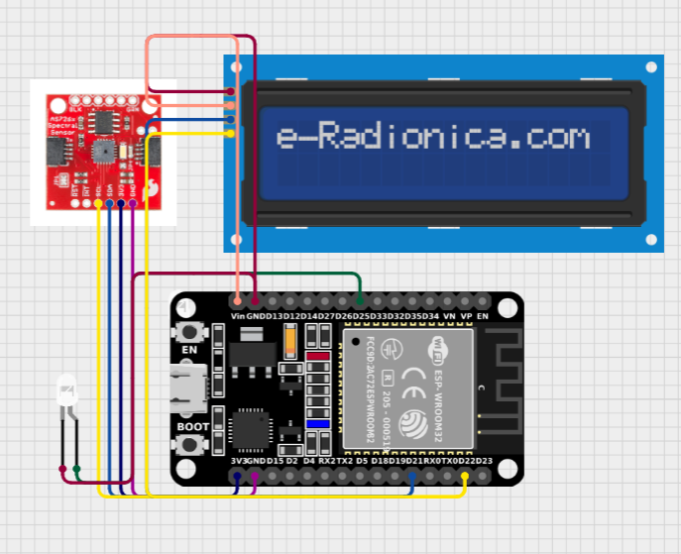
CIRCUIT DIAGRAM
TEAM -6
09

Slide 10
10
METHODOLOGY
Data Collection
Data Pre-processing
FNN
Training & Validation
Testing and Accuracy
Forward Neural Network
ReLU for Hidden Layers
Sigmoid Function for Output Layer
Generated own dataset by referring to research papers for all 6 input channels and labeled them as 0 & 1
75% - training
15% - validation
Model is tested over completely unseen data, compares with the previous performance.
Normalization
Feature Scaling
Detects uncertainity in model’s performance
Hyper Parameter Tuning

Slide 11
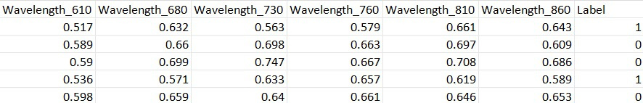
TEAM -6
11
Why FNN?
More suitable for Binary Classification.
Requires less computational power.
Simple data - 6 input wavelength intensities.
Works well for small datasets.
Can learn Non-Linear Relationships.
Easily implemented and debugged.
Handles numerical data well.
Dataset Overview

Slide 12
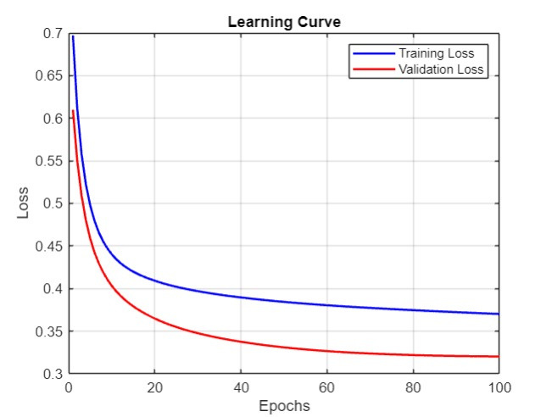

TEAM -6
12
RESULT

Slide 13





TIMELINE OF PROJECT
13
1
2
3
4
5
Components Segregation
Collection of dataset from prototype by intermixing various types of adulterants
Data Pre-processing
Implementing Neural Networks
Improvising Accuracy of the model

Slide 14
TEAM -6
14
FUTURE SCOPE
Multiple-food adulteration detection system
IoT based Mobile Application Integration
Multi sensor integration like AS7263 & AS7265x for better classification accuracy
Detection of adulterant concentration in food.

