Slide 1


NUTRITIOUS AND BUDGET-FRIENDLY MEAL PLANNER FOR ACADEMIC INSTITUTES
BY
K. Varshitha - CB.AI.U4AIM24122
Nikitha Sree TY - CB.AI.U4AIM24132
R. Ashwika - CB.AI.U4AIM24138
V. Sevita Naidu - CB.AI.U4AIM24150
23MAT112 - Mathematics for Intelligent Systems 2
24AIM111 - Introduction to Data Structures & Algorithms

Slide 2
Introduction
Why is it important for young adults to maintain a balanced diet?​
How does junk food affect the health of young adults?​
Physical and Mental Well-being​
Energy Levels​
Immune System​
Chronic Health Issues​
Academic Performance​
Mood and Stress​
Lack of Essential Nutrients ​
Weight Gain & Obesity​
Risk of Chronic Diseases​
Reduced Energy & Focus​
Impact on Mental Health

Slide 3
PROBLEM STATEMENT
STUDENT’S PERSPECTIVE
College students often face multiple challenges when it comes to maintaining a healthy diet. Due to time constraints, financial limitations, and lack of proper meal planning, they frequently opt for fast food, unhealthy snacks, or unbalanced meals, leading to potential health risks such as nutrient deficiencies, weight gain, or fatigue.
ACADEMIC INSTITUTION’S PERSPECTIVE:
Academic institutions struggle to provide nutritious meals while adapting to students' changing preferences. This unpredictability makes it hard to prepare meals in advance, leading to food wastage and financial loss. Balancing nutrition and budget is challenging, often resulting in either excess costs or student dissatisfaction

Slide 4
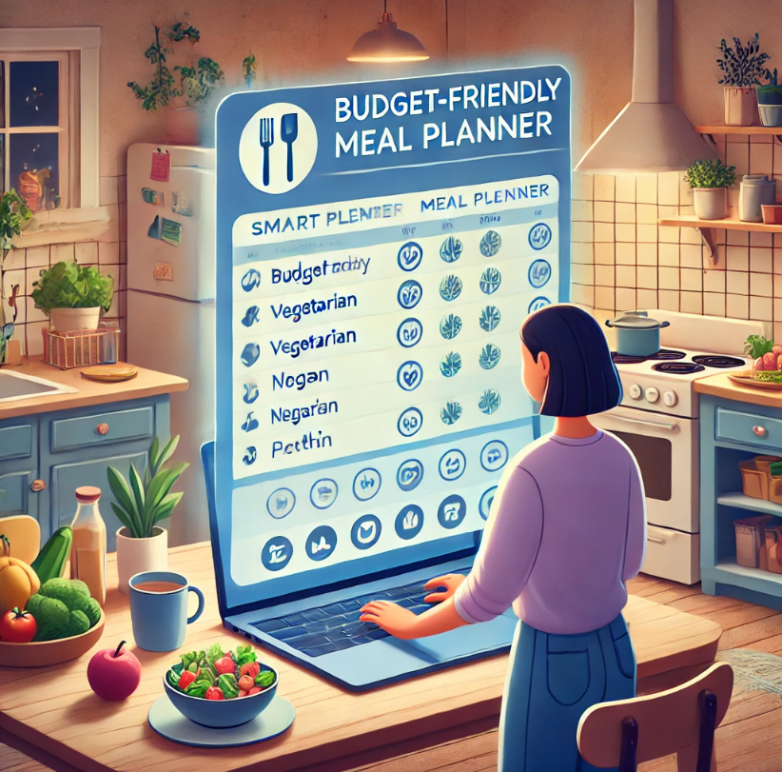
OBJECTIVE
To develop a reinforcement learning-based, nutritious and budget-friendly meal planner to improve the effectiveness of meal planning and optimize meal selection based on balanced nutritional value, student preferences, and cost.

Slide 5
Literature Review
S.no | Topic | Methodology | Findings | Limitations
1. | e-Health Monitoring System with Diet and Fitness Recommendation using Machine Learning -2021 | The system is divided into two main modules: 1. Health monitoring system. 2. Diet and exercise recommendation module. Diabetes, Blood pressure, and Thyroid. | C4.5(classification 4.5) performs better than ID3(Iterative Dichotomiser 3) for classification, providing higher accuracy in recommendations. | The system only supports Diabetes, Blood Pressure, and Thyroid; does not extend to other chronic illnesses.
2. | Meal Plan Monitoring and Recommendation System -2021 | Agile methodology – iterative development Model-View-Controller (MVC) - System’s architecture | Generates custom meal recommendations based on user preferences, calorie requirements, and dietary restrictions. Includes progress tracking dashboards, calorie calculators, and visual analytics. | Adapt the system for children and elderly individuals while customizing recommendations for specific health conditions like diabetes and heart disease.
3. | DIETOS: a recommender system for adaptive diet monitoring and personalized food suggestion -2016 | The system has been constructed on an OWL-based (Ontology Web Language) knowledge base system (KBS). | First diet recommender system incorporating regional foods. DIETOS gives information about the benefits and side effects of several Calabrian foods for specific diseases or healthy conditions. | Only focused on Calabrian regional foods, limiting global applicability. DIETOS relies on user-reported data rather than continuous tracking.

Slide 6
S.no | Topic | Methodology | Findings | Limitations
4. | Personalized Flexible Meal Planning for Individuals with Diet-Related Health Concerns: System Design and Feasibility Validation Study -2023 | This model uses semantic reasoning, fuzzy logic, heuristic search, and multicriteria analysis to create personalized meal plans and optimization functions to generate meals that fit users' health, dietary restrictions, and preferences. | This AI model optimized nutrient values, providing better nutrition for participants compared to user-designed plans. This app effectively controlled sodium intake and met users' dietary preferences. | This model does not update the health updates of the user and remain unchanged. Thus, this becomes a static model and does not evaluate for longer term.
5. | Reinforcement Learning’s Triumph in Crafting Personalized Meal Plans with High User Acceptance | They have used Collaborative Filteration and Reinforcement Learning by taking Dietary Habits & User-preferences. It also uses a feed-back system for refining the recommendations. RL for reward shaping mechanism through ratings, nutriential acceptance. | Integration of Collaborative Filtering and Reinforcement Learning for better meal plans. Average Preference Score : 0.86 but lower acceptance of 2.8 Average Acceptance Score: 4.5 / 5 Average Nutrition Preference Score: 0.92 with an Acceptance Score of 3.8. | User-Preferences are dynamic Did not include cost-effectiveness Similar to apps like Healthify me
Integration of CAverage Acceptance Score: 4.5 / 5
Average Nutrition Preference Score: 0.92 with an Acceptance Score of 3.8.

Slide 7
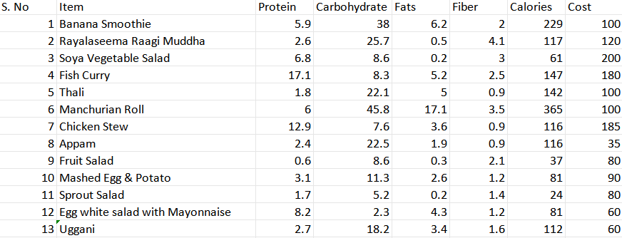
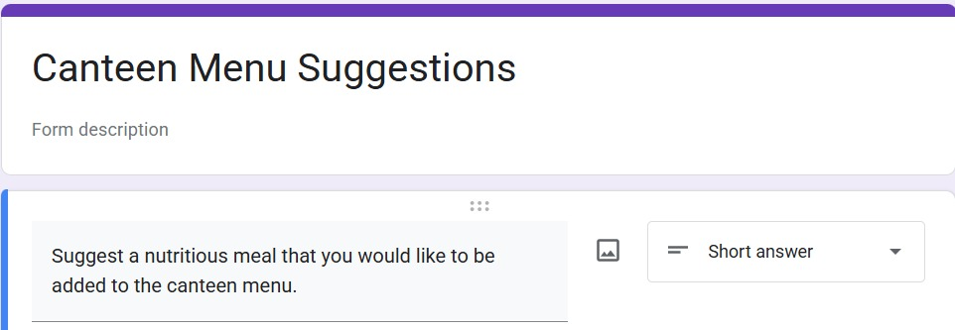
DATASET OVERVIEW
A Minimal Survey

Slide 8
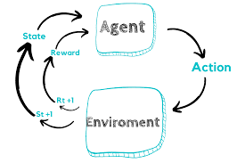
What is reinforcement learning?
Reinforcement Learning (RL) is a type of machine learning focused on making decisions to maximize cumulative rewards in a given situation. Here agent learns to make decisions by performing certain actions and receiving rewards or penalties. Here the earning is driven by the consequences of actions.

Slide 9
Why reinforcement?
Personalized Recommendations
Continuous Improvement
Multi-Objective Optimization
Dynamic Adaptability
Real-Time Decision Making
Learning from Feedback
Handling Complex Environments
Enhanced User Engagement

Slide 10
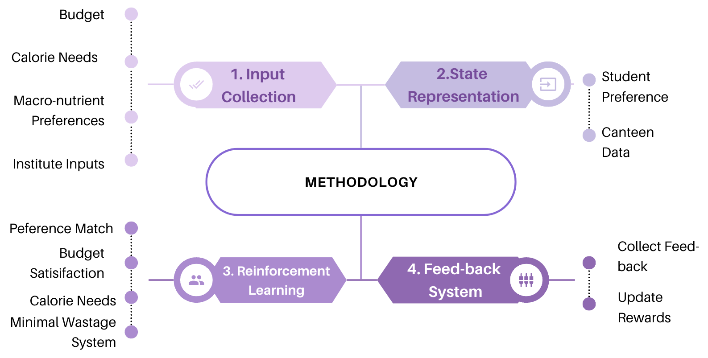
METHODOLOGY

Slide 11
workflow
Collection of Data from the Institute
Survey from the students
Nutritional analysis for the survey data
Working on the Reinforcement learning
Optimization
Creation of web application

Slide 12

Thank you

