Slide 1


NUTRITION BASED MEAL PLANNER FOR MESS
Introduction to data structure and algorithms (24AIM111 )&
Mathematics for Intelligent Systems 2 (24MAT112)
TEAM MEMBERS:
K. Varshitha (CB.AI.U4AIM122)
Nikitha Sree TY (CB.AI.U4AIM24132)
R. Ashwika (CB.AI.U4AIM24138)
V. Sevita Naidu (CB.AI.U4AIM24150)
Team 5

Slide 2
Inputs from the first review:
Issue with the inputs given by the students related to exact nutritional value for the specific person.
Redefine the Problem statement
Redefine the Methodology

Slide 3
Problem Statement
Academic institutions struggle to minimize food spoilage in the mess while managing the student’s liking. In the traditional methods where they rely on manual records which may lead to real-time problems like wastage of food in bulk amounts as it lacks in feed-back mechanisms to verify attendance and wastage time-to-time. These traditional methods stick to a fixed pattern of menus so that it cannot adopt to a certain day’s situation (No improvement in the meal planning).
Our main concern is to solve the wastage of food in the hostel mess, with the feed-back taken from the students that uses RL(Reinforcement Learning) Model so that it suggests meals iteratively by keeping nutritional values in mind.

Slide 4
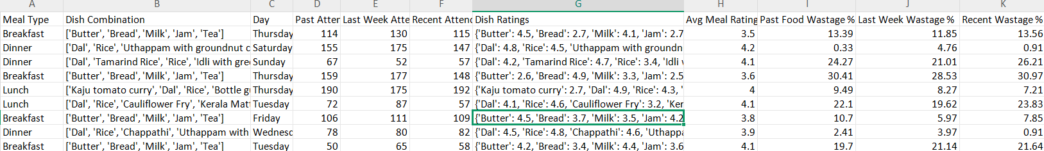
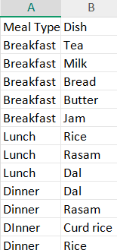
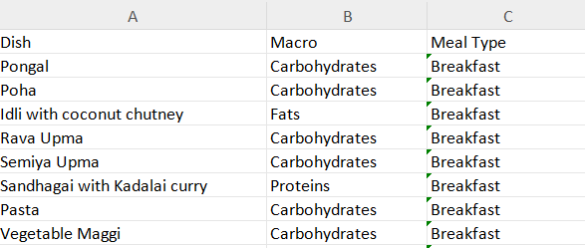
Dataset Preview
Data Collection:
1.Balanced Meals
a. Standard Meals
b. Nutrient Data

Slide 5
Data Structures Used
Data Generation Phase
Data Processing Phase
RL Model Training Phase
NumPy Array - n dimensional arrays for large datasets
Suitable for numeric data
Label Encoding is used for inputs like day of the week(D) and meal type(M)
Dictionaries - maps the inputs to corresponding data entries Q-Table
Mapping it to select best action based on maximum Q-value
Library Used: Pandas
DataFrame (2 dimensional)
Stores and Manipulates attributes efficiently

Slide 6
RL-MODEL
Agent - The meal selection model (Decision Maker)
Environment - Mess System
State - Day of the week & Meal-Type
Action - Suggesting a meal combination with high ratings and low wastage

Slide 7


5. Reward - Assigned based on student Ratings
6. Q-Learning Formula (Bellman Equation)

Slide 8
METHODOLOGY
Select Day & Meal Type
Suggest a meal combination
Get student rating and food wastage
Calculate reward
Update Q-table
OUTPUT

Slide 9
Thank You!

