Slide 1

King County House Sales -Analysis
Keith van doren

Slide 2
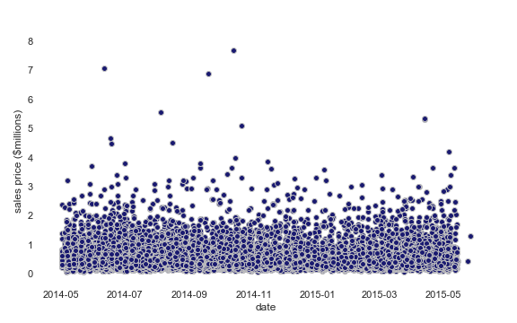
What was analyzed? - 21,597 home sales located in King County, WA - 21 data variables for each sale – ex: Number of bedrooms, sqft… - From May 2014 through May 2015 Why? - Help predict sales prices in the future

Slide 3
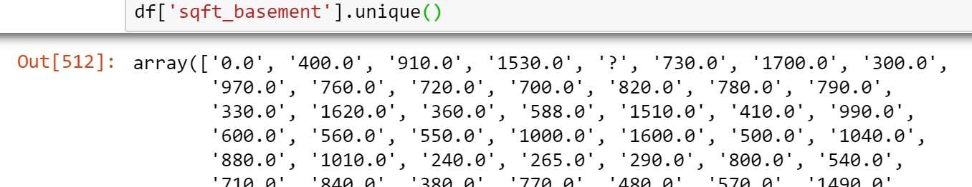
How was the data analyzed?
1. Clean the data – missing data points, etc.
2. Exploratory Data Analysis (EDA)
- What do relationships within the data “look” like?
Ex: Are there outliers for the variables, and what are the distributions of the variables?
3. Build a predictive model – regression based
Ex: Price = 100,000 + (50 * Sqft_Above) + (5,000 * latitude )

Slide 4
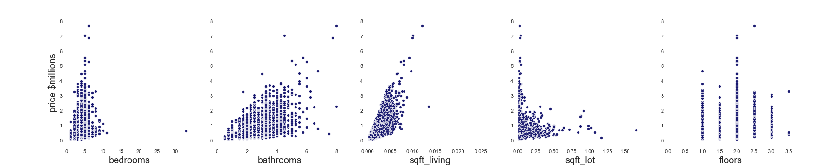
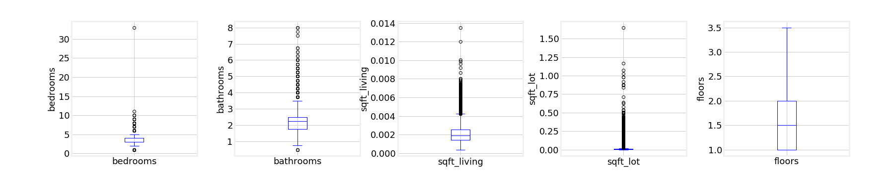
Exploratory Data Analysis (EDA)
1. What do relationships within the data “look” like?
2. Are there outliers for the variables, and what are the distributions of those variables?

Slide 5
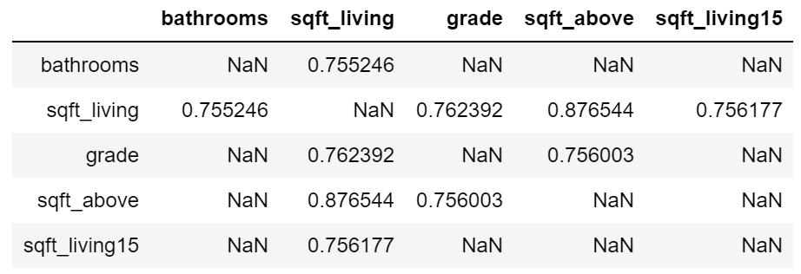

Exploratory Data Analysis (EDA)
3. Which variables are correlated? Are all 'sqft' variables correlated?
4. How should the data distributions be transformed?

Slide 6
Exploratory Data Analysis (EDA)
5. Given there are many possible variables, what variables are important (statistically significant) and what is the least number of variables needed to predict price?
Bedrooms | Bathrooms | Sqft_living | Sqft_lot | # Floors | Waterfront
View | Condition | Grade | Sqft_above | Sqft_bsmnt | Yr_built
Yr_renovated | Zipcode | Latitude | Longitude | Sqft_living15 | Sqft_lot15

Slide 7
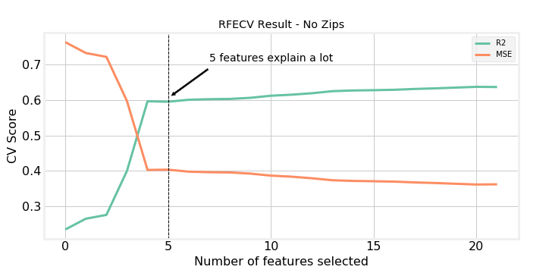
Predictive Model
Results:
Transforming the variables resulted in a total of 84 variables, with zips
Predict prices up to $2,000,000
71 out of 84 variables is optimal
The most significant 35 variables explain 80% of the variability in prices
The most significant 5 variables, excluding zipcodes, explain 60% of the variability in prices

Slide 8
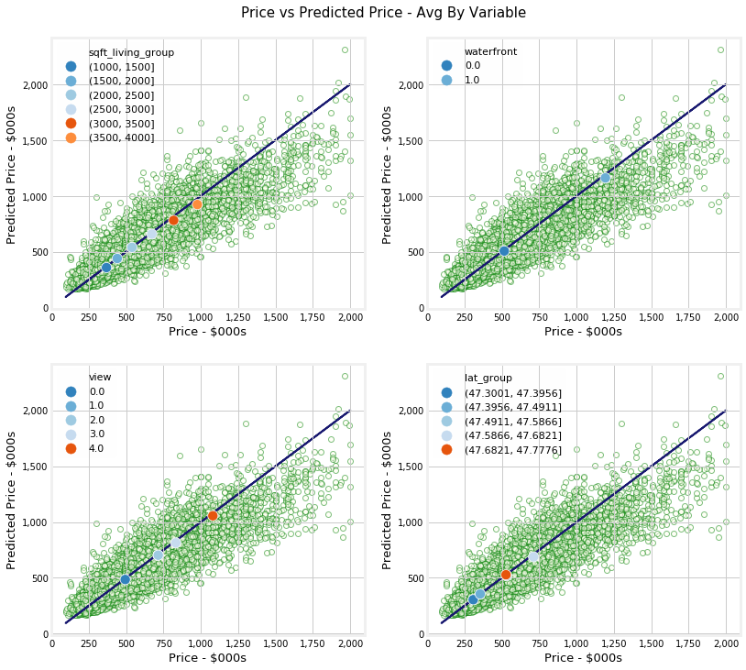
Predictive Model - results
On Average:
Every 500 sqft of living space increases price by approx. $113,000
Waterfront property increases price by approx. $654,000
One higher view ranking increases price by approx. $143,000
Properties with latitudes of 47.587-47.682 have the highest price – in the Seattle area, this is approximately Coleman Park up to View Ridge.
High sqft is correlated with high latitudes (not shown), so location impacts price even more…

Slide 9
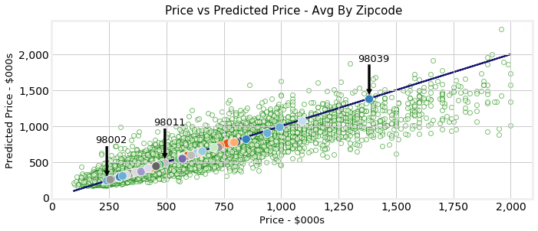
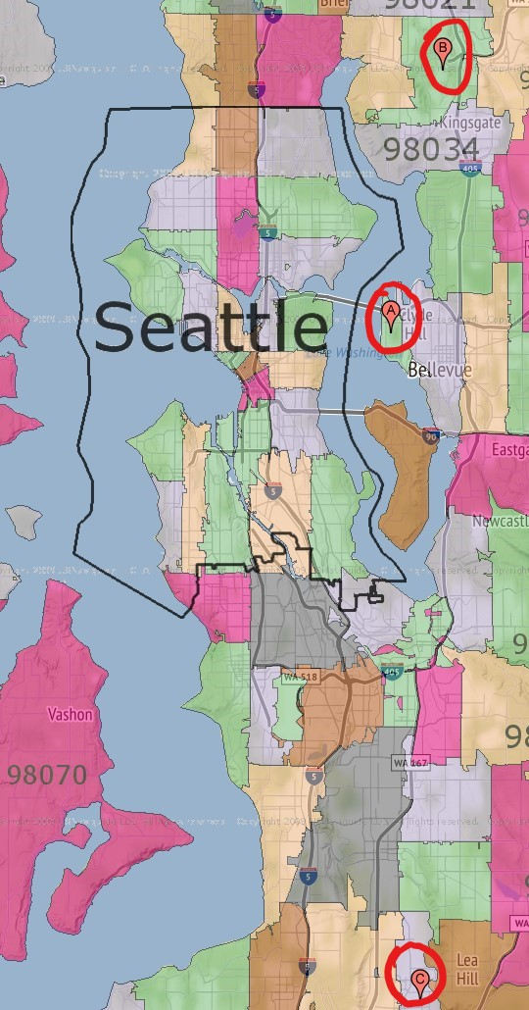
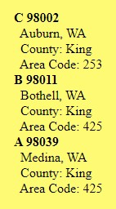
Predictive Model - results
Min avg price – 98002 (Auburn)
Median avg price – 98011 (Bothell)
Max avg price – 98039 (Medina)
On average, properties with the highest sqft, with the best views, along the water, within zipcodes East of downtown Seattle, have the highest predicted price.

Slide 10
Predictive Model
Top 5 variables:
1 | 2 | 3 | 4 | 5
Zipcode | Sqft_living | Waterfront | View | Latitude | Pred. Price
98002 | 2920 | 0 | 0 | 47.3072 | $315 | $-
98002 | 3420 | 0 | 0 | 47.3072 | 350 | +33
98039 | 2920 | 0 | 0 | 47.6328 | 1,333 | +983
98039 | 3420 | 0 | 0 | 47.6328 | 1,478 | +145
98039 | 3420 | 1 | 0 | 47.6328 | 2,247 | +760
98039 | 3420 | 1 | 4 | 47.6328 | 2,209

