Slide 1


SRI VENKATESWARA UNIVERSITY​​
Accredited By ‘NAAC’ With ‘A+’ Grade ​​
Intelligent Campus Assistant Chatbot
Department of MS DataScience
Sri Venkateswara University, Tirupati
Presented by: Kamasani Vishnuvardhan Reddy | Guide: Prof G Anjan Babu , Dept. of CS

Slide 2

SRI VENKATESWARA UNIVERSITY​​
Accredited By ‘NAAC’ With ‘A+’ Grade ​​
Agenda
01
Introduction
02
Problem Statement
03
Objective
04
Literature Review
05
Methodology
06
System Architecture
07
Technology Stack
08
Implementation & Results
09
Future Work
10
References

Slide 3

SRI VENKATESWARA UNIVERSITY​​
Accredited By ‘NAAC’ With ‘A+’ Grade ​​
Introduction
Intelligent campus assistant chatbot developed for Sri Venkateswara University (SVU), Tirupati.

Slide 4
SRI VENKATESWARA UNIVERSITY​​
Accredited By ‘NAAC’ With ‘A+’ Grade ​​
Problem Statement
Fragmented Information
No 24/7 Support
Campus info is scattered across multiple websites, notice boards, and offices, making it hard for students to find quick answers.
Information desks operate only during office hours, leaving students without assistance during evenings, weekends, or holidays.
Time-Consuming Queries
Static Systems
Students spend excessive time visiting administrative offices for simple information like fee structures, exam schedules, or hostel rules.
Existing systems lack natural language understanding and cannot interpret student queries phrased in different ways or languages.

Slide 5
SRI VENKATESWARA UNIVERSITY​​
Accredited By ‘NAAC’ With ‘A+’ Grade ​​
Objective
Primary Goal
RAG Pipeline
Develop an AI-powered campus assistant that delivers accurate, context-aware campus information through a conversational web interface.
Implement Retrieval-Augmented Generation using domain-specific knowledge base with semantic search for high-accuracy responses.
Multi-turn Dialogue
Multi-Language
Support conversational context management for follow-up queries and multi-turn interactions.
Enable communication in English, Telugu, and Hindi to serve diverse student populations.
Reliability
Admin Control
Implement confidence-based response validation and fallback mechanisms to minimize hallucinations.
Provide an administrative dashboard for knowledge base management, FAQ curation, analytics, and system monitoring.

Slide 6
SRI VENKATESWARA UNIVERSITY​​
Accredited By ‘NAAC’ With ‘A+’ Grade ​​
Literature Review
S.no | Paper Title | Source / Date | Methodology / Tech Stack | Key Findings / Metrics | Relevance to Our University Chatbot | Focus Area
1 | Generative AI-Driven Chatbot for Personalized University Information and Assistance | 2024 ICAIQSA, Feb 2025 (IEEE Xplore) | RAG Framework, Vector Database, LLM embeddings for document retrieval | significantly reduced hallucination rate; high context awareness for specific institutional queries. | Direct Blueprint: Validates our architecture (MongoDB Vector Search + RAG) for handling PDF handbooks and admissions data accurately. | Admissions & General Info
2 | Retrieval-Augmented Generation (RAG) Chatbots for Education: A Survey of Applications | 2024 IEEE Access / MDPI (Survey) | Systematic review of RAG vs. Fine-tuning in educational settings | RAG is superior for handling dynamic data (fees, timetables) without retraining; solves the "static knowledge" limit. | Justification: Provides the academic backing for choosing RAG over a simple rule-based or pure LLM approach for SVU. | Educational RAG Survey
3 | Unimib Assistant: Designing a Student-Friendly RAG-Based Chatbot | 2024 AIxHMI Workshop | Custom GPTs, Hybrid Retrieval (Semantic + Keyword), User-Centric Design | High user satisfaction in resolving specific student needs; improved engagement via personalized answers. | UX Patterns: Offers design insights for our "Study Buddy" and "Career Center" modules to ensure student friendliness. | Student Experience (UX)
4 | Development and Evaluation of a University Chatbot Using Deep Learning: A RAG Approach | 2024 CONVERSATIONS Workshop | Deep Learning, Python-based RAG pipeline, BLEU/ROUGE metrics | Established benchmarks for accuracy and response quality in a university domain. | Testing Strategy: benchmarks for our Admin Dashboard analytics (e.g., measuring query accuracy and user feedback). | Performance Evaluation
5 | LLM and RAG Powered Chatbot for the College of Computer Science and Mathematics | Oct 2024 (ResearchGate/IEEE) | Department-specific knowledge base, LLaMA-based text generation | Demonstrated ability to provide immediate, specialized support for specific faculties. | Scalability: Proves our system can be scaled to specific SVU departments (e.g., College of Sciences, Engineering) effectively. | Departmental Support

Slide 7
SRI VENKATESWARA UNIVERSITY​​
Accredited By ‘NAAC’ With ‘A+’ Grade ​​
Methodology
1
2
3
4
5
6
Knowledge Base Design
Embedding Generation
Query Processing
Hybrid Retrieval
Context Assembly
Response Generation
→
→
→
→
→
Structured campus data (PDFs, websites, FAQs) ingested & chunked
all-MiniLM-L6-v2 384-dim vectors stored in MongoDB
Intent classification + query rephrasing via Fast LLM
Vector similarity + Keyword search + RRF fusion (k=60)
Top-k docs merged with chat history & user context
Llama 3.3-70B via Groq generates validated answer
Key Methodology Features
• Cosine similarity threshold ≥ 0.60 for quality control
• Reciprocal Rank Fusion (RRF) combines vector + keyword results
• Session history trimming (last 10 messages) prevents token overflow
• Multi-language support: English, Telugu, Hindi
• Entity extraction for contextual awareness
• Confidence-based fallback: 'Info not available' for low confidence

Slide 8
SRI VENKATESWARA UNIVERSITY​​
Accredited By ‘NAAC’ With ‘A+’ Grade ​​
Technology Stack
Backend
AI / ML
Database
Frontend
Python 3.12+
LangChain 0.2.6
MongoDB Atlas
HTML5 / CSS3
Core programming language
RAG pipeline orchestration
Cloud NoSQL database
Structure and styling
FastAPI
Groq API
Atlas Vector Search
JavaScript (Vanilla)
High-performance async web framework
LLM inference (Llama 3.3-70B)
Cosine similarity indexing
Client-side interactivity
Uvicorn
HuggingFace
PyMongo
Jinja2
ASGI server for production
Sentence-BERT embeddings
Python MongoDB driver
Server-side templating
Pydantic
DuckDuckGo Search
GridFS
PWA / Service Worker
Data validation & serialization
Web search augmentation
File storage for uploads
Offline support & caching
Security: bcrypt + passlib (password hashing) | python-jose (JWT tokens) | Authlib (Google OAuth) | CORS Middleware | Session Middleware

Slide 9
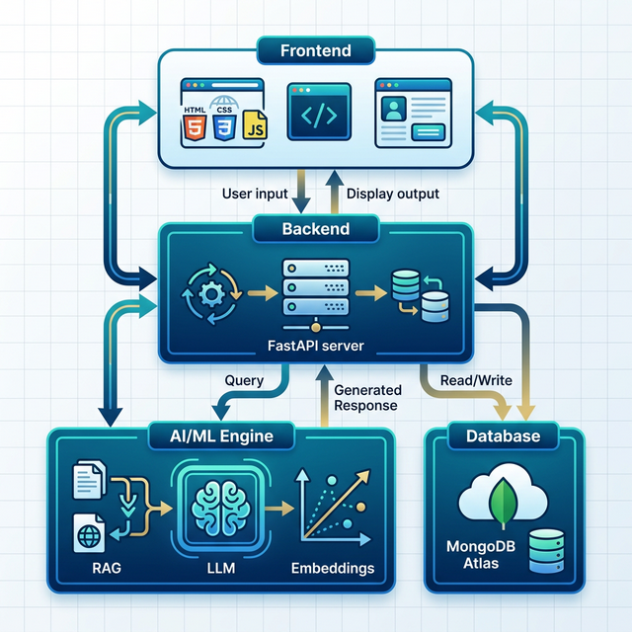
SRI VENKATESWARA UNIVERSITY​​
Accredited By ‘NAAC’ With ‘A+’ Grade ​​
System Architecture
Frontend Layer
HTML5/CSS3/JavaScript web interface Jinja2 templating, AJAX async calls PWA with Service Worker support
Backend Layer
FastAPI (Python) REST API server 8 modular routers: Auth, Chat, Admin, Tickets, Calendar, Study Buddy, Career, Notifications
AI/ML Engine
LangChain RAG pipeline orchestration Groq LLMs: Llama 3.3-70B (smart) + Llama 3.1-8B (fast query rephrasing)
Data Layer
MongoDB Atlas: document storage Vector Search: cosine similarity index Collections: users, FAQs, chat_history, tickets, calendar, documents, analytics

Slide 10
SRI VENKATESWARA UNIVERSITY​​
Accredited By ‘NAAC’ With ‘A+’ Grade ​​
Implementation & Present Results
AI Chat Interface
Present Results & Metrics
Real-time conversational UI with markdown rendering, multi-language support (EN/TE/HI), and voice input/output.
Expected Accuracy
~80-85%
for campus-specific queries
Knowledge Ingestion
Response Time
< 3 seconds
average end-to-end latency
Admin uploads PDFs, URLs, and manual FAQs. Documents are chunked (1000 chars, 200 overlap) and vectorized.
Knowledge Base
15+ categories
admissions, fees, exams, etc.
LLM Models
2 models
Smart (70B) + Fast (8B)
Hybrid Search
Vector Dimensions
384-dim
all-MiniLM-L6-v2 embeddings
Combines vector similarity (cosine ≥ 0.60) + keyword regex search + RRF fusion for maximum retrieval accuracy.
Search Threshold
≥ 0.60
cosine similarity cutoff
Admin Dashboard
Supported Languages
3
English, Telugu, Hindi
Full CRUD for FAQs, document management, user analytics, system logs, and ticket management.
API Endpoints
8 routers
modular REST API design

Slide 11
SRI VENKATESWARA UNIVERSITY​​
Accredited By ‘NAAC’ With ‘A+’ Grade ​​
Future Work
Mobile Application
Short-term
Enhanced Voice AI
Short-term
Develop native Android/iOS apps with push notifications for real-time campus updates and on-the-go access.
Integrate advanced speech-to-text (Whisper) and text-to-speech for natural voice conversations in regional languages.
Advanced Analytics
Mid-term
Study Buddy
Nearly implemented
Implement detailed analytics dashboards with sentiment analysis, usage trends, and predictive query patterns.
This Study Buddy page consists of two features which is study your notes and Zen AI.
ERP Integration
Long-term
Career centre
Nearly Implemented
Connect with university ERP systems for real-time fee payment status, attendance tracking, and grade queries.
This Career centre page consists of two features which is Resume checker and Resume Maker.
11/11

Slide 12
SRI VENKATESWARA UNIVERSITY​​
Accredited By ‘NAAC’ With ‘A+’ Grade ​​
References
Folstad, A., & Brandtzaeg, P. B. (2025). Chatbots and the new world of HCI. Interactions, 24(4), 38-42.
Kuhail, M. A., Alturki, N., Alramlawi, S., & Alhejori, K. (2023). Interacting with educational chatbots: A systematic review. Education and Information Technologies, 28(1), 973-1018.
Generative AI-Driven Chatbot for Personalized University Information and Assistance, Proceedings of the 2024 International Conference on Artificial Intelligence, Quantum Science and Applications (ICAIQSA), IEEE Xplore, Feb. 2025.
Retrieval-Augmented Generation (RAG) Chatbots for Education: A Survey of Applications, IEEE Access / MDPI, 2024.
Unimib Assistant: Designing a Student-Friendly RAG-Based Chatbot, Proceedings of the AIxHMI Workshop, 2024.
Development and Evaluation of a University Chatbot Using Deep Learning: A RAG Approach, Proceedings of the CONVERSATIONS Workshop, 2024.
LLM and RAG Powered Chatbot for the College of Computer Science and Mathematics, ResearchGate / IEEE Publication, Oct. 2024.
Sri Venkateswara University. (2024). Official University Portal. Retrieved from https://svuniversity.edu.in

Slide 13
SRI VENKATESWARA UNIVERSITY​​
Accredited By ‘NAAC’ With ‘A+’ Grade ​​
Thank You!
SVU CampusConnect AI — Intelligent Campus Assistant
Questions & Feedback Welcome

