Slide 1

to predict the next attacks in specific domain in the areas of social-engineering
By 180060010,180050001

Slide 2



What is MALWARE ??
Is it leading up-to Data-Breach ??
What is an ATTACK ?, social-engg attacks

Slide 3
Social engineering attack techniques Social engineering attacks come in many different forms and can be performed anywhere where human interaction is involved.
Baiting
Scareware
Pretexting
Phishing
Spear phishing

Slide 4
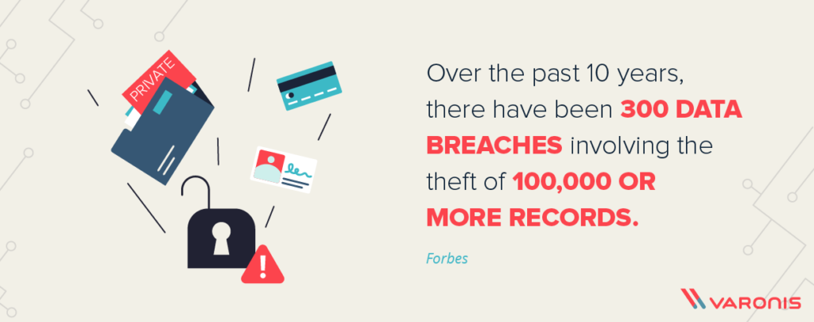
.
Are you READY for an ATTACK ?

Slide 5
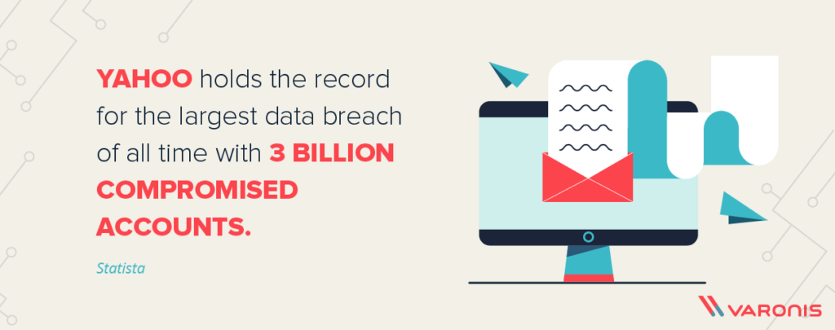
USE-CASE to SELECT this PROJECT:

Slide 6
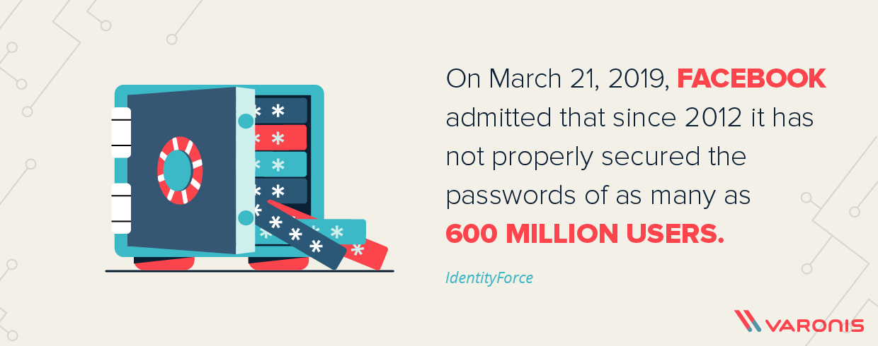
Recent:

Slide 7
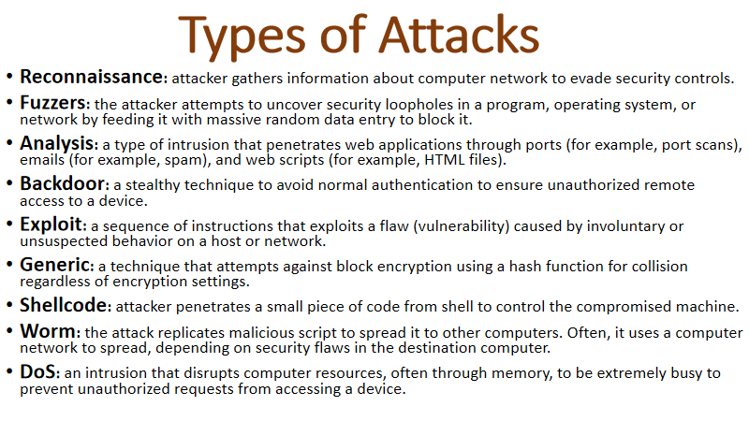

Slide 8
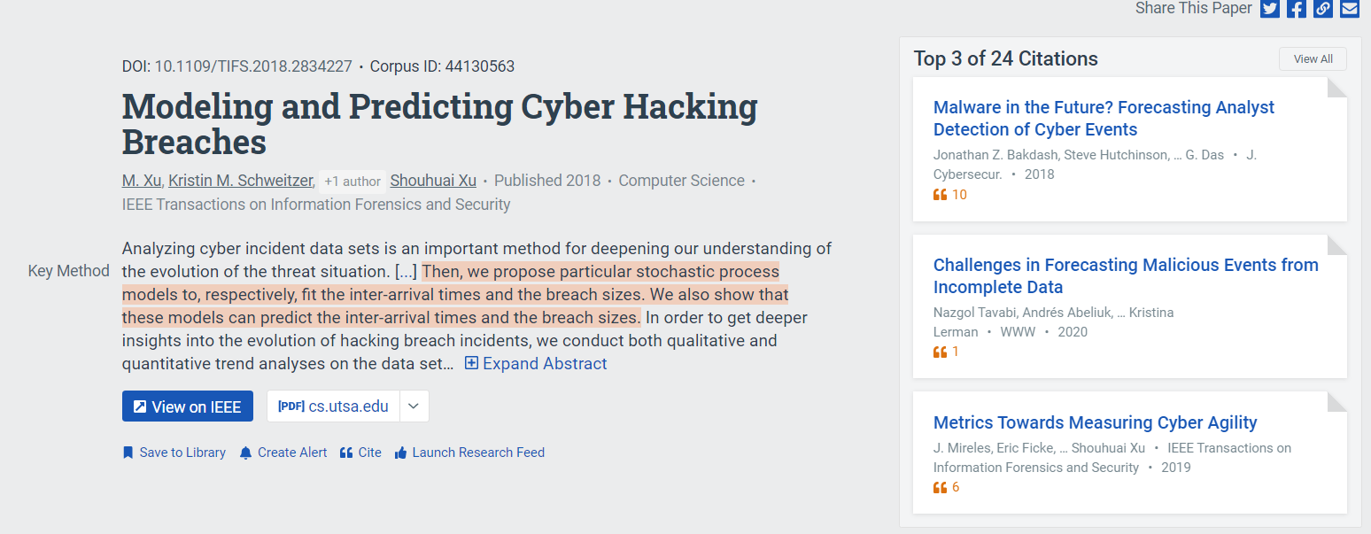
Reference followed:

Slide 9
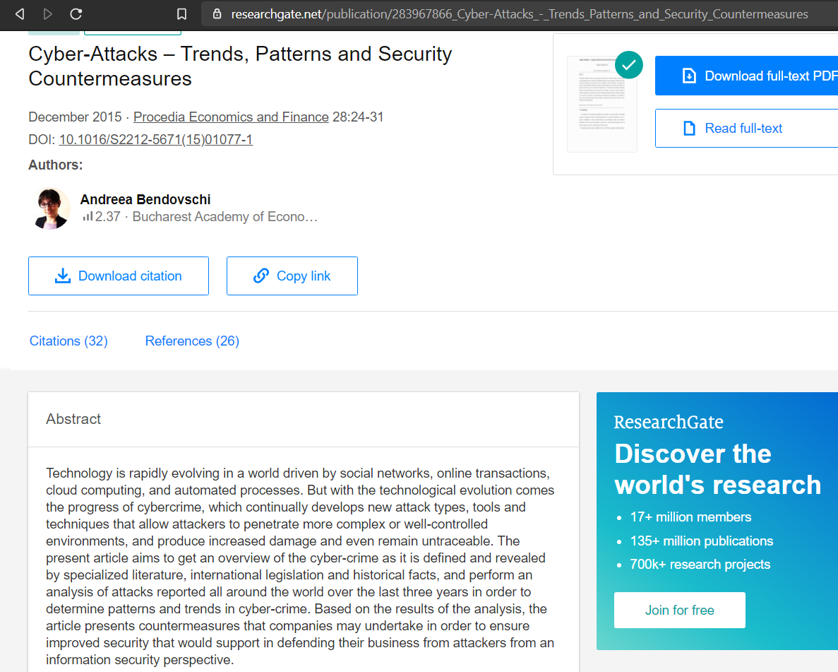

Slide 10
STEPS of our Work-Flow:
DATA COLLECTION
DATA PRE-PROCESSING
( Loading, Dependent and in-dependent Features)
>>Filling Missing data,
>>Scaling Data Transformation,
>>Encoding for categorical Values
>>And Complete Data-Visualization needed for DATA-SCIENTIST

Slide 11
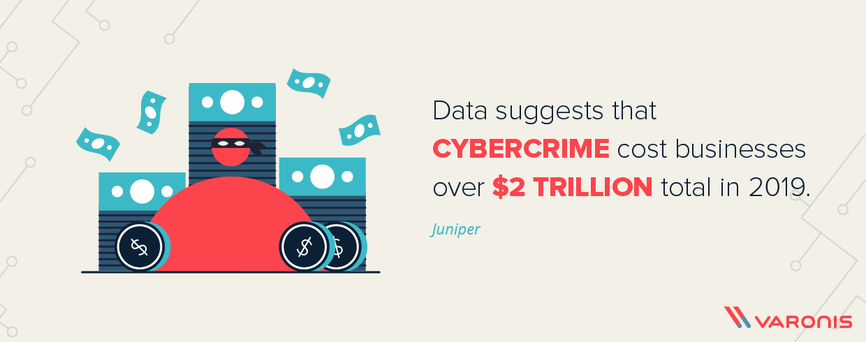
Finally our Out-COME
We can have an idea of the Up-coming Breachs:

