Slide 1

S.C.A.R.D
VISHNU vardhan reddy .k

Slide 2
TABLE OF CONTENTS
Abstract
Introduction
System Requirements
System Architecture
Dataset and Model Training
Methodology
Conclusion

Slide 3
Abstract
Artificial intelligence has captivated the healthcare industry, as multiple studies have indicated that AI tools can perform better than human clinicians at identifying features in images quickly and precisely. This project dubbed S.C.A.R.D [Skin Cancer Detection At Edge for Real time Diagnostics] intends in designing a “Skin Cancer Detector with AI at Edge”, where it helps not only Doctors and Dermatologists to predict the probability of skin cancer, but also for the patients and to suggest remedies to prevent further damage, connecting to forums for discussions and giving a smart search for skin specialists based on their geographic location with a very minimum hardware requirements .

Slide 4
Introduction
Skin cancer, the most common human malignancy, is primarily diagnosed visually, beginning with an initial clinical screening and followed potentially by Dermoscopic analysis, a biopsy and histopathological examination.
Automated classification of skin lesions using images is a challenging task owing to the fine-grained variability in the appearance of skin lesions. Deep convolutional neural networks show potential for general and highly variable tasks across many fine-grained object categories.
Using cloud computing for deep learning allows large datasets to be easily ingested and managed to train algorithms, and it allows deep learning models to scale efficiently and at lower costs using GPU processing power. By leveraging distributed networks, deep learning on the cloud allows you to design, develop and train deep learning applications faster.
Highly accurate Computer vision models process in cloud to perform inference. As the model inferencing is needed when a network is not available, This is where “AI at Edge” comes to play. Edge applications are used for real-time decision making and avoid sending data to cloud to perform inference. As Developing models in cloud is needed, but deploying it in Edge devices is better than centralizing the models in cloud.

Slide 5
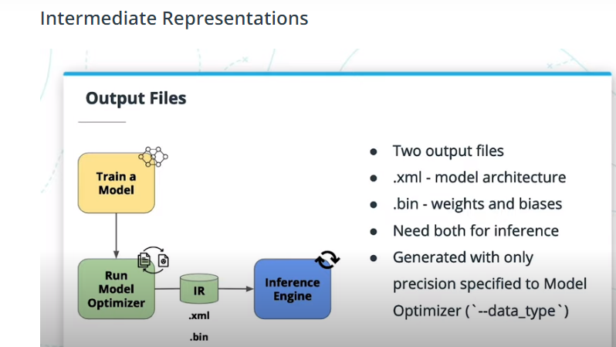
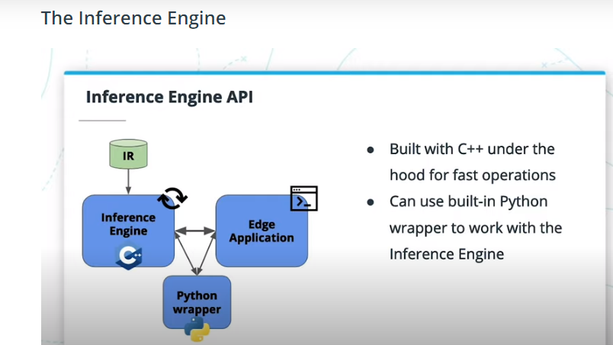
Intel’s Distribution for OpenVINO Toolkit:
OpenVINO [Open Visual Inferencing and Neural Network Optimization] An open source library useful for edge deployment due to its performance maximizations and pre-trained models.
This toolkit helps in optimizing neural network inferencing across a variety of Intel hardware and helps optimizing speed and decrease in model size for inference at Edge.
We can train a model in any Framework in cloud and give it to the Model Optimizer in OpenVINO toolkit which has the ability to convert the model to Intermediate Representation[IR] format for Inference Engine which is the main component to perform inference at Edge.

Slide 6
System Requirements
Hardware Requirements : PC or Desktop[with any intel processors], Camera, 4GB RAM[minimum]
Software Requirements : Python IDE[3.x version], Intel’s OpenVINO toolkit, Google Chrome

Slide 7
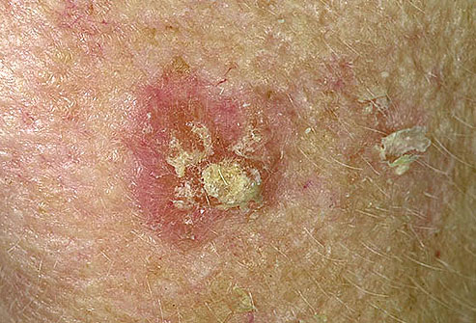
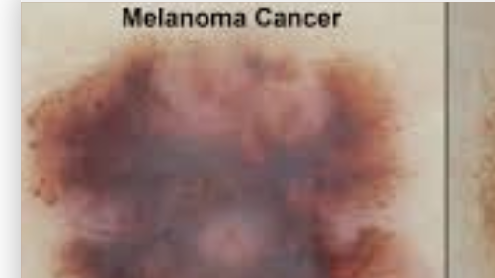
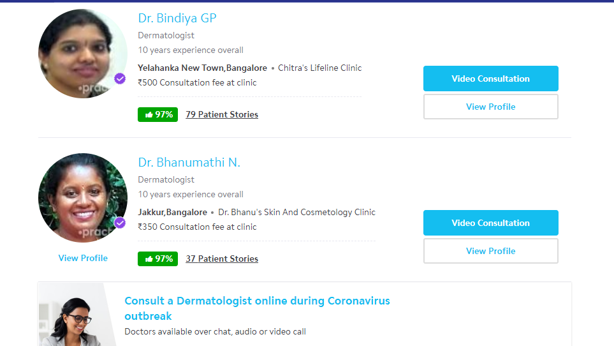
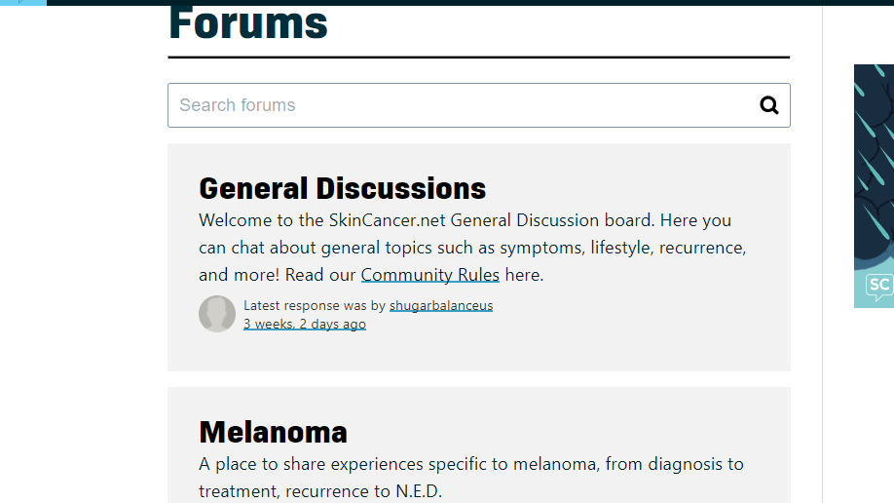
System Architecture
Identifying yourself
Patient
Doctor
List of remedies to prevent further damage
End of program
Upload the pic of infected area
Predict probability of skin cancer
Suggesting remedies
Doctor
Patient
Connect to forums which offers discussions
Forums or skin specialist nearby
Smart search for skin specialist nearby

Slide 8
Dataset and Model Training
nvidia-smi
nvidia-smi
nvidia-smi
Choosing a dataset is important for a problem statement. The Skin Cancer : Benign vs Malignant dataset, a large collection of multi-source dermatoscopic images of common pigmented skin lesions by “Kaggle”.
The dataset contains the important categories such as : Actinic keratoses[akiec], basal cell carcinoma[bcc], benign keratosis-like lesions[bkl], dermatofibroma [df], melanocytic nevi[nv], melanoma[mel] and vascular lesions[vasc], for cancer estimation in these lesions.
Kaggle Kernel a Jupyter notebook environment which offers free [Intel Xeon core CPU and a NVIDIA-SMI GPU along with 25.3GB Ram for 9 hours] to help disseminate machine learning education and research.
As we know Keras is a famous Deep Learning Framework due to its flexibility, we will use it for training the model on the Skin Cancer : Benign vs Malignant dataset in Kaggle Kernel.
Now we are all set to Train the model in the cloud, Save the model which has the best accuracy after testing it on test data, Convert the model using OpenVINO and deploy it in our application to perform faster inference on the Edge/local device with basic Intel processors .

Slide 9
Methodology
We have our trained model converted in IR format with the help of OpenVINO, and it is ready to get deployed in the application.
This application is specifically designed for both Doctors and patients, So the user has to identify themselves either as a Doctor or a patient, this identification is used for the latter part of the application.
After identification, the user is asked to either upload the image of the lesion on their skin from PC or take a picture using webcam. This image is then passed on to the model to perform inference and gives a probability of having cancer within seconds.
After the prediction, the program automatically opens a document which has suggestions, Remedies to prevent further damage on your skin.

Slide 10
As this application is both designed for Doctor as well as for Patient, Here's where the Identification plays the role.
This application further extends to patients offering smart features such as connecting to forums for open discussions on skin cancer or smart search for skin specialists based on the user's geographic location.
If the user chooses to connect to forums, the application automatically directs the user to SkinCancer.net forums, SkinCancer.net community is a highly recommended forum which offers genuine discussions about skin cancer from worldwide.
Else if the user chooses a smart search for skin specialists nearby, the application asks the user to enter their current location i.e.,[Current Area, City].
And based on the location provided, the application searches for skin specialists on that location in Practo and direct the users to the webpage , Practo is India’s leading platform which connects the patients directly with Doctors either through Phone calls or a one-on-one appointments.
This application is completely designed with a beautiful front-end GUI for User Interation with the help of python GUI tool “Tkinter”.

Slide 11
Conclusion
S.C.A.R.D is a skin cancer detector which uses the complete power of the latest and trending technologies, "AI at edge". why Edge?, Edge computing provides the On-premise deployment of the models instead of centralizing it in the cloud, It provides Data security, cutting down the costs of investment on cloud technologies such as [AWS, Azure, GCP] .
Healthcare data is one of the most sensitive data and sending such data across someone else's cloud servers for processing is a voilation of patient’s privacy even though the Cloud Service Providers doesn't use your data, and it is costly for its monthly subscriptions. This application introduces Edge deployment of models which is a one time investment with state of the art performance and promises accurate results with very less time and without any external hardware.
And this is just the tip of the iceberg, as we know that Stanford has created a deep learning model which is able to classify skin cancer better than dermatologists. Deploying such models at Edge will help doctors to get quick insights about the skin lesion of the patient’s.
Running highly advanced deep learning models on Edge devices such as [PC’s or Laptop’s which has the ability to run complex softwares] is better than Mobile devices, And Rural parts of India does not either have enough skin specialists or Smartphones to search for treatment of the skin lesions, In such places, these systems can help lots of people with ease, even without any network connectivity with very less investments.

Slide 12
Thank You

