Slide 1
Workflows
Version 2.0
(after Alex‘ and Risav‘s feedback)

Slide 2
Abstract Spsht Doc
Ontology O_{S}
Spreadsheet Player A
Sally
Spreadsheet Doc S
Abstract Spreadsheet Doc D_{S}
Worksheet S1

Slide 3
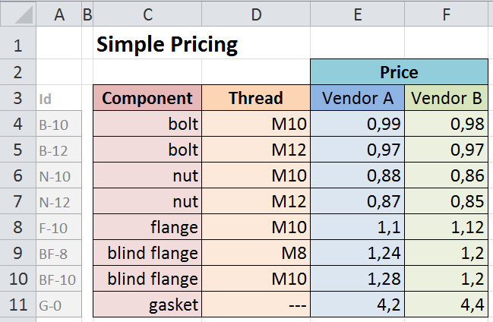
Terminology for the SimplePricing Spsht
„blocks“
A := [C4:C11]
B := [D4:D11]
C := [E4:F11]
D := [E3:F3]
I := [Xn:Ym] (visible as [A4:A11])
„relations“
„ASM
(CSM)“
(Abstract/ Concrete Spreadsheet Model)
r₁ := label[A]
r₂ := label[B]
r₃ := label[C]
r₄ := label[D]
r_{4b} := label[D]
r₅ := label[I]
r_{6a} := funcBlock[A,B,D;C]
r_{6b} := funcBlock[I,D;C]
„functional blocks“
}
„IM“ (Interpretation Mapping)
„value interpretations“
valueInt (B):= Parser_{Threads}
valueInt(C) := Parser_{Price}
„links“
link(r₁):=„https://tnt.kwarc.info/repos/stc/fcad/flange/cds/components.omdoc?component?component“
link(r₂):=„https://tnt.kwarc.info/repos/stc/fcad/flange/cds/ISOmetricthread.omdoc?ISOmetricthread?sISOhexthread“
link(r₃):=„https://tnt.kwarc.info/repos/stc/fcad/flange/cds/cost.omdoc?cost?cost“
link (r₄):=„https://tnt.kwarc.info/repos/stc/fcad/flange/cds/vendor.omdoc?vendor?vendor“
link (r_{4b}):=„https://tnt.kwarc.info/repos/stc/fcad/flange/cds/stakeholder.omdoc?stakeholder?stakeholder"
link(r₅):=„https://tnt.kwarc.info/repos/stc/fcad/flange/cds/partnumber.omdoc?partnumber?part-number“
link(r_{6a}):=„https://tnt.kwarc.info/repos/stc/fcad/flange/cds/vendorprices.omdoc?vendorBasedPriceFunction?compVBPrice“
link(r_{6b}):=„https://tnt.kwarc.info/repos/stc/fcad/flange/cds/vendorprices.omdoc?vendorBasedPriceFunction?partNoVBPrice“

Slide 4
„Project“ Files
Content e.g. „Bolts and Nuts“
Ontology Preferences
Document-Ontologies (standard), e.g. the Spreadsheet-Ontology with definition „depends-on“, maybe this is more general)
Finances-Ontology → Prices-Theory, Vendor-Theory
Construction-Ontology → Bolts-Theory, Nuts-Theory
Frame Environments
Pricing (e.g. Spreadsheets „Pricing“ + „Contract“)
Construction (e.g. CAD doc „Pipe Ends“)

Slide 5
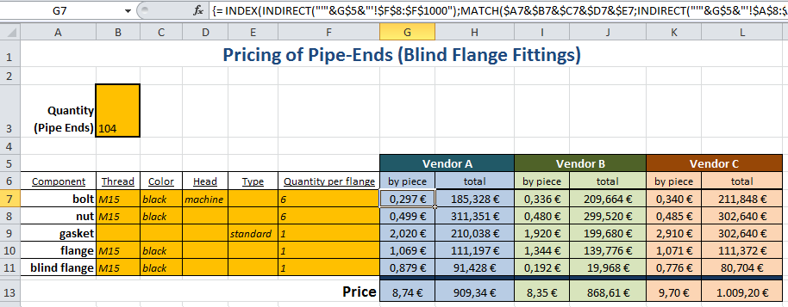
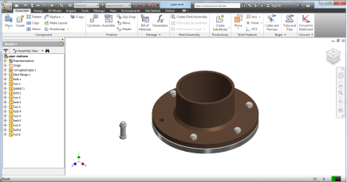
„Project“ Files
„Pricing“
Sally
„PricingSimple“
Give me all the frames!
„Contract“
Give me all the „relations“!
Configuration Service
Give me all the „concepts“!
Planetary
(as ontology editor)
MMT
„CAD doc“

Slide 6
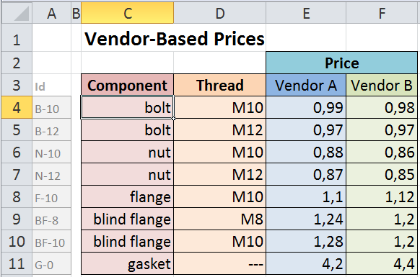
„The“ Editor = A Semantification Editor = „S-Editor“
Version 1.0
Blocks
Relations
Actions
Undo
Redo
Auto
Delete
Join
Value
Worksheets
Meaning
Block
Cell Range
Actions
C4
:
add
vendor
e.g. IsoHexThread
e.g. Thread
e.g. A4:A11
customer

Slide 7
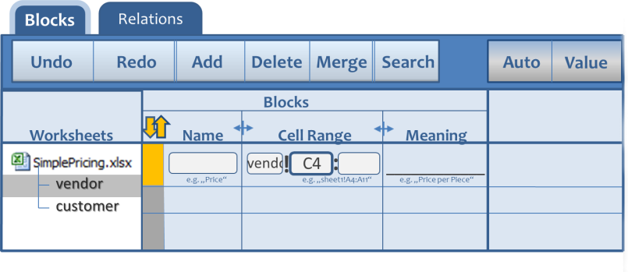
„The“ Editor = A Semantification Editor = „S-Editor“
Version 2.0

Slide 8



„The“ Editor = A Semantification Editor = „S-Editor“
Latest Version
Blocks
Relations
Undo
Redo
Add
Delete
Merge
Auto
Value
Blocks
Worksheets
Name
Cell Range
Concept
!
C4
:
____________
vendor
e.g. „Price“
e.g. „sheet1!A4:A11“
e.g. „Price per Piece“
customer
e.g. Thread

Slide 9



„The“ Editor = A Semantification Editor = „S-Editor“
First View
Context: The user clicked „S-Editor“ in the context menu;
spsht-focus = `[SimplePricing]vendor´!C4
Blocks
Relations
Undo
Redo
Add
Delete
Merge
Auto
Value
Blocks
Worksheets
Name
Cell Range
Concept
!
C4
:
____________
vendor
e.g. „Price“
e.g. „sheet1!A4:A11“
e.g. „Price per Piece“
customer
e.g. Thread

Slide 10
„The“ Editor = A Semantification Editor = „S-Editor“
Block Selection
Context: The user hovered over the first column;
spsht-focus = `[SimplePricing]vendor´!C4
Blocks
Relations
Undo
Redo
Add
Delete
Merge
Auto
Value
Select block!
Blocks
Worksheets
Name
Cell Range
Concept
!
C4
:
____________
vendor
e.g. „Price“
e.g. „sheet1!A4:A11“
e.g. „Price per Piece“
customer
e.g. Thread

Slide 11
„The“ Editor = A Semantification Editor = „S-Editor“
Context: The user clicked on the yellow field in the first column;
spsht-focus = `[SimplePricing]vendor´!C4
Blocks
Relations
Undo
Redo
Add
Delete
Merge
Auto
Value
Blocks
Worksheets
Name
Cell Range
Concept
!
C4
:
____________
vendor
e.g. „Price“
e.g. „sheet1!A4:A11“
e.g. „Price per Piece“
customer
e.g. Thread

Slide 12
„The“ Editor = A Semantification Editor = „S-Editor“
Create a Block
Context: Point of Departure;
spsht-focus = `[SimplePricing]vendor´!C4
Blocks
Relations
Undo
Redo
Add
Delete
Merge
Auto
Value
Blocks
Worksheets
Name
Cell Range
Concept
!
C4
:
____________
vendor
e.g. „Price“
e.g. „sheet1!A4:A11“
e.g. „Price per Piece“
customer

Slide 13
„The“ Editor = A Semantification Editor = „S-Editor“
Context: The user hovers over the range input field;
spsht-focus = `[SimplePricing]vendor´!C4
Blocks
Relations
Undo
Redo
The cell range of the block;
Doubleclick: access range in spreadsheet!
Add
Delete
Merge
Auto
Value
Blocks
Worksheets
Name
Cell Range
Concept
!
C4
:
____________
vendor
e.g. „Price“
e.g. „sheet1!A4:A11“
e.g. „Price per Piece“
customer
e.g. Thread

Slide 14
„The“ Editor = A Semantification Editor = „S-Editor“
Context: The user double-clicked the range input field;
spsht-focus = `[SimplePricing]vendor´!C4

Slide 15
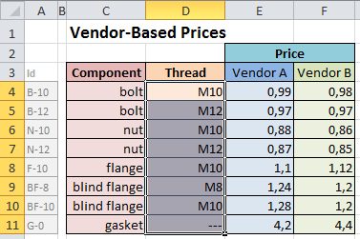
„The“ Editor = A Semantification Editor = „S-Editor“
Context: The user selects range D4:D11;
spsht-focus = `[SimplePricing]vendor´!C4

Slide 16
„The“ Editor = A Semantification Editor = „S-Editor“
Context: The user clicked the S-Editor panel (frame shift);
spsht-focus = `[SimplePricing]vendor´!D4:D11
Blocks
Relations
Undo
Redo
Add
Delete
Merge
Auto
Value
Blocks
Worksheets
Name
Cell Range
Concept
!
D4
:
D11
____________
vendor
e.g. „Price“
e.g. „sheet1!A4:A11“
e.g. „Price per Piece“
customer

Slide 17
„The“ Editor = A Semantification Editor = „S-Editor“
Context: The user hovers over the name input field;
spsht-focus = `[SimplePricing]vendor´!D4:D11
Blocks
Relations
Undo
Redo
Add
Delete
Merge
The name of the block!
Auto
Value
Blocks
Worksheets
Name
Cell Range
Concept
!
D4
:
D11
____________
vendor
e.g. „Price“
e.g. „sheet1!A4:A11“
e.g. „Price per Piece“
customer

Slide 18
„The“ Editor = A Semantification Editor = „S-Editor“
Context: The user clicked the name input field;
spsht-focus = `[SimplePricing]vendor´!D4:D11
Blocks
Relations
Undo
Redo
Add
Delete
Merge
Auto
Value
Blocks
Worksheets
Name
Cell Range
Concept
!
D4
:
D11
____________
vendor
e.g. „Price“
e.g. „sheet1!A4:A11“
e.g. „Price per Piece“
customer

Slide 19
„The“ Editor = A Semantification Editor = „S-Editor“
Context: The user typed in „Thread“;
spsht-focus = `[SimplePricing]vendor´!D4:D11
Blocks
Relations
Undo
Redo
Add
Delete
Merge
Auto
Value
Blocks
Worksheets
Name
Cell Range
Concept
Thread
!
D4
:
D11
____________
vendor
e.g. „Price“
e.g. „sheet1!A4:A11“
e.g. „Price per Piece“
customer

Slide 20
„The“ Editor = A Semantification Editor = „S-Editor“
Context: The user hovers over the meaning input field;
spsht-focus = `[SimplePricing]vendor´!D4:D11
Blocks
Relations
Undo
Redo
Add
Delete
Merge
Auto
Value
Formal concept assigned to block;
Doubleclick: Access concept pool!
Blocks
Worksheets
Name
Cell Range
Concept
Thread
!
D4
:
D11
_________
vendor
e.g. „Price“
e.g. „sheet1!A4:A11“
e.g. „Price per Piece“
customer

Slide 21
„The“ Editor = A Semantification Editor = „S-Editor“
Context: The user clicked on the meaning input field;
spsht-focus = `[SimplePricing]vendor´!D4:D11
Blocks
Relations
Undo
Redo
Add
Delete
Merge
Auto
Value
Blocks
Worksheets
Name
Cell Range
Concept
Thread
!
D4
:
D11
_________
vendor
e.g. „Price“
e.g. „sheet1!A4:A11“
e.g. „Price per Piece“
customer

Slide 22
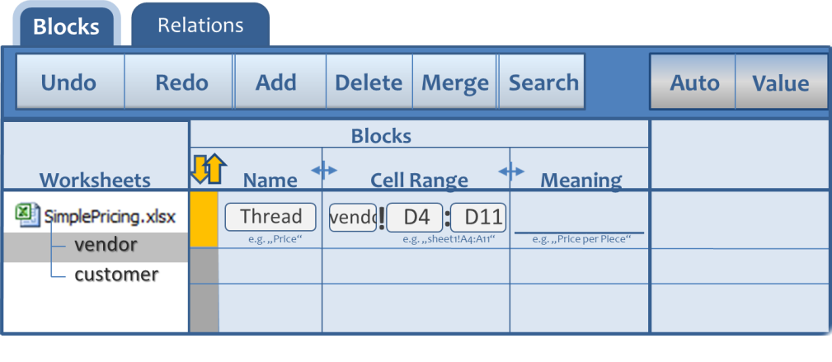
„The“ Editor = A Semantification Editor = „S-Editor“
Context: The user double-clicked in the meaning input field;s
psht-focus =[SimplePricing]vendor´!D4:D11
Planetary
(as ontology editor)

Slide 23
„The“ Editor = A Semantification Editor = „S-Editor“
Context: The user selected the concept with the title „IsoHexThread“ in the ontology editor;
spsht-focus = `[SimplePricing]vendor´!D4:D11
Blocks
Relations
Undo
Redo
Add
Delete
Merge
Auto
Value
Blocks
Worksheets
Name
Cell Range
Concept
!
D4
:
D11
_________
Thread
IsoHexThread
vendor
e.g. „Price“
e.g. „sheet1!A4:A11“
e.g. „Price per Piece“
customer

Slide 24
„The“ Editor = A Semantification Editor = „S-Editor“
Add Button
Context: The user is about to click the „Add button“;
spsht-focus = `[SimplePricing]vendor´!D4:D11
Blocks
Relations
Undo
Redo
Add
Delete
Merge
Auto
Value
Blocks
Worksheets
Name
Cell Range
Concept
Thread
!
D4
:
D11
IsoHexThread
____________
vendor
e.g. „Price“
e.g. „sheet1!A4:A11“
e.g. „Price per Piece“
customer

Slide 25
„The“ Editor = A Semantification Editor = „S-Editor“
Context: The user clicked the „Add button“;
spsht-focus = `[SimplePricing]vendor´!D4:D11
Blocks
Relations
Undo
Redo
Add
Delete
Merge
Auto
Value
Blocks
Worksheets
Name
Cell Range
Concept
!
D4
:
D11
____________
vendor
e.g. „Price“
e.g. „sheet1!A4:A11“
e.g. „Price per Piece“
customer
Thread
!
D4
:
D11
IsoHexThread
____________

Slide 26
„The“ Editor = A Semantification Editor = „S-Editor“
Delete Button
Context: The user is about to click the „Delete button“;
spsht-focus = `[SimplePricing]vendor´!D4:D11
Blocks
Relations
Undo
Redo
Add
Delete
Merge
Auto
Value
Blocks
Worksheets
Name
Cell Range
Concept
!
D4
:
D11
____________
vendor
e.g. „Price“
e.g. „sheet1!A4:A11“
e.g. „Price per Piece“
customer
Thread
!
D4
:
D11
IsoHexThread
____________

Slide 27
„The“ Editor = A Semantification Editor = „S-Editor“
Context: The user clicked the „Delete button“;
spsht-focus = `[SimplePricing]vendor´!D4:D11
Blocks
Relations
Undo
Redo
Add
Delete
Merge
Auto
Value
Blocks
Worksheets
Name
Cell Range
Concept
Thread
!
D4
:
D11
IsoHexThread
____________
vendor
e.g. „Price“
e.g. „sheet1!A4:A11“
e.g. „Price per Piece“
customer

Slide 28
„The“ Editor = A Semantification Editor = „S-Editor“
Auto Button
Context: The user is about to click the „Auto“-Button“;
spsht-focus = `[SimplePricing]vendor´!D4:D11
Blocks
Relations
Undo
Redo
Add
Delete
Merge
Auto
Value
Blocks
Worksheets
Name
Cell Range
Concept
Thread
!
D4
:
D11
IsoHexThread
____________
vendor
e.g. „Price“
e.g. „sheet1!A4:A11“
e.g. „Price per Piece“
customer

Slide 29
„The“ Editor = A Semantification Editor = „S-Editor“
Context: The user hovers about the „Auto“-Button“;
spsht-focus = `[SimplePricing]vendor´!D4:D11
Blocks
Relations
Undo
Redo
Add
Delete
Merge
Auto
Value
Blocks
Suggest blocks automatically!
Worksheets
Name
Cell Range
Concept
Thread
!
D4
:
D11
IsoHexThread
____________
vendor
e.g. „Price“
e.g. „sheet1!A4:A11“
e.g. „Price per Piece“
customer

Slide 30

„The“ Editor = A Semantification Editor = „S-Editor“
Context: The user clicked the „Auto“-Button“;
spsht-focus = `[SimplePricing]vendor´!D4:D11
Blocks
Relations
Undo
Redo
Add
Delete
Merge
Auto
Value
Blocks
Suggested Blocks
Worksheets
Name
Cell Range
Concept
ok
!
C4
:
C11
reject/accept
___________
vendor
!
D4
:
D11
reject/accept
___________
customer
!
E4
:
E11
reject/accept
___________
!
F4
:
F11
reject/accept
___________
Thread
!
D4
:
D11
IsoHexThread
____________

Slide 31
„The“ Editor = A Semantification Editor = „S-Editor“
Context: The user rejected the D4:D11 block and accepted the others;
spsht-focus = `[SimplePricing]vendor´!D4:D11
Blocks
Relations
Undo
Redo
Add
Delete
Merge
Auto
Value
Blocks
Suggested Blocks
Worksheets
Name
Cell Range
Concept
ok
!
C4
:
C11
reject/accept
___________
vendor
!
D4
:
D11
reject/accept
___________
customer
!
E4
:
E11
reject/accept
___________
!
F4
:
F11
reject/accept
___________
Thread
!
D4
:
D11
IsoHexThread
____________

Slide 32

„The“ Editor = A Semantification Editor = „S-Editor“
Context: The user clicks the „ok“-button;
spsht-focus = `[SimplePricing]vendor´!D4:D11
Blocks
Relations
Undo
Redo
Add
Delete
Merge
Auto
Value
Blocks
Worksheets
Name
Cell Range
Concept
!
C4
:
C11
___________
vendor
!
E4
:
E11
___________
customer
!
F4
:
F11
___________
Thread
!
D4
:
D11
IsoHexThread
____________

Slide 33
„The“ Editor = A Semantification Editor = „S-Editor“
Value Button
Context: The user is about to click the „Value“-button;
spsht-focus = `[SimplePricing]vendor´!D4:D11
Blocks
Relations
Undo
Redo
Add
Delete
Merge
Auto
Value
Blocks
Worksheets
Name
Cell Range
Concept
!
C4
:
C11
___________
vendor
!
E4
:
E11
___________
customer
!
F4
:
F11
___________
Thread
!
D4
:
D11
IsoHexThread
____________

Slide 34
„The“ Editor = A Semantification Editor = „S-Editor“
Context: The user hovers about the „Value“-button;
spsht-focus = `[SimplePricing]vendor´!D4:D11
Blocks
Relations
Undo
Redo
Add
Delete
Merge
Auto
Value
Blocks
Determine how to interpret the values in this block!
Worksheets
Name
Cell Range
Meaning
!
C4
:
C11
___________
vendor
!
E4
:
E11
___________
customer
!
F4
:
F11
___________
Thread
!
D4
:
D11
IsoHexThread
____________

Slide 35
„The“ Editor = A Semantification Editor = „S-Editor“
Context: The user clicked the „Value“-button;
spsht-focus = `[SimplePricing]vendor´!D4:D11
Blocks
Relations
Undo
Redo
Add
Delete
Merge
Auto
Value
Blocks
Interpretation of Values
Worksheets
Name
Cell Range
Concept
ok
!
C4
:
C11
___________
value as is
vendor
!
E4
:
E11
___________
value as is
customer
!
F4
:
F11
___________
value as is
Thread
!
D4
:
D11
IsoHexThread
as Thread
____________

Slide 36
„The“ Editor = A Semantification Editor = „S-Editor“
Context: The user changed the „Value“-dropdown menu in the second row to „in hundreds“;
spsht-focus = `[SimplePricing]vendor´!D4:D11
Blocks
Relations
Undo
Redo
Add
Delete
Merge
Auto
Value
Blocks
Interpretation of Values
Worksheets
Name
Cell Range
Concept
ok
!
C4
:
C11
value as is
___________
vendor
!
E4
:
E11
in hundreds
___________
customer
!
F4
:
F11
___________
value as is
Thread
!
D4
:
D11
IsoHexThread
as Thread
____________

Slide 37
„The“ Editor = A Semantification Editor = „S-Editor“
Context: The user clicked the „ok“-button;
spsht-focus = `[SimplePricing]vendor´!D4:D11
Blocks
Relations
Undo
Redo
Add
Delete
Merge
Auto
Value
Blocks
Worksheets
Name
Cell Range
Concept
!
C4
:
C11
___________
vendor
!
E4
:
E11
___________
customer
!
F4
:
F11
___________
Thread
!
D4
:
D11
IsoHexThread
____________

Slide 38
„The“ Editor = A Semantification Editor = „S-Editor“
Merge 2 blocks
Context: The user is about to use the „Merge“-button;
spsht-focus = `[SimplePricing]vendor´!D4:D11
Blocks
Relations
Undo
Redo
Add
Delete
Merge
Auto
Value
Blocks
Worksheets
Name
Cell Range
Concept
!
C4
:
C11
Comp
___________
vendor
Price-A
!
E4
:
E11
___________
Vendor based P
customer
Price-B
!
F4
:
F11
Vendor based P
___________
Thread
!
D4
:
D11
IsoHexThread
____________

Slide 39
„The“ Editor = A Semantification Editor = „S-Editor“
Context: The user selected 2 blocks;
spsht-focus = `[SimplePricing]vendor´!D4:D11
Blocks
Relations
Undo
Redo
Add
Delete
Merge
Auto
Value
Blocks
Worksheets
Name
Cell Range
Concept
!
C4
:
C11
Comp
___________
vendor
Price-A
!
E4
:
E11
___________
Vendor based P
customer
Price-B
!
F4
:
F11
Vendor based P
___________
Thread
!
D4
:
D11
IsoHexThread
____________

Slide 40
„The“ Editor = A Semantification Editor = „S-Editor“
Context: The user clicked the „Merge“-button;
spsht-focus = `[SimplePricing]vendor´!D4:D11
Blocks
Relations
Undo
Redo
Add
Delete
Merge
Auto
Value
Blocks
Worksheets
Name
Cell Range
Concept
!
C4
:
C11
Comp
___________
vendor
Price-A-P
!
E4
:
E11
___________
Vendor based P
customer
!
F4
:
F11
Thread
!
D4
:
D11
IsoHexThread
____________

Slide 41
„The“ Editor = A Semantification Editor = „S-Editor“
Context: The user selected 2 blocks;
spsht-focus = `[SimplePricing]vendor´!D4:D11
Blocks
Relations
Undo
Redo
Add
Delete
Merge
Auto
Value
Blocks
Worksheets
Name
Cell Range
Concept
!
C4
:
C11
Comp
___________
vendor
Price-A
!
E4
:
E11
___________
Vendor based P
customer
Price-B
!
F4
:
F11
Vendor based P
___________
Thread
!
D4
:
D11
IsoHexThread
____________

Slide 42
„The“ Editor = A Semantification Editor = „S-Editor“
Context: The user selected 2 blocks;
spsht-focus = `[SimplePricing]vendor´!D4:D11
Blocks
Relations
Undo
Redo
Add
Delete
Merge
Auto
Value
Blocks
Worksheets
Name
Cell Range
Concept
!
C4
:
C11
Comp
___________
vendor
!
E4
:
E11
Price-A-
Thread
___________
customer
:
!
D4
D11
Price-B
!
F4
:
F11
Vendor based P
___________

Slide 43
„The“ Editor = A Semantification Editor = „S-Editor“
Search Button
Context: The user is about to click the „Search“-button;
spsht-focus = `[SimplePricing]vendor´!D4:D11
Blocks
Relations
Undo
Redo
Add
Delete
Merge
Auto
Value
Blocks
Worksheets
Name
Cell Range
Concept
!
C4
:
C11
Comp
___________
vendor
Price-A
!
E4
:
E11
___________
Vendor based P
customer
Price-B
!
F4
:
F11
Vendor based P
___________
Thread
!
D4
:
D11
IsoHexThread
____________

Slide 44
„The“ Editor = A Semantification Editor = „S-Editor“
Search Button:
Name
Context: The user clicked the „Search“-button;
spsht-focus = `[SimplePricing]vendor´!D4:D11
Blocks
Relations
Undo
Redo
Add
Delete
Merge
Auto
Value
Blocks
ok
Worksheets
Name
Cell Range
Concept
!
C4
:
C11
Comp
___________
vendor
Price-A
!
E4
:
E11
___________
Vendor based P
customer
Price-B
!
F4
:
F11
Vendor based P
___________
Thread
!
D4
:
D11
IsoHexThread
____________

Slide 45
„The“ Editor = A Semantification Editor = „S-Editor“
Context: The typed „Pr“ in the search input field;
spsht-focus = `[SimplePricing]vendor´!D4:D11
Blocks
Relations
Undo
Redo
Add
Delete
Merge
Auto
Value
Pr
Blocks
ok
Name
Meaning
Cell Range
Cell Range
Cell Range
Meaning
Worksheets
Name
Meaning
Name
Price-A
Price-B
Vendor based Price
Vendor based Price
vendor!E4:E11
:
!
:
C11
C4
C11
Comp
C4
vendor!F4:F11
Comp
___________
___________
vendor
Price-A
!
E4
:
E11
___________
Vendor based P
customer
Price-B
!
F4
:
F11
Vendor based P
___________
Thread
!
D4
:
D11
IsoHexThread
____________

Slide 46
„The“ Editor = A Semantification Editor = „S-Editor“
Context: The user selected „Price-B“ ;
spsht-focus = `[SimplePricing]vendor´!D4:D11
Blocks
Relations
Undo
Redo
Add
Delete
Merge
Auto
Value
Price-B
Blocks
ok
Worksheets
Name
Cell Range
Concept
!
C4
:
C11
Comp
___________
vendor
Price-A
!
E4
:
E11
___________
Vendor based P
customer
Price-B
!
F4
:
F11
Vendor based P
___________
Thread
!
D4
:
D11
IsoHexThread
____________

Slide 47
„The“ Editor = A Semantification Editor = „S-Editor“
Context: The user clicked the „ok“-button;
spsht-focus = `[SimplePricing]vendor´!D4:D11
Blocks
Relations
Undo
Redo
Add
Delete
Merge
Auto
Value
Blocks
Worksheets
Name
Cell Range
Concept
!
C4
:
C11
Comp
___________
vendor
Price-A
!
E4
:
E11
___________
Vendor based P
customer
Price-B
!
F4
:
F11
Vendor based P
___________
Thread
!
D4
:
D11
IsoHexThread
____________

Slide 48
„The“ Editor = A Semantification Editor = „S-Editor“
Context: The user clicked the „Search“-button;
spsht-focus = `[SimplePricing]vendor´!D4:D11
Blocks
Relations
Undo
Redo
Add
Delete
Merge
Auto
Value
Blocks
ok
Worksheets
Name
Cell Range
Concept
!
C4
:
C11
Comp
___________
vendor
Price-A
!
E4
:
E11
___________
Vendor based P
customer
Price-B
!
F4
:
F11
Vendor based P
___________
Thread
!
D4
:
D11
IsoHexThread
____________

Slide 49
„The“ Editor = A Semantification Editor = „S-Editor“
Search Button:
Meaning
Context: The user clicked the „Search“-button;
spsht-focus = `[SimplePricing]vendor´!D4:D11
Blocks
Relations
Undo
Redo
Add
Delete
Merge
Auto
Value
Blocks
ok
Worksheets
Name
Cell Range
Concept
!
C4
:
C11
Comp
___________
vendor
Price-A
!
E4
:
E11
___________
Vendor based P
customer
Price-B
!
F4
:
F11
Vendor based P
___________
Thread
!
D4
:
D11
IsoHexThread
____________

Slide 50
„The“ Editor = A Semantification Editor = „S-Editor“
Context: The typed „Ven“ in the search input field;
spsht-focus = `[SimplePricing]vendor´!D4:D11
Blocks
Relations
Undo
Redo
Add
Delete
Merge
Auto
Value
Ven
Blocks
ok
Meaning
Name
Cell Range
Worksheets
Name
Cell Range
Meaning
Vendor based Price
Vendor based Price
Price-A
Price-B
vendor!E4:E11
!
C4
:
C11
vendor!F4:F11
Comp
___________
vendor
Price-A
!
E4
:
E11
___________
Vendor based P
customer
Price-B
!
F4
:
F11
Vendor based P
___________
Thread
!
D4
:
D11
IsoHexThread
____________

Slide 51
„The“ Editor = A Semantification Editor = „S-Editor“
Context: The user selected „Vendor based Price| Price A“ ;
spsht-focus = `[SimplePricing]vendor´!D4:D11
Blocks
Relations
Undo
Redo
Add
Delete
Merge
Auto
Value
Vendor based Price
Blocks
ok
Worksheets
Name
Cell Range
Concept
!
C4
:
C11
Comp
___________
vendor
Price-A
!
E4
:
E11
___________
Vendor based P
customer
Price-B
!
F4
:
F11
Vendor based P
___________
Thread
!
D4
:
D11
IsoHexThread
____________

Slide 52
„The“ Editor = A Semantification Editor = „S-Editor“
Context: The user clicked the „ok“-button;
spsht-focus = `[SimplePricing]vendor´!D4:D11
Blocks
Relations
Undo
Redo
Add
Delete
Merge
Auto
Value
Blocks
Worksheets
Name
Cell Range
Concept
!
C4
:
C11
Comp
___________
vendor
Price-A
!
E4
:
E11
___________
Vendor based P
customer
Price-B
!
F4
:
F11
Vendor based P
___________
Thread
!
D4
:
D11
IsoHexThread
____________

Slide 53
„The“ Editor = A Semantification Editor = „S-Editor“
Search Button:
Ok-button
Context: The user clicked the „Search“-button;
spsht-focus = `[SimplePricing]vendor´!D4:D11
Blocks
Relations
Undo
Redo
Add
Delete
Merge
Auto
Value
Blocks
ok
Cell Range
Concept
Worksheets
Name
Cell Range
Meaning
Name
!
C4
:
C11
Comp
___________
vendor
Price-A
!
E4
:
E11
___________
Vendor based P
customer
Price-B
!
F4
:
F11
Vendor based P
___________
Thread
!
D4
:
D11
IsoHexThread
____________

Slide 54
„The“ Editor = A Semantification Editor = „S-Editor“
Context: The user clicked the „ok“-button;
spsht-focus = `[SimplePricing]vendor´!D4:D11
Blocks
Relations
Undo
Redo
Add
Delete
Merge
Auto
Value
Blocks
Worksheets
Name
Cell Range
Concept
!
C4
:
C11
Comp
___________
vendor
Price-A
!
E4
:
E11
___________
Vendor based P
customer
Price-B
!
F4
:
F11
Vendor based P
___________
Thread
!
D4
:
D11
IsoHexThread
____________

Slide 55
„The“ Editor = A Semantification Editor = „S-Editor“
Search Button:
x-button
Context: The user clicked the „Search“-button;
spsht-focus = `[SimplePricing]vendor´!D4:D11
Blocks
Relations
Undo
Redo
Add
Delete
Merge
Auto
Value
Blocks
ok
Cell Range
Concept
Worksheets
Name
Cell Range
Meaning
Name
!
C4
:
C11
Comp
___________
vendor
Price-A
!
E4
:
E11
___________
Vendor based P
customer
Price-B
!
F4
:
F11
Vendor based P
___________
Thread
!
D4
:
D11
IsoHexThread
____________

Slide 56
„The“ Editor = A Semantification Editor = „S-Editor“
Context: The user clicked the „x“-button;
spsht-focus = `[SimplePricing]vendor´!D4:D11
Blocks
Relations
Undo
Redo
Add
Delete
Merge
Auto
Value
Blocks
Worksheets
Name
Cell Range
Concept
!
C4
:
C11
Comp
___________
vendor
Price-A
!
E4
:
E11
___________
Vendor based P
customer
Price-B
!
F4
:
F11
Vendor based P
___________
Thread
!
D4
:
D11
IsoHexThread
____________

Slide 57
„The“ Editor = A Semantification Editor = „S-Editor“
Search Button:
Cell Range
Context: The user clicked the „Search“-button;
spsht-focus = `[SimplePricing]vendor´!D4:D11
Blocks
Relations
Undo
Redo
Add
Delete
Merge
Auto
Value
vendor
!
:
Blocks
ok
Worksheets
Name
Cell Range
Concept
!
C4
:
C11
Comp
___________
vendor
Price-A
!
E4
:
E11
___________
Vendor based P
customer
Price-B
!
F4
:
F11
Vendor based P
___________
Thread
!
D4
:
D11
IsoHexThread
____________

Slide 58
„The“ Editor = A Semantification Editor = „S-Editor“
Context: The user typed „E4“ in the active search input field;
spsht-focus = `[SimplePricing]vendor´!D4:D11
Blocks
Relations
Undo
Redo
Add
Delete
Merge
Auto
Value
vendor
!
E4
:
Blocks
ok
Cell Range
Name
Meaning
Worksheets
Name
Cell Range
Meaning
vendor!E4:E11
Price-A
Vendor based Price
!
C4
:
C11
Comp
___________
vendor
Price-A
!
E4
:
E11
___________
Vendor based P
customer
Price-B
!
F4
:
F11
Vendor based P
___________
Thread
!
D4
:
D11
IsoHexThread
____________

Slide 59
„The“ Editor = A Semantification Editor = „S-Editor“
Context: The user selected „Vendor based Price| Price A“ ;
spsht-focus = `[SimplePricing]vendor´!D4:D11
Blocks
Relations
Undo
Redo
Add
Delete
Merge
Auto
Value
vendor
!
E4
:
E11
Blocks
ok
Worksheets
Name
Cell Range
Concept
!
C4
:
C11
Comp
___________
vendor
Price-A
!
E4
:
E11
___________
Vendor based P
customer
Price-B
!
F4
:
F11
Vendor based P
___________
Thread
!
D4
:
D11
IsoHexThread
____________

Slide 60
„The“ Editor = A Semantification Editor = „S-Editor“
Context: The user clicked the „ok“-button;
spsht-focus = `[SimplePricing]vendor´!D4:D11
Blocks
Relations
Undo
Redo
Add
Delete
Merge
Auto
Value
Blocks
Worksheets
Name
Cell Range
Concept
!
C4
:
C11
Comp
___________
vendor
Price-A
!
E4
:
E11
___________
Vendor based P
customer
Price-B
!
F4
:
F11
Vendor based P
___________
Thread
!
D4
:
D11
IsoHexThread
____________

Slide 61
„The“ Editor = A Semantification Editor = „S-Editor“
Context: The user typed „E11“ in the active search input field;
spsht-focus = `[SimplePricing]vendor´!D4:D11
Blocks
Relations
Undo
Redo
Add
Delete
Merge
Auto
Value
vendor
!
:
E11
Blocks
ok
Cell Range
Name
Meaning
Worksheets
Name
Cell Range
Meaning
vendor!E4:E11
Price-A
Vendor based Price
!
C4
:
C11
Comp
___________
vendor
Price-A
!
E4
:
E11
___________
Vendor based P
customer
Price-B
!
F4
:
F11
Vendor based P
___________
Thread
!
D4
:
D11
IsoHexThread
____________

Slide 62
„The“ Editor = A Semantification Editor = „S-Editor“
Context: The user selected „Vendor based Price| Price A“ ;
spsht-focus = `[SimplePricing]vendor´!D4:D11
Blocks
Relations
Undo
Redo
Add
Delete
Merge
Auto
Value
vendor
!
E4
:
E11
Blocks
ok
Worksheets
Name
Cell Range
Concept
!
C4
:
C11
Comp
___________
vendor
Price-A
!
E4
:
E11
___________
Vendor based P
customer
Price-B
!
F4
:
F11
Vendor based P
___________
Thread
!
D4
:
D11
IsoHexThread
____________

Slide 63
„The“ Editor = A Semantification Editor = „S-Editor“
Context: The user clicked the „ok“-button;
spsht-focus = `[SimplePricing]vendor´!D4:D11
Blocks
Relations
Undo
Redo
Add
Delete
Merge
Auto
Value
Blocks
Worksheets
Name
Cell Range
Concept
!
C4
:
C11
Comp
___________
vendor
Price-A
!
E4
:
E11
___________
Vendor based P
customer
Price-B
!
F4
:
F11
Vendor based P
___________
Thread
!
D4
:
D11
IsoHexThread
____________

Slide 64

„The“ Editor = A Semantification Editor = „S-Editor“
Column Slider
vendor
Context: The user clicked on the column slider symbol ;
spsht-focus = `[SimplePricing]vendor´!C4
Blocks
Relations
Undo
Redo
Add
Delete
Merge
Auto
Value
Blocks
Worksheets
Name
Cell Range
Meaning
!
C4
:
____________
vendor
e.g. „Price“
e.g. „sheet1!A4:A11“
e.g. „Price per Piece“
customer
e.g. Thread

Slide 65
„The“ Editor = A Semantification Editor = „S-Editor“
Context: The user moved the column slider to the left;
spsht-focus = `[SimplePricing]vendor´!C4
Blocks
Relations
Undo
Redo
Add
Delete
Merge
Auto
Value
Blocks
Worksheets
Name
Cell Range
Meaning
vendor
!
C4
:
____________
vendor
e.g. „Price“
e.g. „sheet1!A4:A11“
e.g. „Price per Piece“
customer
e.g. Thread

Slide 66
„The“ Editor = A Semantification Editor = „S-Editor“
Context: The user moved the column slider into its original position;
spsht-focus = `[SimplePricing]vendor´!C4
Blocks
Relations
Undo
Redo
Add
Delete
Merge
Auto
Value
Blocks
Worksheets
Name
Cell Range
Meaning
!
C4
:
____________
vendor
e.g. „Price“
e.g. „sheet1!A4:A11“
e.g. „Price per Piece“
customer
e.g. Thread

Slide 67
„The“ Editor = A Semantification Editor = „S-Editor“
Context: The user released the column slider symbol ;
spsht-focus = `[SimplePricing]vendor´!C4
Blocks
Relations
Undo
Redo
Add
Delete
Merge
Auto
Value
Blocks
Worksheets
Name
Cell Range
Meaning
!
C4
:
____________
vendor
e.g. „Price“
e.g. „sheet1!A4:A11“
e.g. „Price per Piece“
customer
e.g. Thread

