Slide 1
Workflows
Version 2.0
(after Alex‘ and Risav‘s feedback)

Slide 2
Abstract Spsht Doc
Ontology O_{S}
Spreadsheet Player A
Sally
Spreadsheet Doc S
Abstract Spreadsheet Doc D_{S}
Worksheet S1

Slide 3
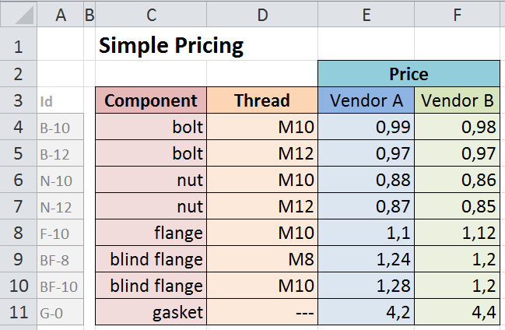
Terminology for the SimplePricing Spsht
„blocks“
A := [C4:C11]
B := [D4:D11]
C := [E4:F11]
D := [E3:F3]
I := [Xn:Ym] (visible as [A4:A11])
„relations“
„ASM
(CSM)“
(Abstract/ Concrete Spreadsheet Model)
r₁ := label[A]
r₂ := label[B]
r₃ := label[C]
r₄ := label[D]
r_{4b} := label[D]
r₅ := label[I]
r_{6a} := funcBlock[A,B,D;C]
r_{6b} := funcBlock[I,D;C]
„functional blocks“
}
„IM“ (Interpretation Mapping)
„value interpretations“
valueInt (B):= Parser_{Threads}
valueInt(C) := Parser_{Price}
„links“
link(r₁):=„https://tnt.kwarc.info/repos/stc/fcad/flange/cds/components.omdoc?component?component“
link(r₂):=„https://tnt.kwarc.info/repos/stc/fcad/flange/cds/ISOmetricthread.omdoc?ISOmetricthread?sISOhexthread“
link(r₃):=„https://tnt.kwarc.info/repos/stc/fcad/flange/cds/cost.omdoc?cost?cost“
link (r₄):=„https://tnt.kwarc.info/repos/stc/fcad/flange/cds/vendor.omdoc?vendor?vendor“
link (r_{4b}):=„https://tnt.kwarc.info/repos/stc/fcad/flange/cds/stakeholder.omdoc?stakeholder?stakeholder"
link(r₅):=„https://tnt.kwarc.info/repos/stc/fcad/flange/cds/partnumber.omdoc?partnumber?part-number“
link(r_{6a}):=„https://tnt.kwarc.info/repos/stc/fcad/flange/cds/vendorprices.omdoc?vendorBasedPriceFunction?compVBPrice“
link(r_{6b}):=„https://tnt.kwarc.info/repos/stc/fcad/flange/cds/vendorprices.omdoc?vendorBasedPriceFunction?partNoVBPrice“

Slide 4
„Project“ Files
Content e.g. „Bolts and Nuts“
Ontology Preferences
Document-Ontologies (standard), e.g. the Spreadsheet-Ontology with definition „depends-on“, maybe this is more general)
Finances-Ontology → Prices-Theory, Vendor-Theory
Construction-Ontology → Bolts-Theory, Nuts-Theory
Frame Environments
Pricing (e.g. Spreadsheets „Pricing“ + „Contract“)
Construction (e.g. CAD doc „Pipe Ends“)

Slide 5
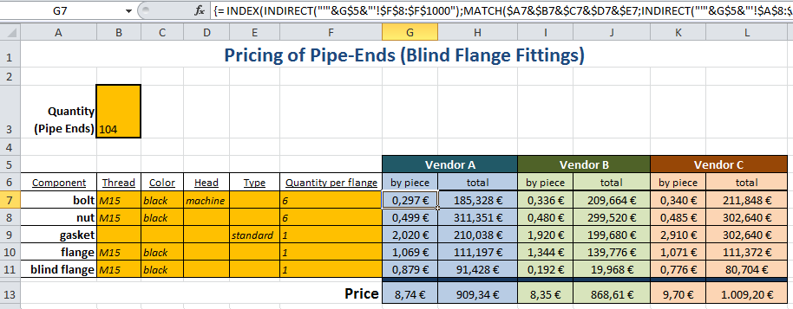
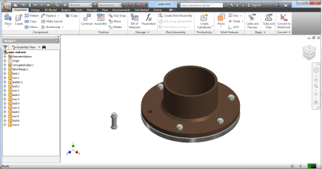
„Project“ Files
„Pricing“
Sally
„PricingSimple“
Give me all the frames!
„Contract“
Give me all the „relations“!
Configuration Service
Give me all the „concepts“!
Planetary
(as ontology editor)
MMT
„CAD doc“

Slide 6



„The“ Editor = A Semantification Editor = „S-Editor“
Latest Version for Blocks
Blocks
Relations
Undo
Redo
Add
Delete
Merge
Auto
Value
Blocks
Worksheets
Name
Cell Range
Concept
!
C4
:
____________
vendor
e.g. „Price“
e.g. „sheet1!A4:A11“
e.g. „Price per Piece“
customer

Slide 7
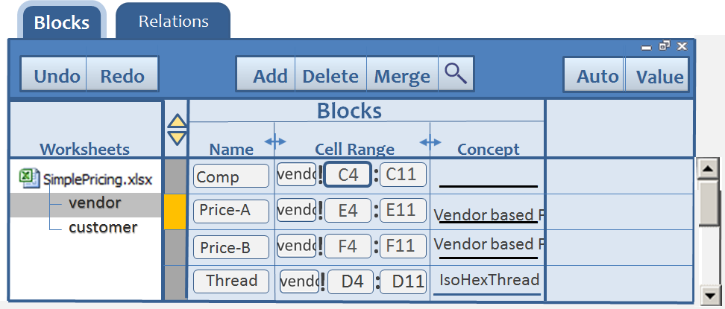
„The“ Editor = A Semantification Editor = „S-Editor“
First Version for Relations
Blocks
Relations
Undo
Redo
Add
Delete
Merge
Blocks
Worksheets
Block
Relation Type
Blocks
depends on
vendor
customer
e.g. „Price“
e.g. „sheet1!A4:A11“
e.g. „Price per Piece“

Slide 8
„The“ Editor = A Semantification Editor = „S-Editor“
First View
Context: The user worked on block creation
(focus on block „Price-A“;spsht-focus =[SimplePricing]vendor´!C4
Blocks
Relations
Undo
Redo
Refine
Add
Delete
Merge
Relations
Worksheets
Block
Relation Type
Blocks
Price-A
vendor
customer
e.g. „Price“
e.g. „sheet1!A4:A11“
e.g. „Price per Piece“

Slide 9
„The“ Editor = A Semantification Editor = „S-Editor“
First Version for Relations
Price-A
Blocks
Relations
Undo
Redo
Add
Delete
Auto
Relation for Block:
Price-A
!
E4
E11
Vendor based P
ok
Worksheets
___________
Block
Relation Type
Blocks
vendor
customer
Price-A
depends on
e.g. „Price“
e.g. „sheet1!A4:A11“
e.g. „Price per Piece“

Slide 10
„The“ Editor = A Semantification Editor = „S-Editor“
First Version for Relations
Blocks
Relations
Undo
Redo
Add
Delete
Merge
Auto
Value
Blocks
Worksheets
Name
Cell Range
Concept
!
C4
:
____________
vendor
e.g. „Price“
e.g. „sheet1!A4:A11“
e.g. „Price per Piece“
customer
e.g. Thread

