Slide 1
Workflows

Slide 2
Abstract Spsht Doc
Ontology O_{S}
Spreadsheet Player A
Sally
Spreadsheet Doc S
Abstract Spreadsheet Doc D_{S}
Worksheet S1

Slide 3
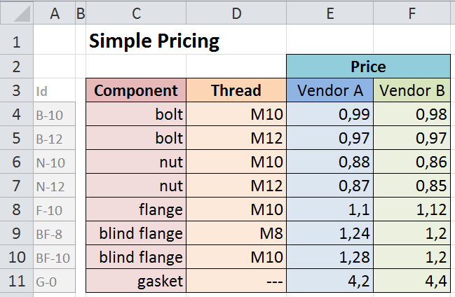
Terminology for the SimplePricing Spsht
„blocks“
A := [C4:C11]
B := [D4:D11]
C := [E4:F11]
D := [E3:F3]
I := [Xn:Ym] (visible as [A4:A11])
„relations“
„ASM
(CSM)“
(Abstract/ Concrete Spreadsheet Model)
r₁ := label[A]
r₂ := label[B]
r₃ := label[C]
r₄ := label[D]
r_{4b} := label[D]
r₅ := label[I]
r_{6a} := funcBlock[A,B,D;C]
r_{6b} := funcBlock[I,D;C]
„functional blocks“
}
„IM“ (Interpretation Mapping)
„value interpretations“
valueInt (B):= Parser_{Threads}
valueInt(C) := Parser_{Price}
„links“
link(r₁):=„https://tnt.kwarc.info/repos/stc/fcad/flange/cds/components.omdoc?component?component“
link(r₂):=„https://tnt.kwarc.info/repos/stc/fcad/flange/cds/ISOmetricthread.omdoc?ISOmetricthread?sISOhexthread“
link(r₃):=„https://tnt.kwarc.info/repos/stc/fcad/flange/cds/cost.omdoc?cost?cost“
link (r₄):=„https://tnt.kwarc.info/repos/stc/fcad/flange/cds/vendor.omdoc?vendor?vendor“
link (r_{4b}):=„https://tnt.kwarc.info/repos/stc/fcad/flange/cds/stakeholder.omdoc?stakeholder?stakeholder"
link(r₅):=„https://tnt.kwarc.info/repos/stc/fcad/flange/cds/partnumber.omdoc?partnumber?part-number“
link(r_{6a}):=„https://tnt.kwarc.info/repos/stc/fcad/flange/cds/vendorprices.omdoc?vendorBasedPriceFunction?compVBPrice“
link(r_{6b}):=„https://tnt.kwarc.info/repos/stc/fcad/flange/cds/vendorprices.omdoc?vendorBasedPriceFunction?partNoVBPrice“

Slide 4
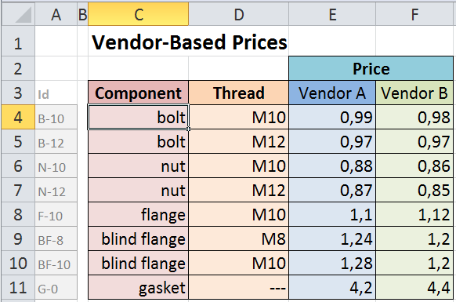
„The“ Editor = A Semantification Editor = „S-Editor“
Context: The user started the S-Editor via context menu,
spsht-focus = `[SimplePricing]vendor´!C4
Blocks
Relations
Options
Undo
Redo
Auto
Delete
Join
Value
Worksheets
Meaning
Block
Cell Range
Options
C4
:
add
vendor
e.g. IsoHexThread
e.g. Thread
e.g. A4:A11
customer

Slide 5
„The“ Editor = A Semantification Editor = „S-Editor“
Context: The user entered the block name and has double-clicked the meaning field; spsht-focus = `[SimplePricing]vendor´!C4
Blocks
Relations
Options
Undo
Redo
Auto
Delete
Join
Value
Tooltip: Doubleclick for
meaning options!
Worksheets
Meaning
Block
Cell Range
Options
Thread
C4
:
add
vendor
e.g. IsoHexThread
e.g. Thread
e.g. A4:A11
customer

Slide 6
„The“ Editor = A Semantification Editor = „S-Editor“
Context: The user selected the meaning (ontology concept) and has double-clicked the cell range field; spsht-focus = `[SimplePricing]vendor´!C4
Blocks
Relations
Options
Undo
Redo
Auto
Delete
Join
Value
Worksheets
Meaning
Block
Cell Range
Options
IsoHexThread
Thread
C4
:
add
vendor
e.g. IsoHexThread
e.g. Thread
e.g. A4:A11
customer

Slide 7
„The“ Editor = A Semantification Editor = „S-Editor“
Context: The user selected range C4:C11 in the spreadsheet and clicked (somewhere on the S-Editor);
spsht-focus = `[SimplePricing]vendor´!C4:C11
Blocks
Relations
Options
Undo
Redo
Auto
Delete
Join
Value
Worksheets
Meaning
Block
Cell Range
Options
IsoHexThread
Thread
C4
:
C11
add
vendor
e.g. IsoHexThread
e.g. Thread
e.g. A4:A11
customer

Slide 8
„The“ Editor = A Semantification Editor = „S-Editor“
Context: The user clicked on „add“ button;
spsht-focus = `[SimplePricing]vendor´!C4:C11
Blocks
Relations
Options
Undo
Redo
Auto
Delete
Join
Value
Worksheets
Meaning
Block
Cell Range
Options
IsoHexThread
Thread
C4
:
C11
vendor
C4
:
C11
add
customer
e.g. IsoHexThread
e.g. Thread
e.g. A4:A11

Slide 9
„The“ Editor = A Semantification Editor = „S-Editor“
Context: The user clicked inside the meaning (row 2) and selected „Price“ concept;
spsht-focus = `[SimplePricing]vendor´!C4:C11
Blocks
Relations
Options
Undo
Redo
Auto
Delete
Join
Value
Worksheets
Meaning
Block
Cell Range
Options
IsoHexThread
Thread
C4
:
C11
vendor
Price
:
add
customer
e.g. IsoHexThread
e.g. Thread
e.g. A4:A11

Slide 10
„The“ Editor = A Semantification Editor = „S-Editor“
Context: The user clicked inside the meaning (row 2) and selected „Price“ concept;
spsht-focus = `[SimplePricing]vendor´!C4:C11
Blocks
Relations
Options
Undo
Redo
Auto
Delete
Join
Value
Worksheets
Meaning
Block
Cell Range
Options
IsoHexThread
Thread
C4
:
C11
vendor
Vendor-Based Price
Price
E4
:
E11
customer
Vendor-Based Price
Price
F4
:
F11
:
add
e.g. IsoHexThread
e.g. Thread
e.g. A4:A11

Slide 11
„The“ Editor = A Semantification Editor = „S-Editor“
Context: The user activated „Delete“.
Blocks
Relations
Options
Undo
Redo
Auto
Delete
Join
Value
✓
Worksheets
Meaning
Block
Cell Range
Options
IsoHexThread
Thread
C4
:
C11
del
vendor
Vendor-Based Price
Price
E4
:
E11
del
customer
Vendor-Based Price
Price
F4
:
F11
del
:
add
e.g. IsoHexThread
e.g. Thread
e.g. A4:A11

Slide 12
„The“ Editor = A Semantification Editor = „S-Editor“
Context: The user activated „Join“.
Blocks
Relations
Options
Undo
Redo
Auto
Delete
Join
Value
✓
✓
Worksheets
Meaning
Block
Cell Range
Options
IsoHexThread
Thread
C4
:
C11
del
join
vendor
Vendor-Based Price
Price
E4
:
E11
del
join
customer
Vendor-Based Price
Price
F4
:
F11
del
join
:
add
join
e.g. IsoHexThread
e.g. Thread
e.g. A4:A11

Slide 13
„The“ Editor = A Semantification Editor = „S-Editor“
Context: The user activated „Value“. Note that „Delete“ and „Join“ vanish automatically.
Blocks
Relations
value as is
in millions
Options
in thousands
Undo
Redo
Auto
Delete
Join
Value
as Thread
✓
Worksheets
Meaning
Block
Cell Range
Options
IsoHexThread
Thread
C4
:
C11
value as is
vendor
Vendor-Based Price
Price
E4
:
E11
value as is
customer
Vendor-Based Price
Price
F4
:
F11
value as is
:
save
e.g. IsoHexThread
e.g. Thread
e.g. A4:A11

