Slide 1
Transforming the Tail: Evaluating Top-Coding and Distributional Adjustments in Skewed Healthcare Expenditure Models
Kimberly T Wiggins
December 2025
Notes:
Introduce yourself, outline agenda for 30-minute talk.

Slide 2
Agenda
Agenda:
Statement of the Problem
Common Approaches to Address Problems
Questions
Methodology
Pilot Study
Notes:
Introduce yourself, outline agenda for 30-minute talk.

Slide 3
Introduction
“For decades, “how to contain health care costs?” has been a major recurring theme for health economists and policymakers around the world. Therefore, credible empirical analyses of the right tail of health expenditure distributions harbor great potential to answer some of the most pressing policy questions.” (Karlsson et al., 2024)
Notes:
Explain why modeling healthcare costs matters and challenges posed by skewed data.

Slide 4
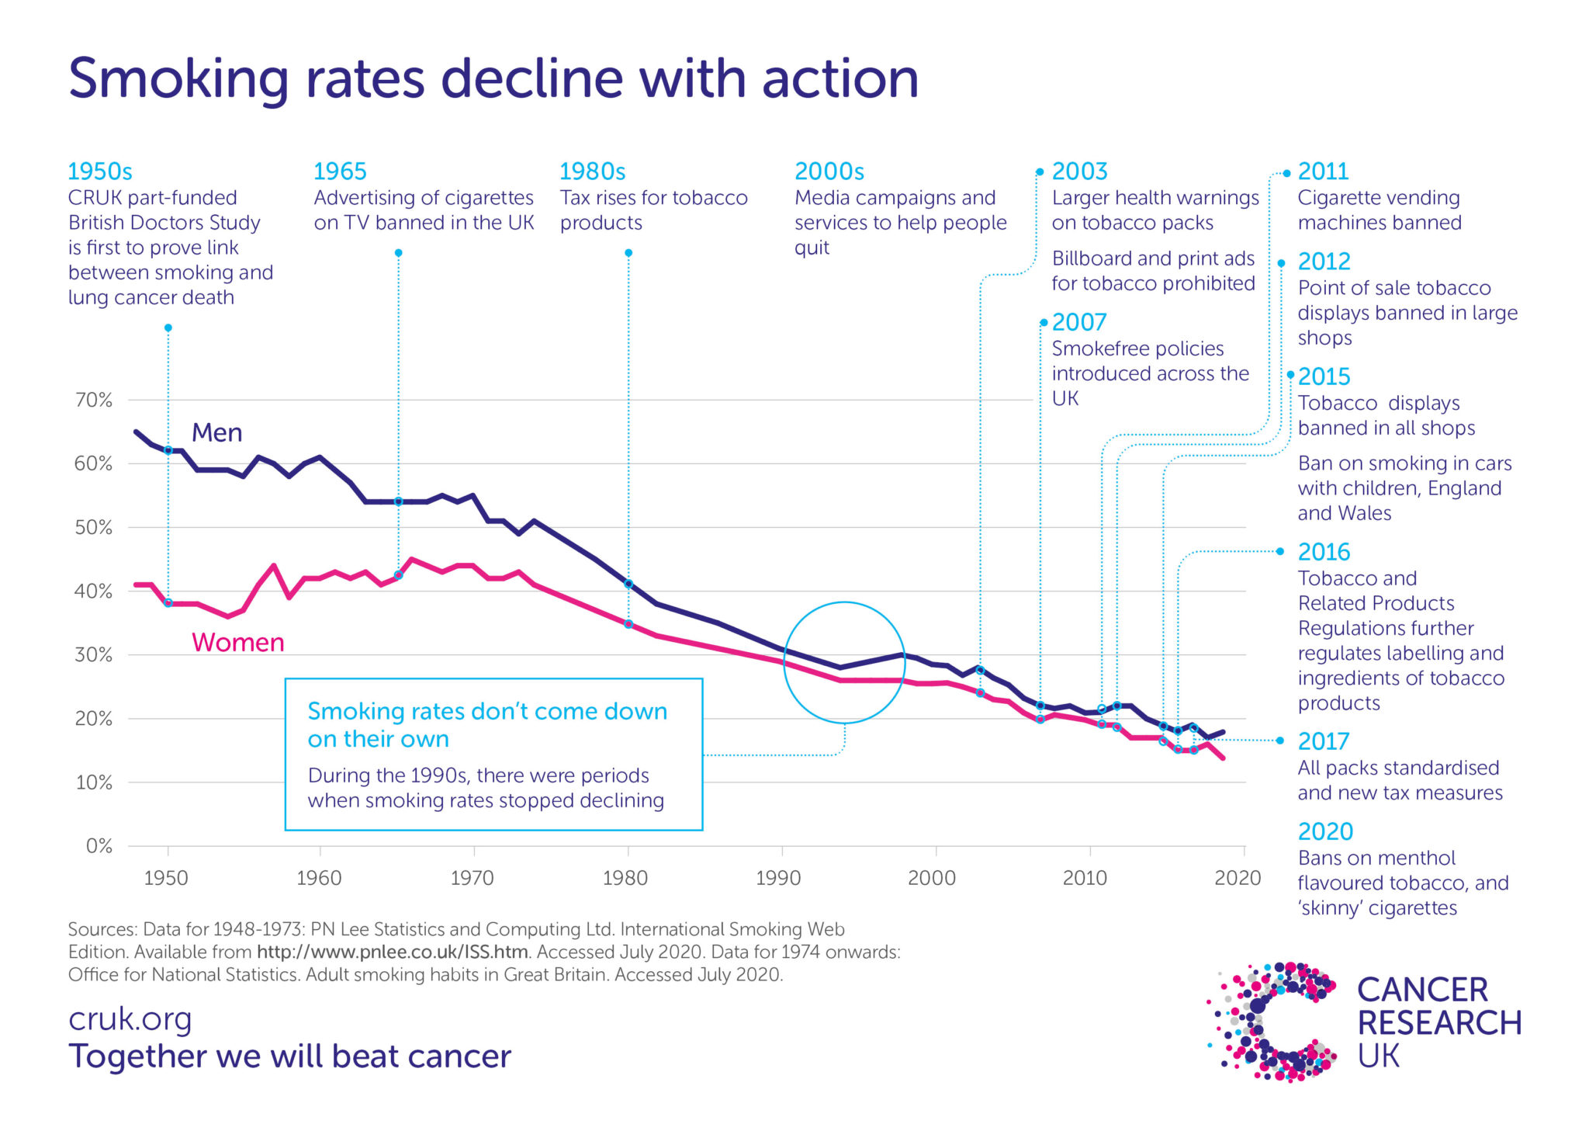
The goal
Figure XX: Example of analysis of intervention, marginal estimates
Frequently, the main goal of empirical analysis in this area is to obtain reliable estimates of policy parameters like the marginal effects or average marginal effects of x on some function of the conditional distribution of y and its corresponding marginal effects. (i.e.: how change in a predictor variable affects the outcome, adjusting for other factors)
(Smith, 2022)
Notes:
Frequently, the main goal of empirical analysis in this area is to obtain reliable estimates of policy parameters like the marginal effects or average marginal effects of x on some function of the conditional distribution of y (typically E[y|x]) and its corresponding marginal effects. In practical terms, this means estimating how change in a predictor variable (e.g., receiving a treatment, being insured, or living in a rural vs urban environment) affects expected healthcare expenditures, adjusting for other factors. For example, if the variable x represents participation in a health intervention, the marginal effect quantifies how much average spending is expected to increase or decrease for individuals who received the intervention compared to those who did not. These estimates are critical for informing policy decisions and evaluating the impact of an intervention.
In the context of a two-part model, marginal effects often reflect the combined influence of both the likelihood of any spending and the expected amount conditional on spending, making them especially relevant for skewed, zero-inflated data like healthcare costs

Slide 5
Introduction
Healthcare cost modeling matters:
Policy decisions regarding allocation and evaluation of interventions rely on accurate, reliable determinations about the costs of medical care and expenditures
Ubiquitous modeling challenges: skewness, mass at zero, heteroskedasticity -> no unified approach, rather a surplus of methods and recommendations
Notes:
Explain why modeling healthcare costs matters and challenges posed by skewed data.

Slide 6
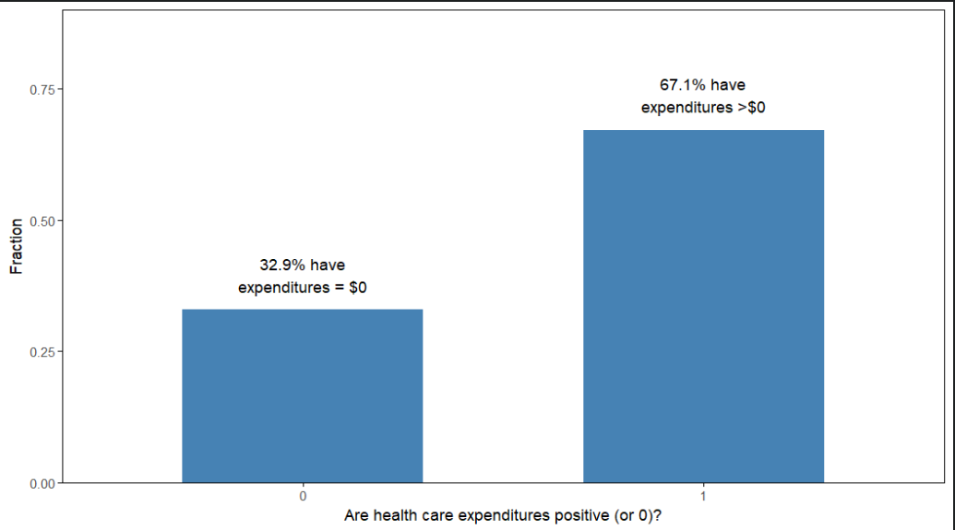
Healthcare Expenditure Modeling Challenges
Figure 1: Empirical data, split between zeros and nonzeros
Characteristics:
Mass at zero
Heavy right-skew
High variance
Notes:
Mass at zero: Mixed discrete-continuous random variables with two basic statistical features: y_i > 0 and y_i = 0, observed often enough that there are compelling substantive and statistical reasons for special treatment, with mass at point zero rending a single index model undesirable

Slide 7
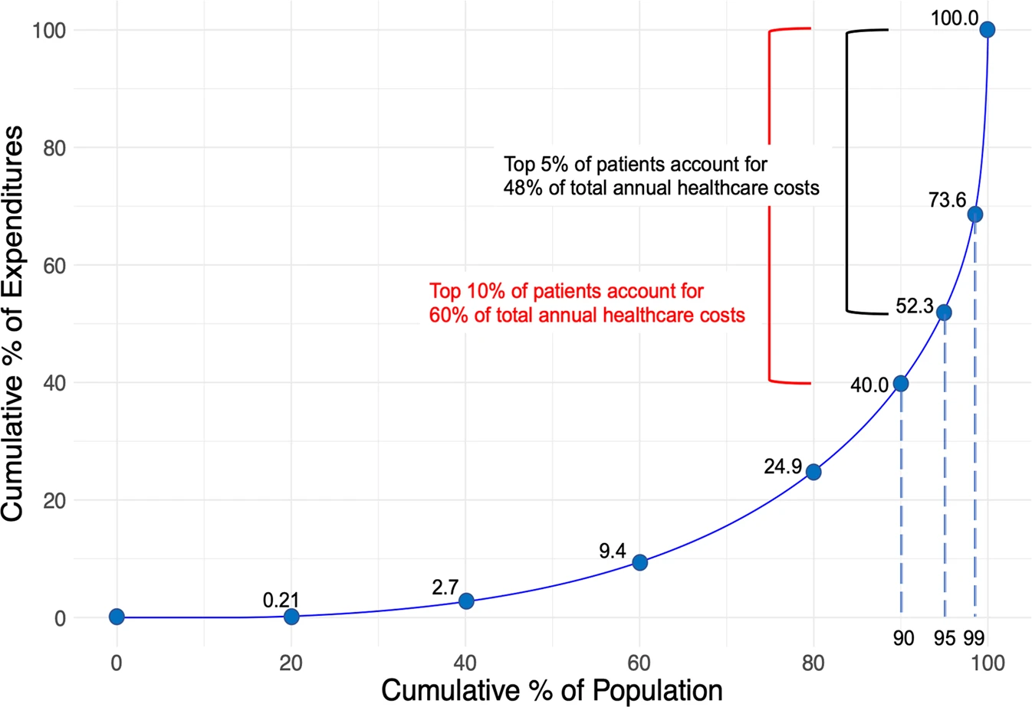
Healthcare Expenditure Challenges
Characteristics:
Mass at zero
Heavy right-skew
High variance
Image from: Osawa, I., Goto, T., Yamamoto, Y., & Tsugawa, Y. (2020). Machine-learning-based prediction models for high-need high-cost patients using nationwide clinical and claims data. NPJ digital medicine, 3(1), 148. https://doi.org/10.1038/s41746-020-00354-8
Notes:
Discuss mass at zero, skewness, and heteroskedasticity.

Slide 8
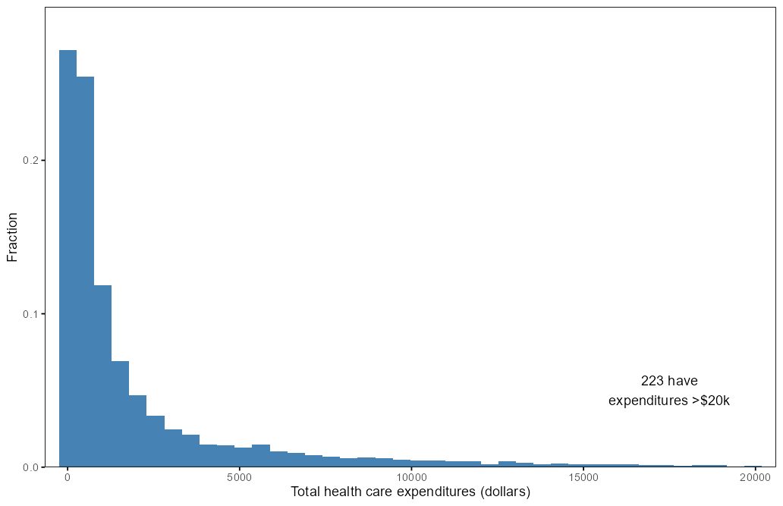
Healthcare Expenditure Modeling Challenges
Figure 2: Truncated Histogram
Characteristics:
Mass at zero
Heavy right-skew
High variance
Notes:
Discuss mass at zero, skewness, and heteroskedasticity.

Slide 9
Healthcare Expenditure Challenges
Mullahy (2024): healthcare spending for US civilian, noninstitutionalized population surpassed $2 trillion
  14% of the population had no expenditures at all
  5% accounted for nearly 50% of all healthcare spending
Holle et al. (2021) study spanning 17 years:
  50% of annual health care expenditures consistently attributed to 4.2-4.8% of the U.S. population.
  Nonspenders stayed consistently around 20%
Wodchis et al. (2016) 3-yr study of high-cost users:
  1/3 of high-cost users (individuals with 5% of costs) in 2009 remained in this category for the two years following.
Global issue
Characteristics:
Mass at zero
Heavy right-skew
High variance
Notes:
Well documented across studies, locations

Slide 10
A Note on Extreme Values
Neither classical outliers nor measurement errors
Represent real users
Simple (though common) methods to handle such as removal/trimming will affect the reliability of the inferences drawn in the study
May/may not be influential

Slide 11
Heavy Skew: Scope of the Problem
“Choosing an appropriate method for regression analyses of cost data is problematic because it must focus on population means while taking into account the typically skewed distribution of the data.” (Barber & Thompson, 2004)
“The validity of the inferences drawn in virtually every archival accounting research study has the potential to be affected by how influential observations are identified and treated.” (Leone et al., 2019)
“When researchers ignore abnormal observations, especially with respect to dependent variables, their empirical results can be misleading. Unfortunately, the fact remains underappreciated in studies of political science…” (Choi, 2022)
Notes:
Well documented across fields: third bullet political science, second bullet accounting.

Slide 12
Healthcare Expenditure Challenges
Single Best Approach May Not Exist
Single best approach may not exist (Bhattarai, 2013) (Sullivan et al., 2021)(Manning et al., 2005)
Multiple models should be tried (guided by economic theory and underlying distribution of the HCE data)
Leone et al (2019) review of 1833 studies (2006-2014): “There is no universally correct solution when it comes to identifying and treating influential observations … all approaches invariably require judgment and care on researchers’ part”
Characteristics:
Mass at zero
Heavy right-skew
High variance
Notes:
Well documented across studies, locations

Slide 13
Healthcare Expenditure Challenges
Inconsistent Reporting
Sullivan et al (2021): 3000 business journals (2007-2018): surprisingly diverse array of methods used to discover and treat outliers, noting widely varying – or, even more concerning, non-existent – approaches to detection and treatment. Many articles simply referred to their removal without details.
  Even ‘top business journals’ were “strikingly deficient in consistently reporting whether outliers were considered and how they were detected, particularly regarding the non-disclosure of a level of significance. … This wide variety of methods and frequent non-disclosure of methods cannot represent best practice”
Characteristics:
Mass at zero
Heavy right-skew
High variance
Notes:
Well documented across studies, locations

Slide 14
Healthcare Expenditure Challenges
Inconsistent Reporting
From the empirical study I based this project on, you can see how unsatisfactory this documentation is:
“Although our statistical models are designed to account for skewness, they are not designed to take extreme values such as these into account. Although it is tempting to drop these observations, we are reluctant to do so because we cannot be sure that they are outliers in any real sense. As a compromise, we topcode the value of the expenditure for each of these 35 observations at $50,000.” (Deb & Norton, 2018)
Characteristics:
Mass at zero
Heavy right-skew
High variance
Notes:
Why not designed to take extreme values into account? I couldn’t find a reference or reasoning.
Compromise: 50k? Why?? No reference to this value in literature. (35 isn’t 5%)

Slide 15
Healthcare Expenditure Challenges
Why the lack of common approach?
Each method has +/-, but no acceptance of any method as a reasonable compromise between ease of implementation and effectiveness.
Textbooks include details, but many advise users implement several or all methods: challenging for researchers up against time or financial constraints
Using several methods can be problematic itself as it can lead to familiar problem of multiple comparisons
Many commonly used methods today evolved from rules-of-thumb or conventional wisdom evolved from periods with limited computational resources (hence low dimensionality, etc.)
Characteristics:
Mass at zero
Heavy right-skew
High variance
Notes:
Why not designed to take extreme values into account? I couldn’t find a reference or reasoning.
Compromise: 50k? Why?? No reference to this value in literature. (35 isn’t 5%)

Slide 16
Healthcare Expenditure Challenges
Why lack of consistent approach?
Variation in terminology and operationalization of terms
  Leone et al (2019): of the 532 studies that used winsorization, 63% winsorized all variables, 6% winsorized only dependent variable, 10% winsorized all independent variables, 18% wrote (“Leave out some variables”), and 3% reported winsorization but did not specify how.
Characteristics:
Mass at zero
Heavy right-skew
High variance
Notes:
Why not designed to take extreme values into account? I couldn’t find a reference or reasoning.
Compromise: 50k? Why?? No reference to this value in literature. (35 isn’t 5%)

Slide 17
Healthcare Expenditure Challenges
Characteristics:
Mass at zero
Heavy right-skew
High, Non-constant Variance (Heteroskedasticity)

Slide 18
Healthcare Expenditure Challenges
Expense data often exhibit variability that increases as the mean expense increases
Variance more concentrated around high-cost cases, amplified by presence of extreme values
As few as four observations have impacted estimates
This study
The use of GLMs allows researcher to explicitly model the heteroskedasticity by allowing the variance of the outcome to exist as a function of its predicted value through the choice of appropriate distributional family
Characteristics:
Mass at zero
Heavy right-skew
High, Non-constant Variance (Heteroskedasticity)

Slide 19
Healthcare Expenditure Challenges
“ … outcomes were estimates with large standard errors, very sensitive to high-cost patients:
  “Part of the explanation of the large standard errors is the strongly skewed distribution of health care costs with a small fraction of the population accounting for a large share of the total health spending and mean costs well above median cost. Variance is even more concentrated in the high-cost cases, and exacerbated by the presence of large outliers. As a result, even sophisticated models with large sets of control variables are faced with a portion of high costs not well captured by the model.” (Geurts et al., 2022)
In heavy-tailed or outlier-prone distributions, predicted regression lines tend to track outlying observations more closely, fitting them at the expense of the rest of the sample data in order to minimize the sum of squared errors, and producing estimated results that are likely to encourage researchers to make incorrect inferences about the data (Choi, 2009).
Characteristics:
Mass at zero
Heavy right-skew
High, Non-constant Variance (Heteroskedasticity)
Notes:
Well documented across studies, locations

Slide 20
The Problem with OLS
“OLS for ln(y) is one of the most prevalently used (and most prevalently misused) models for analyzing [healthcare expenditure] data.” (Manning et al., 2005)
Notes:
Explain why OLS fails under these conditions.

Slide 21
The Problem with OLS
OLS assumptions violated:
Normality
Homoscedasticity
Linearity
Notes:
Explain why OLS fails under these conditions.

Slide 22
The Problem with OLS
OLS assumptions violated:
Normality
Notes:
The normality assumption in OLS regression states that the error terms should be normally distributed, which is crucial for valid hypothesis testing and confidence intervals.
Understanding the Normality Assumption
In the context of OLS regression, the normality assumption specifically refers to the distribution of the error terms (residuals) in the regression model. This assumption is important for several reasons:
Statistical Inference: When the error terms are normally distributed, it allows for valid statistical inference, including hypothesis testing and the construction of confidence intervals for the regression coefficients. This is because many statistical tests rely on the normality of the sampling distribution of the estimators.
2
Central Limit Theorem: Even if the error terms are not normally distributed, the Central Limit Theorem suggests that the sampling distribution of the OLS estimators will approach normality as the sample size increases, provided that the sample size is sufficiently large. This means that for large samples, the normality assumption is less critical.
2
Model Validity: If the normality assumption is violated, it may indicate that the model is misspecified or that there are outliers affecting the results. In such cases, the estimates may still be unbiased, but they may not be efficient, leading to wider confidence intervals and less reliable hypothesis tests.
2
4 Sources
Implications of Violating the Normality Assumption
If the normality assumption is violated, several issues may arise:
Inaccurate Inference: Hypothesis tests may yield misleading results, leading to incorrect conclusions about the significance of predictors.
Wider Confidence Intervals: The confidence intervals for the regression coefficients may be wider than they should be, reducing the precision of estimates.
Alternative Approaches: If normality is a concern, analysts may consider using robust regression techniques, transforming the dependent variable, or employing generalized linear models (GLMs) that do not require normality of the error terms.
2
2 Sources

Slide 23
Alternatives to OLS
Better methods:
GLM
Two-Part Models
Notes:
Introduce alternatives: GLM, TPM, DiD.

Slide 24
Difference-in-Differences
Considered by many to be most important strategy in applied economics
Changes in mean spending compared with mean changes in a control group (often with some sort of risk adjustment), with the latter representing expected outcome had the project not been implemented
Treatment effect captured by one interaction term, the difference-in-differences estimator: the indicator for treatment (treated vs control) by the post-treatment time indicator (e.g., pre vs post)
  This is the variable of interest in my study
“Treatment effect on the treated” is often reported in such studies
Notes:
In the policy world, common to see DiD

Slide 25
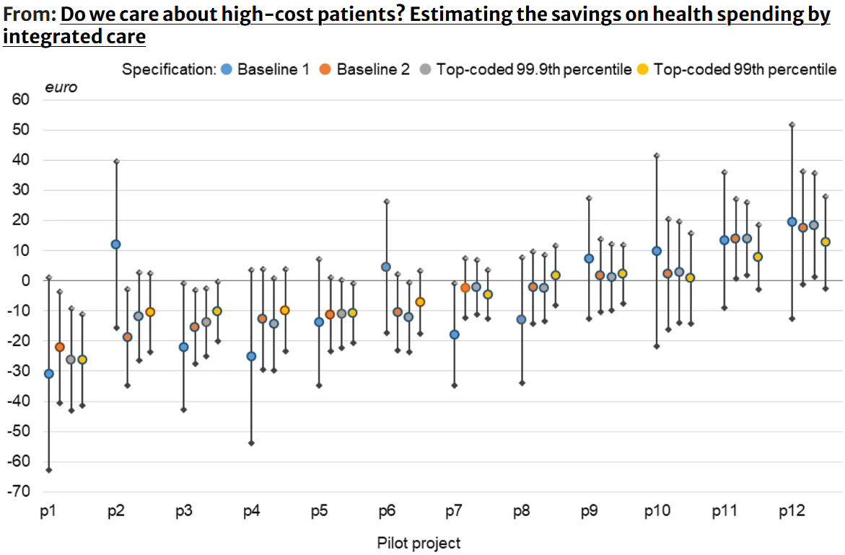
Difference-in-Differences: Example
Notes:
Geurts, 2022 who also looked at top-coding, this is estimator beta_3

Slide 26
Difference-in-Differences
Strengths
  Allows researchers to adjust for unobserved, time-invariant confounders and to estimate treatment effects in quasi-experimental settings (or where randomization not feasible)
  Particularly useful where only a subset of population and pre/post intervention data available for both treated and control groups
Limitations
  Validity hinges on parallel trends assumption
  In non-linear models, interpretation of interaction terms can become more complex as treatment effects may vary across individuals depending on covariate profiles
  Can be sensitive where skewness and heteroskedasticity are common
Methodological complexities motivating the need for simulation-based evaluations of estimator performance under realistic conditions (such as this study)
Notes:
Validity hinges on the parallel trends assumption: that in the absence of treatment, the outcome trajectories of treated and control groups would have followed the same path. Violations of this assumption can lead to biased estimates

Slide 27
Common Approaches to Handling Skew
Data Transformation
  Power Transformations (Box-Cox Transformations)
  Log Transformation
Data Treatment
  Truncation
  Winsorization
  Top-coding
Modeling
In practice, research uses a combination of modeling and transformation to address the multifactorial issues encountered in HCE data. (Empirical data)
Notes:
Summarize literature and gaps.

Slide 28
Purpose of the Study
To evaluate how different treatments of extreme values influence the performance of a two-part model with a generalized linear model in the second part in the context of HCE data.
Compare three top-coding strategies under range of simulated conditions to determine which method yields most accurate, reliable estimate of the treatment effect (beta_3) in second part of TPM:
  Standard top-coding
  mean-preserved top-coding
  Median-preserved top-coding

Slide 29
Two-Part Model
Description

Slide 30
Two-Part Model
Equation with DiD

Slide 31
Top-Coding Strategies
Brief, big-picture

Slide 32
Simulation Design Overview
Factorial design:
- Sample sizes
- Magnitude
- Proportion
- Treatments
Simulation Design:
- Sample sizes: 250, 1000, 3000
- Extreme value magnitude: $50K-$3M
- Proportion: 1%, 5%, 10%
- Treatments: Raw, Top-coded, Mean-preserved, Median-preserved
Notes:
Describe simulation design and factorial structure.

Slide 33
Research Questions

Slide 34
Literature Review
“Several recent papers have addressed these modeling issues from a variety of points of view (e.g., Mullahy, 1998, Manning, 1998, Blough et al., 1999, Angrist, 2001, Manning and Mullahy, 2001). To our knowledge, there is no general empirical approach that simultaneously “makes irrelevant” the decision to transform or not and the choice of two-part versus one-part modeling while also allowing for possibly complex interactions of explanatory variables on the outcome of interest.” (Gilleskie & Mroz, 2004)
Notes:
Summarize literature and gaps.

Slide 35
Purpose of the Study
By systematically evaluating these methods through simulation, the study aims to provide practical guidance for researchers modeling skewed, zero-inflated cost data and to contribute to the broader methodological literature on handling extreme values in health economics.
By complementing empirical analysis with simulation, the study provides a more comprehensive understanding of methodological performance across a range of plausible scenarios.

Slide 36
Methodological Component
Employs Monte Carlo simulation (500 replications)
Simulation design systematically varies three key factors
  Sample Size
  Proportion of Extreme Values
  Magnitude of Extreme Values
Mirrors structure and distributional features of real-world HCE data by mimicking empirical study
Part 2 of TPM estimated using GLM with gamma distribution and log link
Performance of each method evaluated on bias, empirical standard error, and CI coverage for interaction term
Notes:
. This design allows for a full, comprehensive assessment of how each method performs under realistic but controlled conditions, offering insights that would not be possible through empirical analysis alone.

Slide 37
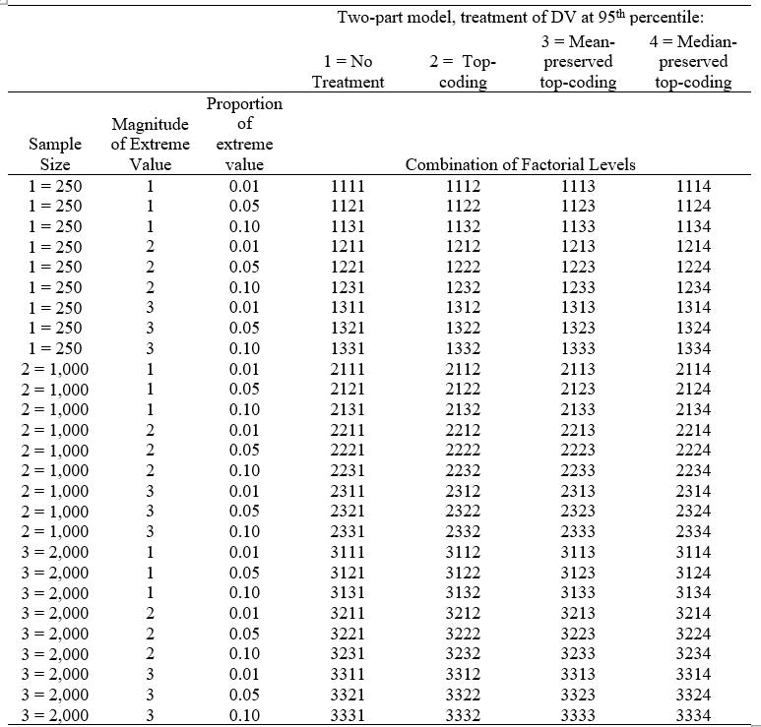
Design Grid
Notes:
. This design allows for a full, comprehensive assessment of how each method performs under realistic but controlled conditions, offering insights that would not be possible through empirical analysis alone.

Slide 38
Study Significance
Addresses methodological gap in literature: Lack of systematic guidance on how to handle extreme values in HCE data
Provides simulation-based comparison of estimator performance across range of realistic data conditions.
Findings offer guidance for applied researchers seeking to balance need for robust estimation with realities of skewed, high-variance data.
Contributes to more transparent and evidence-based approach to data preprocessing in the estimation of costs of healthcare delivery in health services research
Broader implications for policy-relevant research
Notes:
Although the two-part model has become a standard approach for analyzing cost data with a mass at zero and right-skewed distribution, the treatment of extreme values, particularly through top-coding, remains inconsistently applied and/or justified. Researchers often rely on ad hoc decisions about top-coding thresholds or transformations without either evaluating or disclosing how these choices affect their estimates
Beyond methodological contributions, the study has broader implications for policy-relevant research. Accurate estimation of treatment effects in healthcare cost models is essential for evaluating interventions, allocating resources, and informing policy decisions. By clarifying how different top-coding strategies influence key inferential metrics, such as bias, standard error, and confidence interval coverage, this work contributes to the credibility and reproducibility of empirical findings in health economics and related fields

Slide 39
Data Transformations
Data Transformation
  Power Transformations (Box-Cox Transformations)
  Log Transformation
Data Treatment
  Truncation
  Winsorization
  Top-coding
Modeling
Notes:
Summarize literature and gaps.

Slide 40
Power (Box-Cox) Transformations
Definition: Any transformation that raises numbers to an exponent (e.g., square root transformation, inverse transformation)
Application Examples: Square root function most common
Strengths: Render a continuous variable more symmetric, improve normality
Limitations: Back transformations will cause problems as estimates will be biased by the process
Notes:
Application Examples: as only the square root function is easily retransformed back to the original scale. Log-normal variables (i.e. variables that are normally distributed after log transformation) are popular across many fields of science (Osborne, 2010).

Slide 41
Log Transformation
Special case of the Box-Cox transformation
Definition: Target variables replaced with log(x), where base of log determined by analyst. If error term not normally distributed but is homoscedastic, smearing estimator is applied
Application Examples: So common in HCE data it seems “automatic response”
Strengths: Render a continuous variable more symmetric, improve normality
Limitations:
  Leads to biased estimations
  Back transformations will cause problems as estimates will be biased by the process
    These models “invariably do worse than linear models once this is done” (Randall P. Ellis, 2018)
  Log of 0 undefined, so common practice is to add 1 to any values before taking log (which some authors say is not recommended as results tend to be very sensitive to methods of handling zeros)
Notes:
Application Examples: as only the square root function is easily retransformed back to the original scale. Log-normal variables (i.e. variables that are normally distributed after log transformation) are popular across many fields of science (Osborne, 2010).

Slide 42
Data Treatment
Methods:
  Winsorization
  Top-coding
  Mean/Median preserved

Slide 43
Documentation Gaps
Inconsistent reporting
Lack of systematic evaluation
Notes:
Explain documentation gaps and lack of consensus.

Slide 44
Two-Part Model Explained
Part 1: Logit for probability
Part 2: GLM for positive costs
Two-Part Model:
[Logit Model] -> Predicts probability of positive cost
[GLM Model] -> Models positive costs
Notes:
Explain Two-Part Model structure.

Slide 45
Empirical Data Summary
MEPS data:
- ACA expansion
- N=16,640
- Highly skewed costs
Notes:
Summarize empirical data and ACA example.

Slide 46
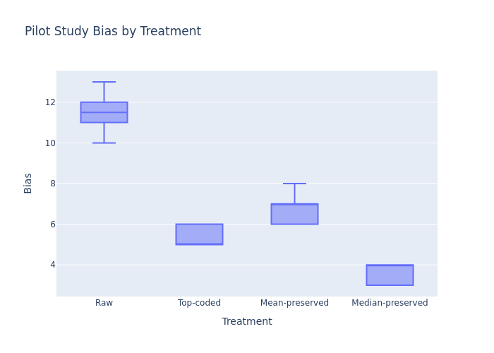
Pilot Study Results
Raw estimates biased
Top-coding improves bias
Median-preserved best coverage
Notes:
Discuss pilot results and implications.

Slide 47
Factorial ANOVA
Plan to review (interactions, etc.) Will look at effect size,
Explain interaction first. (If 3-way interaction, have to interpret conditional effect)
Notes:
Discuss pilot results and implications.

Slide 48
Expected Contributions
Guidance for researchers
Improved transparency
Notes:
Highlight contributions to literature and practice.

Slide 49
Limitations & Assumptions
Simulation assumptions
Focus on TPM+GLM
Interaction term only
Notes:
Acknowledge limitations and assumptions.

Slide 50
Next Steps & Timeline
Complete full simulation
Draft discussion
Policy implications
Notes:
Outline next steps and timeline.

