Slide 1
Transforming the Tail: Evaluating Top-Coding and Distributional Adjustments in Skewed Healthcare Expenditure Models
Kimberly T Wiggins
Data Analyst, Instructor; CU Anschutz Department of Family Medicine
Data and Analytics Team Lead, CAMPHIRE
December 2025
Notes:
Introduce yourself, thank you for being here and being willing to be on my committee. I’m sincerely looking forward to your input.
By night I’m a PhD student, started in 2020, passed my comps in the spring, this is my proposal, and I hope to defend next semester.
By day I’m a …
CAMPHIRE: Colorado Ambulatory Partnership for Heal Innovation and Research Excellence.
Interested in the Literature review, relevant to work.
Got this under 30 minutes last night, but I’m really nervous so we’ll see!!

Slide 2
Agenda
Agenda:
Statement of the Problem
Common Approaches to Address Problems
Questions
Study, Methodology
Pilot Study
Notes:
Introduce yourself, outline agenda for 30-minute talk.

Slide 3
Introduction
“For decades, “how to contain health care costs?” has been a major recurring theme for health economists and policymakers around the world. Therefore, credible empirical analyses of the right tail of health expenditure distributions harbor great potential to answer some of the most pressing policy questions.” (Karlsson et al., 2024)
Notes:
Explain why modeling healthcare costs matters and challenges posed by skewed data.

Slide 4
Introduction
Healthcare cost modeling matters:
Policy decisions regarding allocation and evaluation of interventions rely on accurate, reliable determinations about the costs of medical care and expenditures
Ubiquitous modeling challenges: skewness, mass at zero, heteroskedasticity -> no unified approach, rather a surplus of methods and recommendations
Notes:
Explain why modeling healthcare costs matters and challenges posed by skewed data.
Let’s take a look at some of these characteristics in more detail, and then how it’s been addressed.

Slide 5
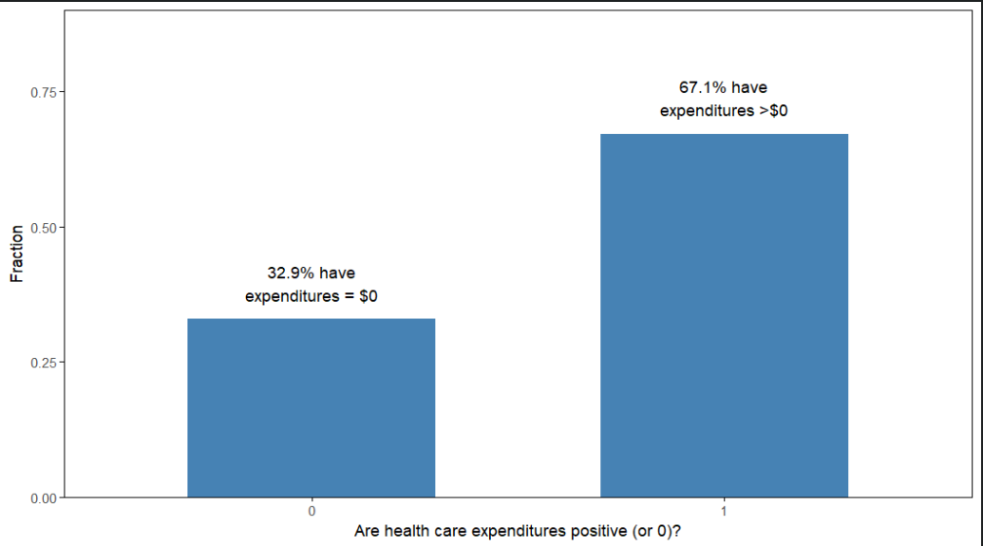
Healthcare Expenditure Modeling Challenges
Figure 1: Empirical dataset, split between zeros and nonzeros.
Characteristics:
Mass at zero
Heavy right-skew
High variance
Other sources: Mullahy (2024); Holle et al. (2021); Wodchis et al. (2016), +
Notes:
Mass at zero: Mixed discrete-continuous random variables with two basic statistical features: y_i > 0 and y_i = 0, observed often enough that there are compelling substantive and statistical reasons for special treatment, with mass at point zero rending a single index model undesirable.

Slide 6
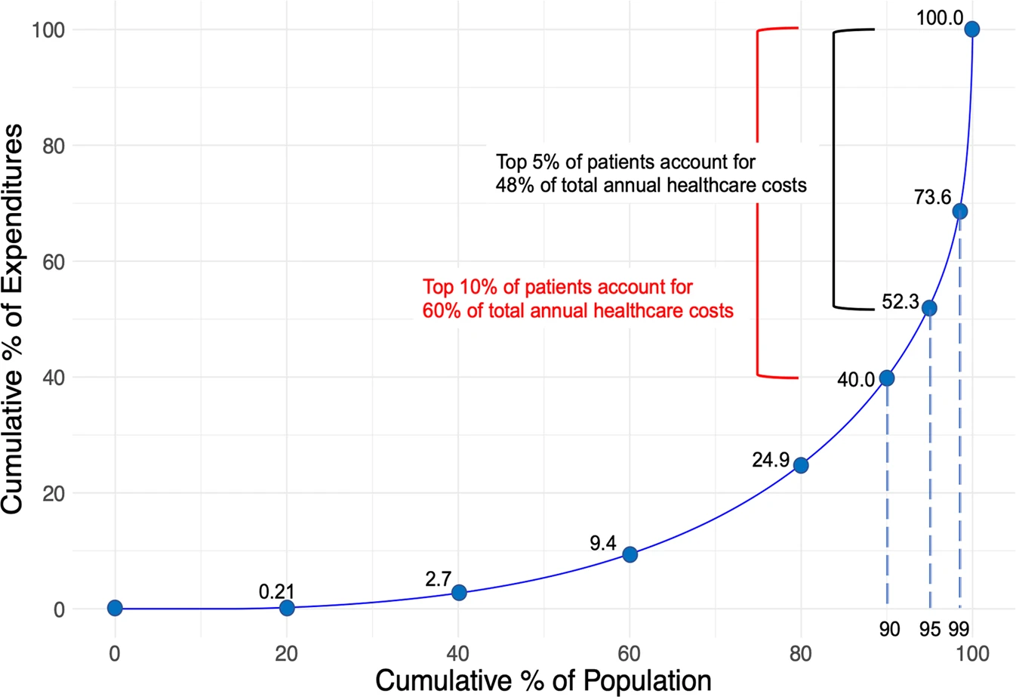
Healthcare Expenditure Challenges
Characteristics:
Mass at zero
Heavy right-skew
High variance
Image from: Osawa, I., Goto, T., Yamamoto, Y., & Tsugawa, Y. (2020). Machine-learning-based prediction models for high-need high-cost patients using nationwide clinical and claims data. NPJ digital medicine, 3(1), 148. https://doi.org/10.1038/s41746-020-00354-8.
Other sources consistent with 5%/50% estimates: Mullahy (2024); Holle et al. (2021); Wodchis et al. (2016): One-third of high-cost users remained in this category for 2+ years following
Notes:
Mullahy (2024): healthcare spending for US civilian, noninstitutionalized population surpassed $2 trillion; 14% of the population had no expenditures at all; 5% accounted for nearly 50% of all healthcare spending
Holle et al. (2021) study spanning 17 years: 50% of annual health care expenditures consistently attributed to 4.2-4.8% of the U.S. population. Nonspenders stayed consistently around 20%
Wodchis et al. (2016) 3-yr study of high-cost users: 1/3 of high-cost users (individuals with 5% of costs) in 2009 remained in this category for the two years following.
Global issue

Slide 7
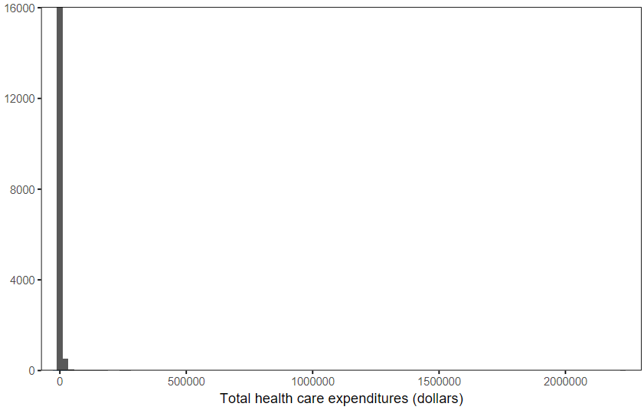
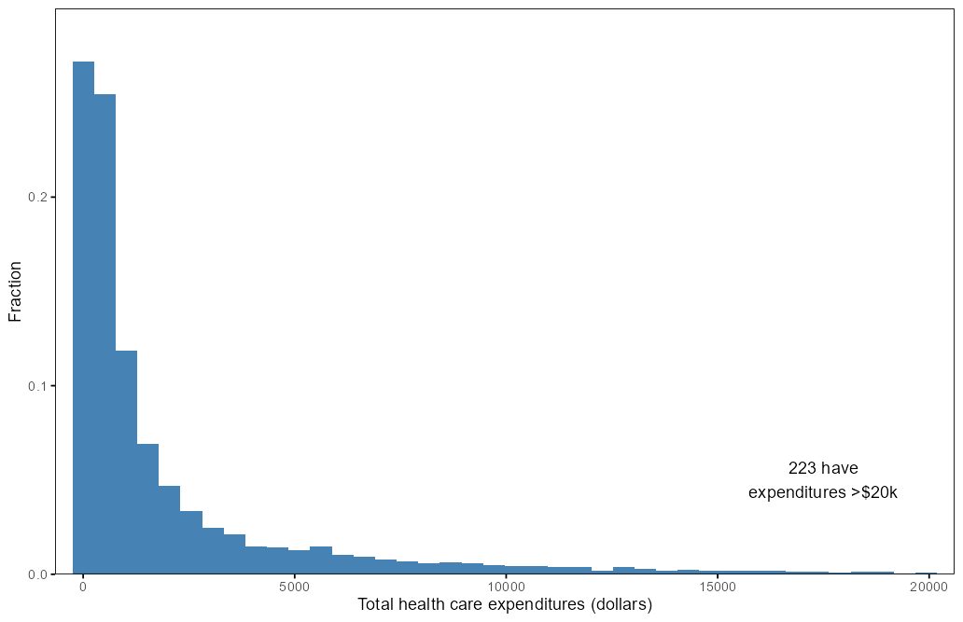
Healthcare Expenditure Modeling Challenges
Figure 2: Full Histogram
Characteristics:
Mass at zero
Heavy right-skew
High variance
Figure 3: Truncated Histogram
Notes:
Mine looks like most, but this one went to $2million… like most.

Slide 8
A Note on Extreme Values
“Neither classical outliers nor measurement errors”; represent real users
Simple (though common) methods to handle (such as removal/trimming) will affect the reliability of the inferences drawn in the study
Notes:
My husband was one of these. These are real people.
‘classical outliers’ that arouse some suspicion or deviate markedly from other members in the sample. They might deviate markedly, but they’re expected (don’t deviate markedly from what we expect in HCE)
“When researchers ignore abnormal observations, especially with respect to dependent variables, their empirical results can be misleading. Unfortunately, the fact remains underappreciated in studies of political science…” (Choi, 2022)

Slide 9
Healthcare Expenditure Challenges
HCE data often exhibit variability that increases as the mean expense increases
The use of GLMs allows researcher to explicitly model the heteroskedasticity
This study will use GLM to address but issue not included in design grid / conditions
Characteristics:
Mass at zero
Heavy right-skew
High, Non-constant Variance (Heteroskedasticity)
Notes:
Variance more concentrated around high-cost cases, amplified by presence of extreme values
“ … outcomes were estimates with large standard errors, very sensitive to high-cost patients:
“Part of the explanation of the large standard errors is the strongly skewed distribution of health care costs with a small fraction of the population accounting for a large share of the total health spending and mean costs well above median cost. Variance is even more concentrated in the high-cost cases, and exacerbated by the presence of large outliers. As a result, even sophisticated models with large sets of control variables are faced with a portion of high costs not well captured by the model.” (Geurts et al., 2022)
In heavy-tailed or outlier-prone distributions, predicted regression lines tend to track outlying observations more closely, fitting them at the expense of the rest of the sample data in order to minimize the sum of squared errors, and producing estimated results that are likely to encourage researchers to make incorrect inferences about the data (Choi, 2009).
Use of GLM: by allowing the variance of the outcome to exist as a function of its predicted value through the choice of appropriate distributional family

Slide 10
Modeling
OLS assumptions violated:
Normality
Homoscedasticity
Linearity
“OLS for ln(y) is one of the most prevalently used (and most prevalently misused) models for analyzing [healthcare expenditure] data.” (Manning et al., 2005)
Best practice: two-part model (Part 2: Gamma distribution, log link)
Notes:
Explain why OLS fails under these conditions.

Slide 11
The Current State: Dealing with Skew
Issue | Citation
Single Best Approach May Not Exist | Bhattarai, 2013; Buntin & Zaslavsky, 2004; Leone et al., 2019; Malehi et al., 2015; Manning et al., 2005; Manning et al., 2009; Mullahy, 2009; Sullivan et al., 2021
Lack of Consistency in Studies, Documentation Gaps | Diehr, 1999 (many possible explanations for discrepancies); Leone et al., 2019 (little … demonstrating efficacy/trade-offs associated with approaches, inconsistent reporting); Mihaylova et al., 2011; Sullivan et al., 2021 (surveyed nearly 3000 journals, 2007-2018, found ‘surprisingly diverse array’, ‘strikingly deficient’)
Reason for Lack of Common Approach | ‘toolkit technique’ Leads to adjustment for multiple corrections Large variety of methods, abbreviated discourse Variation in terminology, operationalization
Notes:
Single best may not exist:
Multiple models should be tried (guided by economic theory and underlying distribution of the HCE data)
Leone et al (2019) review of 1833 studies (2006-2014): “There is no universally correct solution when it comes to identifying and treating influential observations … all approaches invariably require judgment and care on researchers’ part”
Sullivan: “surprisingly diverse array of methods used to discover and treat outliers”, noting widely varying – or even more concerning, non-existent – approaches to outlier detection. They write that even the top business journals were, “strikingly deficient in consistently reporting whether outliers were considered and how they were detected, particularly regarding the non-disclosure of a level of significance. …
“Such inconsistencies make it difficult, if not impossible, to precisely replicate those studies, to make comparisons with the results of related studies, or to reconcile conflicting results between studies” (Leone et al., 2019) They found that only 68% of papers reviewed even mentioned influential observations or describe their approach to identify or treat observations, leaving nearly one-third (32%) neither mentioning influential observations or not clearly describing their approach to identify such observations.
Abbreviated discourse: Even where they are mentioned, textbooks or methodological suggestions have historically paid little attention to false detection rates or overall level of significance for any one method.
Reasons:
Each method has +/-, but no acceptance of any method as a reasonable compromise between ease of implementation and effectiveness.
Textbooks include details, but many advise users implement several or all methods: challenging for researchers up against time or financial constraints
Using several methods can be problematic itself as it can lead to familiar problem of multiple comparisons
Many commonly used methods today evolved from rules-of-thumb or conventional wisdom evolved from periods with limited computational resources (hence low dimensionality, etc.)

Slide 12
Example: Empirical Study
“Although our statistical models are designed to account for skewness, they are not designed to take extreme values such as these into account. Although it is tempting to drop these observations, we are reluctant to do so because we cannot be sure that they are outliers in any real sense. As a compromise, we topcode the value of the expenditure for each of these 35 observations at $50,000.” (Deb & Norton, 2018)
Notes:
From a paper we use at work to guide how we handle our economic modeling:
Example of how unsatisfactory this documentation is
Why not?
No justification?

Slide 13
Common Approaches
Approach | Method | Citations
Data Transformation | Power (Box-Cox) Transformations | Bicego & Baldo, 2016; Diehr, 1999; Gilleskie & Mroz, 2004; Karlsson, 2024; Metcalf & Casey, 2016; Mullahy, 2024; Mullahy & Norton, 2024; Mihaylova, 2011; Osborne, 2010; Randall P. Ellis, 2018; Ruppert, 2001
 | Log Transformation | Aihounton & Henningsen, 2021; Cantoni & Ronchetti, 2006; Chen & Roth, 2024; Chen & Zhou, 2006; Dalton & Norton, 2000; Deb & Burgess, 2003; De Brauw & Herskowitz, 2021; Diehr, 1999; Duan, 1983; Duan, 1983; Geurts, 2022; Gilleskie & Mroz, 2004; Karlsson, 2024; Manning, 1987; Malehi, 2015; Metcalf & Casey, 2016; Mihaylova, 2011; Mullahy, 2009; Mullahy, 2024; Mullahy & Norton, 2024; Osborne, 2010; Polgreen, 2012; Randall P. Ellis, 2018; Rogowski & Newhouse, 1992
Data Treatment | Truncation | Belsley, 1980; Leone, 2019; Geurts, 2022; Karlsson, 2024; Mihaylova, 2011; Metcalf & Casey, 2016; Mullahy, 2023; Murphy, 2018; Randahl & Vegelius, 2024; Sullivan, 2021;
 | Winsorization | Leone, 2019; Randahl & Vegelius, 2024; Sullivan, 2021; Weichle, 2013; Wicklin, 2023;
 | Topcoding | Deb & Norton, 2018; Geurts, 2022; Kandilov, 2018; Randall P. Ellis, 2018
Modeling | One-part models (Cox PH, GLM) | Alshakhs, 2023; Barber & Thompson, 2004; Belotti, 2015; Buntin & Zaslavsky, 2004; Basu , 2004; Blough, 1999; Deb, 2017; Deb & Norton, 2018; Diehr , 1999; Gilleskie & Mroz, 2004; Gregori, 2006; Hardin & Hilbe, 2007; Karlsson, 2024; Lee & Conway, 2022; Malehi, 2015; Manning, 2005; Mihaylova, 2011; Mullahy, 1998; Polgreen & Brooks, 2012; Weichle, 2013
 | Two-part models | Belotti, 2015; Cragg, 1971; Deb & Norton, 2018; Diehr, 1999; Duan, 1984; Gilleskie & Mroz, 2004; Jones & Yen, 2000; Kapitula, 2015; Manning, 1998; Manning & Mullahy, 2001; Mullahy, 2024; Yen & Jones, 1997
In practice, research has often relied on a combination of modeling and transformations to address the multifactorial issues encountered in HCE data (empirical study, this study)
Notes:
Mea Culpa: Data Transformation intro was in Data Treatment section… fixed now, but bad in version I sent them.
Data Transformation: ALL data points, not just extreme values. Rescales entire target. Data Treatment in a preprocessing step is treating only portion of the data (in preprocessing) – altering/ capping extreme values directly, leaving the rest of the target untouched.
Log Transformation: Special case of Box-Cox when lambda=0
Truncation: Remove
Winsorization: a symmetric process that, rather than removing extreme values, instead replaces the smallest k and largest k data values with less extreme values at that cutoff point
- Variation in terminology and operationalization of terms
Leone et al (2019): of the 532 studies that used winsorization, 63% winsorized all variables, 6% winsorized only dependent variable, 10% winsorized all independent variables, 18% wrote (“Leave out some variables”), and 3% reported winsorization but did not specify how.

Slide 14
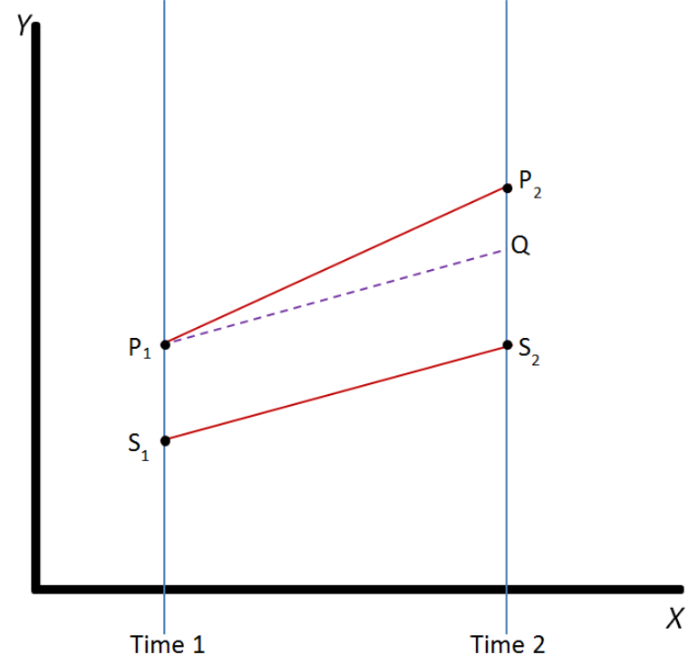
Difference-in-Differences
Considered by many to be most important strategy in applied economics
Treatment effect captured by one interaction term, the difference-in-differences estimator: the indicator for treatment (treated vs control) by the post-treatment time indicator (e.g., pre vs post)
  This is the variable of interest in my study
Notes:
In the policy world, common to see DiD analysis. Observational study data. Studies differential effect of a treatment on a ‘treatment group’ vs control group
QE method, can use observational data, estimates the effect of a treatment by mean changes in spending over time for a treatment group to mean changes in a control group, with the latter representing expected outcome had the project not been implemented
Strengths
Allows researchers to adjust for unobserved, time-invariant confounders and to estimate treatment effects in quasi-experimental settings (or where randomization not feasible)
Particularly useful where only a subset of population and pre/post intervention data available for both treated and control groups
Limitations
Validity hinges on parallel trends assumption
In non-linear models, interpretation of interaction terms can become more complex as treatment effects may vary across individuals depending on covariate profiles
Can be sensitive where skewness and heteroskedasticity are common
Methodological complexities motivating the need for simulation-based evaluations of estimator performance under realistic conditions (such as this study)

Slide 15
Questions

Slide 16
Purpose of the Study
To evaluate how different treatments of extreme values influence the performance of a two-part model with a generalized linear model in the second part in the context of HCE data.
Compare three top-coding strategies under range of simulated conditions to determine which method yields most accurate, reliable estimate of the treatment effect in second part of TPM:

Slide 17
Top-Coding Strategies
Treatment | Description
Topcoding | Values above the 95th percentile are capped and replaced with the value at the 95th percentile
Mean-Preserved Topcoding | Total expenditures truncated at 95th percentile, values above this threshold were replaced with the mean of all values exceeding the cutoff. (Dickinson & Wiggins, 2025)
Median-Preserved Topcoding | Total expenditures were truncated at the 95th percentile, and values above this threshold were replaced with the median of all values exceeding the cutoff.

Slide 18
Empirical Study
Modeling Health Care Expenditures and Use, Deb & Norton, 2018
2011 ACA expansion
provides natural DiD study
Examined whether people aged 23-25 were affected by the expansion
Data source: MEPS
  Pre: 2008-2010, Post: 2011-2014
  Treatment: Ages 23-25, Control: Ages 27-29
  N: 17,899 (mine following I/E: 16,640)
Highly skewed costs (Figures 1, 2 were from empirical dataset)
Notes:
Previously, common practice for private insurers to drop nonstudent dependents at age 19 and student dependents at age 23; the expansion allowed dependents to remain on their parents’ health insurance coverage until they turn 26 yo.
“This expansion in coverage points to a powerful natural experiment using a difference-in-differences design”; treatment and control groups could be created from ages 23-25 and 27-29 respectively, and pre and post years could be created from 2008-2010 (pre-ACA) and 2011-2014 (post-ACA). The authors explored if people aged 23-25 were affected by the ACA policy using a treatment effect on the treated differences in differences model described previously.

Slide 19
Research Questions
Notes:
Raw bias percentage: Average deviation of estimated coefficient from true value (0)
Empirical SE: measures variability of estimated coefficients across replications (calc’d as sample SD of the B estimates)
Coverage: Proportion of replications in which the 95% CI for estimated coefficient includes the true value (in this case, 0)

Slide 20
Design Grid (3x3x3x4=108)
 | Conditions
Treatment | Sample Size | Magnitude of Extreme Values | Proportion of Extreme Values
Raw | Small (N=250) | Small (50k to 1m) | Small (1%)
Topcoding | Moderate (N=1000) | Typical (50k to 2m) | Typical (5%)
Mean-Preserved Topcoding | Large (N=2000) | Large (50k to 3m) | Large (10%)
Median-Preserved Topcoding
Notes:
One area I’d really like feedback is design grid,
Small ones (ie 250) to stress test, larger sample size would possibly stabilize. Still would be a good size for some interventions, though if doing observational from large scale datasets (like Medicaid) those are in the tens or even hundreds of thousands and we do we still have issues and we topcode. This design allows for a full, comprehensive assessment of how each method performs under realistic but controlled conditions, offering insights that would not be possible through empirical analysis alone.

Slide 21
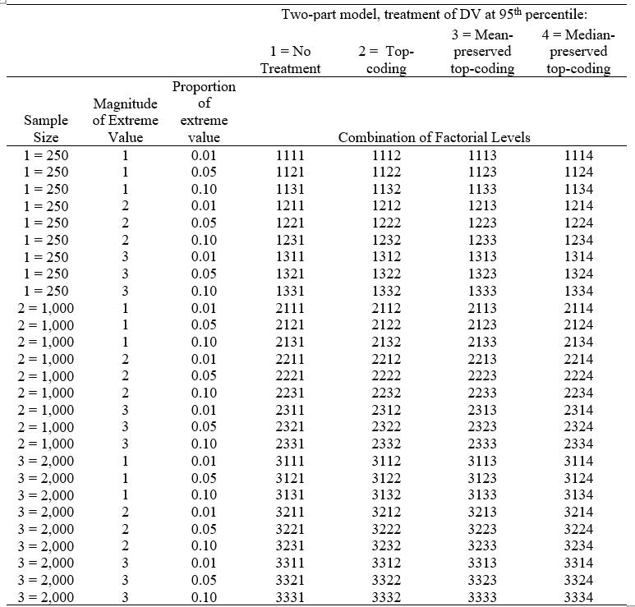
Experimental Conditions
Notes:
. This design allows for a full, comprehensive assessment of how each method performs under realistic but controlled conditions, offering insights that would not be possible through empirical analysis alone.

Slide 22
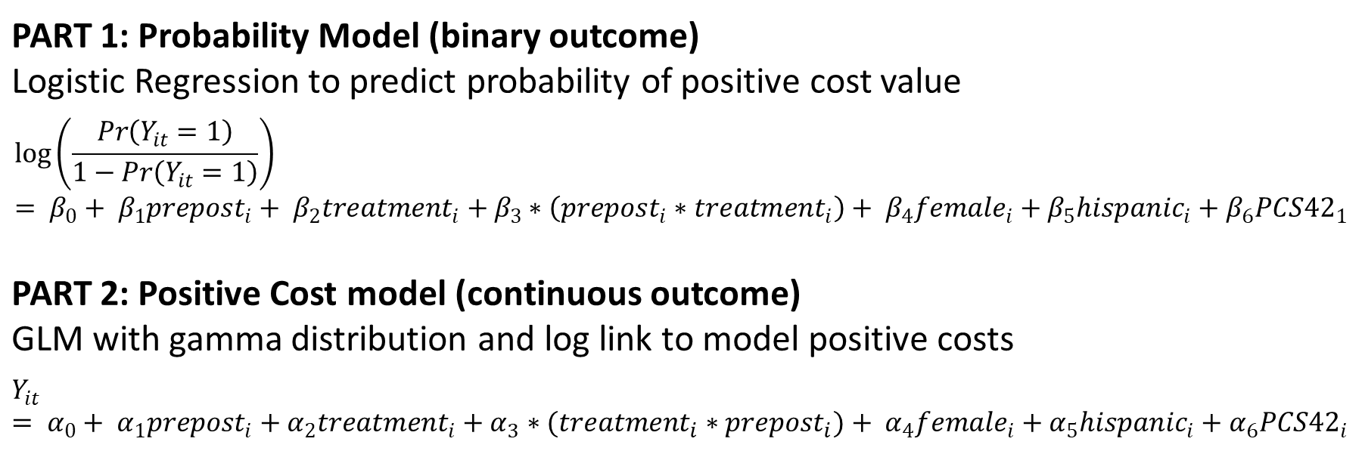
Two-Part Model
PART 1: Probability Model (binary outcome) Logistic Regression to predict probability of positive cost value
$$\log\left(\frac{\operatorname{Pr}\left(Y_{it}=1\right)}{1−\operatorname{Pr}\left(Y_{it}=1\right)}\right)= β_{0}+ β_{1}prepost_{i}+ β_{2}treatment_{i}+β_{3}∗\left(prepost_{i}∗treatment_{i}\right)+ β_{4}female_{i}+β_{5}hispanic_{i}+β_{6}PCS{42}_{1}$$
PART 2: Positive Cost model (continuous outcome) GLM with gamma distribution and log link to model positive costs
$$Y_{it}= α_{0}+ α_{1}prepost_{i}+α_{2}treatment_{i}+α_{3}∗(treatment_{i}∗prepost_{i})+ α_{4}female_{i}+α_{5}hispanic_{i}+α_{6}PCS{42}_{i}$$
Notes:
Part 1: Logit (log of the odds)
DGF did not include interaction
Part 2 Conditional
Where Treatment is ages 23-25

Slide 23
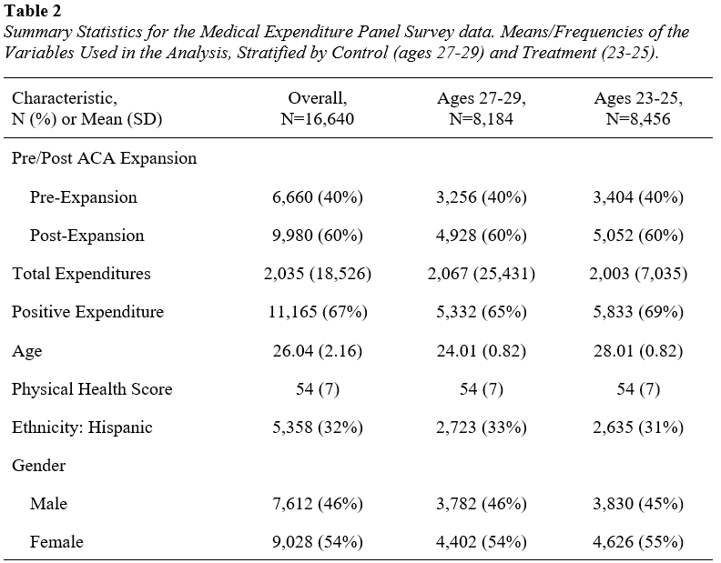
Empirical
Data Summary
Notes:
Relatively balanced across arms

Slide 24
Methodological Process
Simulation
Monte Carlo simulation (500 replications) mirroring structure, distributional features of real-world HCE (mimics empirical study)
Estimation & Evaluation
Step 1) Apply selected treatment to each dataset
Step 2) Fit the two-part model
Step 3) Extract the coefficient (bias), standard error for interaction term and coverage from cost model
Step 4) Aggregate results across 500 replications; compare estimates
Notes:
. This design allows for a full, comprehensive assessment of how each method performs under realistic but controlled conditions, offering insights that would not be possible through empirical analysis alone.
The simulation Mirrors structure and distributional features of real-world HCE data by mimicking empirical study (DGF)

Slide 25
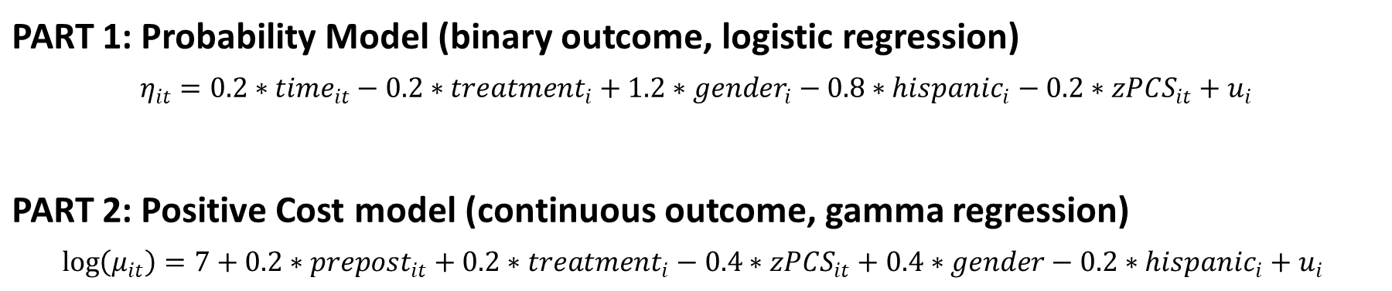
DGF: Two-Part Model Specifications
Used estimates from empirical data analysis
PART 1: Probability Model (binary outcome, logistic regression)
$$η_{it}=0.2∗time_{it}−0.2∗treatment_{i}+1.2∗gender_{i}−0.8∗hispanic_{i}−0.2∗zPCS_{it}+u_{i}$$
PART 2: Positive Cost model (continuous outcome, gamma regression)
$$\log\left(μ_{it}\right)=7+0.2∗prepost_{it}+0.2∗treatment_{i}−0.4∗zPCS_{it}+0.4∗gender−0.2∗hispanic_{i}+u_{i}$$
Notes:
DGF did not include interaction
Part 2 Conditional
Where Treatment is ages 23-25

Slide 26
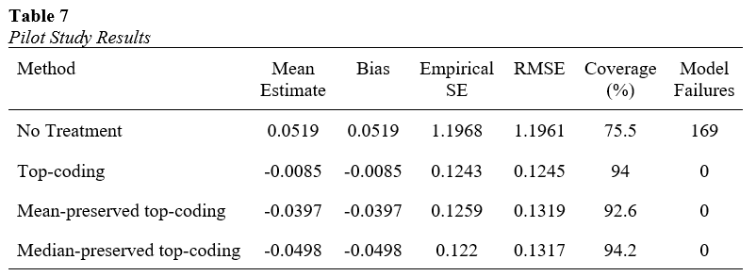
Pilot Study Results
Top-coding reduces bias, SE
Median-preserved best coverage
Notes:
Discuss pilot results and implications.

Slide 27
Full Factorial ANOVA
lm_bias <- lm(Bias ~ Method * SampleSize * Magnitude * Proportion, data = data)
- In R, * expands to main effects + all interactions (4 main effects, 6 two-way interactions, 4 three-way interactions, 1 four-way interaction)
4-way interaction, conditional effect
  All four factors jointly determine estimator performance
  Statements about effects will specify all four factor levels (ex: “For large samples with high proportion of extreme values and highest magnitude, Method A reduces bias more than Method B” or “On average, Method 1 reduces bias compared to raw data, across all sample sizes and extreme-value conditions”
Effect size will be examined (variance explained via partial η²)
Will look at conditional/model-based contrasts (emmeans in R) to quantify size of differences attributable to the interaction, including CI’s, across factor combinations
Notes:
Full factorial linear model for bias, including ME of x,x,x,x as well as all possible 2way, 3way, and the 4 way interaction among these factors.
The four-way interaction term quantifies whether the three-way relationship among method, sample size, and magnitude of extreme values itself varies across levels of the proportion of extremes. In practice, this means that the performance differences between methods across sample sizes and extreme-value severity are conditional on how frequently extreme values occur.
1. Use Variance Explained (η² / Partial η²)
In ANOVA or linear models, the effect size of an interaction can be expressed as the proportion of variance it explains.
Partial η² is common:
ηpartial2=SSinteractionSSinteraction+SSerror\eta^2_{\text{partial}} = \frac{SS_{\text{interaction}}}{SS_{\text{interaction}} + SS_{\text{error}}}
This tells you how much of the variability in Bias, SE, or Coverage is attributable to the interaction, controlling for other terms.

Slide 28
Study Significance
Addresses methodological gap in literature: Lack of systematic guidance on how to handle extreme values in HCE data
Provides simulation-based comparison of estimator performance across range of realistic data conditions.
Findings offer guidance for applied researchers seeking to balance need for robust estimation with realities of skewed, high-variance data.
Contributes to more transparent and evidence-based approach to data preprocessing in the estimation of costs of healthcare delivery in health services research
Broader implications for policy-relevant research
Notes:
Although the two-part model has become a standard approach for analyzing cost data with a mass at zero and right-skewed distribution, the treatment of extreme values, particularly through top-coding, remains inconsistently applied and/or justified. Researchers often rely on ad hoc decisions about top-coding thresholds or transformations without either evaluating or disclosing how these choices affect their estimates
Beyond methodological contributions, the study has broader implications for policy-relevant research. Accurate estimation of treatment effects in healthcare cost models is essential for evaluating interventions, allocating resources, and informing policy decisions. By clarifying how different top-coding strategies influence key inferential metrics, such as bias, standard error, and confidence interval coverage, this work contributes to the credibility and reproducibility of empirical findings in health economics and related fields

Slide 29
Limitations & Assumptions
Simulation assumptions
Focus on TPM+GLM
Interaction term only
Notes:
DGP may not full capture complexity of real-world healthcare systems
Didn’t use random effect (intercept) / mixed-effects model (couldn’t get to empirical data I chose to converge)
TPM + GLM may not be generalizable to machine learning, quantile regression, cumulative LR
Single interaction term, results may differ for other covariates

Slide 30
Thank You
Notes:
My sincerest thanks for not only your time, but also your feedback

