Slide 1

EPL Kit System
by IRWW

Slide 2
System Design
A multi-user system to make sure library staff can easily:
search through available kits
perform and maintain bookings
see which kits are arriving or need to be sent out
confirm kits that have been sent/received
set-up new kits
make sure necessary email notifications are sent

Slide 3
Scope Definition
System will have:
Bookings that are systemically up-to-date
Buffered dates for booking kits
Email notifications to associated persons
A Stand-alone system separate from EPL’s main
Kit and bookings database within the standalone system
A means of tracking missing components

Slide 4
System Proposal
Access roles: [Admin and Staff]
Built for the web: Runs beautifully on PHP with Laravel
Information on bookings by system notifies users if problems arise
Searches choose the fastest available kit
Confirm shipment is sent/received

Slide 5
System Proposal
Admin
Maintain kit database, create, update or remove kits
Maintain bookings, and other database records
View reports:
i.e., Damaged Items or pending system activities

Slide 6
System Proposal
Staff
Ability to search and put kits on hold
Ability to leave notes when booking kits
Be able to leave email notifications
Report missing/damaged components

Slide 7
Visual Design
Example: As a user, I need to see branch bookings as well as bookings by User ID

Slide 8
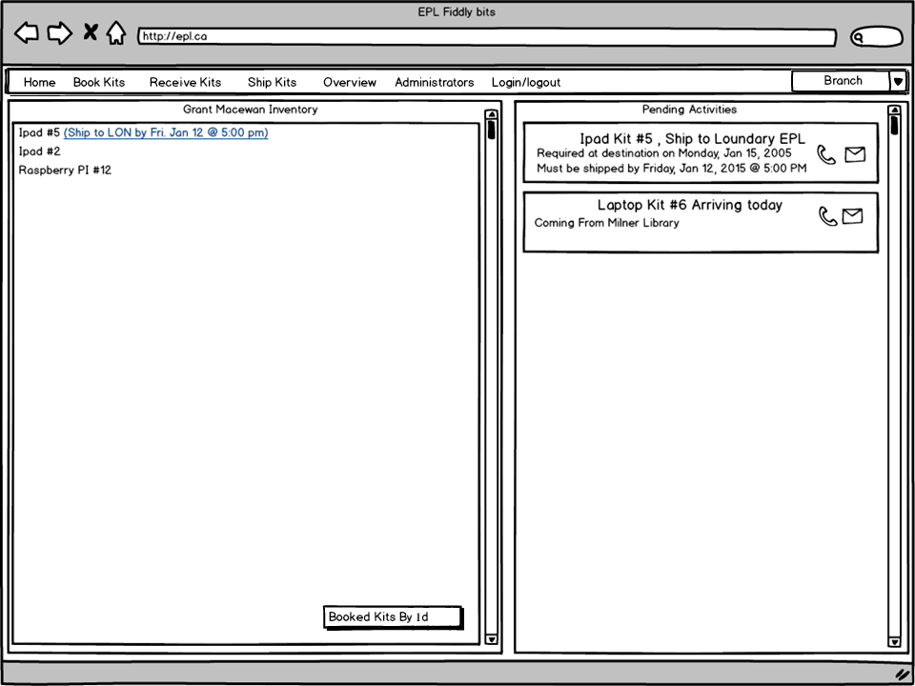

Slide 9
Visual Design
Example: As a user, I need to be able to see and search available kits that suit my needs

Slide 10
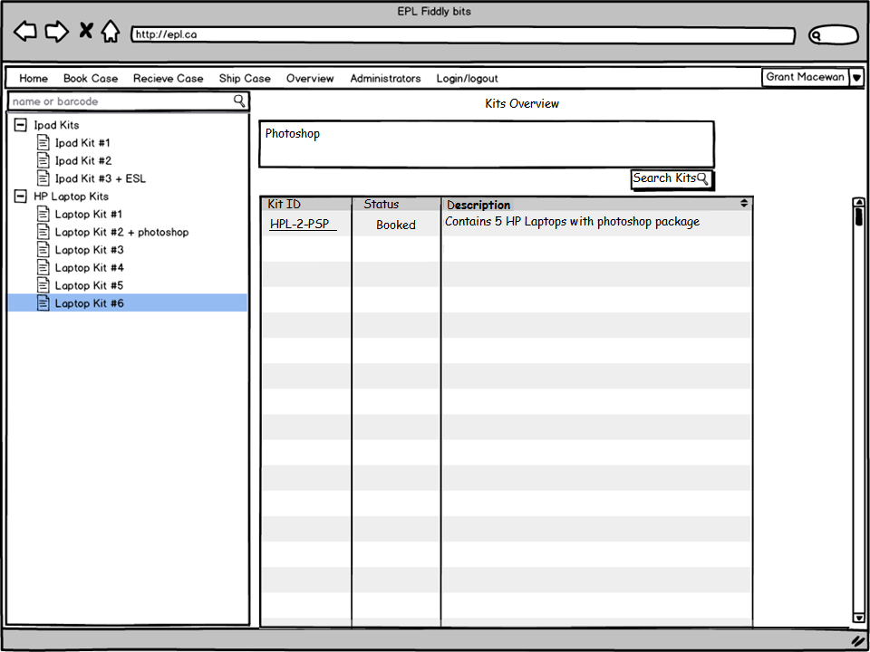

Slide 11
Visual Design
Example: As a user, I need to be able to easily book kits

Slide 12
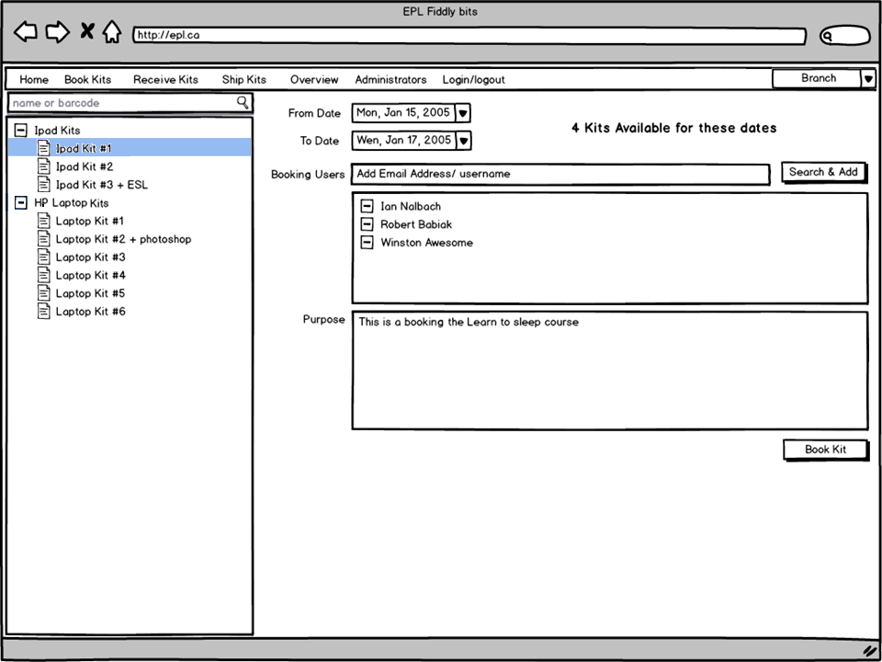

Slide 13
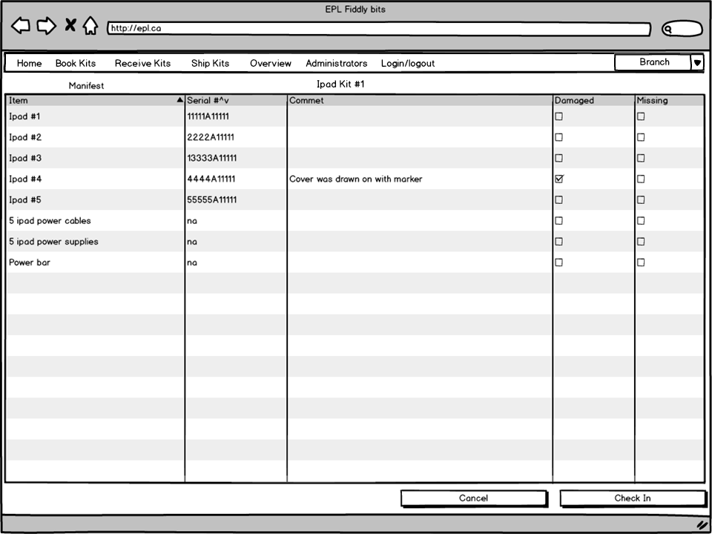

Slide 14
Visual Design
Example: As a User, I need to confirm kits sent in or kits needed to be sent out

Slide 15
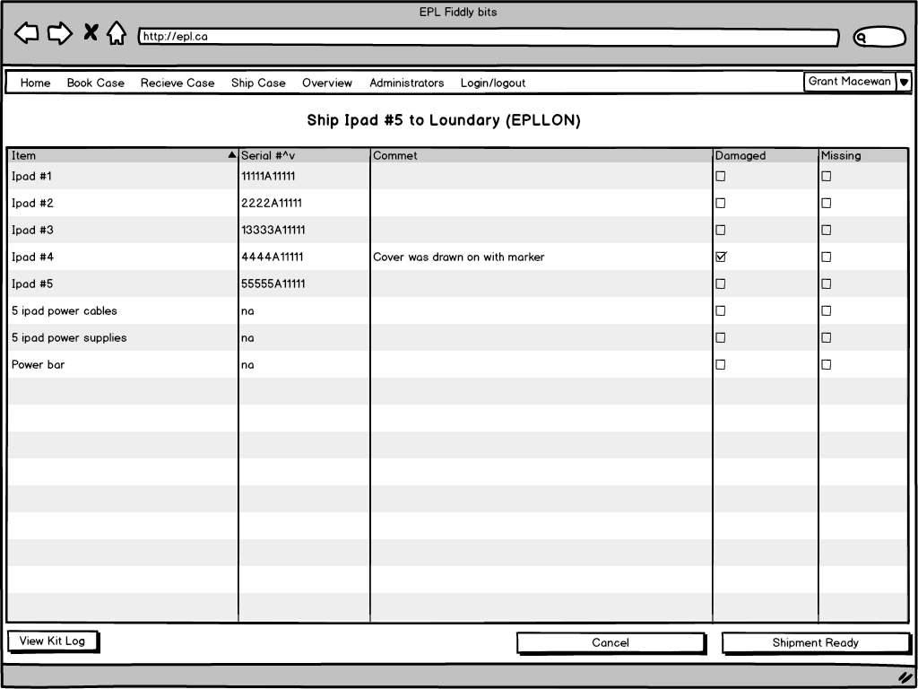

Slide 16
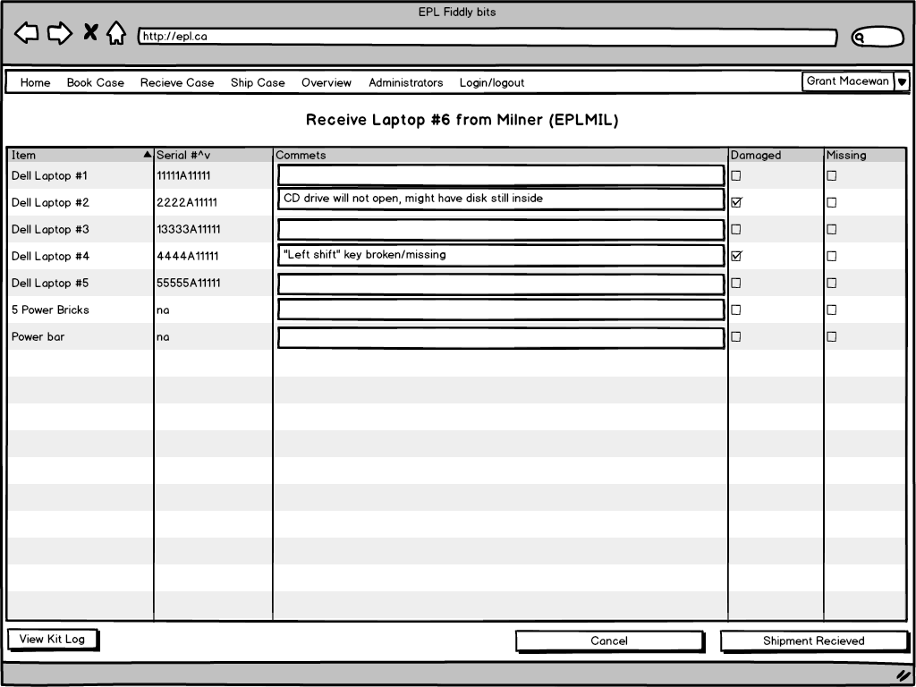

Slide 17
Visual Design
Example:
As an administrator of this system, I need to be able to manage the kit database and modify kit information as well as access system logs

Slide 18
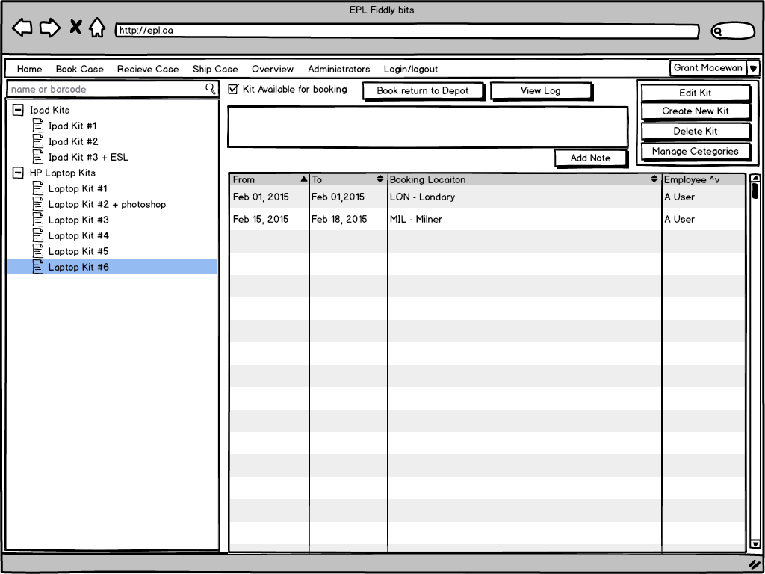

Slide 19
