Slide 1

EPL Kit System
by IRWW

Slide 2
System Design
A multi-user system to make sure library staff can easily:
search through available kits
perform and maintain bookings
see which kits are arriving or need to be sent out
confirm kits that have been sent/received
set-up new kits
make sure necessary email notifications are sent

Slide 3
Scope Definition
System will have:
Bookings that are systemically up-to-date
Buffered dates for booking kits
Email notifications to associated persons
A Stand-alone system separate from EPL’s main
Kit and bookings database within the standalone system
A means of tracking missing components

Slide 4
System Proposal
Access roles: [Admin and Staff]
Built for the web: Runs beautifully on PHP with Laravel
Information on bookings by system notifies users if problems arise
Searches choose the fastest available kit
Confirm shipment is sent/received

Slide 5
System Proposal
Admin
Maintain kit database, create, update or remove kits
Maintain bookings, and other database records
View reports:
i.e., Damaged Items or pending system activities

Slide 6
System Proposal
Staff
Ability to search and put kits on hold
Ability to leave notes when booking kits
Be able to leave email notifications
Report missing/damaged components

Slide 7
Visual Design
Mockups: The main screen and showing branch location on a map

Slide 8
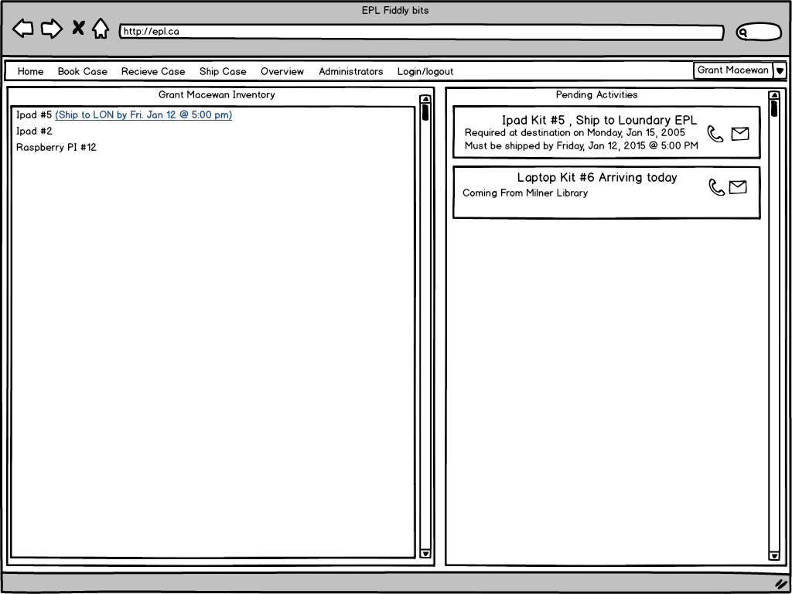

Slide 9
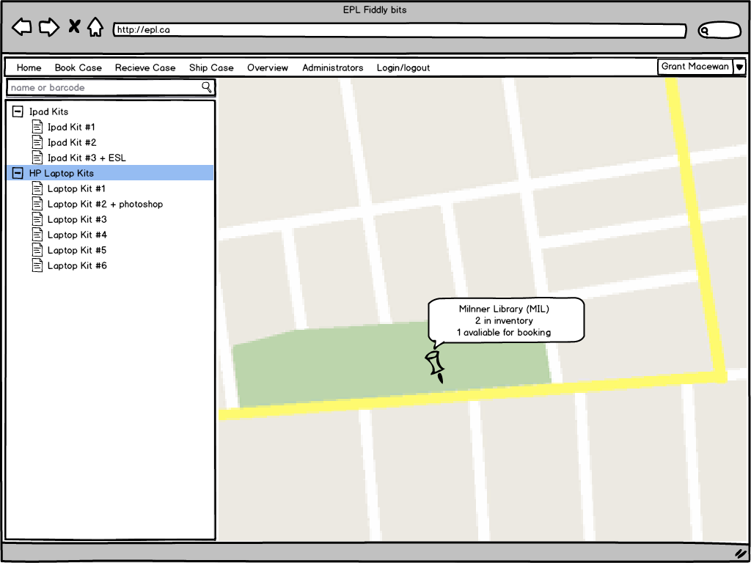

Slide 10
Visual Design
Mockups: Example for booking a kit

Slide 11
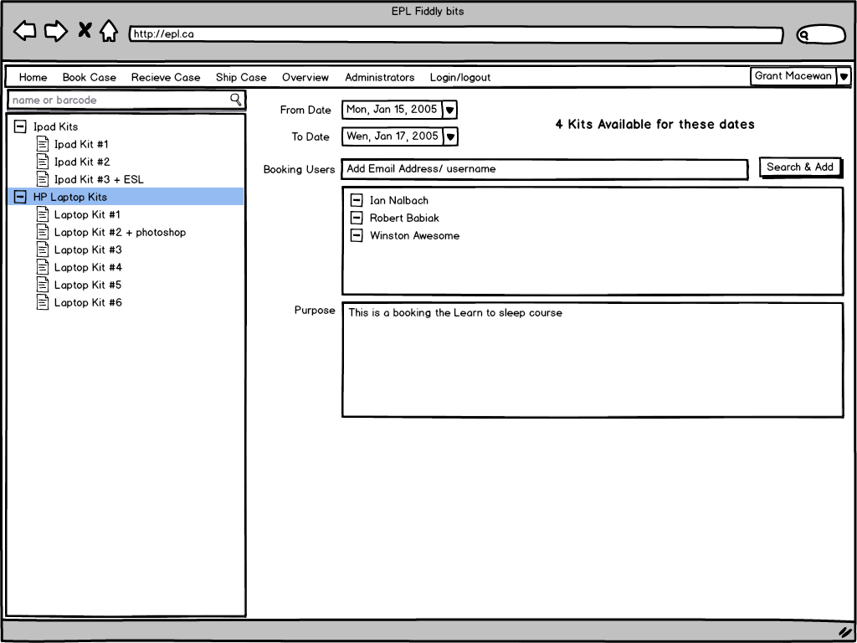

Slide 12
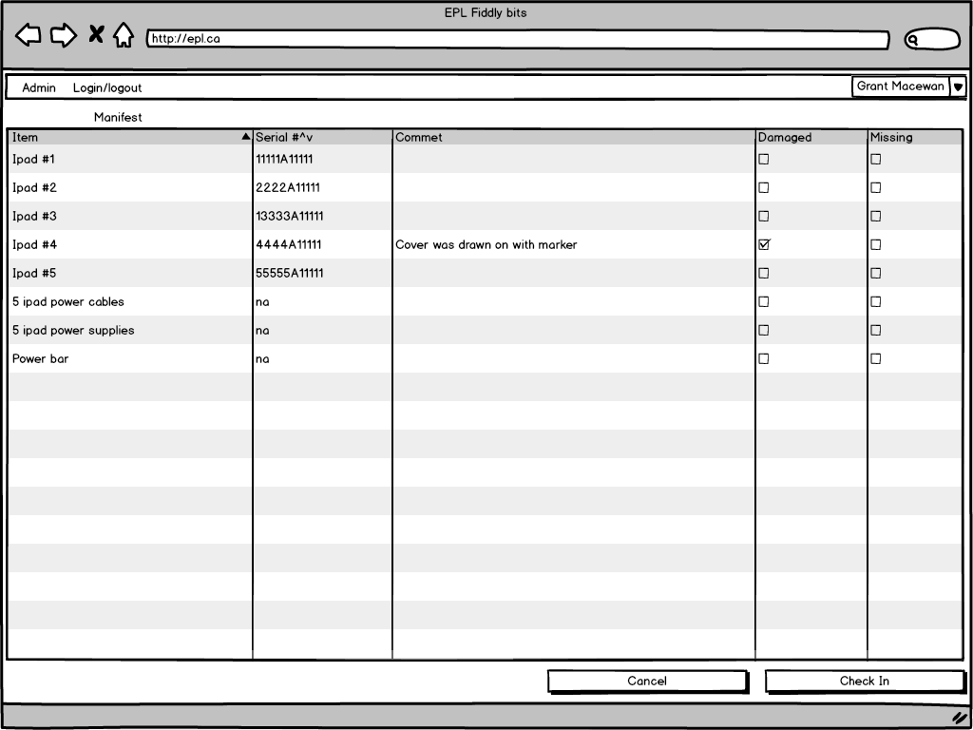

Slide 13
Visual Design
Mockups: Confirming items sent out or received

Slide 14
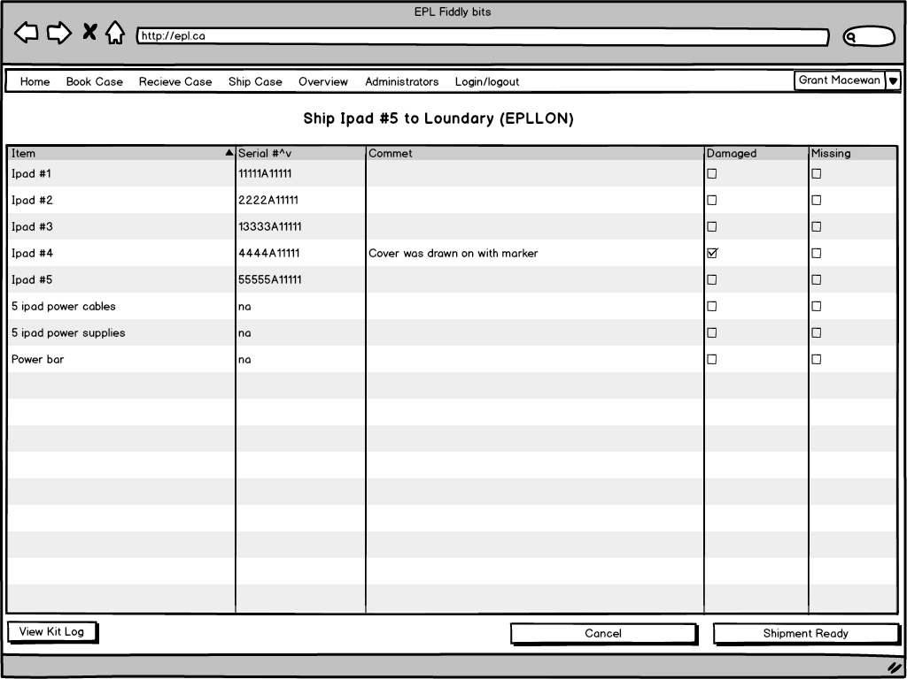

Slide 15
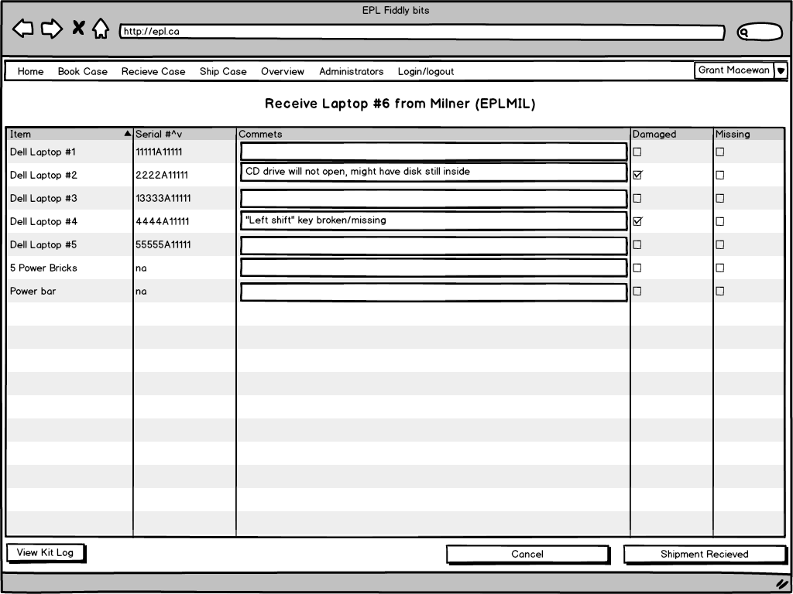

Slide 16
Visual Design
Mockups:
Admin screen + including Laptop Kit item description

Slide 17
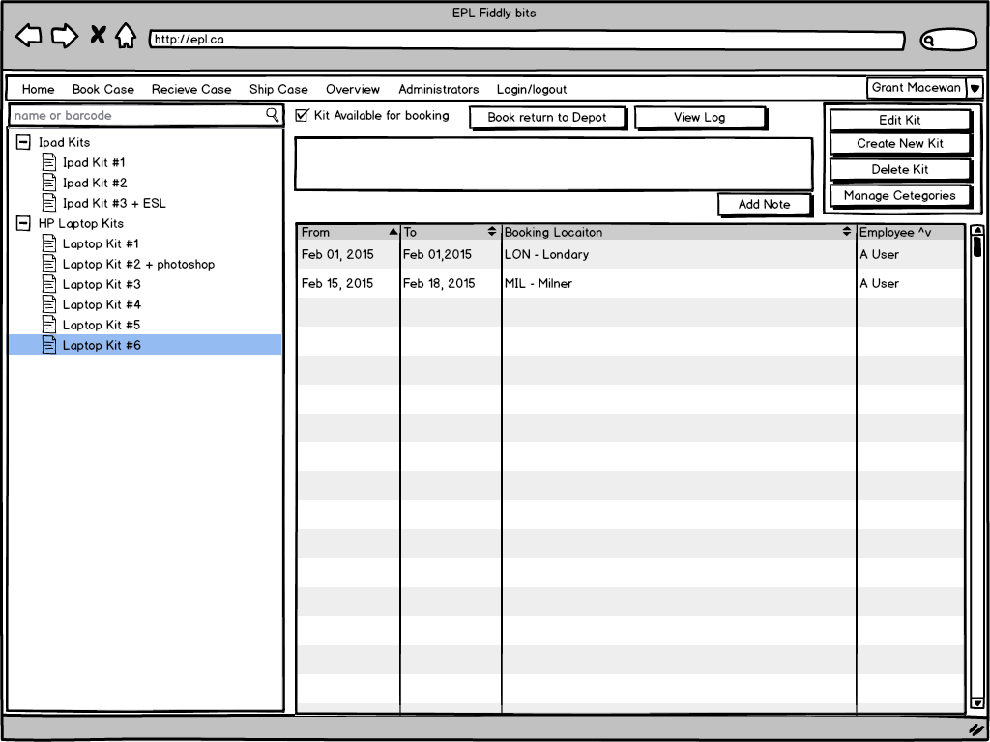

Slide 18
