Slide 1
A Brief Introduction to GWAS
Eric Karlins
Genomics Data Specialist
Bioinformatics and Computational Biosciences Branch
Office of Cyber Infrastructure and Computational Biology
September 19, 2019

Slide 2
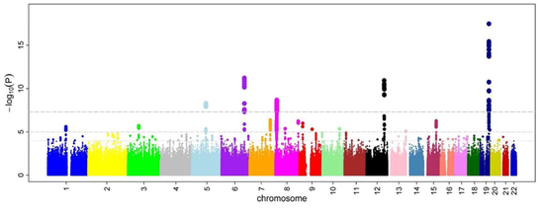
What is GWAS?
Genome Wide Association Study
an observational study of a genome-wide set of genetic variants in different individuals to see if any variant is associated with a trait (wikipedia).

Slide 3
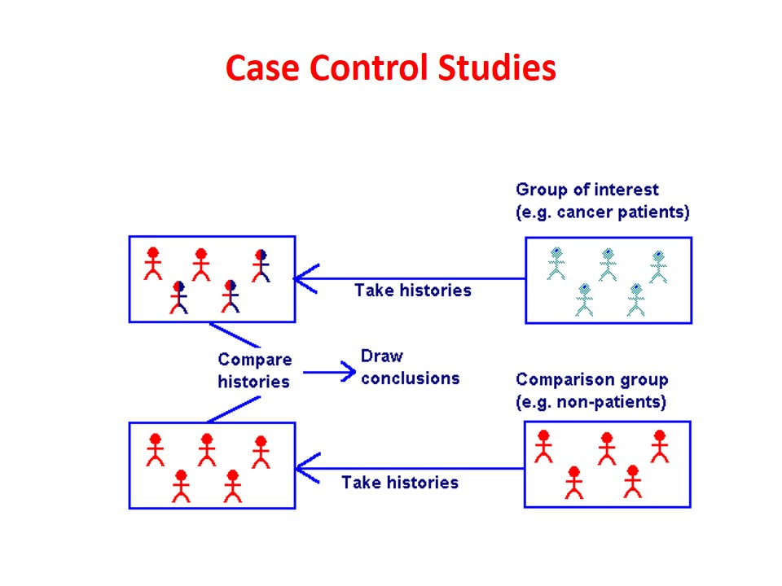
Sample Collection
http://howmed.net/community-medicine/case-control-studies/

Slide 4
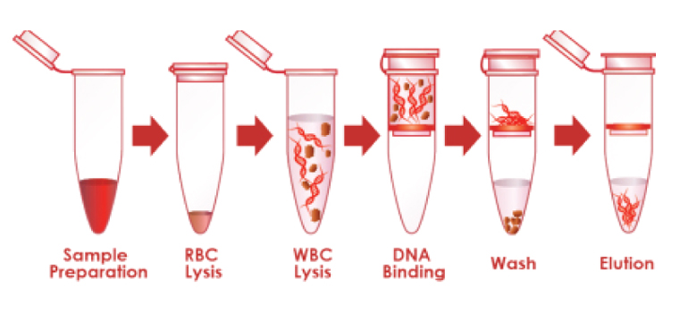
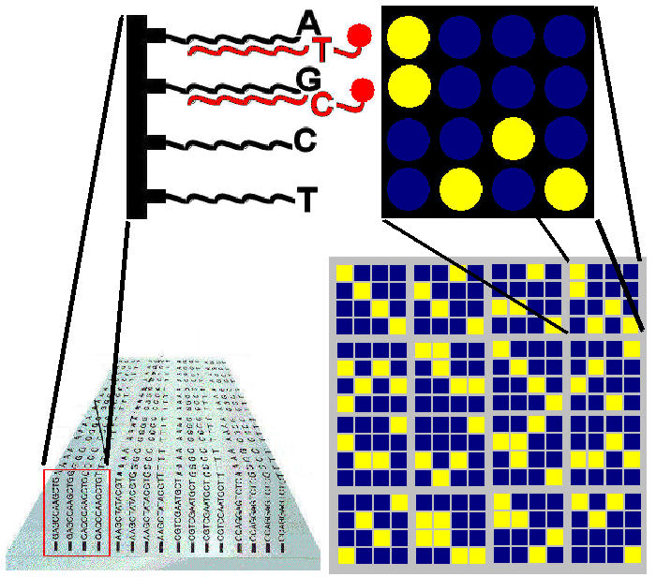
Genotyping Assay
DNA extraction from whole blood
SNP genotyping array
(100K to 5M markers)

Slide 5
Can you find the associated SNP?
Cases:
AGAGCAGTCGACAGGTATAGCCTACATGAGATCGACATGAGATCGGTAGAGCCGTGAGATCGACATGATAGCC
AGAGCCGTCGACATGTATAGTCTACATGAGATCGACATGAGATCGGTAGAGCAGTGAGATCGACATGATAGTC
AGAGCAGTCGACAGGTATAGTCTACATGAGATCGACATGAGATCGGTAGAGCCGTGAGATCGACATGATAGCC
AGAGCAGTCGACAGGTATAGCCTACATGAGATCAACATGAGATCGGTAGAGCAGTGAGATCGACATGATAGCC
AGAGCCGTCGACATGTATAGCCTACATGAGATCGACATGAGATCGGTAGAGCCGTGAGATCAACATGATAGCC
AGAGCCGTCGACATGTATAGCCTACATGAGATCGACATGAGATCGGTAGAGCAGTGAGATCAACATGATAGCC
AGAGCCGTCGACAGGTATAGCCTACATGAGATCGACATGAGATCGGTAGAGCAGTGAGATCAACATGATAGTC
AGAGCAGTCGACAGGTATAGCCTACATGAGATCGACATGAGATCTGTAGAGCCGTGAGATCGACATGATAGCC
Controls:
AGAGCAGTCGACATGTATAGTCTACATGAGATCGACATGAGATCGGTAGAGCAGTGAGATCAACATGATAGCC
AGAGCAGTCGACATGTATAGTCTACATGAGATCAACATGAGATCTGTAGAGCCGTGAGATCGACATGATAGCC
AGAGCAGTCGACATGTATAGCCTACATGAGATCGACATGAGATCTGTAGAGCCGTGAGATCAACATGATAGCC
AGAGCCGTCGACAGGTATAGCCTACATGAGATCGACATGAGATCTGTAGAGCCGTGAGATCGACATGATAGTC
AGAGCCGTCGACAGGTATAGTCTACATGAGATCGACATGAGATCTGTAGAGCCGTGAGATCAACATGATAGCC
AGAGCAGTCGACAGGTATAGTCTACATGAGATCGACATGAGATCTGTAGAGCAGTGAGATCGACATGATAGCC
AGAGCCGTCGACAGGTATAGCCTACATGAGATCGACATGAGATCTGTAGAGCCGTGAGATCGACATGATAGCC
AGAGCCGTCGACAGGTATAGTCTACATGAGATCAACATGAGATCTGTAGAGCAGTGAGATCGACATGATAGTC

Slide 6
Can you find the associated SNP?
Cases:
AGAGCAGTCGACAGGTATAGCCTACATGAGATCGACATGAGATCGGTAGAGCCGTGAGATCGACATGATAGCC
AGAGCCGTCGACATGTATAGTCTACATGAGATCGACATGAGATCGGTAGAGCAGTGAGATCGACATGATAGTC
AGAGCAGTCGACAGGTATAGTCTACATGAGATCGACATGAGATCGGTAGAGCCGTGAGATCGACATGATAGCC
AGAGCAGTCGACAGGTATAGCCTACATGAGATCAACATGAGATCGGTAGAGCAGTGAGATCGACATGATAGCC
AGAGCCGTCGACATGTATAGCCTACATGAGATCGACATGAGATCGGTAGAGCCGTGAGATCAACATGATAGCC
AGAGCCGTCGACATGTATAGCCTACATGAGATCGACATGAGATCGGTAGAGCAGTGAGATCAACATGATAGCC
AGAGCCGTCGACAGGTATAGCCTACATGAGATCGACATGAGATCGGTAGAGCAGTGAGATCAACATGATAGTC
AGAGCAGTCGACAGGTATAGCCTACATGAGATCGACATGAGATCTGTAGAGCCGTGAGATCGACATGATAGCC
Controls:
Associated SNP
AGAGCAGTCGACATGTATAGTCTACATGAGATCGACATGAGATCGGTAGAGCAGTGAGATCAACATGATAGCC
AGAGCAGTCGACATGTATAGTCTACATGAGATCAACATGAGATCTGTAGAGCCGTGAGATCGACATGATAGCC
AGAGCAGTCGACATGTATAGCCTACATGAGATCGACATGAGATCTGTAGAGCCGTGAGATCAACATGATAGCC
AGAGCCGTCGACAGGTATAGCCTACATGAGATCGACATGAGATCTGTAGAGCCGTGAGATCGACATGATAGTC
AGAGCCGTCGACAGGTATAGTCTACATGAGATCGACATGAGATCTGTAGAGCCGTGAGATCAACATGATAGCC
AGAGCAGTCGACAGGTATAGTCTACATGAGATCGACATGAGATCTGTAGAGCAGTGAGATCGACATGATAGCC
AGAGCCGTCGACAGGTATAGCCTACATGAGATCGACATGAGATCTGTAGAGCCGTGAGATCGACATGATAGCC
AGAGCCGTCGACAGGTATAGTCTACATGAGATCAACATGAGATCTGTAGAGCAGTGAGATCGACATGATAGTC

Slide 7
GWAS Results-Manhattan Plot

Slide 8
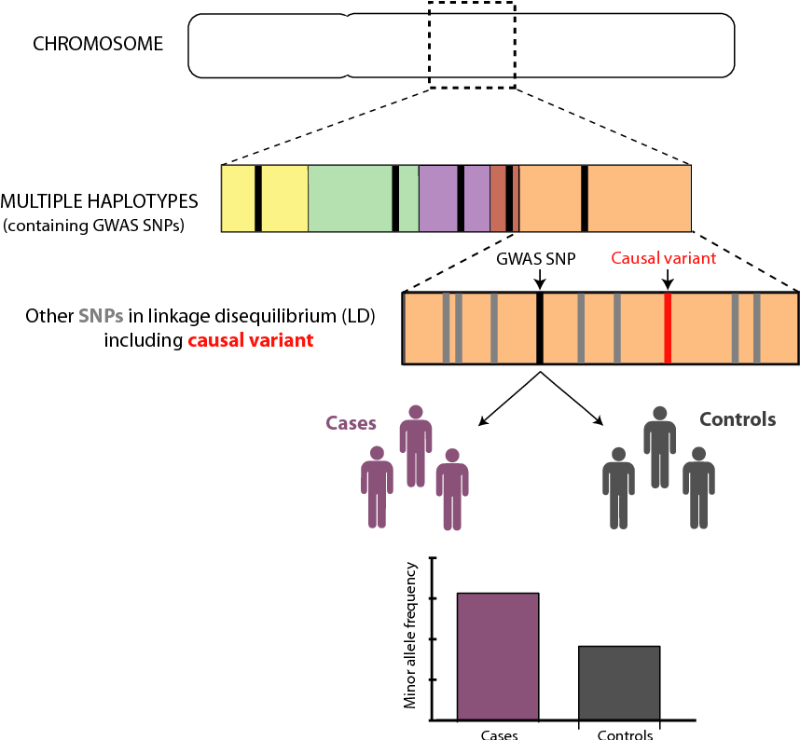
GWAS hit is probably not causal variant

Slide 9
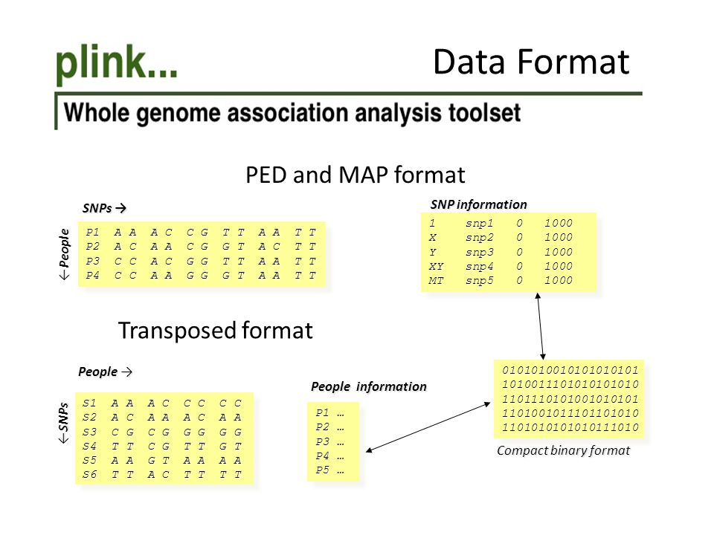
GWAS Bioinformatics
http://zzz.bwh.harvard.edu/plink/
https://www.cog-genomics.org/plink/1.9/

Slide 10
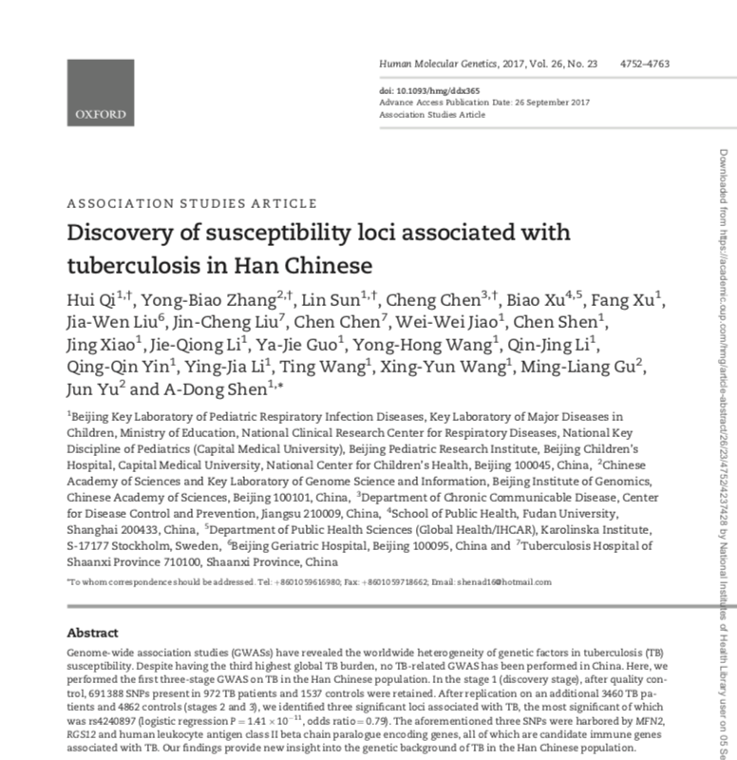
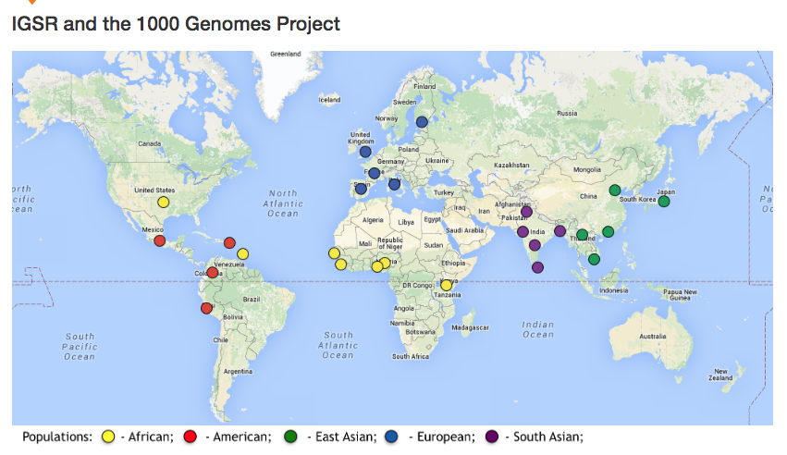
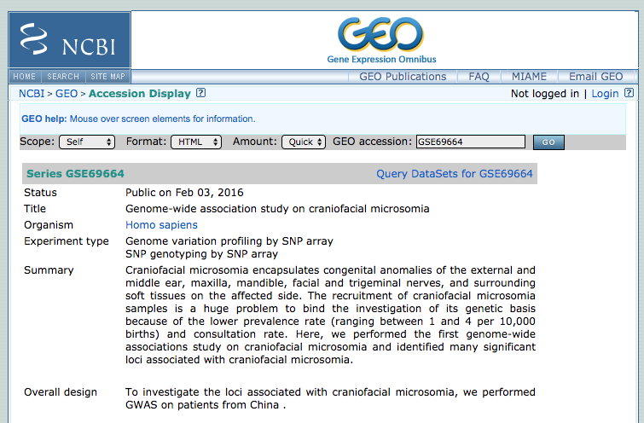
Test data for interactive session
~1000 TB cases downloaded
from dbGaP
~3000 controls downloaded
from dbGaP and 1000G

