Slide 1
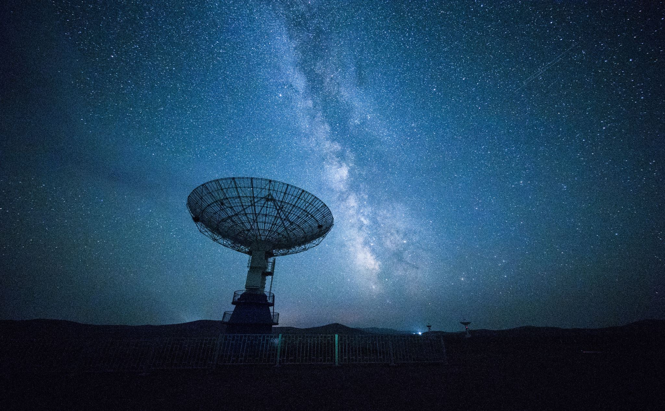
Investigating Trends in UFO sightings and US elections
Shelby Bearrows, Sam Cramer, Gurhar Khalsa, Kara Wolley

Slide 2
Description
Our primary goal is to investigate trends in UFO sightings in the United States by better understanding patterns of sightings, occurrences and sighting location. We also look at trends in UFO shape (circle, oval) to better understand advances in alien technology or at least how human perception of aliens have changed over time. Then, we predict where and when UFO sightings occur based on the outcomes of US presidential and general elections.

Slide 3
Questions
Are UFO sightings increasing over time?
If UFO sightings do increase over time, how is that correlated with the turn out rate for elections?
In states that vote Republican are there more or less UFO sightings?
How does term number effect the number of UFO sightings? Is this also dependent on the political party?

Slide 4
Prior Work
Prior work on this dataset includes 166 notebooks presenting analysis on kaggle (https://www.kaggle.com/NUFORC/ufo-sightings/notebooks) Some of the most commonly explored questions include: Frequency of sightings by location (including per capita), word cloud analysis on the description attribute, shape of UFOs by time of year, sightings by shape and season, and shape frequencies, just to name a few avenues of exploration. Perhaps the most explored question is whether sightings have increased over time, the data seem to show that they have. Among the correlational questions explored one chi-square analysis revealed a relationship between sightings and region (https://www.kaggle.com/adhok93/eda-and-chi-squared-test). While shape over time has been explored, the time variable was usually by week or month, rather than by decade for example (this could be interesting to explore). Merging this dataset with election data will likely add a new level of novelty to our work not present in the prior work.

Slide 5
Proposed Work
Cleaning - The UFO dataset is especially 'dirty' and will to remove symbols and format dates and state abbreviations. This will also be necesarry prior to merging with the US Elections dataset. The US Elections dataset seems much cleaner but likely will need some cleaning.
Preprocessing - The UFO dataset will need to have some values input that are missing. Some values may remain null, but many are predictable, such as if the 'county' value for a row of data is blank, but we know the state is 'TX,' it's safe to input the USA for the country value.
Integration - Merge the UFO dataset with the US elections dataset. This will drop some UFO sightings that occured outside of the US states.
Mining - Questions 1 and 2 in Description could be explored with histogram analysis and correlation analysis respectivly. Duration of sighting for question two may have to be converted into an interval variable or nominal for chi-square testing. - A chi square test could be applied to question 3 as well to establish any correlation between UFO shape and cities. - We may have to define similarity measures between shapes like "sphere" and "circle" vs "sphere" and "triangle" for question 4 - Histogram analysis may shed some initial light on say the shapes used to describe UFOs and the gender of the person reporting the sighting for question 5. - A term cloud may provide insight into language in sighting descriptions

Slide 6
Evaluation

