Slide 1
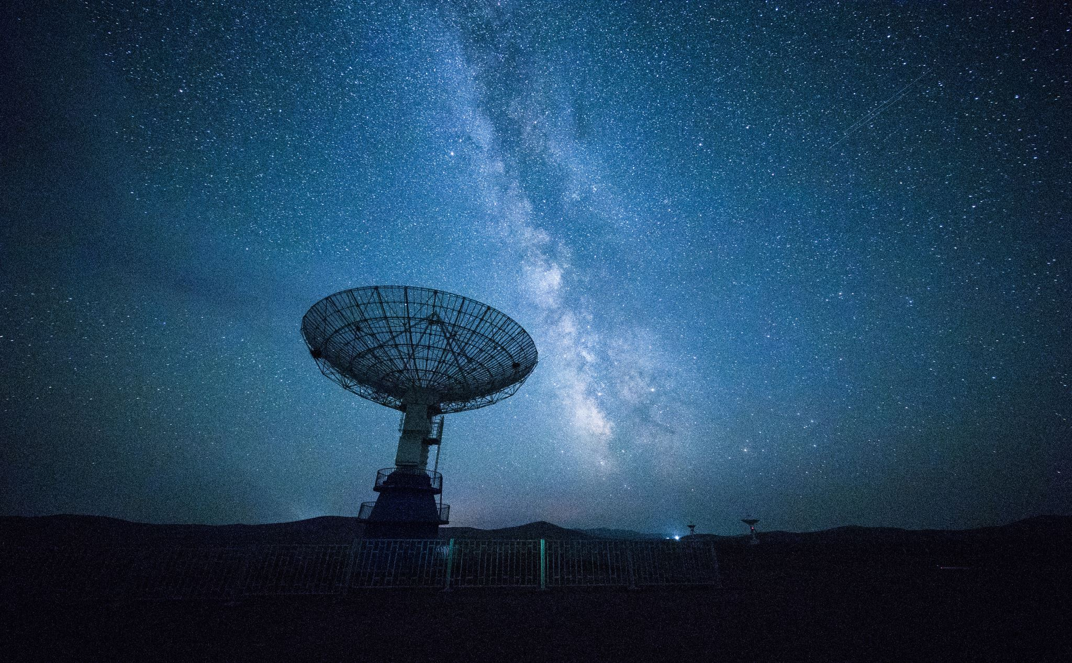
Investigating Trends in UFO sightings and US elections
Shelby Bearrows, Sam Cramer, Gurhar Khalsa, Kara Wolley

Slide 2
Description
Investigate trends in UFO sightings in the United States
Better understand patterns of sightings, occurrences and sighting location
Identify trends in UFO shape to better understand advances in alien technology or at least how human perception of aliens have changed over time.
Predict where and when UFO sightings occur based on the outcomes of US presidential and general elections.

Slide 3
Questions
Are UFO sightings increasing over time?
How has the UFO shape changed over time?
If UFO sightings do increase over time, how is that correlated with the turn out rate for elections?
Do states that vote Republican have significantly more UFO sightings?
How does term number effect the number of UFO sightings? Is this also dependent on the political party?

Slide 4
Prior Work
Some of the most commonly explored topics on UFO sightings are frequency of sightings by location, word cloud analysis on the description attribute, shape of UFOs by time of year, sightings by shape and season, and shape frequencies, just to name a few avenues of exploration. Perhaps the most explored question is whether sightings have increased over time. Work done by others seem to indicate that they have.
Among the correlational questions explored are chi-square analysis revealed a relationship between sightings and region(www.kaggle.com/adhok93/eda-and-chi-squared-test).
Geospatial analysis of UFO sightings has also been explored previously using heatmaps (www.kaggle.com/abigaillarion/ufo-reports-in-united-states).

Slide 5
Datasets
Main Dataset:
https://www.kaggle.com/NUFORC/ufo-sightings
Available as csv files on personal computers of team members as well as on our GitHub page.
Supplemental Datasets
https://www.kaggle.com/tunguz/us-elections-dataset
Available as csv files on personal computers of team members and on our GitHub page.
The merged dataset (“merged_ufo_elect_data.csv”) can be found on our GitHub
Tools
Python
Tableau
Matlab

Slide 6
Proposed Work
Cleaning
The UFO dataset is especially 'dirty’. Reformatting of dates, state name and removal of random symbols (&, !, #) from the comments attribute is necessary. Cleaning will be necessary prior to merging with the US Elections dataset. The US Elections dataset appears to be much cleaner.
Preprocessing
Correct for missing values. Some values may remain null, but many are predictable, such as if the 'county' value for a row of data is blank, but we know the state is 'TX,' it's safe to input the USA for the country value.
Identify erroneous data and outliers.
Integration
Merge the UFO dataset with the US elections dataset. This will drop some UFO sightings that occurred outside of the US states.

Slide 7
Evaluation
Histograms to identify classification of UFO shape or visualizations by election terms (bins of years)
Heatmaps to visualize geographical location of UFO sightings to support hypotheses.
Apiori to quantify minimal support
Correlation measures including Pearson’s and lift.
Student t test for the comparison of means

Slide 8


