Slide 1
GN420 練習題
範圍 : class

Slide 2
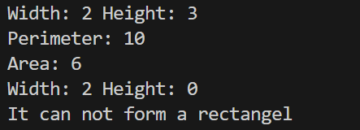
Exercise #1
建立一個 class Rectangle，Rectangle 中屬性有 width, height，方法有
isRectangel() 判斷是 width, height 是否可以構成 rectangle
cal_perimeter() 回傳其周長
cal_area() 回傳其面積
Output:

Slide 3
class Rectangle:
def __init__(self,width,height):
self.width = width
self.height = height
def isRectangel(self):
return self.width>0 and self.height>0
def cal_perimeter(self):
return 2*(self.width+self.height)
def cal_area(self):
return self.width*self.height

Slide 4
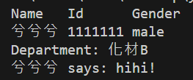
Exercise #2
建立一個 class Student，Student 中屬性有 name, id, gender, departures，方法有
printInfo() 輸出 Student 的 name, id, gender
getDepartment() 透過 id 來判斷此學生是哪個學院的
say(message) 輸出 name says message
Output:

Slide 5
class Student:
def __init__(self,name,id,gender):
self.name = name
self.id = id
self.gender = gender
self.departments = {'03':'電乙A','04':'電乙B','05':'電甲A','06':'電甲B','07':'電丙A',
'08':'機械A','09':'機械B','10':'化材A','11':'化材B','12':'工管A','13':'工管B',
'14':'資工A','15':'資工B','33':'資工C','16':'資管A','17':'資管B',
'18':'資傳A（設計組）','20':'資傳B（科技組）','22':'管院A（企管）',
'23':'管院B（企管）','24':'管院C（財金）','25':'管院D（財金）','26':'管院E（國
企）','99':'管院I（國企）','28':'管院F（會計）','29':'應外A','30':'中語A','31':'社政A','32':'藝設A','27':'管院英專G','35':'資訊英專A','36':'人社英專A','37':'電通英專A','38':'工程英專A'}
def printInfo(self):
print('Name ','Id ','Gender')
print(self.name, self.id,self.gender)
def getDepartment(self):
departmentID = self.id[3:5]
if departmentID not in self.departments:
print('Error id!')
return
return self.departments[departmentID]

Slide 6
def say(self,message):
print(self.name,’says:',message)

Slide 7
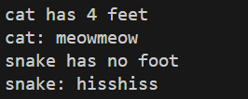
Exercise #3
建立一個 class Animal，Animal 中屬性有 name, sound, feet，方法有
printInfo() 輸出 Animal 的 name, feet
say() 輸出 Animal 的叫聲
Output:

Slide 8
class Animal:
def __init__(self, name,sound,feet):
self.name = name
self.sound = sound
self.feet = feet
def printInfo(self):
if self.feet ==0:
print(self.name,'has no foot')
elif self.feet ==1:
print(self.name,'has a foot')
else:
print(self.name,'has',self.feet,'feet')
def say(self):
print(self.name+': '+self.sound*2)

Slide 9
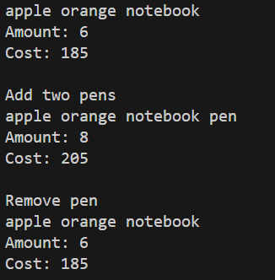
Exercise #4
建立一個 class ShoppingCart，ShoppingCart 中屬性有 basket(存放購買的物品), info(物品的數量、價格)，方法有
getAmount() 回傳購物車內有多少商品數量
getCost() 回傳現在所需花費的金額
add(thing1,price1) 將物品新增至 basket、info 中
remove(thing) 移除特定物品
myBasket() 輸出 basket 內的所有商品
格式: sc = ShoppingCart(['apple', 'orange','notebook’],
{'apple':[2,20], 'orange':[1,25],'notebook':[3,40]})
也可以自己設計加入或刪除特定的商品數量!
Output:

Slide 10
class ShoppingCart:
def __init__(self,basket,info):
self.basket = basket
self.info = info
def getAmount(self):
amount = 0
for i in self.basket:
amount+=self.info[i][0]
return amount
def getCost(self):
cost = 0
for i in self.basket:
cost+=self.info[i][0]*self.info[i][1]
return cost
def add(self,thing1,price1):
if thing1 not in self.basket:
self.basket.append(thing1)
if thing1 not in self.info:
self.info.update({thing1:[1,price1]})
else:
self.info[thing1][0]+=1

Slide 11
def remove(self,thing):
if thing not in self.basket:
print(thing,'was not be ordered!')
return
self.basket.remove(thing)
del self.info[thing]
def myBasket(self):
for i in self.basket:
print(i,end = ' ')
print()

