Slide 1
GN420 練習題
範圍 :string, list, dictionary, if

Slide 2
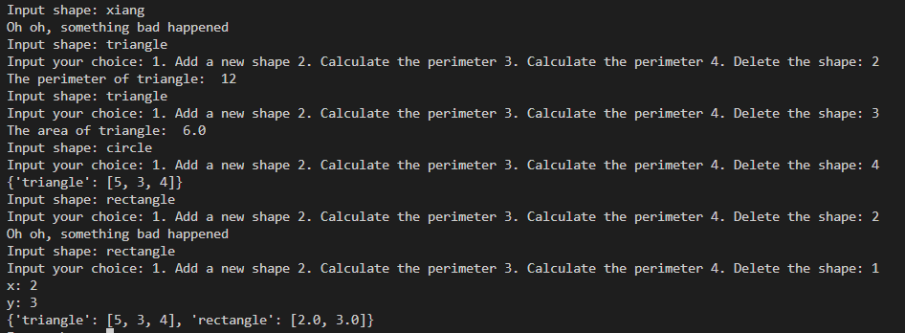
Exercise #1
求面積與周長(以下範例只包括圓形、長方形、三角形)
function 1. 新增一個圖形，接者輸入該圖形的長度(格式: 5,3,4)
function 2. 求周長
function 3. 求面積
function 4. 刪除圖形
Output:

Slide 3
import math
PI = math.pi
data = {'circle':5,'triangle':[5,3,4]}
a = 1
shape = input('Input shape: ')
if shape == 'circle':
choice = int(input('Input your choice: 1. Add a new shape 2. Calculate the perimeter 3. Calculate the perimeter 4. Delete the shape: '))
if choice == 1:
r = float(input('r: '))
if r>0:
data.update({shape:r})
print(data)
else:
print('Cannot form a circle')
elif choice == 2 and shape in data:
print('The perimeter of cirlce: ', 2*PI*data[shape])
elif choice == 3 and shape in data:
print('The area of circle: ', PI*(data[shape]**2))
elif choice == 4 and shape in data:
del data[shape]
print(data)
else:
print('Oh oh, something bad happened')

Slide 4
elif shape == 'triangle':
choice = int(input('Input your choice: 1. Add a new shape 2. Calculate the perimeter 3. Calculate the perimeter 4. Delete the shape: '))
if choice == 1:
triangle_len = [float(input('a: ')),float(input('b: ')),float(input('c: '))]
triangle_len.sort()
if triangle_len[0]+triangle_len[1]>triangle_len[2]:
data.update({shape:triangle_len})
print(data)
else:
print("Cannot form a triangle")
elif choice == 2 and shape in data:
len = data[shape]
print('The perimeter of triangle: ', len[0]+len[1]+len[2])
elif choice == 3 and shape in data:
len = data[shape]
s = (len[0]+len[1]+len[2])/2
sea_dragon = (s*(s-len[0])*(s-len[1])*(s-len[2]))**0.5
print('The area of triangle: ', sea_dragon)
elif choice == 4 and shape in data:
del data[shape]
print(data)
else:
print('Oh oh, something bad happened')

Slide 5
elif shape == 'rectangle':
choice = int(input('Input your choice: 1. Add a new shape 2. Calculate the perimeter 3. Calculate the perimeter 4. Delete the shape: '))
if choice == 1:
rectangle_len = [float(input('x: ')),float(input('y: '))]
if rectangle_len[0]>0 and rectangle_len[1]>0 :
data.update({shape:rectangle_len})
print(data)
else:
print("Cannot form a rectangle")
elif choice == 2 and shape in data:
print('The perimeter of rectangle: ', 2*(data[shape][0]+data[shape][1]))
elif choice == 3 and shape in data:
print('The area of rectangle: ', data[shape][0]*data[shape][1])
elif choice == 4 and shape in data:
del data[shape]
print(data)
else:
print('Oh oh, something bad happened')
else:
print('Oh oh, something bad happened')

Slide 6
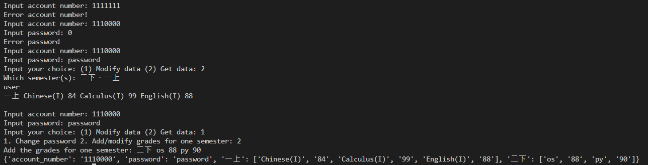
Exercise #2
實作一個成績系統，自訂一個 user_name = {account_number:'', password:'',一上:[]}
而此系統有兩種功能，選擇(1) 修改資料 (2) 獲取資料...
修改資料內有 1. 更改密碼(需再輸入一次密碼) 2. 添加/修改一個學期的成績(格式: 學期 課名 成績)...
獲取資料內有 1. 哪幾個學期的成績(ex: 一上、二下)...
Output:

Slide 7
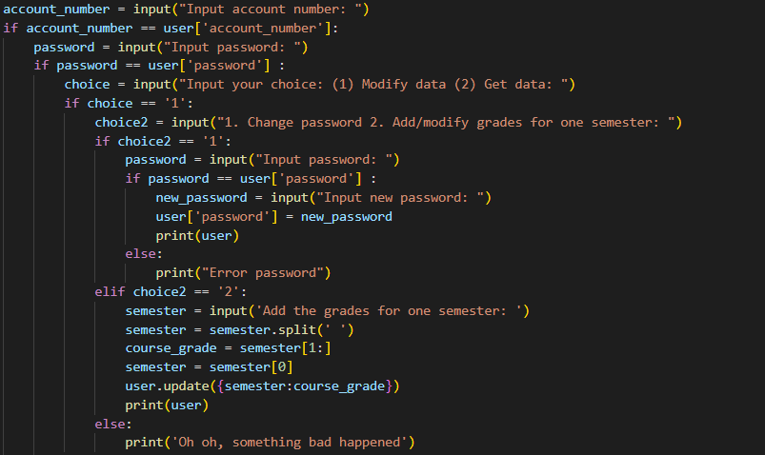
user = {'account_number':'1110000', 'password':'password',
'一上':['Chinese(I)', '84', 'Calculus(I)', '99', 'English(I)', '88’]}

Slide 8
