Slide 1
A COMPARISON OF MACHINE LEARNING ALGORITHMS ON DETECTION OF PHISHING WEBSITES

Slide 2

TEAM
Madhuri Vedulla - 700741625
Kamala Ramesh - 700745451
Priyanka Bojja - 700739528
Sai Priyanka Narra - 700741613

Slide 3






CONTRIBUTION
Person | Task
Madhuri Vedulla (700741625) | Data Collection + Documentation
Kamala Ramesh (700745451) | Feature Extraction + Documentation
Priyanka Bojja (700739528) | Model Implementation (3) + Documentation
Sai Priyanka Narra (700741613) | Model Implementation (3) + Documentation

Slide 4

MOTIVATION
Phishing – most frequent cyber attacks
Includes pretending to be trustworthy websites to steal sensitive
data like,
Login and Password Details Credit Card Credentials Personal Information
These information are then used for identity theft and financial fraud.
Hence Phishing website detection is critical to protect personal
information and prevent financial losses.

Slide 5


OBJECTIVE
4
To compare the performance of different machine learning algorithms
for detecting phishing websites and evaluating them based on metrics.
Proposed Algorithms:
Logistic Regression
K-Nearest Neighbor classifier
Naive Bayes Classifiers
Random Forest classifier
Decision tree classifier
Support Vector Machine

Slide 6

RELATED WORK
There are several related works that discuss on the evolution of Phishing attack in the recent times
The discussions include,
Types of Phishing
Methods used to identify Phishing
Lexical Structure
Features Extraction Techniques
Model Development
Model Testing and Evaluation
Results and Comparison

Slide 7
PROBLEM STATEMENT
3
In order to avoid getting phished,
Users should have awareness of phishing websites.
Have a blacklist of phishing websites which requires the knowledge
of website being detected as phishing.
Detect them in their early appearance, using machine learning and
deep neural network algorithms.
Of the above methods, the machine learning models can be trained to identify and classify phishing websites more accurately than traditional rule-based approaches

Slide 8
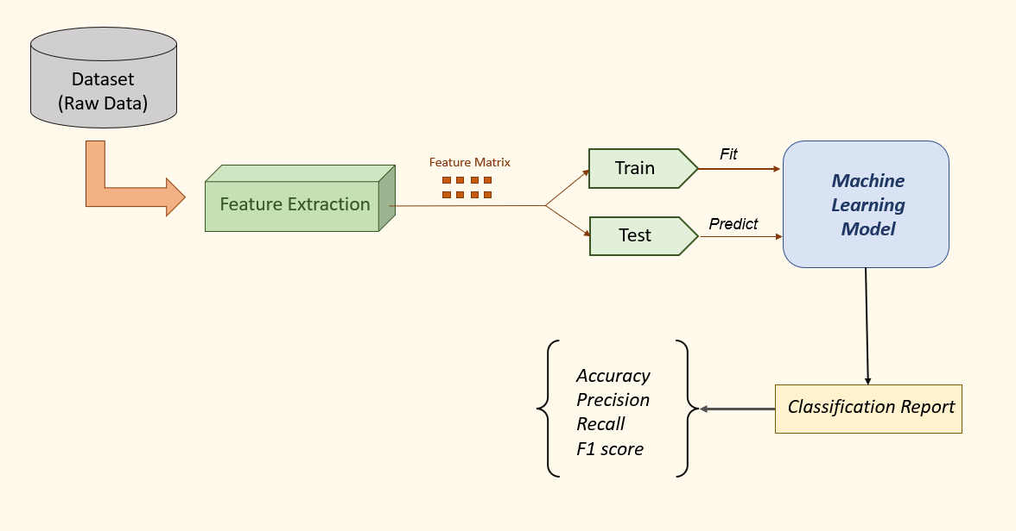
PROPOSED SOLUTION

Slide 9
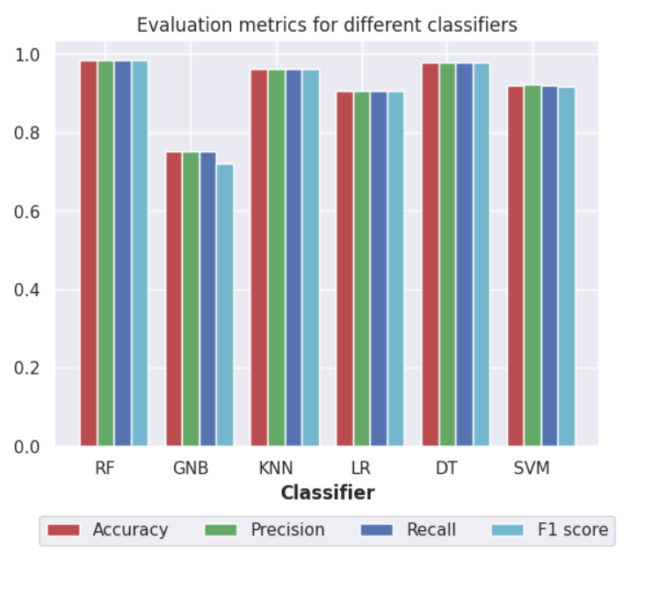
RESULTS & SIMULATIONS
Models/Metrics | Accuracy (%) | Precision | Recall | f1-score
Random Forest | 98.5 | 0.985 | 0.985 | 0.985
Gaussian Naïve Bayes | 75.2 | 0.751 | 0.752 | 0.720
K Nearest Neighbor | 96.1 | 0.961 | 0.961 | 0.961
Logistic Regression | 90.7 | 0.907 | 0.907 | 0.906
Decision Tree | 97.8 | 0.978 | 0.978 | 0.978
Support Vector Machines | 92.0 | 0.922 | 0.920 | 0.918

Slide 10

REFERENCES
10
[1] M. Korkmaz, O. K. Sahingoz and B. Diri, "Detection of Phishing Websites by Using Machine Learning-Based URL Analysis," 2020 11th International Conference on Computing, Communication and Networking Technologies (ICCCNT), Kharagpur, India, 2020, pp. 1-7, doi: 10.1109/ICCCNT49239.2020.9225561.
[2] M. H. Alkawaz, S. J. Steven, A. I. Hajamydeen and R. Ramli, "A Comprehensive Survey on Identification and Analysis of Phishing Website based on Machine Learning Methods," 2021 IEEE 11th IEEE Symposium on Computer Applications & Industrial Electronics (ISCAIE), Penang, Malaysia, 2021,
pp. 82-87, doi: 10.1109/ISCAIE51753.2021.9431794.
[3] J. Kumar, A. Santhanavijayan, B. Janet, B. Rajendran and B. S. Bindhumadhava, "Phishing Website Classification and Detection Using Machine Learning," 2020 International Conference on Computer Communication and Informatics (ICCCI), Coimbatore, India, 2020, pp. 1-6, doi: 10.1109/ICCCI48352.2020.9104161.
[4] S. Sindhu, S. P. Patil, A. Sreevalsan, F. Rahman and M. S. A. N., "Phishing Detection using Random Forest, SVM and Neural Network with Backpropagation," 2020 International Conference on Smart Technologies in Computing, Electrical and Electronics (ICSTCEE), Bengaluru, India, 2020, pp. 391-394, doi: 10.1109/ICSTCEE49637.2020.9277256.
[5] PhishTank-Friends of PhishTank,” PhishTank. [Online]. Available: https://www.phishtank.com/friends.php. [Accessed: 09-Mar-2020].
[6] Marchal, S. (Creator) (2014). PhishStorm - phishing / legitimate URL dataset. Aalto University. urlset(v.zip). 10.24342/f49465b2-c68a-4182- 9171-075f0ed797d5
[7] S. Zaman, S. M. Uddin Deep, Z. Kawsar, M. Ashaduzzaman and A. I. Pritom, "Phishing Website Detection Using Effective Classifiers and Feature Selection Techniques," 2019 2nd International Conference on Innovation in Engineering and Technology (ICIET), Dhaka, Bangladesh, 2019, pp. 1-6, doi: 10.1109/ICIET48527.2019.9290554.

Slide 11
THANK YOU

