Slide 1

Test Framework for Shaders
Project for the course
„Visuelle Effekte“ (Visual Effects)
Kaveh Yousefi

Slide 2
Version History
Version | Date | Changes
1.0 | 10.07.2015 | First version, document created.
1.1 | 23.09.2015 | Added parameter description for extended Lommel-Seeliger model, and corrected mistake having mixed-up the Schlick approximation for the Fresnel term with the empirical approximation.
1.2 | 23.09.2015 | Corrected a mistake in the empirical approximation formula for the Fresnel term, having forgotten the exponent (“power”).
1.3 | 23.09.2015 | Added further problem information and hyperlinks to the project files.
1.4 | 23.09.2015 | Corrected a mistake on page 50, calling the normal distribution function the “standard distribution function”.
1.5 | 23.09.2015 | Corrected a mistake on page 19, where the “masking” and “shadowing” labels were mixed-up.

Slide 3
Content
Goals
Definitions
Presentation of implemented shaders
Description of the test framework
Evaluation and future work

Slide 4
Goal
The goal is the implementation of a shader test framework.
Utilized technologies:
  HTML5
  JavaScript
  WebGL
  CSS (Cascading Stylesheets).
Contains implementations of various shaders*.
Allows
  experimenting with different lighting models
  comparing different lighting models.
*) Note: A shading model is usually a rephrasing and simplification of a BRDF (Bidirection Reflectance Distribution Function). See [dempski2005advanced], page 90.

Slide 5
Definitions
Anisotropy:
  A material's reflective property depends on the angle of the viewer looking at the surface.
  Opposite: isotropy.
Fresnel effect:
  The fraction of the reflection/refracted light depends on the viewing angle.
  Example: At some angles water seems “less transparent”.
Sources: [3drender2001]; [dempski2005advanced], page 89.

Slide 6

Example - Anisotropy
Example of anisotropy: The lighted area's shape changes with the viewing angle.

Slide 7

Example – Fresnel Effect
A Blinn-Phong shader with Fresnel effect: Areas pointing away from the light source are lit more intensely.

Slide 8

Presented Models
Ashikhmin-Shirley
Cook-Torrance
Gooch
Lommel-Seeliger
Minnaert
Oren-Nayar
Phong (Lambert) variants
  Phong
  Blinn-Phong
  Schlick
  Gaussian
Strauss
Ward (anisotropic)

Slide 9

Ashikhmin-Shirley

Slide 10

Ashikhmin-Shirley
An anisotropic, specular model.
Comprised of a diffuse ρd and a specular term ρs.
Uses two exponential factors (nu, nv):
  Determine the specular reflection's shape.
  Can be very large, for instance, larger than 10000.
  If nu = nv: specular area is circular, similar to Phong model.
Formula:

Slide 11

Ashikhmin-Shirley
Diffuse term:
  May optionally be replaced by a more efficient, but less realistic, term, e.g., a Lambertian.
  Formula:

Slide 12

Ashikhmin-Shirley
Specular term:
  Contains a Fresnel term, usually the Schlick approximation.
  Uses the two exponential factors nu, nv.
  Needs two additional vectors besides the surface normal:
    Tangent (U)
    Bitangent (V).
  Formula:

Slide 13
Ashikhmin-Shirley - Parameters
Parameter | Description | Notes
diffuseColor (Rd) | The diffuse surface color.
specularColor (Rs) | The specular surface color.
exponentX (Nu) | Exponent to control lobe. | Creates anisotropy.
exponentY (Nv) | Exponent to control lobe. | Creates anisotropy.
referenceAxis (epsilon) | Basic 3D vector to define the reference frame together with the surface normal. | Usually no parameter, but the vector (1, 0, 0).
Source: [engel2008programming], page 283.

Slide 14

Cook-Torrance

Slide 15
Cook-Torrance
Physically based lighting model.
Regards the surface as a set of microfacets, each pointing to a certain direction.
Simulates shadowing and masking:
  shadowing: Microfacets can prevent light from reaching other microfacets.
  masking: Microfacets can block light from being reflected from other microfacets to the viewer.
  Both effects influence the diffuse and specular term.

Slide 16

Cook-Torrance - shadowing
Visual description of shadowing. Inspired by [engel2008programming], page 239.

Slide 17

Cook-Torrance - masking
Visual description of masking. Inspired by [engel2008programming], page 240.

Slide 18

Cook-Torrance
Formula:
Three terms define the appearance:
  Geometric term G
  Fresnel term F
  Roughness term D

Slide 19
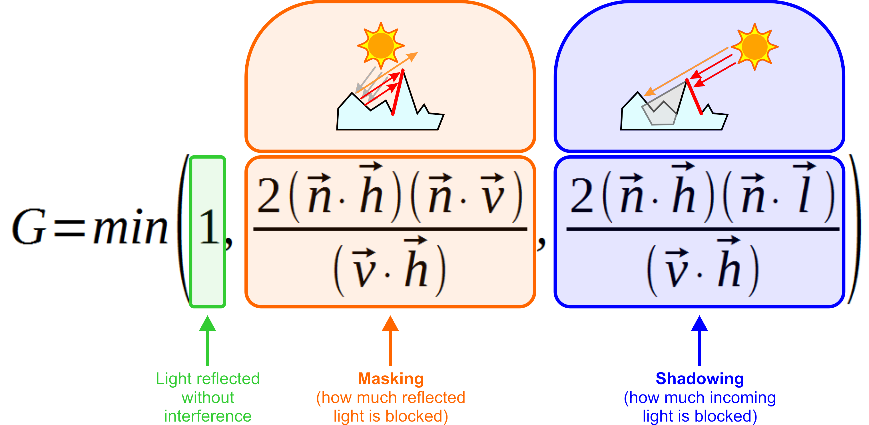
Cook-Torrance
Geometric term:
  Takes shadowing and masking into account.

Slide 20


Cook-Torrance
Fresnel term:
  Controls the amount of reflected light.
  Determines reflection of microfacets, and how metallic the surface appears.
  Replaces specular light of other models. ⇒ More realistic.
  Usually implemented by Schlick's approximation.
Sources: [cook1981reflectance], page 311-312; [dempski2005advanced], page 104, 154.

Slide 21

Cook-Torrance
Roughness term:
  Roughness depends on the distribution of the microfacets' slopes.
  Calculation is based on a distribution function.
  For instance the Beckmann distribution:
Application:
  Various materials, but especially metals.

Slide 22
Cook-Torrance - Parameters
Parameter | Description | Notes
distributionParameter | Roughness factor for the distribution function. | In sources usually named c.
roughness | Roughness factor for the roughness term.
reflectionCoefficient | Factor for the Fresnel term. | In sources usually named R0.

Slide 23

Gooch

Slide 24
Gooch
Introduced in 1998 by Amy Gooch, Bruce Gooch, Peter Shirley and Elaine Cohen.
A lighting model for non-photorealistic rendering (NPR).
Goal:
  Articulate contours by means of colors.
Setup:
  Usually only one light source.
  The paper describes further configurations, for instance:
    A second light source with special properties.
    Additional drawing of the object edges as lines.

Slide 25

Gooch
Formula:

Slide 26
Gooch - Parameters
Parameter | Description | Notes
surfaceColor | Basic surface color.
coolColor | Color for “cold” areas.
warmColor | Color for “warm” areas.
coolMixValue | Determines how much of the surface color should be mixed into the cool color.
warmMixValue | Determines how much of the surface color should be mixed into the warm color.

Slide 27

Lommel-Seeliger

Slide 28

Lommel-Seeliger
Diffuse model.
Based on the Hapke function.
  But avoids the more complex term.
Rough and dusty look.
Formula:
Applications:
  Dusty surfaces, for instance, the moon.
Source: [shlyaev2014].

Slide 29
Lommel-Seeliger (extended)
Extension:
  No general term found for configuring the roughness.
  Thus: own experiments on parametrization.
  Two insights called up:
    The Minnaert model uses a roughness parameter as an exponent.
    The empirical approximation for the Fresnel term [fernando2003cg] allows for good configuration, also using an exponent.
  ⇒ Thus: Reproduction of the empirical approximation formula to extend the Lommel-Seeliger model.

Slide 30

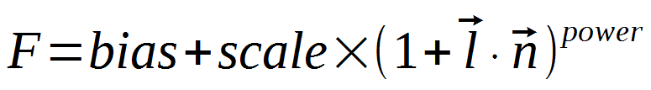
Lommel-Seeliger (extended)
Resulting formula:
To allow comparison, the empirical approximation formula:
Source: [fernando2003cg], chapter “7.4.1 The Fresnel Effect”.

Slide 31
Lommel-Seeliger (extended)
Parameter | Description | Notes
diffuseBias | Basic brightness/darkness. | Very sensitive, as it is an additive term.
diffuseScale | Increases or decreases the intensity of the lit area. The larger the value, the more intense.
diffuseExponent | Decreases or increases the size of the area to be lit. The larger the value, the smaller the area.
Notes:
  An experimental approach is necessary.
    The descriptions above are only observations; they are not mathematically proven.
    Actually all three parameters influence the light intensity.
  Especially combinations of negative and positive values yield interesting results.

Slide 32
Lommel-Seeliger (extended)
Advantages of the extended model:
  Wide range of effects possible:
    very rough (like clothes)
    approximately metallic (if using specular term).
Disadvantages of the extended model:
  Difficult configuration, as parameters are very sensible and not intuitive.
  Intense bright and dark areas show up unexpectedly:
    Reason: Little mathematical experience and insight of the author.
  Very few configurations achieve useful results.

Slide 33

Minnaert

Slide 34

Minnaert
Diffuse model.
Actually developed for other purpose.
Uses a roughness factor.
Characteristic dark stripes around edges.
Applications:
  Simulate clothes, especially velvet.
Formula:
Source: [dempski2005advanced], page 99.

Slide 35
Minnaert - Parameters
Parameter | Description | Notes
diffuse color (D) | Diffuse surface color.
roughness (m) | Roughness factor.

Slide 36

Oren-Nayar

Slide 37
Oren-Nayar
A purely diffuse model (no specular component).
Extends the Lambert concept.
Adds roughness:
  Surface is comprised of tiny microfacets.
  Roughness is based on normal distribution of the microfacets:
    High distribution ⇒ great differences in the directions.
Results are usually “flatter” than the Lambert model.
Applications:
  Rough surfaces.
    For example: moon, clay, dirt, clothes.

Slide 38

Oren-Nayar
Formula:
Source: Copied from [dempski2005advanced], page 98.

Slide 39
Oren-Nayar - Parameters
Parameter | Description | Notes
diffuse color (D) | Diffuse surface color.
roughness (σ) | Roughness term.

Slide 40

Phong

Slide 41
Phong
One of the oldest models.
Important, as it introduces a specular reflection.
  Calculated via a reflection vector.
Rather not physically plausible.
But easy to implement.
Application:
  Basically all materials.
  But especially plastics.

Slide 42
Phong - Parameters
Parameter | Description | Notes
ambient color | Color from the surrounding.
diffuse color | Diffuse material color.
emissive color | Color emitted from the object.
specular color | Specular material color.
shininess | Intensity of the surface's shining.

Slide 43

Blinn-Phong

Slide 44
Blinn-Phong
Derived from the Phong lighting model.
Uses a half vector to increase efficiency.
Can yield more realistic results.
Applications:
  Generally all materials.
  But especially plastics.

Slide 45

Schlick Specular Model

Slide 46

Schlick Specular Model
Variation of the Phong lighting model.
Goal: more efficient calculation.
  Replaces the expensive exponentiation.

Slide 47

Schlick Specular Model
Problem:
  Exponentiation with non-integer exponent is expensive.
Solution:
  Replace the exponentiation with an approximating term:

Slide 48
Schlick Specular Model
Result:
  Reflection is similar to Phong lighting model.
    Shape of specularly lit areas are almost identical.
  Though the light is more scattered.
    Objects are “brighter”.

Slide 49

Gaussian Specular Model

Slide 50
Gaussian Specular Model
Variation of the Phong/Blinn-Phong lighting model.
Goal:
  Simulation of microfacets.
Problem:
  The Phong model uses a Lambertian diffuse term.
  This term does not take microfacets into account.
  ⇒ Rather unrealistic.
Solution:
  Microfacets are being simulated by the normal distribution (Gaussian distribution) function.

Slide 51


Gaussian Specular Model
Formula:
Attention:
  The term “shininess” is being used in compliance to the Phong terminology.
  Actually its meaning is exactly the opposite:
    The higher the shininess, the rougher the surface.
  ⇒ The parameter m is a roughness factor.

Slide 52
Gaussian Specular Model
Result:
  Objects look less like plastic.
Advantage:
  More realistic.
Disadvantage:
  Less efficient than the default Phong/Blinn-Phong model.
    Especially because of the arcus cosinus function.

Slide 53
Summary – Phong Variations
Model | Characteristics
Phong | Standard model with three issues: - inefficient reflection formula - inefficient exponentiation formula - unrealistic (Lambert) diffuse term.
Blinn-Phong | More efficient by replacing the reflection formula.
Schlick Specular Model | More realistic by replacing the exponentiation.
Gaussian Specular Model | More realistic, but less efficient, by modeling microfacets.

Slide 54

Strauss

Slide 55
Strauss
Goals:
  Simple to understand and to handle parameters.
  At the same time simulation of a broad range of materials.
Combines parts of existing lighting models.
Application:
  Various materials.
  Especially well-suited for metals.

Slide 56
Strauss - Parameters
Parameter | Description | Notes
metalness m | How metallic does the surface look? | Range: [0, 1].
smoothness s | How smooth is the surface? | Range: [0, 1].
transparency t | Simulates the effect of lighting. | Not identical to the RGBA alpha transparency, but should be equal. Range: [0, 1].
surface color c | (Diffuse) RGB surface color. | Usually the only color to be set.
index of refraction n | Index of refraction. | Not used in the shader, but part of the ray-tracing or global illumination.
fresnel constant Kf | Affects the Fresnel term. | Usually not a parameter, but a constant with Kf = 1.12.
shadow constant Ks | Affects the simulation of shadowing. | Usually not a parameter, but a constant with Ks = 1.01.
off-specular peak k | Additional value for very rough surfaces. | Usually not a parameter, but a constant with k = 0.1.
highlight base color C1 | Base color for the specular term. | Usually constant white color.

Slide 57

Ward (anisotropic)

Slide 58
Ward (anisotropic)
Empirical model: based on observations.
  Equations created from retrieved data.
Rather physically plausible.
Two variations exist:
  isotropic
  anisotropic.
Anisotropy is achieved through two orthogonal roughness coefficients (X- and Y-direction).
Applications:
  Metals, especially brushed ones.

Slide 59

Ward (anisotropic)
Formula:
where
  D – diffuse surface color
  S – specular surface color
  σx – roughness coefficient along the X-axis
  σy – roughness coefficient along the Y-axis
Source: Copied from [dempski2005advanced], page 100.

Slide 60
Ward - Parameters
Parameter | Description | Notes
direction | Material direction as 3D vector.
roughness.x | Roughness coefficient along the X-axis. | Responsible for anisotropy.
roughness.y | Roughness coefficient along the Y-axis. | Responsible anisotropy.

Slide 61
Framework – Concept (1/3)
Various lighting models are offered.
  Each vertex or fragment shader is implemented in its own file.
  Its content is read by a PHP script and inserted into the dynamic web page.
The lighting models can be selected in an HTML form, part of the Shader Chooser page.
  Each model is represented by its own button.
  Click it sends an unique shader identifier via GET request to the HTML page containing the WebGL canvas.
  The PHP script mentioned above selects the fragment shader associated the identifier, creating the GLSL code block.

Slide 62

Framework – Concept (2/3)
The Shader Chooser form represents each implemented lighting model by an own button. Moving the mouse into such a button displays information regarding the model.

Slide 63
Framework – Concept (3/3)
The scene contains 3D objects.
  They can be selected with a menu structure.
⇒ Simulates a flat scene graph (actually a “scene list”).
The navigation (rotation) is possible by using a computer mouse.

Slide 64
Framework – Configuration (1/2)
Each lighting model is associated with a set of dynamically created HTML configuration elements.
  For example: The Minnaert shader needs a roughness spinner, the Cook-Torrance shader a set of radiobuttons to set the distribution function.
Shared properties exist.
  For instance: transparency (slider), Fresnel block.
Further properties, independent of the lighting model are
  lights
  fog.

Slide 65

Framework – Configuration (2/2)
A capture of the configuration screen for the Cook-Torrance shader. The yellow block to the left contains shader-specific properties, as well as the “scene graph” (top of it). The right block contains light and fog parameters.
At the top, the toolbar for inserting external models (OBJ format) and spheres is visible.

Slide 66
Framework – Architecture (1/2)
The architecture is loosely leaned on the Java 3D specification. [sowizral1997java].
Thus, a great number of “classes” (types) with clearly defined responsibilities have been defined.
Primary goals:
  Extensibility
    E.g., new shader materials.
    E.g., abstract “superclass” for geometries.
  Readability
    E.g., by utilizing JavaScript files as modules.
    E.g., by defining one “class” per uniform variable type.

Slide 67

Framework – Architecture (2/2)
Excerpt from the current system architecture as class UML diagram.

Slide 68
Development Status
Feature | Type | Status
Mouse based navigation | mandatory | Partially implemented.
Textures | mandatory | Implemented.
Fresnel effect | mandatory | Implemented.
Dynamic configuration elements | mandatory | Implemented.
Model transformations | mandatory | Partially implemented.
Ashikhmin-Shirley shader | optional | Implemented.
Lafortune shader | optional | Not implemented.
Schlick specular shader | optional | Implemented.
Shader per object | optional | Not implemented.
Insertion of 3D objects | optional | Partially implemented.

Slide 69
Problems (1/3)
WebGL error messages
  Setting the light properties generates WebGL exceptions.
  But changes seem to work none the less.
Shader appearance
  Some shaders do not look very realistic and/or correct.
  Especially the Ashikhmin-Shirley shader is too dark.
    An implementation working with Java 3D does not share this problem.
  The Cook-Torrance shader's reflectance is not “metallic” enough compared to the Java 3D version.

Slide 70
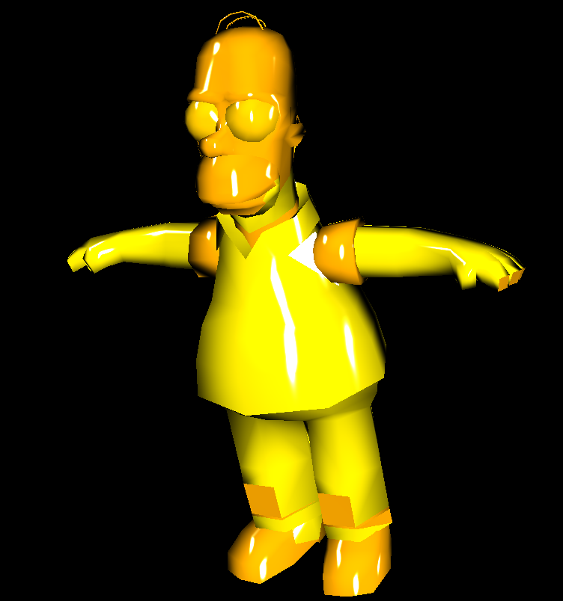
Problems (2/3)
Example for a correct looking Ashikhmin-Shirley result. Taken from an own Java 3D project.

Slide 71
Problems (3/3)
Fog update problem
  The fog parameters do not update properly
Two types of lights missing
  No headlight implemented.
  No spotlight implemented.
Scene object updating problem
  Inserting a new object or a sphere does not lead to updating the scene without navigation a bit.
XAMPP
  Used for dynamic content creation.
  But obstacle for new users.

Slide 72
Conclusion
The project is modestly successful.
Lacks many features.
At least the implemented shaders can be configured and tested.
The files can be found on the internet:
  Main page: https://github.com/KY-ARVR/VisuelleEffekte_SS-2015
  Project data: https://github.com/KY-ARVR/VisuelleEffekte_SS-2015/tree/master/Project/VisuelleEffekte
  This presentation: https://github.com/KY-ARVR/VisuelleEffekte_SS-2015/tree/master/Final_Presentation

Slide 73
Future Work
Possible extensions may be:
  Interactive picking by mouse.
  Shadow calculation.
  Efficiency comparisons between shaders.
  Further shaders, for instance:
    Heidrich-Seidel
    Lafortune.

Slide 74
Bibliography (1/2)
[3drender2001], Jeremy Birn, Fresnel Effect, http://www.3drender.com/glossary/fresneleffect.htm
[cook1981reflectance] Robert L. Cook, Kenneth E. Torrance, A Reflectance Model for Computer Graphics, 1981, http://www.cs.columbia.edu/~belhumeur/courses/appearance/cook-torrance.pdf
[dempski2005advanced] Dempski, Kelly and Viale, Emmanuel, Advanced Lighting and Materials with Shaders, 2005
[engel2008programming] Wolfgang F. Engel, Jack Hoxley, Ralf Kornmann, Niko Suni, Jason Zink, Programming Vertex, Geometry, and Pixel Shaders, 2008

Slide 75
Bibliography (2/2)
[fernando2003cg] Randima Fernando, Mark J. Kilgard, The Cg Tutorial: The Definitive Guide to Programmable Real-Time Graphics, 2003, http://http.developer.nvidia.com/CgTutorial/cg_tutorial_chapter07.html
[kornmann2011d3dbook] Ralf Kornmann, D3DBook, 2011, http://content.gpwiki.org/D3DBook:Table_Of_Contents
[shlyaev2014] Sergey Shlyaev, Diffuse Shaders, 2014, http://www.shlyaev.com/rnd/37-cpp-category/60-diffuseshaders
[sowizral1997java] Kevin Sowizral, Kevin Rushforth, Henry Sowizral, The Java 3D API Specification, 1997

