Slide 1

Test Framework for Shaders
Project for the course
„Visuelle Effekte“ (Visual Effects)
Kaveh Yousefi

Slide 2
Version History
Version | Date | Changes
1.0 | 10.07.2015 | First version, document created.

Slide 3
Content
Goals
Definitions
Presentation of implemented shaders
Description of the test framework
Evaluation and future work

Slide 4
Goal
The goal is the implementation of a shader test framework.
Utilized technologies:
  HTML5
  JavaScript
  WebGL
  CSS (Cascading Stylesheets).
Contains implementations of various shaders*.
Allows
  experimenting with different lighting models
  comparing different lighting models.
*) Note: A shading model is usually a rephrasing and simplification of a BRDF (Bidirection Reflectance Distribution Function). See [dempski2005advanced], page 90.

Slide 5
Definitions
Anisotropy:
  A material's reflective property depends on the angle of the viewer looking at the surface.
  Opposite: isotropy.
Fresnel effect:
  The fraction of the reflection/refracted light depends on the viewing angle.
  Example: At some angles water seems “less transparent”.
Sources: [3drender2001]; [dempski2005advanced], page 89.

Slide 6

Example - Anisotropy
Example of anisotropy: The lighted area's shape changes with the viewing angle.

Slide 7

Example – Fresnel Effect
A Blinn-Phong shader with Fresnel effect: Areas pointing away from the light source are lit more intensely.

Slide 8
Presented Models
Ashikhmin-Shirley
Cook-Torrance
Gooch
Lommel-Seeliger
Minnaert
Oren-Nayar
Phong model variants
  Phong
  Blinn-Phong
  Schlick
  Gaussian
Strauss
Ward (anisotropic)

Slide 9
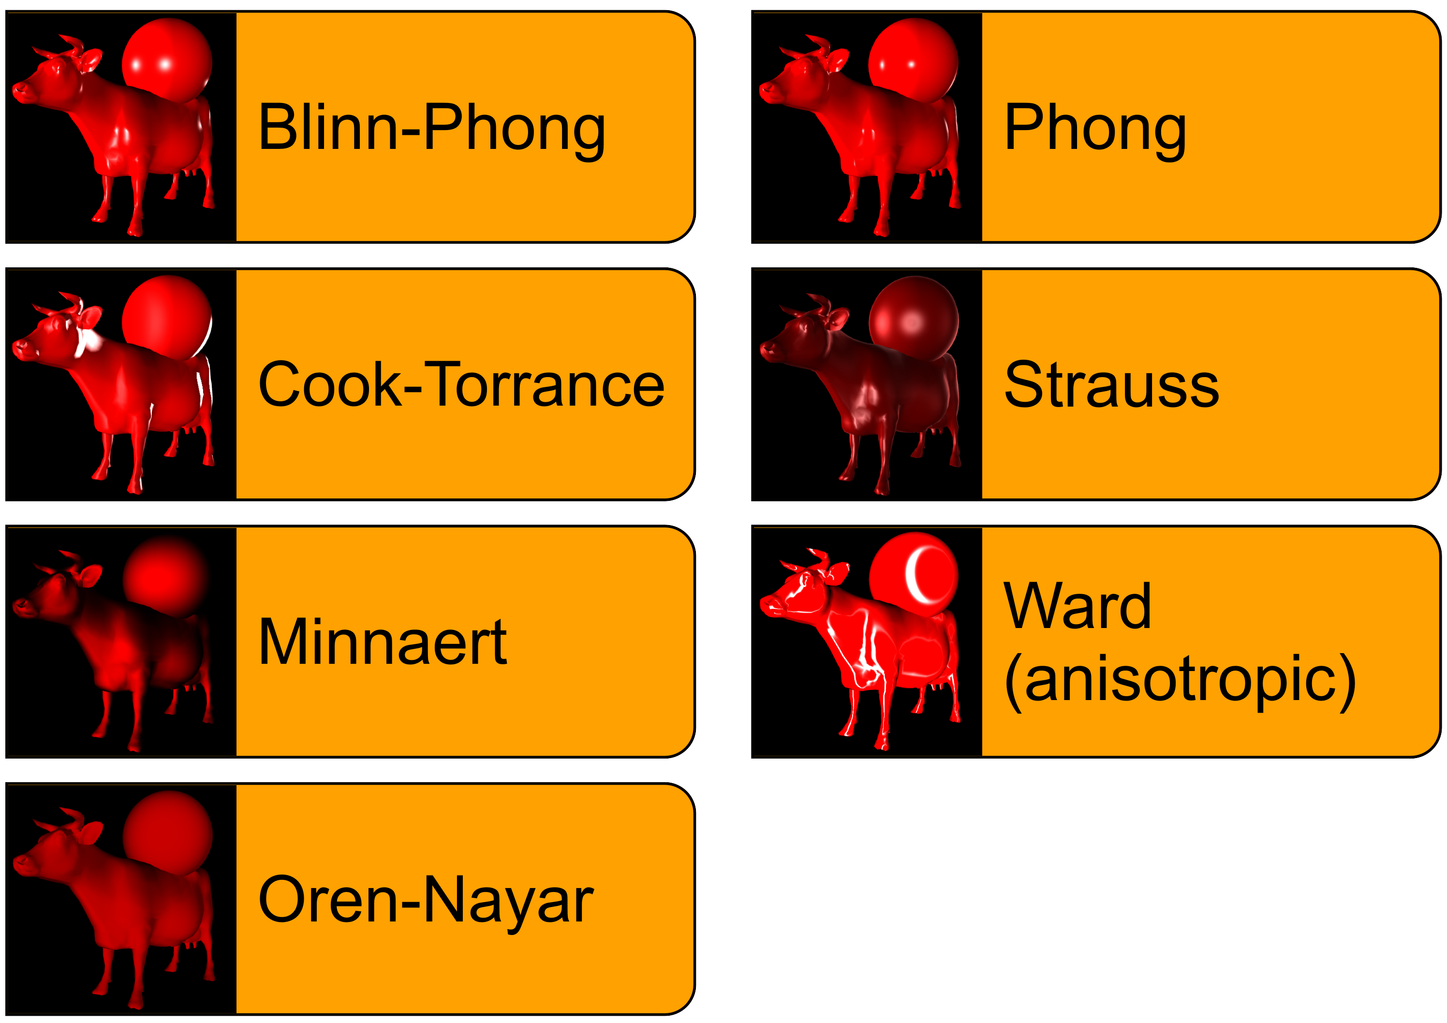

Slide 10
Ashikhmin-Shirley
An anisotropic, specular model.
Comprised of a diffuse and a specular term.
Uses two exponential factors (nu, nv):
  Determine the specular reflection's shape.
  Can be very large, for instance, larger than 10000.
  If nu = nv: specular area is circular, similar to Phong model.

Slide 11
Ashikhmin-Shirley
Diffuse term:
  May optionally be replaced by a more efficient, but less realistic, term, e.g., a Lambertian.
  XXXXXX
Specular term:
  Contains a Fresnel term, usually the Schlick approximation.
  Uses the two exponential factors nu, nv.
  Needs two additional vectors besides the surface normal:
    Tangent (U)
    Bitangent (V).

Slide 12
Ashikhmin-Shirley - Parameters
Parameter | Description | Notes
diffuseColor (Rd) | The diffuse surface color.
specularColor (Rs) | The specular surface color.
exponentX (Nu) | Exponent to control lobe. | Creates anisotropy.
exponentY (Nv) | Exponent to control lobe. | Creates anisotropy.
referenceAxis (epsilon) | Basic 3D vector to define the reference frame together with the surface normal. | Usually no parameter, but the vector (1, 0, 0).
Source: [engel2008programming], page 283.

Slide 13
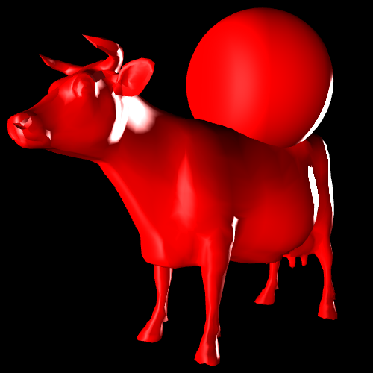
Cook-Torrance

Slide 14
Cook-Torrance
Physically based lighting model.
Regards the surface as a set of microfacets, each pointing to a certain direction.
Simulates shadowing and masking:
  shadowing: Microfacets can prevent light from reaching other microfacets.
  masking: Microfacets can block light from being reflected from other microfacets to the viewer.
  Both effects influence the diffuse and specular term.

Slide 15

Cook-Torrance - shadowing
Visual description of shadowing. Inspired by [engel2008programming], page 239.

Slide 16

Cook-Torrance - masking
Visual description of masking. Inspired by [engel2008programming], page 240.

Slide 17

Cook-Torrance
Formula:
Three terms define the appearance:
  Geometric term G
  Fresnel term F
  Roughness term D

Slide 18

Cook-Torrance
Geometric term:
  Takes shadowing and masking into account.

Slide 19


Cook-Torrance
Fresnel term:
  Controls the amount of reflected light.
  Determines reflection of microfacets, and how metallic the surface appears.
  Replaces specular light of other models. ⇒ More realistic.
  Usually implemented by Schlick's approximation.
Sources: [cook1981reflectance], page 311-312; [dempski2005advanced], page 104, 154.

Slide 20

Cook-Torrance
Roughness term:
  Roughness depends on the distribution of the microfacets' slopes.
  Calculation is based on a distribution function.
  For instance the Beckmann distribution:
Application:
  Various materials, but especially metals.

Slide 21
Cook-Torrance - Parameters
Parameter | Description | Notes
distributionParameter | Roughness factor for the distribution function. | In sources usually named c.
roughness | Roughness factor for the roughness term.
reflectionCoefficient | Factor for the Fresnel term. | In sources usually named R0.

Slide 22
Gooch
Introduced in 1998 by Amy Gooch, Bruce Gooch, Peter Shirley and Elaine Cohen.
A lighting model for non-photorealistic rendering (NPR).
Goal:
  Articulate contours by means of colors.
Setup:
  Usually only one light source.
  The paper describes further configurations, for instance:
    A second light source with special properties.
    Additional drawing of the object edges as lines.

Slide 23

Gooch
Formula:

Slide 24
Gooch - Parameters
Parameter | Description | Notes
surfaceColor | Basic surface color.
coolColor | Color for “cold” areas.
warmColor | Color for “warm” areas.
coolMixValue | Determines how much of the surface color should be mixed into the cool color.
warmMixValue | Determines how much of the surface color should be mixed into the warm color.

Slide 25

Lommel-Seeliger
Diffuse model.
Based on the Hapke function.
  But avoids the more complex term.
Rough and dusty look.
Formula:
Applications:
  Dusty surfaces, for instance, the moon.
Source: [shlyaev2014].

Slide 26
Lommel-Seeliger (extended)
Extension:
  No general term found for configuring the roughness.
  Thus: own experiments on parametrization.
  Two insights called up:
    The Minnaert model uses a roughness parameter as an exponent.
    The Schlick approximation for the Fresnel term allows good configuration, also using an exponent.
  ⇒ Thus: Reproduction of the Schlick approximation formula to extend the Lommel-Seeliger model.

Slide 27

Lommel-Seeliger (extended)
Resulting formula:

Slide 28
Lommel-Seeliger (extended)
Parameter | Description | Notes
diffuseBias | Basic brightness/darkness. | Very sensitive, as additive term.
diffuseScale
diffuseExponent
Notes:
  Experimental approach necessary.
  Especially combinations of negative and positive values yield interesting results.

Slide 29
Lommel-Seeliger (extended)
Advantages of the extended model:
  Wide range of effects possible:
    very rough (like clothes)
    approximately metallic (if using specular term).
Disadvantages of the extended model:
  Difficult configuration, as parameters are very sensible and not intuitive.
  Intense bright and dark areas show up unexpectedly:
    Reason: Little mathematical experience and insight of the author.
  Very few configurations achieve useful results.

Slide 30
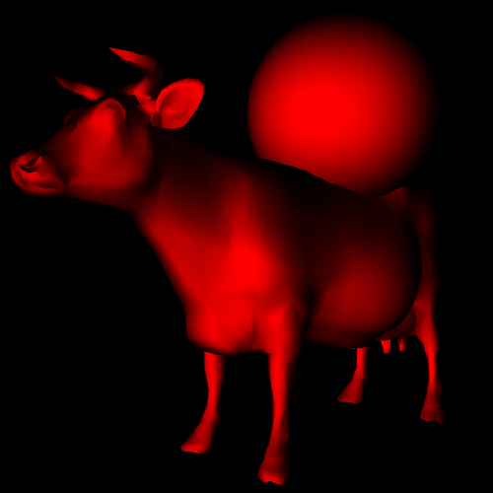
Minnaert

Slide 31

Minnaert
Diffuse model.
Actually developed for other purpose.
Uses a roughness factor.
Characteristic dark stripes around edges.
Applications:
  Simulate clothes, especially velvet.
Formula:
Source: [dempski2005advanced], page 99.

Slide 32
Minnaert - Parameters
Parameter | Description | Notes
diffuse color (D) | Diffuse surface color.
roughness (m) | Roughness factor.

Slide 33
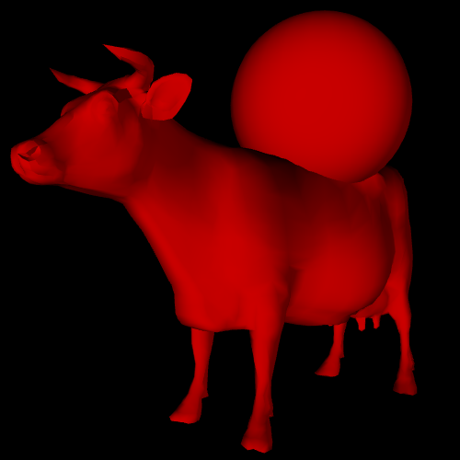
Oren-Nayar

Slide 34
Oren-Nayar
A purely diffuse model (no specular component).
Extends the Lambert concept.
Adds roughness:
  Surface is comprised of tiny microfacets.
  Roughness is based on normal distribution of the microfacets:
    High distribution ⇒ great differences in the directions.
Results are usually “flatter” than the Lambert model.
Applications:
  Rough surfaces.
    For example: moon, clay, dirt, clothes.

Slide 35

Oren-Nayar
Formula:
Source: Copied from [dempski2005advanced], page 98.

Slide 36
Oren-Nayar - Parameters
Parameter | Description | Notes
diffuse color (D) | Diffuse surface color.
roughness (σ) | Roughness term.

Slide 37
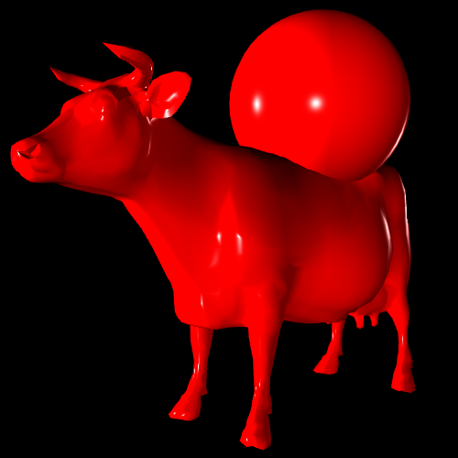
Phong

Slide 38
Phong
One of the oldest models.
Important, as it introduces a specular reflection.
  Calculated via a reflection vector.
Rather not physically plausible.
But easy to implement.
Application:
  Basically all materials.
  But especially plastics.

Slide 39
Phong - Parameters
Parameter | Description | Notes
ambient color | Color from the surrounding.
diffuse color | Diffuse material color.
emissive color | Color emitted from the object.
specular color | Specular material color.
shininess | Intensity of the surface's shining.

Slide 40
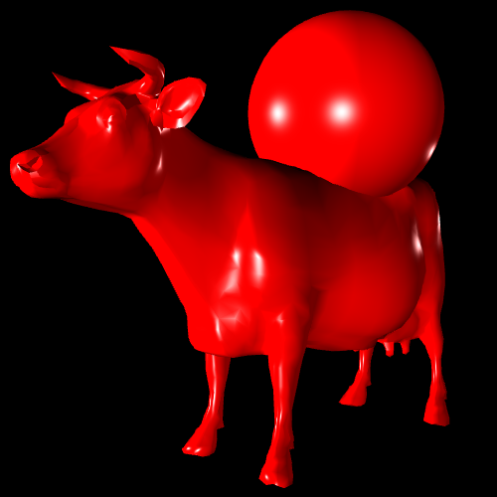
Blinn-Phong

Slide 41
Blinn-Phong
Derived from the Phong lighting model.
Uses a half vector to increase efficiency.
Can yield more realistic results.
Applications:
  Generally all materials.
  But especially plastics.

Slide 42

Schlick Specular Model
Variation of the Phong lighting model.
Goal: more efficient calculation.
  Replaces the expensive exponentiation.

Slide 43

Schlick Specular Model
Problem:
  Exponentiation with non-integer exponent is expensive.
Solution:
  Replace the exponentiation with an approximating term:

Slide 44
Schlick Specular Model
Result:
  Reflection is similar to Phong lighting model.
    Shape of specularly lit areas are almost identical.
  Though the light is more scattered.
    Objects are “brighter”.

Slide 45
Gaussian Specular Model
Variation of the Phong/Blinn-Phong lighting model.
Goal:
  Simulation of microfacets.
Problem:
  The Phong model uses a Lambertian diffuse term.
  This term does not take microfacets into account.
  ⇒ Rather unrealistic.
Solution:
  Microfacets are being simulated by the standard distribution function.

Slide 46


Gaussian Specular Model
Formula:
Attention:
  The term “shininess” is being used in compliance to the Phong terminology.
  Actually its meaning is exactly the opposite:
    The higher the shininess, the rougher the surface.
  ⇒ The parameter m is a roughness factor.

Slide 47
Gaussian Specular Model
Result:
  Objects look less like plastic.
Advantage:
  More realistic.
Disadvantage:
  Less efficient than the default Phong/Blinn-Phong model.
    Especially because of the arcus cosinus function.

Slide 48
Summary – Phong Variations
Model | Characteristics
Phong | Standard model with three issues: - inefficient reflection formula - inefficient exponentiation formula - unrealistic (Lambert) diffuse term.
Blinn-Phong | More efficient by replacing the reflection formula.
Schlick Specular Model | More realistic by replacing the exponentiation.
Gaussian Specular Model | More realistic, but less efficient, by modeling microfacets.

Slide 49
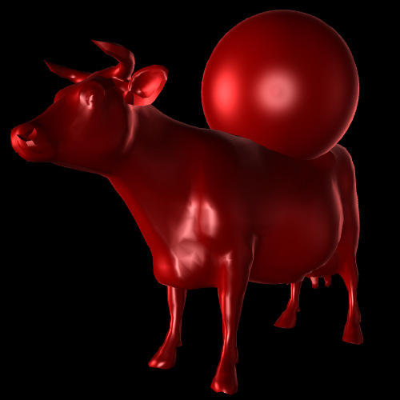
Strauss

Slide 50
Strauss
Goals:
  Simple to understand and to handle parameters.
  At the same time simulation of a broad range of materials.
Combines parts of existing lighting models.
Application:
  Various materials.
  Especially well-suited for metals.

Slide 51
Strauss - Parameters
Parameter | Description | Notes
metalness m | How metallic does the surface look? | Range: [0, 1].
smoothness s | How smooth is the surface? | Range: [0, 1].
transparency t | Simulates the effect of lighting. | Not identical to the RGBA alpha transparency, but should be equal. Range: [0, 1].
surface color c | (Diffuse) RGB surface color. | Usually the only color to be set.
index of refraction n | Index of refraction. | Not used in the shader, but part of the ray-tracing or global illumination.
fresnel constant Kf | Affects the Fresnel term. | Usually not a parameter, but a constant with Kf = 1.12.
shadow constant Ks | Affects the simulation of shadowing. | Usually not a parameter, but a constant with Ks = 1.01.
off-specular peak k | Additional value for very rough surfaces. | Usually not a parameter, but a constant with k = 0.1.
highlight base color C1 | Base color for the specular term. | Usually constant white color.

Slide 52
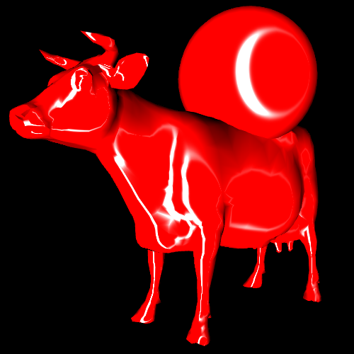
Ward (anisotropic)

Slide 53
Ward (anisotropic)
Empirical model: based on observations.
  Equations created from retrieved data.
Rather physically plausible.
Two variations exist:
  isotropic
  anisotropic.
Anisotropy is achieved through two orthogonal roughness coefficients (X- and Y-direction).
Applications:
  Metals, especially brushed ones.

Slide 54

Ward (anisotropic)
Formula:
where
  D – diffuse surface color
  S – specular surface color
  σx – roughness coefficient along the X-axis
  σy – roughness coefficient along the Y-axis
Source: Copied from [dempski2005advanced], page 100.

Slide 55
Ward - Parameters
Parameter | Description | Notes
direction | Material direction as 3D vector.
roughness.x | Roughness coefficient along the X-axis. | Responsible for anisotropy.
roughness.y | Roughness coefficient along the Y-axis. | Responsible anisotropy.

Slide 56
Framework – Concept (1/3)
Verschiedene Shading-Modelle werden angeboten.
  Jeder Vertex- bzw. Fragment-Shader residiert in einer eigenen Datei und wird zurzeit mittels PHP eingelesen und der Quellcode in HTML eingebettet.
Die Auswahl des Shader-Modells erfolgt in einem eigenen HTML-Formular, dem „Shader Chooser“.
  Die Auswahl wird an das entsprechende PHP-Script versandt und dort ausgewertet.
  Daraufhin wird, wie oben beschrieben, die dynamische Einsetzung von GLSL-Code durchgeführt.

Slide 57
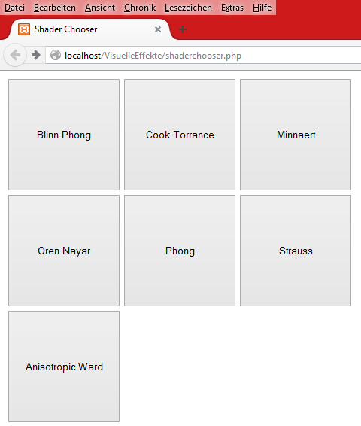
Framework – Concept (2/3)
The Shader Chooser form presents each implemented shading model by an own button. Moving the mouse into such a button displays information regarding the model.

Slide 58
Framework – Concept (3/3)
3D-Objekte befinden sich in der Szene.
  Die Objekte können über Menüstruktur ausgewählt werden: Entweder einzeln oder alle gleichzeitig.
⇒ Simulation eines flachen Szenegraphen (eigentlich eine „Szeneliste“).
Die Steuerung innerhalb der Szene ist über Computermaus oder Tastatur möglich.

Slide 59
Framework – Configuration (1/2)
Dynamische HTML-Bedienelemente existieren.
Je nach Shader sind unterschiedliche Parameter notwendig.
  Adäquate Steuerelemente werden bereitgestellt.
  Diese ermöglichen die Einstellung der Parameter.
  Bsp.: Farbe, Rauheit.
Übergreifende Einstellungen sind daneben möglich.
  Bsp.: Transparenz.
Weitere Szene-Elemente sind unabhängig davon konfigurierbar:
  Licht, Nebel

Slide 60
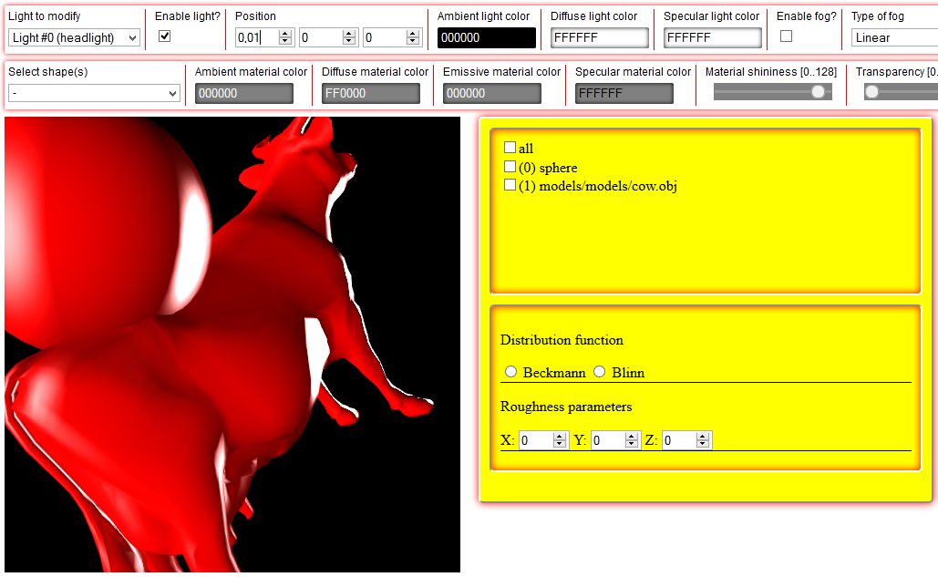
Framework – Configuration (2/2)
Beispiel für angestrebte dynamische Konfiguration: Nur die Parameter des aktuell geladenen Cook-Torrance-Shaders werden in der gelben Tafel angezeigt. Darüber ist der Szenegraph sichtbar.

Slide 61
Framework – Architecture (1/2)
The architecture is loosely leaned on the Java 3D specification. [sowizral1997java].
Thus, a great number of “classes” (types) with clearly defined responsibilities have been defined.
Primary goals:
  Extensibility
    E.g., new shader materials.
    E.g., abstract “superclass” for geometries.
  Readability
    E.g., by utilizing JavaScript files as modules.
    E.g., by defining one “class” per uniform variable type.

Slide 62

Framework – Architecture (2/2)
Excerpt from the current system architecture as class UML diagram.

Slide 63
Development Status
Feature | Type | Status
Mouse based navigation | mandatory | Partially implemented.
Textures | mandatory | Implemented.
Fresnel effect | mandatory | Implemented.
Dynamic configuration elements | mandatory | Implemented.
Model transformations | mandatory | Partially implemented.
Ashikhmin-Shirley shader | optional | Implemented.
Lafortune shader | optional | Not implemented.
Schlick specular shader | optional | Implemented.
Shader per object | optional | Not implemented.
Insertion of 3D objects | optional | Partially implemented.

Slide 64
Problems
WebGL error messages
  Setting the light properties generates WebGL exceptions.
  But changes seem to work none the less.
XAMPP
  Used for dynamic content creation.
  But obstacle for new users.

Slide 65
Future Work
Possible extensions may be:
  Interactive picking by mouse.
  Shadow calculation.
  Efficiency comparisons between shaders.
  Further shaders, for instance:
    Heidrich-Seidel
    Lafortune.

Slide 66
Bibliography (1/2)
[3drender2001], Jeremy Birn, Fresnel Effect, http://www.3drender.com/glossary/fresneleffect.htm
[cook1981reflectance] Robert L. Cook, Kenneth E. Torrance, A Reflectance Model for Computer Graphics, 1981, http://www.cs.columbia.edu/~belhumeur/courses/appearance/cook-torrance.pdf
[dempski2005advanced] Dempski, Kelly and Viale, Emmanuel, Advanced Lighting and Materials with Shaders, 2005
[engel2008programming] Wolfgang F. Engel, Jack Hoxley, Ralf Kornmann, Niko Suni, Jason Zink, Programming Vertex, Geometry, and Pixel Shaders, 2008
[kornmann2011d3dbook] Ralf Kornmann, D3DBook, 2011, http://content.gpwiki.org/D3DBook:Table_Of_Contents

Slide 67
Bibliography (2/2)
[shlyaev2014] Sergey Shlyaev, Diffuse Shaders, 2014, http://www.shlyaev.com/rnd/37-cpp-category/60-diffuseshaders
[sowizral1997java] Kevin Sowizral, Kevin Rushforth, Henry Sowizral, The Java 3D API Specification, 1997

