Slide 1
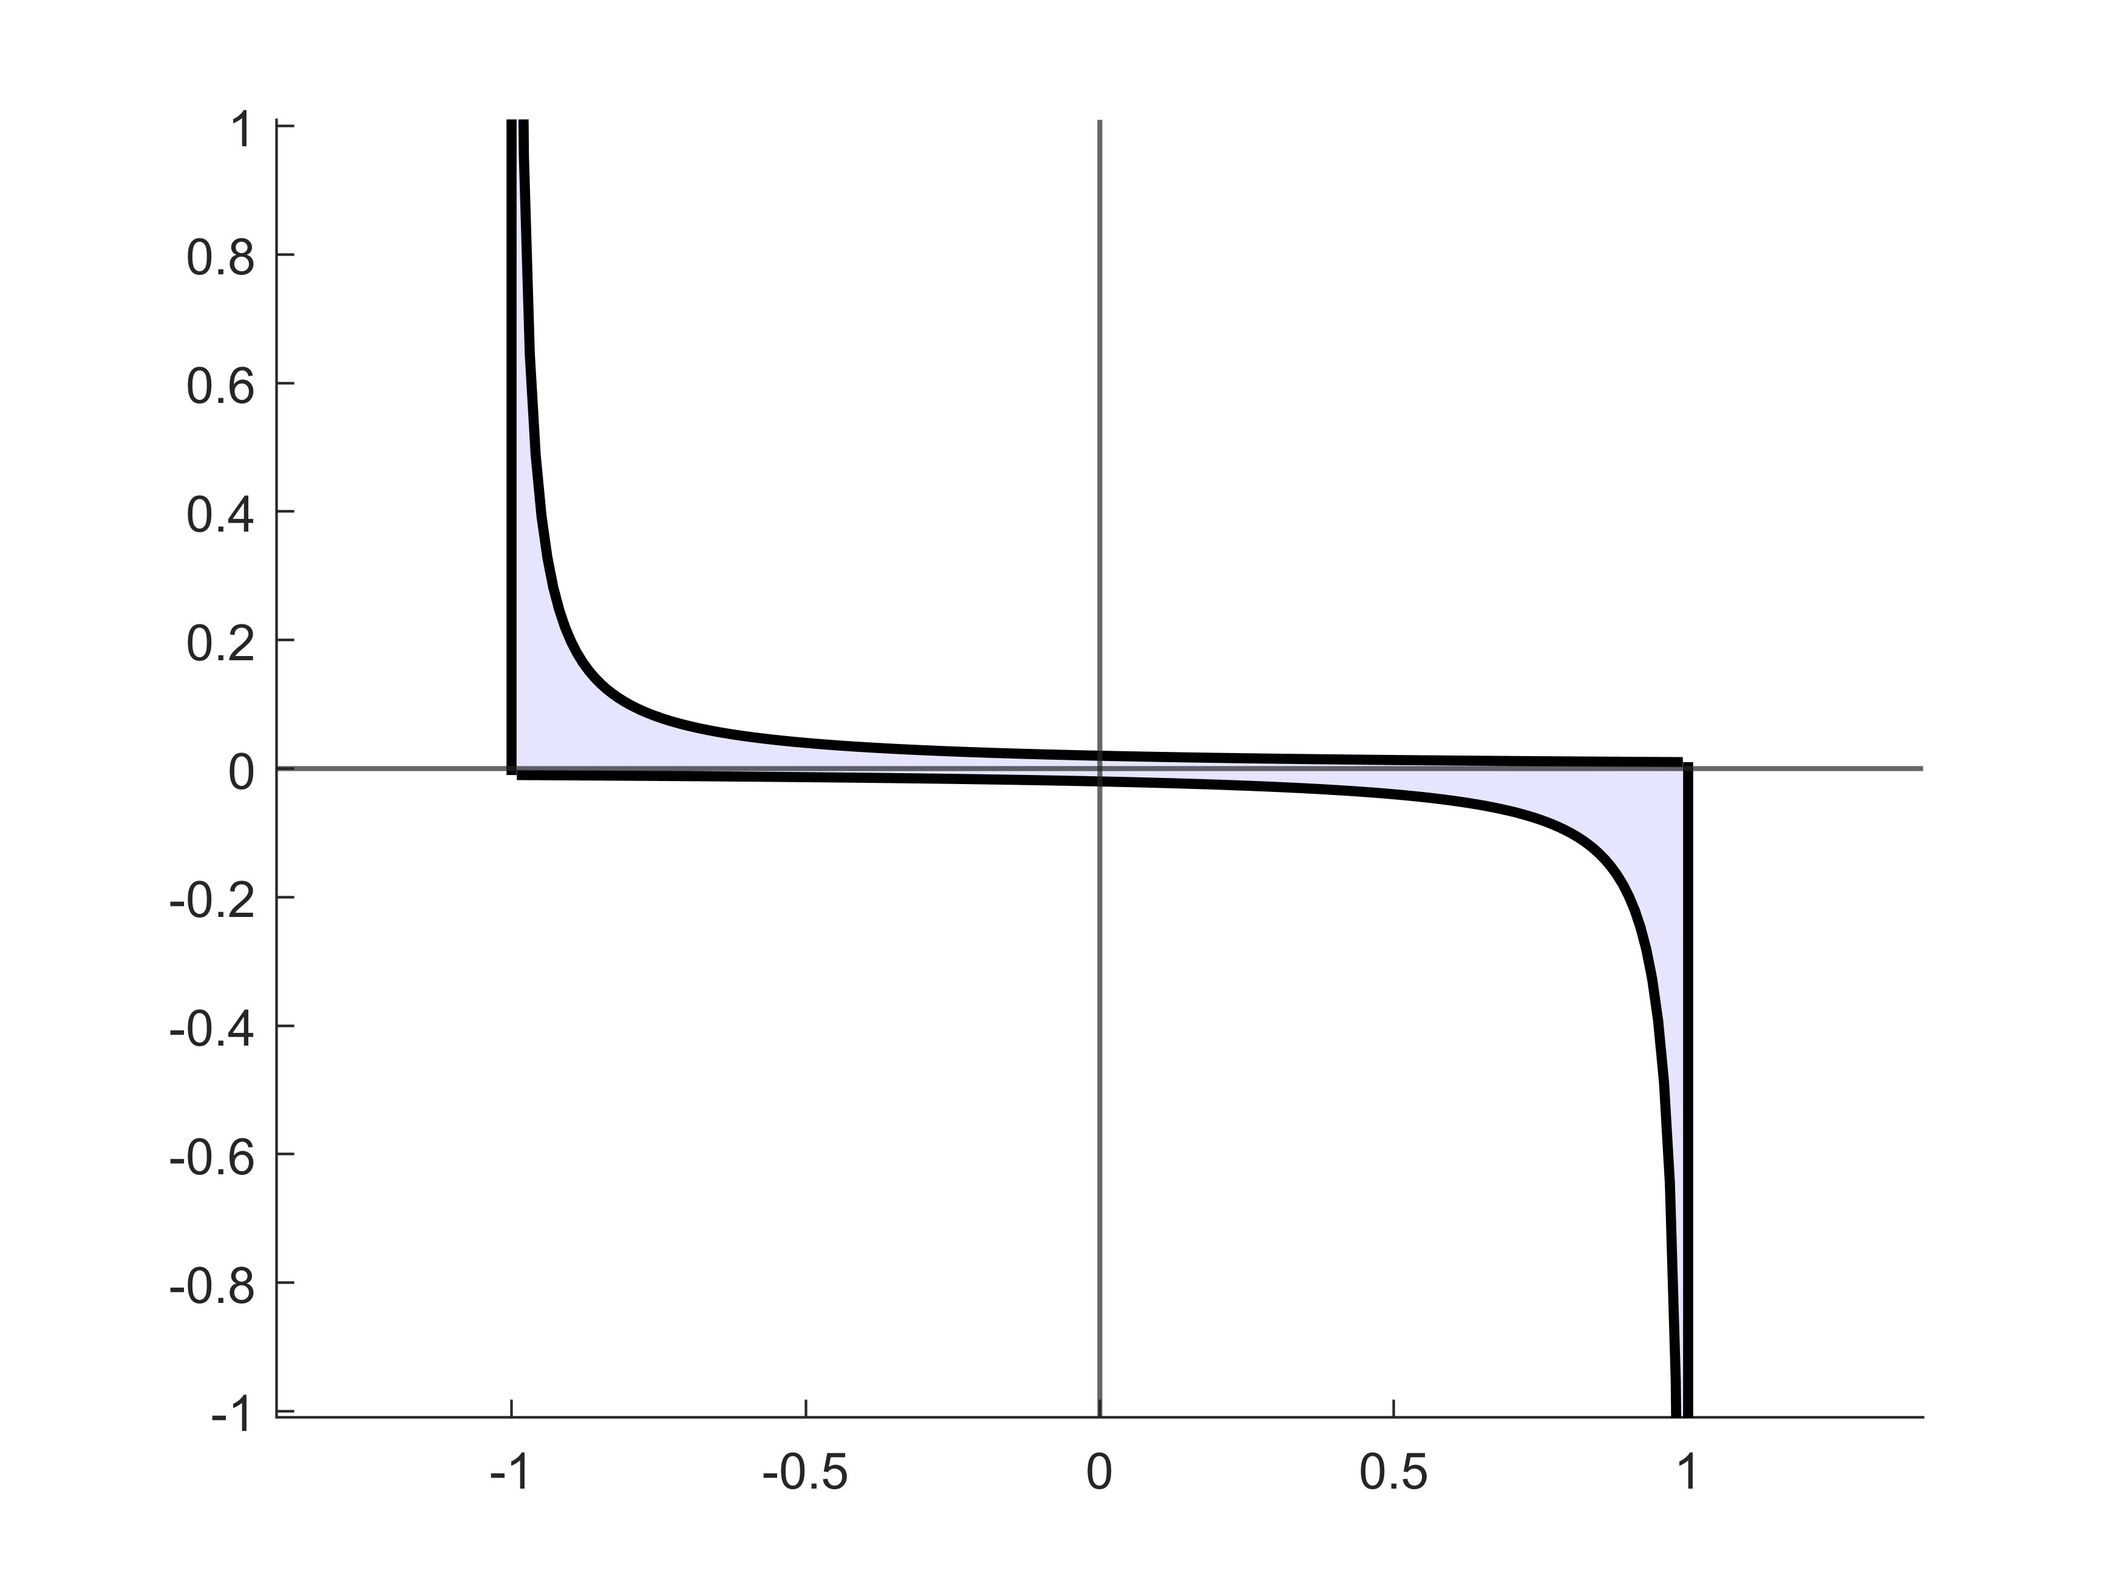






$$\left(λ_{n,i}−b_{l}\right)η_{n,i}=s$$
$$η_{n,i}$$
$$λ_{n,i}=b_{l}$$
$$\left(b_{u}−λ_{n,i}\right)η_{n,i}=−s$$
$$λ_{n,i}=b_{u}$$
$$λ_{n,i}$$

