Slide 1
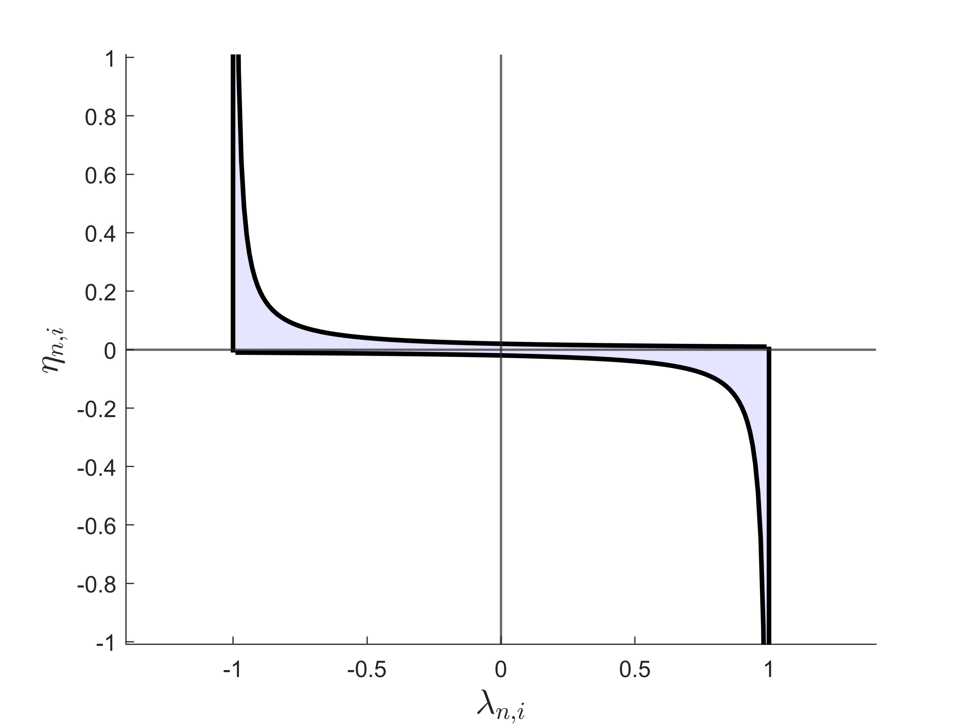




$$\left(λ_{n,i}−b_{l}\right)η_{n,i}=s$$
$$λ_{n,i}=b_{l}$$
$$λ_{n,i}=b_{u}$$
$$\left(b_{u}−λ_{n,i}\right)η_{n,i}=−s$$

