Slide 1
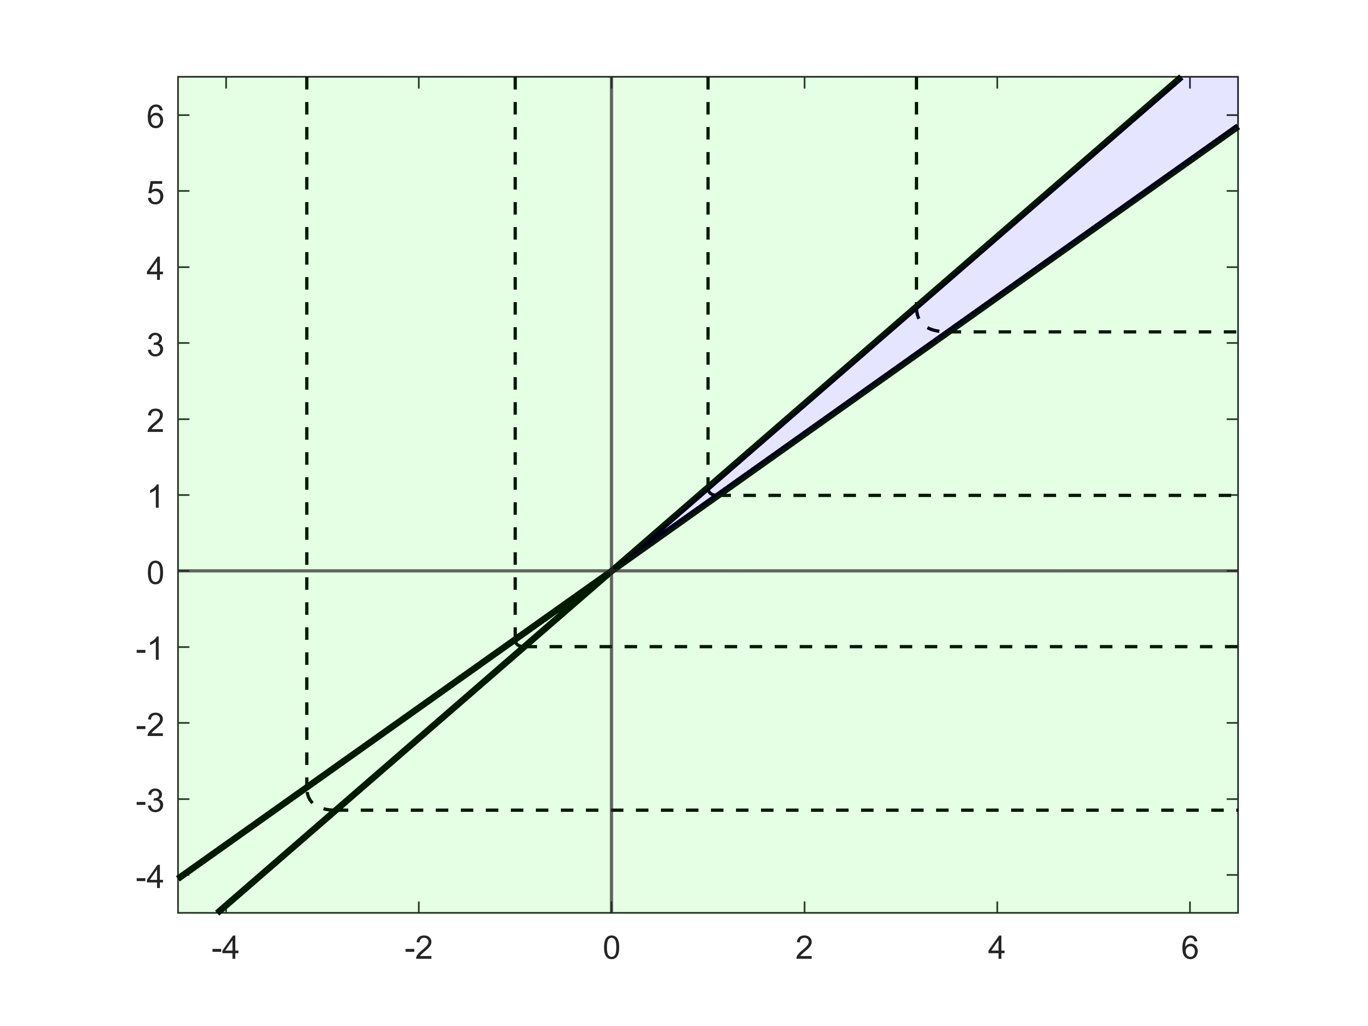




$$η_{i}=bλ_{i}$$
$$η_{i}=aλ_{i}$$
$$η_{i}$$
$$λ_{i}$$

Slide 2
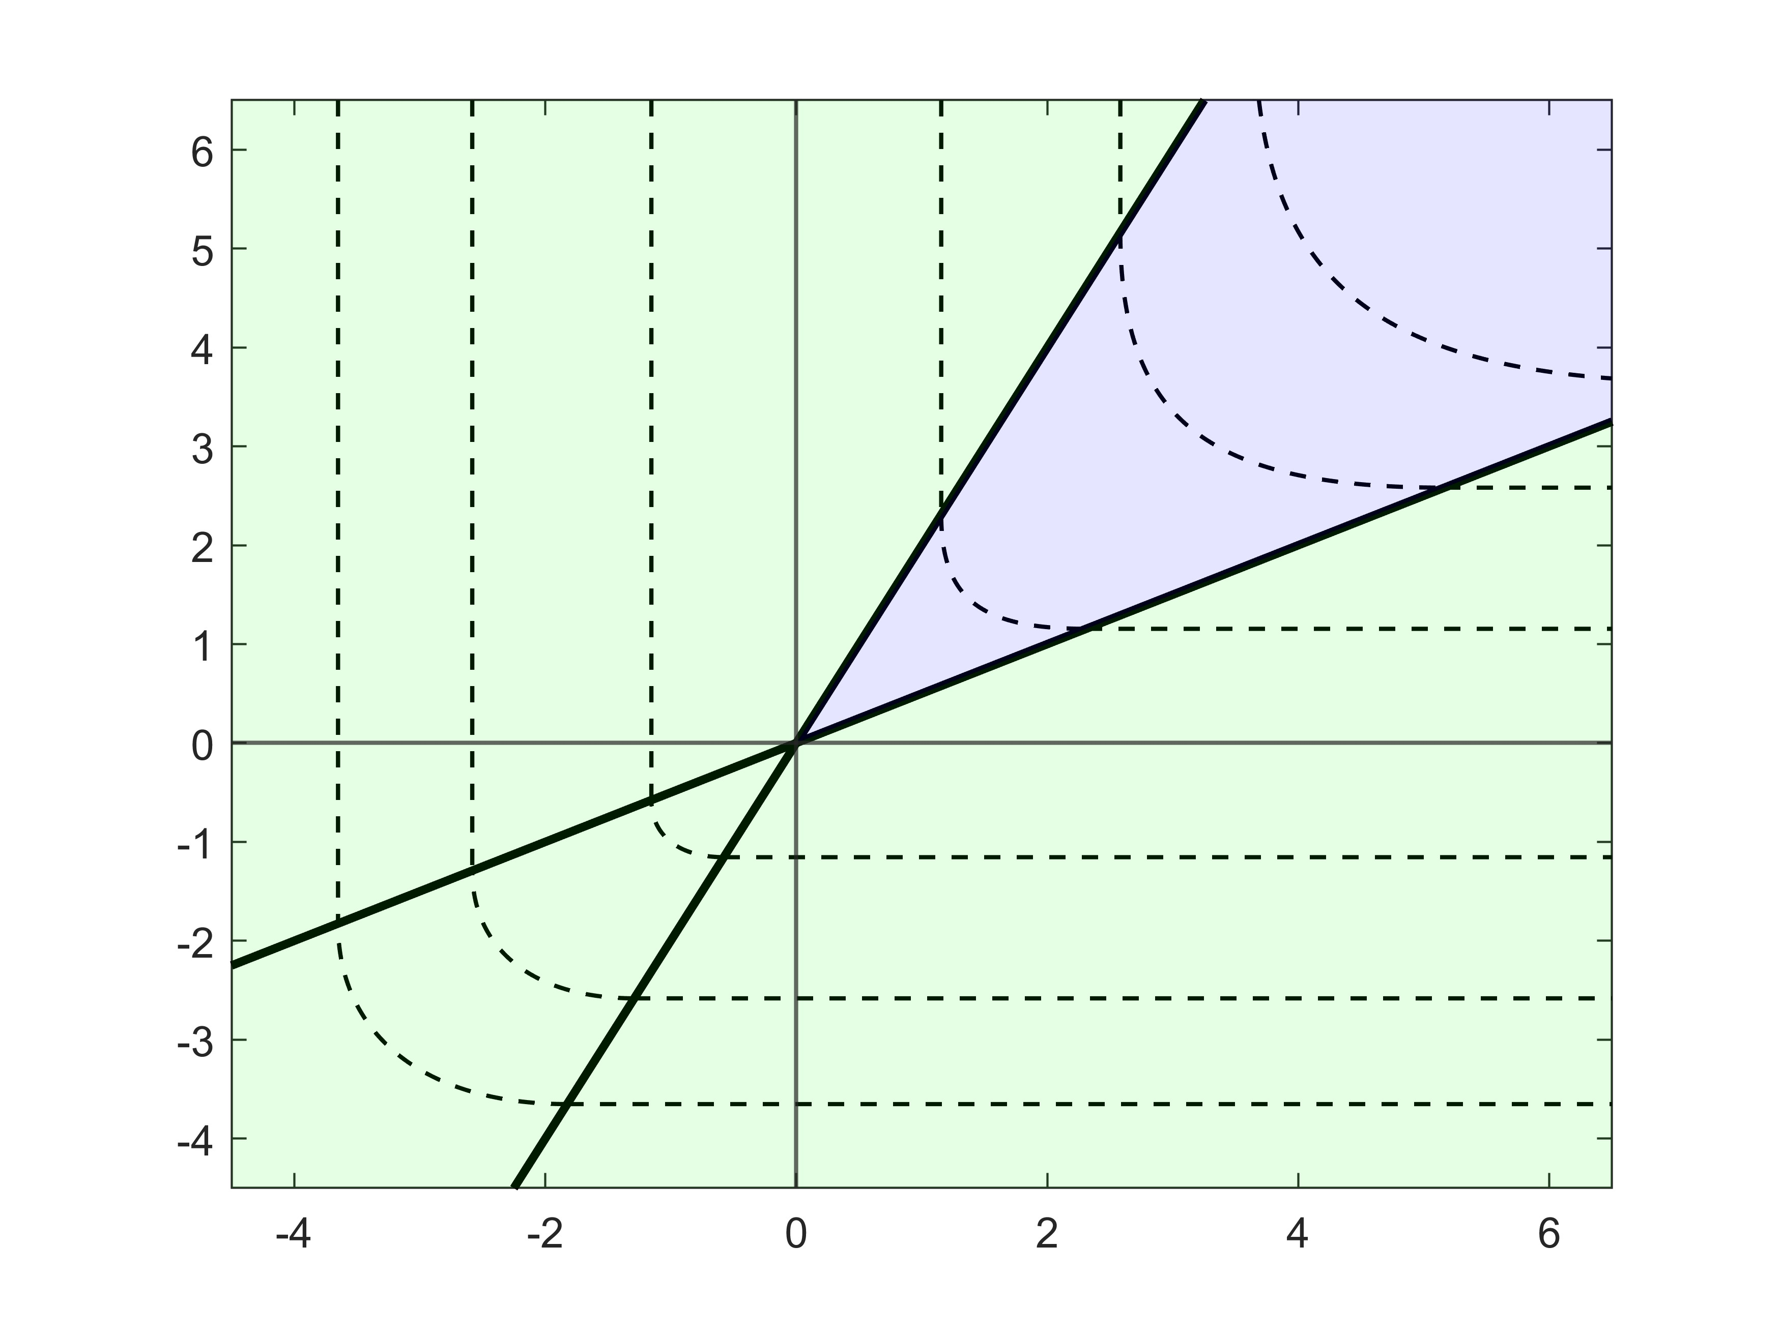


$$η_{i}=bλ_{i}$$
$$η_{i}$$
$$η_{i}=aλ_{i}$$
$$λ_{i}$$

Slide 3
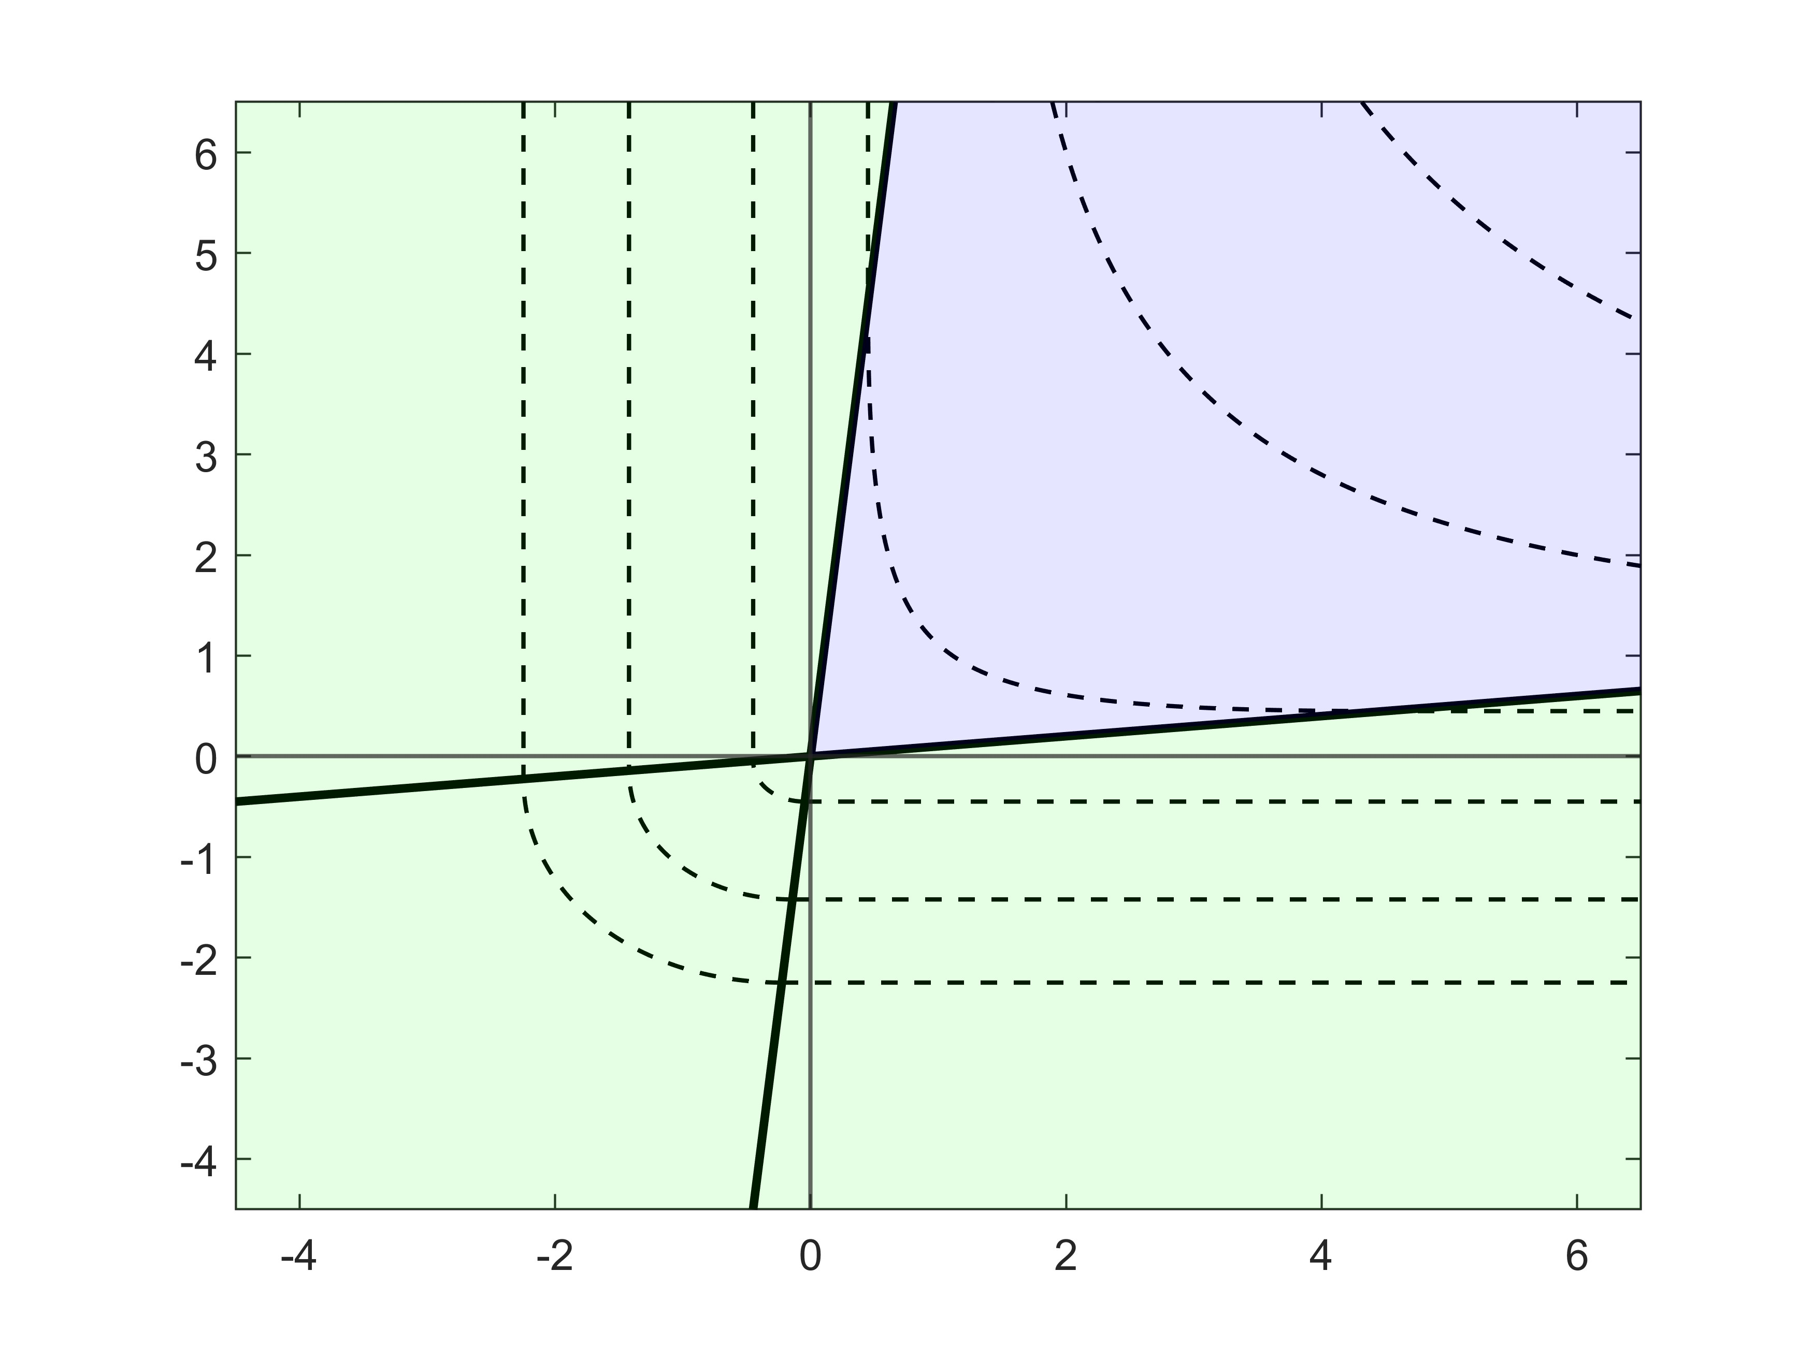


$$η_{i}=bλ_{i}$$
$$η_{i}$$
$$η_{i}=aλ_{i}$$
$$λ_{i}$$

Slide 4
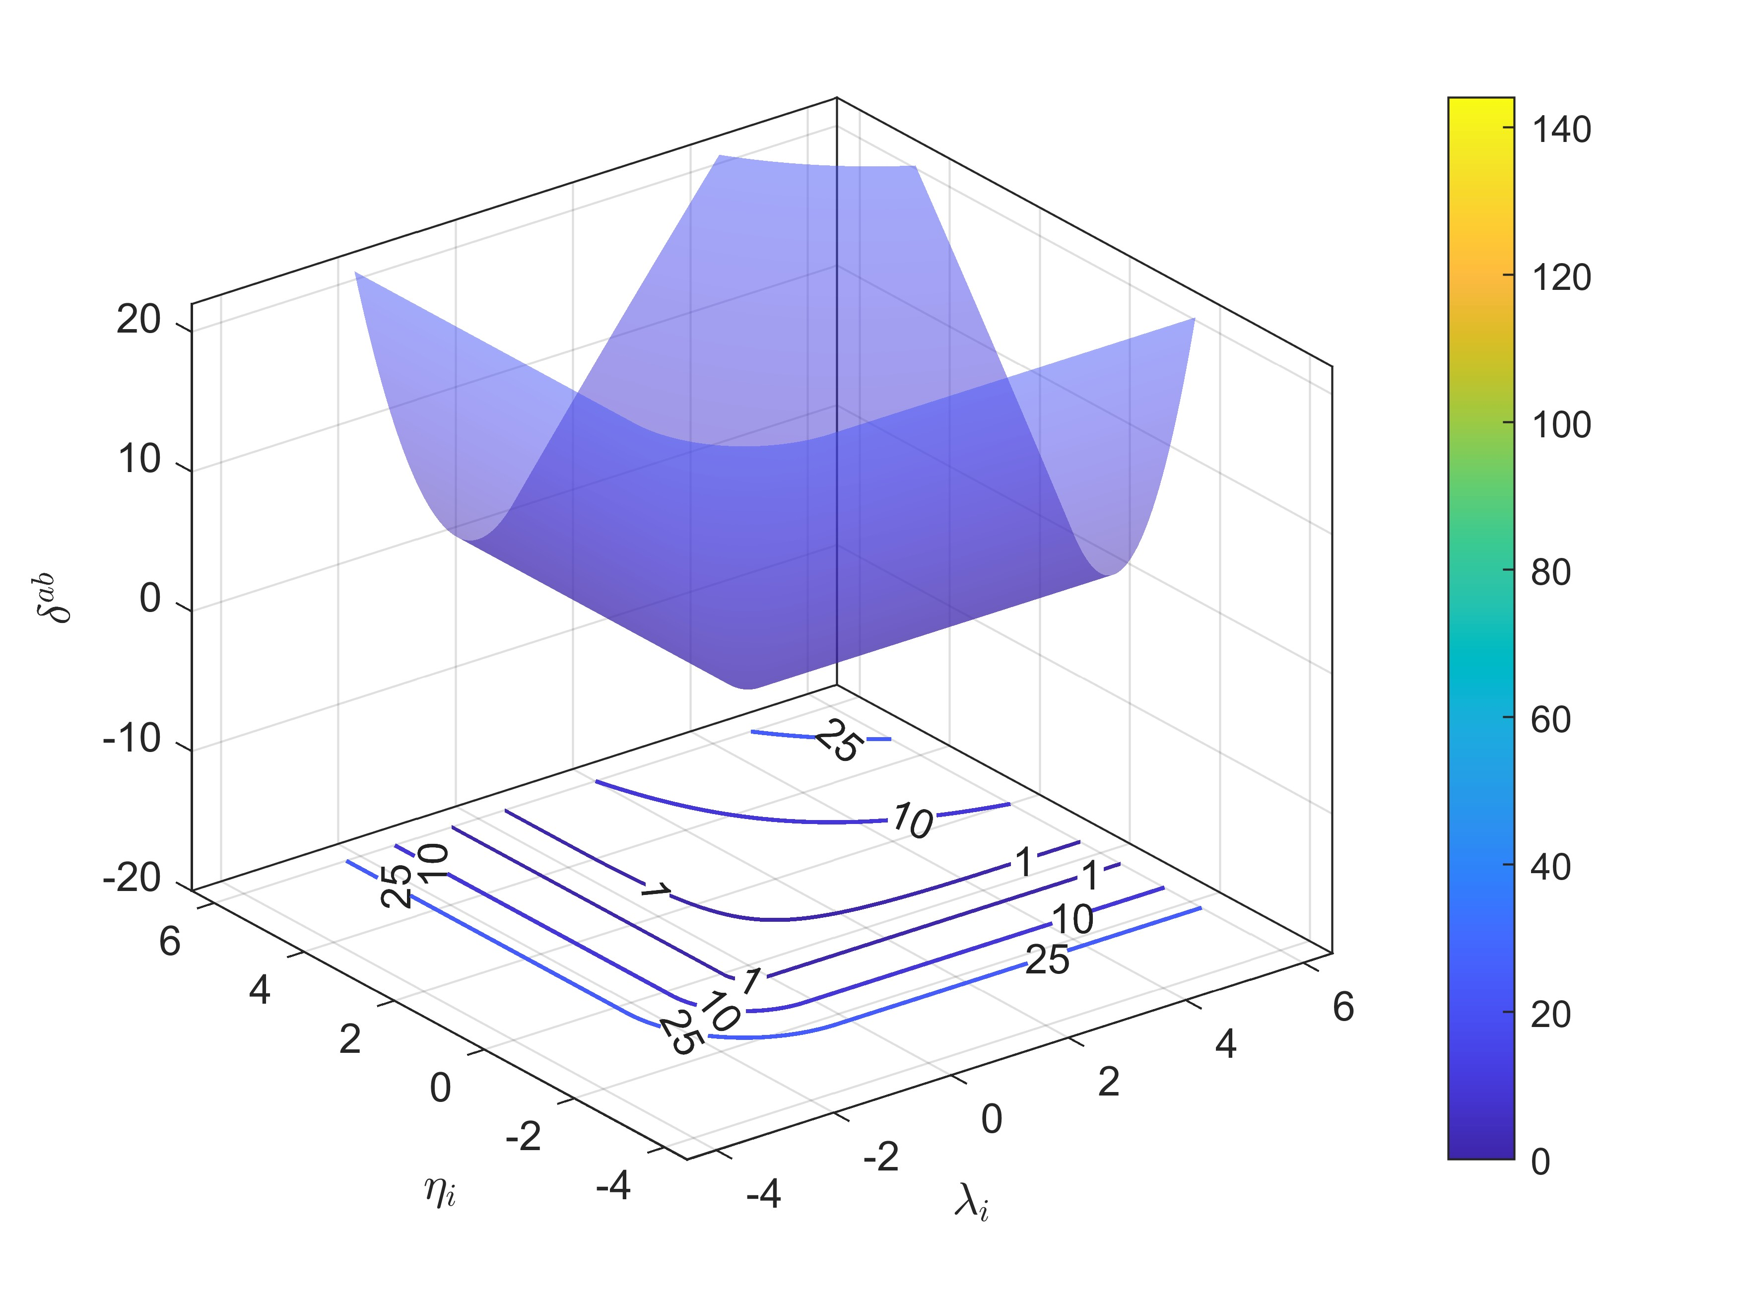

Slide 5
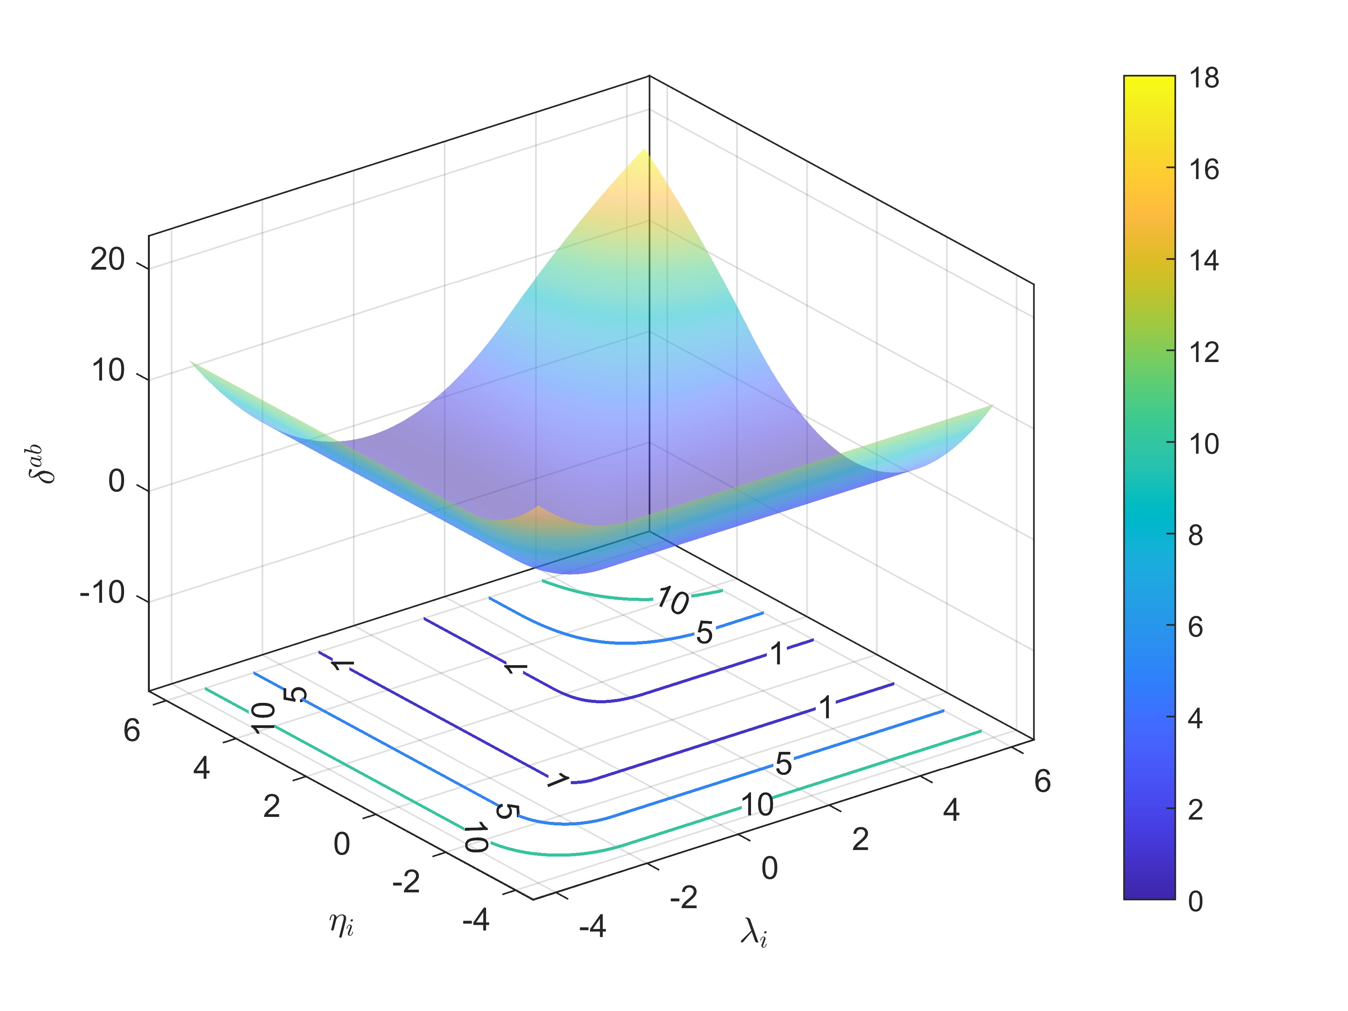

Slide 6
