Slide 1
Stacks

Slide 2
Chapter 8
  Stacks
Overview
  The specification, use, and implementation of the Stack ADT.

Slide 3
Chapter Objectives
1. Understanding and applying the Stack ADT.
2. Implementing the Stack ADT as a C++ Class.
3. Implementing a Stack using an array.
4. Implementing a Stack using a dynamic list.
5. Implementing an ADT with C++ templates.
6. Applications of the Stack ADT.

Slide 4
Robot Navigation Problem
Lets suppose that we adopt the following basic strategy for the robot:
1. If possible, move in the direction of the target.
If there are two directions both of which move the robot closer to the target, choose one arbitrarily.
(strategies may be fixed or arbitrary)
2. If the robot can’t move toward the target, try any other move arbitrarily.

Slide 5
Initial conditions
T
R

Slide 6
The robot hits a dead end
T
R

Slide 7
backs up,tries new direction
T
R

Slide 8
Robot Navigation Problem
Based on our discussion above, we add the following rules to our algorithm:
3. As the robot moves, it marks the squares so that the robot doesn’t revisit them, except as indicated in rule 4.
4. When the robot reaches a dead end, it backs up through its previous positions until it finds an unexplored direction to try.

Slide 9
Backtracking
When base case is encountered we must backtrack
Go to the stack of previously visited squares
Pop them off one by one until a viable direction appears

Slide 10
Robot’s path to the target
T

Slide 11
Question
At various decision points in the search traced above, the robot could choose to try “up” or “to the right” first. Which did it choose? Would it have made any difference in this case if it had used a different strategy?

Slide 12
Compare fixed strategies
Right, Up, Down, Left
  Similar to arbitrary path shown
Up, Right, Down, Left
  Superior to arbitrary strategy
Left, Down, Right, Up
  Wander’s ‘aimlessly’ until it runs into target

Slide 13
The stack
The solution to this problem requires backtracking, which requires storing previously visited locations in reverse order
The last one visited is the first one you backtrack to
Such a structure is called a ‘stack’

Slide 14
The Container ADT
Containers are structures that hold multiple objects
Stacks are one type of container
Stacks obey the rule
“Last in, first out” (LIFO)

Slide 15
Classic stack example
Cafeteria trays, sheets of paper in a laser printer, etc.
LIFO
You ‘push’ items on
You ‘pop’ items off
Must always know where the top of the structure is
Must know if the stack is empty
Sometimes useful to know if it is full

Slide 16
Stack ADT
Characteristics:
• A stack S stores items of some type (stackElementType) in Last-In, First-Out (LIFO) order.
Operations:
stackElementType S.pop()
Precondition: !S.isEmpty()
Postcondition: S = S with top removed
Returns: The item x such that S.push(x) was the most recent invocation of push.

Slide 17
Stack ADT: push() and top()
void S.push(stackElementType)
Precondition: None
Postcondition: Item x is added to the stack, such that a subsequent S.pop() returns x.
stackElementType S.top()
Precondition: ! S.isEmpty()
Postcondition: None
Returns: The item x such that S.push(x) was the most recent invocation of push.

Slide 18
Stack ADT: isEmpty()
bool S.isEmpty()
Precondition: None
Postcondtion: None
Returns: true if and only if S is
empty, i.e., contains no
data items.

Slide 19
Stacks and lists
Stacks share many of the characteristics of lists, except they have a restriction on where data must be accessed or stored (only at the top)
Data in stacks is homogeneous
Use list-type implementations

Slide 20
Ways to implement stacks
Arrays
Linked lists (dynamic stacks)

Slide 21
Array implementations
What is wrong with the following example?

Slide 22
Array-based stack (version 1)
0
?
0
a
0
b
1
?
1
?
1
a
2
?
2
?
2
?
push('a')
push('b')
3
?
3
?
3
?
4
?
4
?
4
?
5
?
5
?
5
?

Slide 23
Problems
The top is fixed, therefore all access for storage (push) or retreival (pop) must go through it.
To keep it LIFO, the most recent item must be on top
As new items are added older items must shuffle down.
This is slow and unnecessary

Slide 24
A better implementation
Instead of fixing the top and moving the data, fix the data and move the top
As long as we know what top is we can still do all push and pop functions associated with LIFO

Slide 25
Version 2: floating top
top = -1
top = 0
top = 1
0
?
0
a
0
a
1
?
1
?
1
b
2
?
2
?
2
?
push('a')
push('b')
3
?
3
?
3
?
4
?
4
?
4
?
5
?
5
?
5
?

Slide 26
Code Example 8-1
// Code Example 8-1: Stack implemented using an Array
const int maxStackSize = 1000;
typedef char StackElementType;

Slide 27
Class Stack
class Stack {
public:
Stack();
void push(StackElementType item);
StackElementType pop();
StackElementType top();
bool isEmpty();
private:
StackElementType stackArray[maxStackSize];
int topIndex;
};

Slide 28
Stack constructor
// cx8-2.cpp
// Code Example 8-2: Implementation file, stack implemented using an Array
#include "cx8-1.h"
Stack::Stack()
{
topIndex = -1;
}

Slide 29
push() and pop() methods
void Stack::push(StackElementType item)
{ ++topIndex;
// ensure array bounds not exceeded
assert(topIndex < maxStackSize);
stackArray[topIndex] = item;
}
StackElementType Stack::pop()
{ // ensure array bounds not exceeded
assert(topIndex >= 0);
int returnIndex(topIndex);
--topIndex;
return stackArray[returnIndex];
}

Slide 30
top() and isEmpty() methods
StackElementType Stack::top()
{
// ensure array bounds not exceeded
assert(topIndex >= 0);
return stackArray[topIndex];
}
bool Stack::isEmpty()
{
return bool(topIndex == -1);
}

Slide 31
Templates
Templates are C++ tools that can be used to create generic classes
Regular stack classes consist of one designated data type (from last example):
const int maxStackSize = 1000;
typedef char StackElementType;
private:
StackElementType stackArray[maxStackSize];

Slide 32
Templates (continued)
To use the previous code with a stack consisting of an array of ints, instead of chars, we would have to rewrite portions of it.
A stack template would not have to be rewritten. The orginal class definition would be generic, allowing us to later declare a stack of any designated type. Example:
int main()
{ Token t;
Stack < double > s;
double op1, op2;
bool done(false);

Slide 33
Pros and cons of templates
Templates are not necessary if your ADT
  Addresses only a specific client need
  Is not intended for reuse
Templates are necessary if your ADT is
  Intended to be a general solution
  Intended to be reused
  Intended to work with any client

Slide 34
Use of templates
These are utilized heavily in Chapters 8 and 9
Use of them is optional in your labs
Nevertheless, let’s take a look at one of them for an array-based stack

Slide 35
template syntax
‘template <class YourType>’ becomes part of the class definition and must also become the leading part of every member function.

Slide 36
Stack template class
// cx8-3.h
// Code Example 8-3: Stack declaration rewritten as a templated class
const int maxStackSize = 1000;

Slide 37
Code Example 8-3
template < class StackElementType >
class Stack {
public:
Stack();
void push(StackElementType item);
StackElementType pop();
StackElementType top();
bool isEmpty();
bool isFull();
private:
StackElementType stackArray[maxStackSize];
int topIndex;
};

Slide 38
Template constructor
// Code Example 8-4: Definition of Stack member functions using templates
#include "cx8-3.h”
template < class StackElementType >
Stack < StackElementType >::Stack()
{
topIndex = -1;
}

Slide 39
Stack template push()
template < class StackElementType >
void Stack < StackElementType >::push(StackElementType item)
{
++topIndex;
// ensure array bounds not exceeded
assert(topIndex < maxStackSize);
stackArray[topIndex] = item;
}

Slide 40
Stack template pop()
template < class StackElementType >
StackElementType Stack < StackElementType >::pop()
{
// ensure array bounds not exceeded
assert(topIndex >= 0);
int returnIndex(topIndex);
--topIndex;
return stackArray[returnIndex];
}

Slide 41
Stack template top()
template < class StackElementType >
StackElementType Stack < StackElementType >::top()
{
// ensure array bounds not exceeded
assert(topIndex >= 0);
return stackArray[topIndex];
}

Slide 42
isEmpty() and isFull()
template < class StackElementType >
bool Stack < StackElementType >::isEmpty()
{
return bool(topIndex == -1);
}
template < class StackElementType >
bool
Stack < StackElementType >::isFull()
{
return topIndex == maxStackSize - 1;
}

Slide 43
Linked-list implementation
Array-based stacks have the disadvantage that they are static structures
They may waste space
They may not have enough

Slide 44
Dynamic stacks
Dynamic stacks
  Do not have unused space
  Do have extra memory requirements (for pointers0
  Do not run out of space, unless there is no more room on the heap

Slide 45
List-based stack, public
template < class StackElementType >
class Stack {
public:
Stack();
void push(StackElementType e);
StackElementType pop();
StackElementType top();
bool isEmpty();

Slide 46
The private section
Must include a structure definition or be based on another class that defines the node object
Similar to linked lists

Slide 47
List-based stack, private
private:
struct Node;
typedef Node * Link;
struct Node {
StackElementType data;
Link next;
};
Link head;
};

Slide 48
Constructor
template < class StackElementType>
Stack < StackElementType >::Stack()
{
head = 0;
}

Slide 49
Push
Pushing a value onto the stack means having to create a new node, assign it the data value, and prepend it to the linked list
The pointer to this node becomes the top of the stack (head of the list)

Slide 50
push
template < class StackElementType >
void
Stack < StackElementType >::push(StackElementType e)
{
Link addedNode = new Node;
assert(addedNode);
addedNode->data = e;
addedNode->next = head;
head = addedNode;
}

Slide 51
Stack applications
Calculator
Maze solving

Slide 52
Implementing a calculator
Standard notation for arithmetic expression is called ‘infix’
The operator is ‘in between’ pairs of operands.
Example 5+7
Problem: ambiguity
  5 + 7 / 2 // which is done first

Slide 53
Precedence rules
Infix ambiguity is solved by precedence rules
1. Evaluate expressions in parentheses
2. * and / before + and -
3. Equal precedence goes left to right

Slide 54
Other forms of expressions
Infix is only one method of representing expressions.
Others are ‘postfix’ and ‘prefix’
In postfix expressions the operators come after operand pairs (57+)
In prefix expressions the operators come before operand pairs. (+57)

Slide 55
Reverse Polish Notation
RPN is a postfix expression form
It requires no parentheses
It also requires a stack
Rules
  1. Evaluate from left to right
  2. When you encounter an operator you immediately apply it to the operands that preceded it. Then put the result on the stack

Slide 56
Tokenization
Input characters are either operators or operands
Each is evaluated as a ‘token’ and the appropriate action taken for that token.
This process is called ‘tokenization’ or ‘lexical analysis’

Slide 57
expression:
3 4 - 5 3 * -
3 4 - 5 3 * -
3 4 - 5 3 * -
stack:
3
4
3 - 4 =
-1
3
expression:
3 4 - 5 3 * -
3 4 - 5 3 * -
3 4 - 5 3 * -
stack:
5
3
5 * 3 =
15
-1
5
-1
-1
expression:
3 4 - 5 3 * -
stack:
-1 -15 =
-16
Final result on top of stack

Slide 58
The Token Class
Includes a derived type. Each token will be one of these:
Enum tokenType {operandToken, operatorToken, eolToken, eofToken, badToken}
Also includes
Enum operatorType {none, add, subtract, multiply, divide}
Example:
Class Token { public: tokenType nextToken(); // get next token in stream operatorType getOperator(); // return operator double getOperand(); // return operand

Slide 59
Reverse Polish program
// Code Example 8-7: RPN Evaluator
#include "sx8-1.h" // Stack class, with "clear" operation added
#include "sx8-3.h" // Token class definition
int main()
{
Token t;
Stack < double > s;
double op1, op2;
bool done(false);

Slide 60
while (!done) {
switch(t.nextToken()) {
case operandToken:
s.push(t.getOperand());
break;
case operatorToken:
// op2 is the top of the stack, op1 is the next value down
// first, have to make sure there are 2 items to pop
if (s.isEmpty() || (op2 = s.pop(), s.isEmpty()))
cerr << "Not enough operands for operator!\n";

Slide 61
Code Example 8-7
else { // get op1, then apply appropriate operator
op1 = s.pop();
switch(t.getOperator()) {
case add: s.push(op1 + op2); break;
case subtract: s.push(op1 - op2); break;
case multiply: s.push(op1 * op2); break;
case divide:
if (op2 == 0)
cerr << "Division by zero!\n";
else
s.push(op1 / op2);
break;
}
}

Slide 62
break;
case eofToken:
done = true; // break intentionally omitted here
case eolToken:
if (!s.isEmpty()) // if there's something in stack, display it
cout << "--> " << s.pop() << '\n';
s.clear(); // clear the stack for the next line
break;
case badToken:
cerr << "Input error!\n";
break;
}
}
return 0;
}

Slide 63
How recursion is implemented
Function calls are stored and returned in LIFO order
When a function is initiated, it gets its own copies of parameters.
Upon a recursive call, the data for the original function, along with the address of where the call occurred, must be stored somewhere.
They get stored on a stack, as ‘stack frames’ or ‘activation records’

Slide 64
Stack frames
A stack frame contains all that is necessary to restart a function
  The location of the next instructions
  The values of all local variables
  The values of all parameters

Slide 65
The function call
A call to function g from function f
  Loads a stack frame
  Pushes the frame on to the ‘call stack’
  Binds the formal parameters for g to the actual parameters for f
  Transfers control to the first instruction in g.

Slide 66
The return
To return to function f from g
  Pop the top stack frame from the call stack
  Use the values in the stack frame to reinitialize the values for f
  Bind the return value for the call to g
  Transfer control to the return address in function f

Slide 67
An example
A recursive power function
Computes the integer power of a floating point number

Slide 68
Recursive power function
double power (double base, int exponent)
{
if (exponent < 1)
return 1.0;
else {
int lower_exponent;
double lower_power, result;
lower_exponent = exponent - 1;
lower_power = power(base, lower_exponent); // *1*
result = lower_power * base;
return result;
}
}

Slide 69
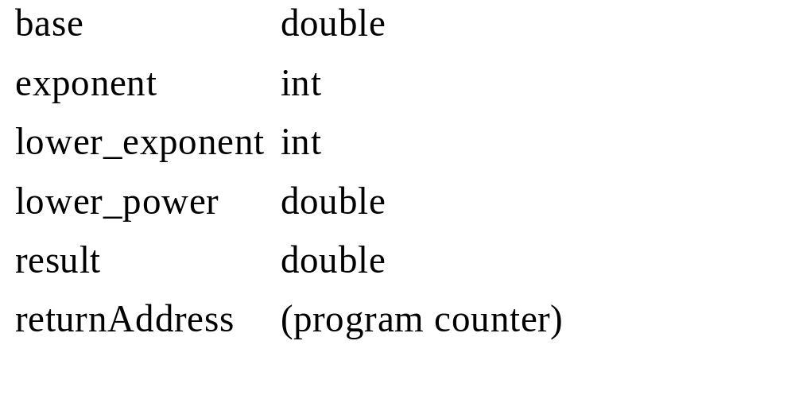
Empty stack frame for power
Label Type Value

Slide 70
Initial state
The function is called as follows:
  cout << power(1.7, 3)
Initial bindings
  base is 1.7
  exponent is 3
When the first recursive call is reached we have this...

Slide 71
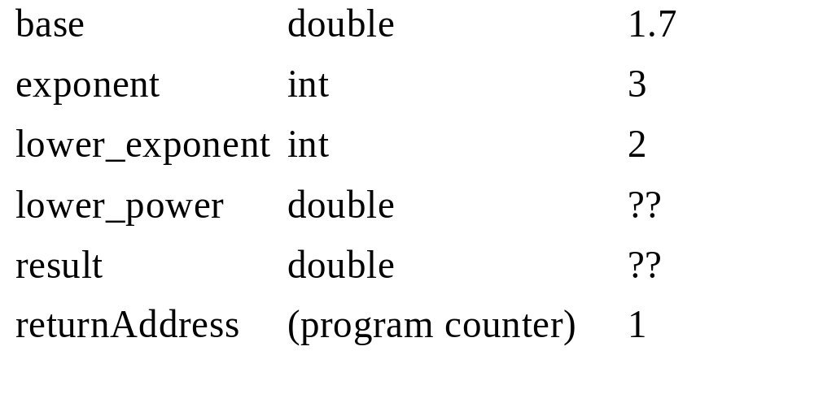
Frame 1
Label Type Value

Slide 72
Recursion
The initial call is now suspended
The frame is placed on the stack
New bindings take place
  base = 1.7
  exponent = 2
A new function call begins

Slide 73

Frame 2
Label Type Value

Slide 74
Recursion, again
This frame is pushed onto the stack as the result of the next recursive call
Values are bound for that call
Another stack frame is built

Slide 75

Frame 3
Label Type Value

Slide 76
One more time
The current frame is pushed onto the stack.
Values are bound for the next call and another stack frame created.

Slide 77

Frame 4
Label Type Value

Slide 78
Base case reached
Since ‘exponent’ is now less than 1 there is no more recursion.
The value ‘1’ is returned to the previous call
Frame 4 is popped off the stack and restarted from where it left off

Slide 79
Recursive backtracking
When Frame 4 finishes executing it returns a value
Frame 3 is popped off the stack and picks up the value returned by Frame 4.
When Frame 3 finishes it returns to Frame 2, which returns to Frame 1
Each are popped off the stack and resume their business.

Slide 80
Each return does this
Pops a frame off of the stack
Restores its data state
Replaces the call to power with the return value
Continues execution at the return address

Slide 81
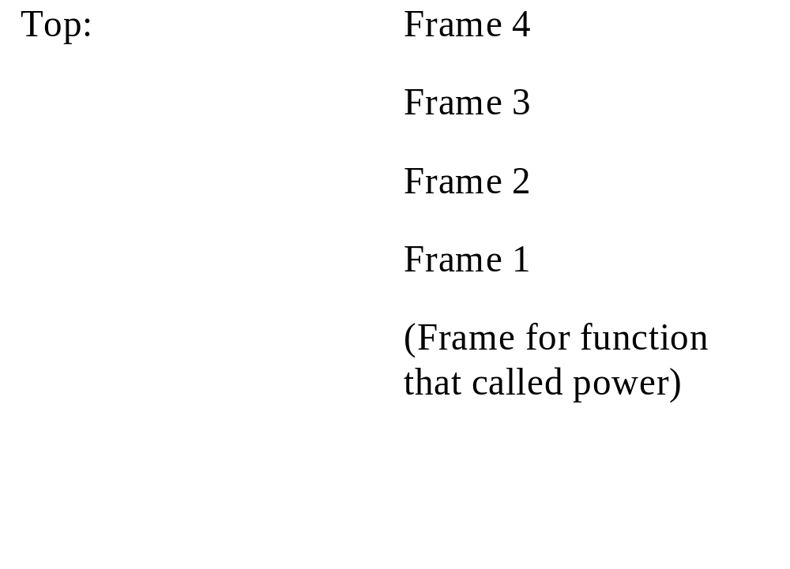
Base case reached

Slide 82
Chapter Summary
The Stack ADT is a LIFO data structure characterized by the operations push and pop.
The Stack ADT can be implemented using either an array, which has a fixed maximum size, or a linked list which can grow dynamically.

Slide 83
Summary continued
Generic classes can be created using templates in C++.
Reverse Polish Notation (RPN) expressions can be conveniently evaluated with a Stack ADT.
The Stack ADT can be used to organize the stack frames used at runtime to keep track of function calls, both recursive and non-recursive.

Slide 84
Optional
Code for solution to Robot problem.

Slide 85
Back to the robot problem
Think of the maze as an xy coordinate system with the origin in the lower left (the starting point)
Every time a cell is entered it is stored in a stack so we can come back to it if we need to.

Slide 86
Figure 8-8: Directions in the x-y plane
y increasing
x increasing

Slide 87
Square status
enum SquareStatus {clear, blocked, markedForward, markedBackward,
invalid_coordinate};

Slide 88
class Maze
class Maze {
public:
Maze(char * filename);
int getRows();
int getCols();
void markSquareForward(const MazeCoordinate mc);
void markSquareBackward(const MazeCoordinate mc);
SquareStatus querySquare(const MazeCoordinate mc) const;
void display();
private:
int * * mazeBits;
int mazeRows;
int mazeCols;
};

Slide 89
Header file for Maze
// cx8-10.h
// Code Example 8-10: header file for MazeCoordinate class
// MazeDirection represents all the possible directions that the robot can
// move in the maze. The values for the enums are convenient for
// representing the directions in a set
enum MazeDirection {mz_north = 1, mz_south = 2, mz_east = 4, mz_west = 8};

Slide 90
Code Example 8-10
class MazeCoordinate {
public:
MazeCoordinate();
MazeCoordinate(int x, int y);
void setX(const int x);
void setY(const int y);
MazeCoordinate neighbor(const MazeDirection dir);
int getX() const;
int getY() const;

Slide 91
Code Example 8-10
private:
int x_coord;
int y_coord;
};
int operator==(const MazeCoordinate mc1, const MazeCoordinate mc2);
int operator!=(const MazeCoordinate mc1, const MazeCoordinate mc2);
#endif

Slide 92
Code Example 8-11
// cx8-11.cpp
// Code Example 8-11: main function in robot navigation program
#include "sx8-1.h" // stack declarations
#include "cx8-9.h" // maze
// A MazeCoordinateStack is a stack that stores objects of type MazeCoordinate
typedef Stack < MazeCoordinate > MazeCoordinateStack;
// defined in cx8-12.cpp
MazeCoordinate getXY(const Maze & maze);

Slide 93
// defined in cx8-13.cpp
bool moveAttempt(MazeCoordinate & currentPosition, const MazeCoordinate goal,
Maze & maze, MazeCoordinateStack & posStack);
int main()
{
// set up the maze and the initial positions
Maze maze("cx8-11.dat"); // creates maze from data file
// ask the user for the start and target positions
cout << "Enter X, Y coordinates for start position: ";
const MazeCoordinate start = getXY(maze);
cout << "Enter X, Y coordinates for target position: ";

Slide 94
const MazeCoordinate goal = getXY(maze);
MazeCoordinate currentPosition(start);
MazeCoordinateStack positionStack;
while (currentPosition != goal) {
if (!moveAttempt(currentPosition, goal, maze, positionStack)) {
cerr << "Stuck at position: (" << currentPosition.getX() <<
"," << currentPosition.getY() << ")\n";
maze.display();
return 1;
}
}
cout << "Maze goal achieved.\n";
maze.display();
return 0;
}

Slide 95
Code Example 8-12
// cx8-12.cpp
// Code Example 8-12: function GetXY
#include "cx8-9.h" // declaration of the Maze (and MazeCoordinate)
MazeCoordinate getXY(const Maze & maze)
{
int x, y;
MazeCoordinate returnXY;
while (1) {
cin >> x >> y;
returnXY.setX(x);

Slide 96
Code Example 8-12
returnXY.setY(y);
switch(maze.querySquare(returnXY)) {
case clear: return returnXY;
case blocked:
cout << "The position you've chosen is blocked by a wall.\n";
break;
case invalid_coordinate:
cout << "The position you've chosen is not inside the maze.\n";
break;
default:
cout << "There's something wrong with the maze!\n";
assert(0);
}
cout << "Enter another X, Y: ";
}
}

Slide 97
Code Example 8-13
// cx8-13.cpp
// Code Example 8-13: function moveAttempt
#include "sx8-1.h" // Stack declaration
#include "cx8-9.h" // Maze declaration
// A MazeCoordinateStack is a stack that stores objects of type MazeCoordinate
typedef Stack < MazeCoordinate > MazeCoordinateStack;
// defined in cx8-14.cpp
bool directionQuery(const MazeCoordinate pos, const MazeCoordinate target, const MazeDirection dir);

Slide 98
Code Example 8-13
// defined in cx8-15.cpp
bool tryMove(Maze & maze, MazeCoordinate & currentPosition,
const MazeDirection dir, MazeCoordinateStack & posStack);
// moveAttempt tries to make any move from the currentPosition;
// if a move is made, return true, otherwise return false (indicating
// that we're stuck with no valid moves).
// PRECONDITION: currentPosition is a valid position in the maze
// POSTCONDITION: maze, posStack, and currentPosition all updated to
// indicate the move
// RETURNS: true if a move was found, else false

Slide 99
Code Example 8-13
bool moveAttempt(MazeCoordinate & currentPosition, const MazeCoordinate goal,
Maze & maze, MazeCoordinateStack & posStack)
{
// try all desirable directions
if (directionQuery(currentPosition, goal, mz_north) &&
tryMove(maze, currentPosition, mz_north, posStack))
return true;
else if (directionQuery(currentPosition, goal, mz_south) &&
tryMove(maze, currentPosition, mz_south, posStack))
return true;
else if (directionQuery(currentPosition, goal, mz_west) &&
tryMove(maze, currentPosition, mz_west, posStack))
return true;

Slide 100
Code Example 8-13
else if (directionQuery(currentPosition, goal, mz_east) &&
tryMove(maze, currentPosition, mz_east, posStack))
return true;
// if robot couldn't move in desired direction, try the rest
if (!directionQuery(currentPosition, goal, mz_north) &&
tryMove(maze, currentPosition, mz_north, posStack))
return true;
else if (!directionQuery(currentPosition, goal, mz_south) &&
tryMove(maze, currentPosition, mz_south, posStack))
return true;
else if (!directionQuery(currentPosition, goal, mz_west) &&
tryMove(maze, currentPosition, mz_west, posStack))
return true;

Slide 101
Code Example 8-13
else if (!directionQuery(currentPosition, goal, mz_east) &&
tryMove(maze, currentPosition, mz_east, posStack))
return true;
// no possible move -- can we back up?
if (posStack.isEmpty()) // nope! we're stuck!
return false;
else { // back up
maze.markSquareBackward(currentPosition);
currentPosition = posStack.pop();
return true;
}
}

Slide 102
Code Example 8-14
// cx8-14.cpp
// Code Example 8-14: function directionQuery
#include "cx8-9.h"
// directionQuery takes two positions and a direction, returning
// true if the proposed direction will take the robot in the direction
// from the first position to the second position, and false if the
// proposed direction will not
bool directionQuery(const MazeCoordinate pos, const MazeCoordinate target,
const MazeDirection dir)

Slide 103
Code Example 8-14
{
switch(dir) {
case mz_north: return bool(pos.getY() < target.getY());
case mz_south: return bool(pos.getY() > target.getY());
case mz_east: return bool(pos.getX() < target.getX());
case mz_west: return bool(pos.getX() > target.getX());
default: assert(0); // should never get here!
return false;
}
}

Slide 104
Code Example 8-15
// cx8-15.cpp
// Code Example 8-15: function tryMove
#include "sx8-1.h" // Stack declaration
#include "cx8-9.h" // Maze declarations
// A MazeCoordinateStack is a stack that stores objects of type MazeCoordinate
typedef Stack < MazeCoordinate > MazeCoordinateStack;
// tryMove takes a maze, a position in the maze, a direction, and a stack.
// If the dir represents a valid move, then push the currentPosition
// onto the stack, mark the currentPosition in the maze to indicate

Slide 105
Code Example 8-15
// a forward move from that position, update currentPosition to move in
// that direction, and return true.
// Otherwise, return false.
// PRECONDITIONS: currentPosition is a valid position in maze
// POSTCONDITIONS: If a move can be made in direction "dir",
// the value of currentPosition is updated, the maze is marked to indicate
// the move, and the old position is pushed onto the stack.
// RETURNS: true if the proposed move was made, else false

Slide 106
Code Example 8-15
bool tryMove(Maze & maze, MazeCoordinate & currentPosition,
const MazeDirection dir, MazeCoordinateStack & posStack)
{
MazeCoordinate tryCoordinate = currentPosition.neighbor(dir);
if (maze.querySquare(tryCoordinate) == clear) {
posStack.push(currentPosition);
maze.markSquareForward(currentPosition);
currentPosition = tryCoordinate;
return true;
}
else
return false;
}

