Slide 1
Concrete Compressive Strength

Slide 2
Problem Description
Concrete is the most important material in civil engineering.
The strength of concrete ( the compressive strength) is the measure of how much load the concrete can carry without failure and it depends on a number of parameters
Since concrete is used for foundation and floorings, it is important for it to be strong to hold the weight.

Slide 3
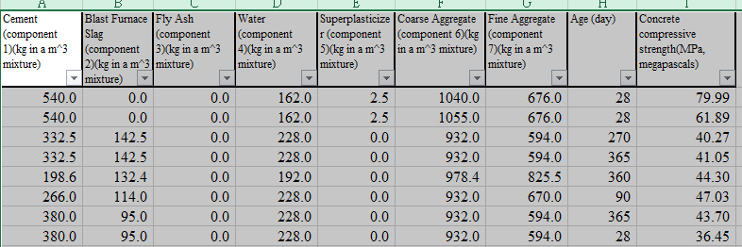
Data Description
This project has data on the amount of the different components of concrete and the age (days) that the concrete was cured.
The focus of this experiment was the concrete compressive strength that these components gave.

Slide 4
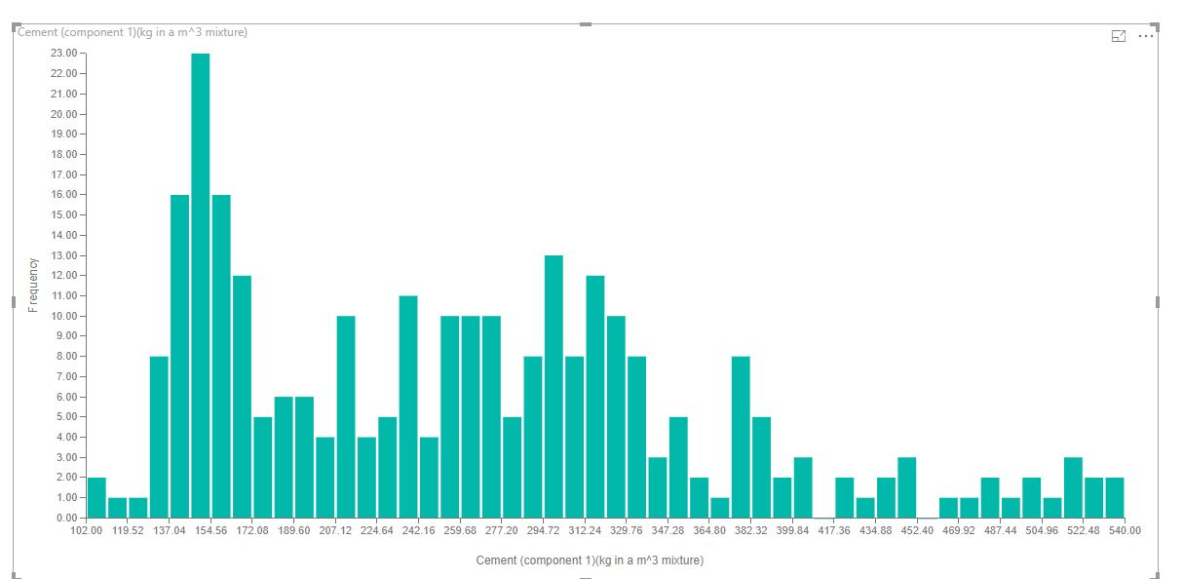
Analytics: Data Features
Notes:
Cement component: The highest amount of cement is 155 kg in 1 cubic meter mixture and the highest is 540kg

Slide 5
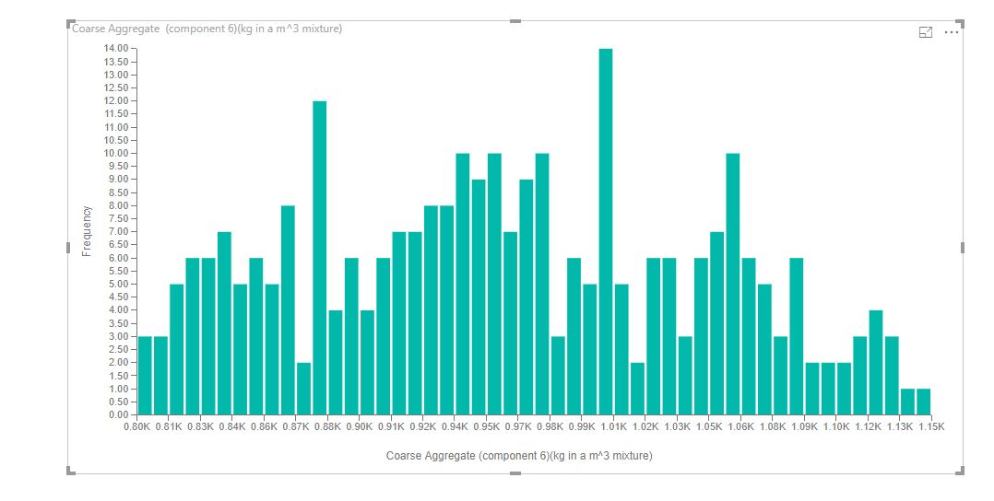
Notes:
Coarse Aggregate: For coarse aggregate, the highest amount is 1.0K kg in a cubic meter mixture and the highest is about 1.15K

Slide 6
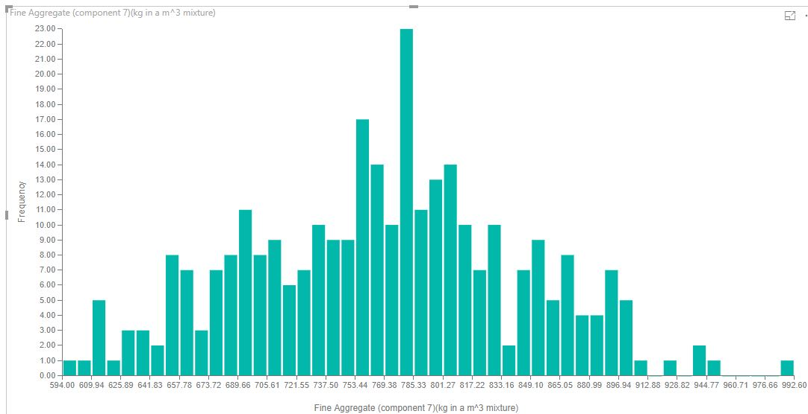
Notes:
Fine Aggregate: For fine aggregate, the highest amount in a cubic meter mixture is (769.38kg- 785kg )and the highest is around 992.60kg

Slide 7
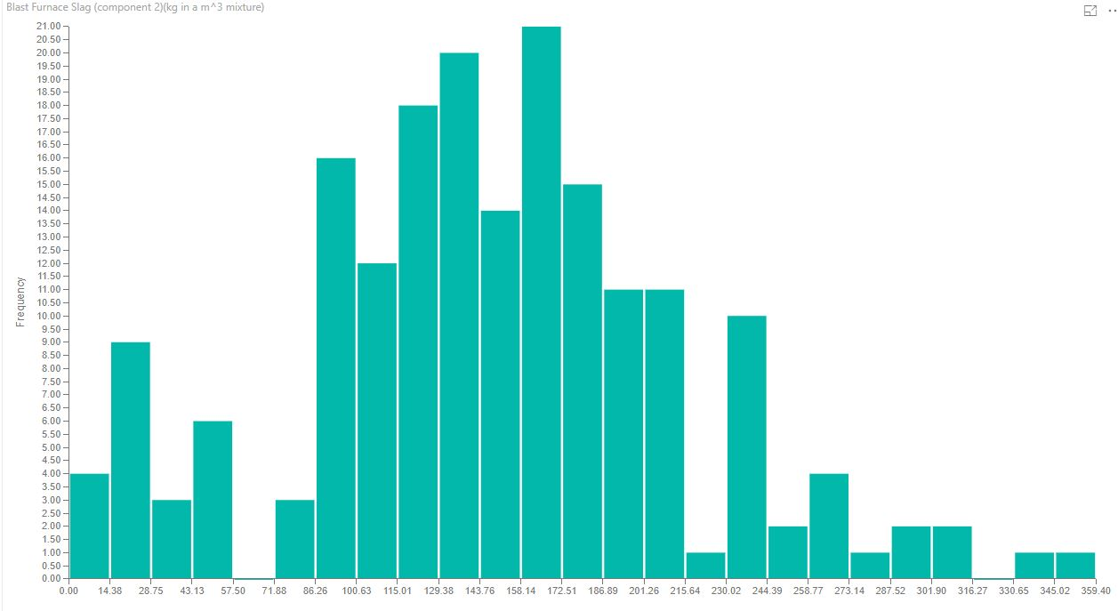
Notes:
The highest amount of blast furnace is between 158.14kg and 172.51kg in a cubic meter mixture and the least used is between 316.27kg and 330.65kg

Slide 8
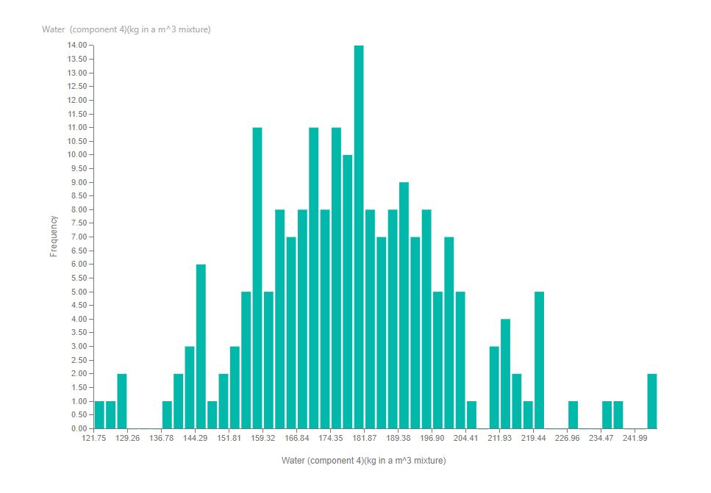
Notes:
Water Component: The highest amount of water in a cubic meter mixture is about 181.87kg

Slide 9
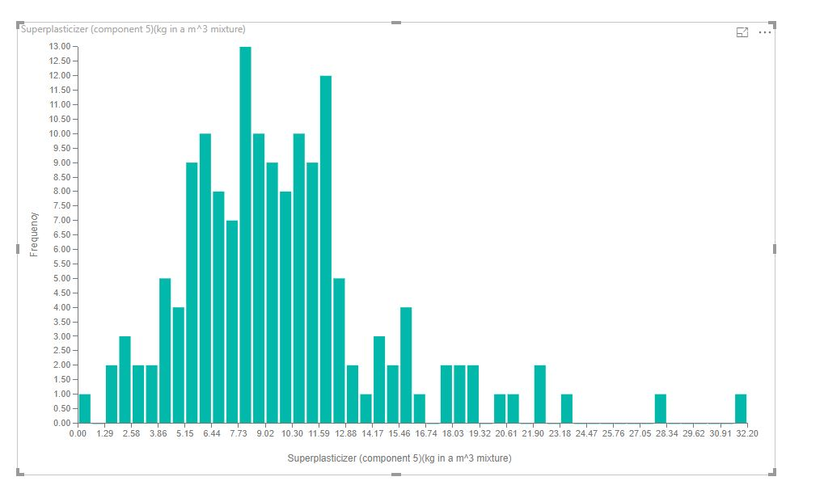
Notes:
Superplasticizer: The most frequently used superplasticizer is about 7.73kg in a cubic meter mixture.

Slide 10
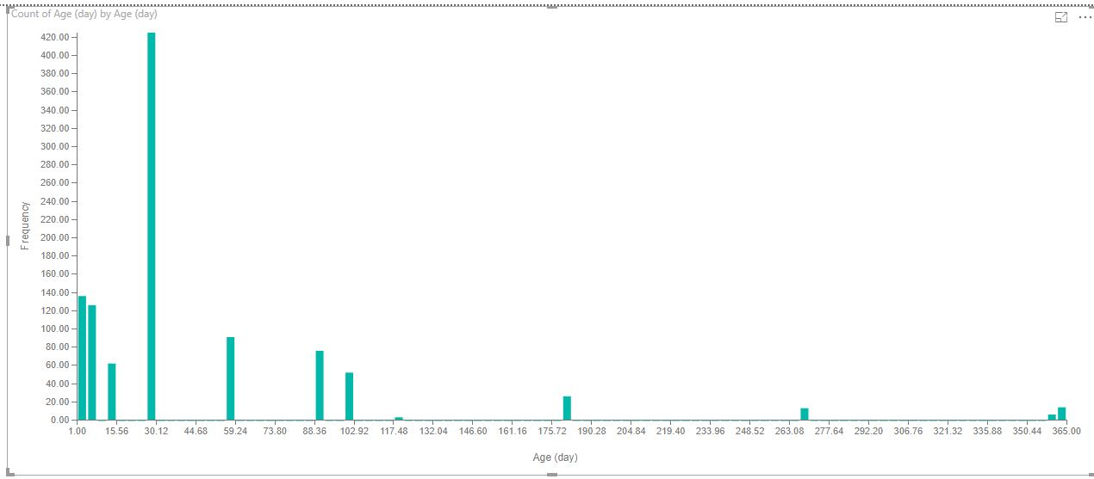
Notes:
Age; The highest amount of days for curing is between 28-30 days.

Slide 11
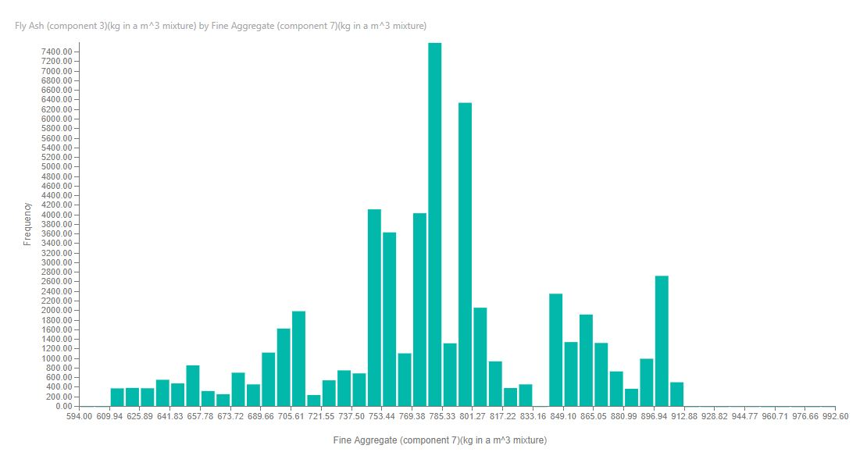
Notes:
Fly ah component : the highest flyash component by fine aggregate is 785.33kg in a cubic mixture

Slide 12
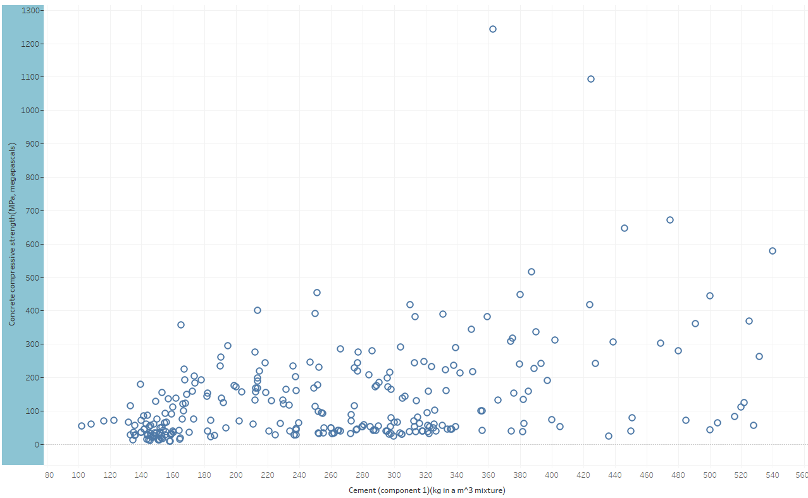
Concrete Strength vs Features
Notes:
The highest compressive strength is about 250 MPa when the cement component is about 370kg in a cubic meter mixture. This graph shows that the more the amount of cement added, the higher the strength, therefore the compressive strength depends on it.

Slide 13
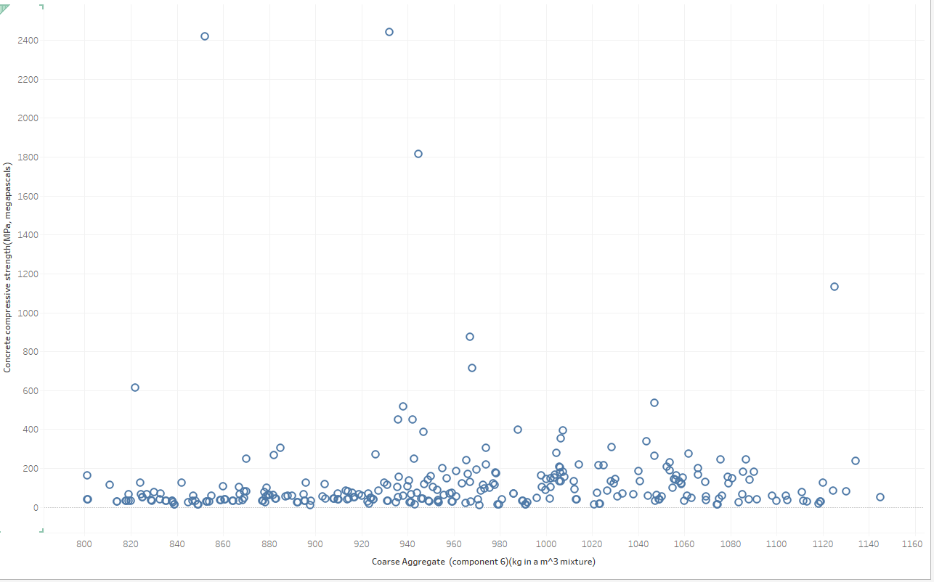
Notes:
Coarse Aggregate; The highest compressive strength occurs about 2430MPa when the coarse aggregate component is about 930kg in a cubic meter mixture

Slide 14
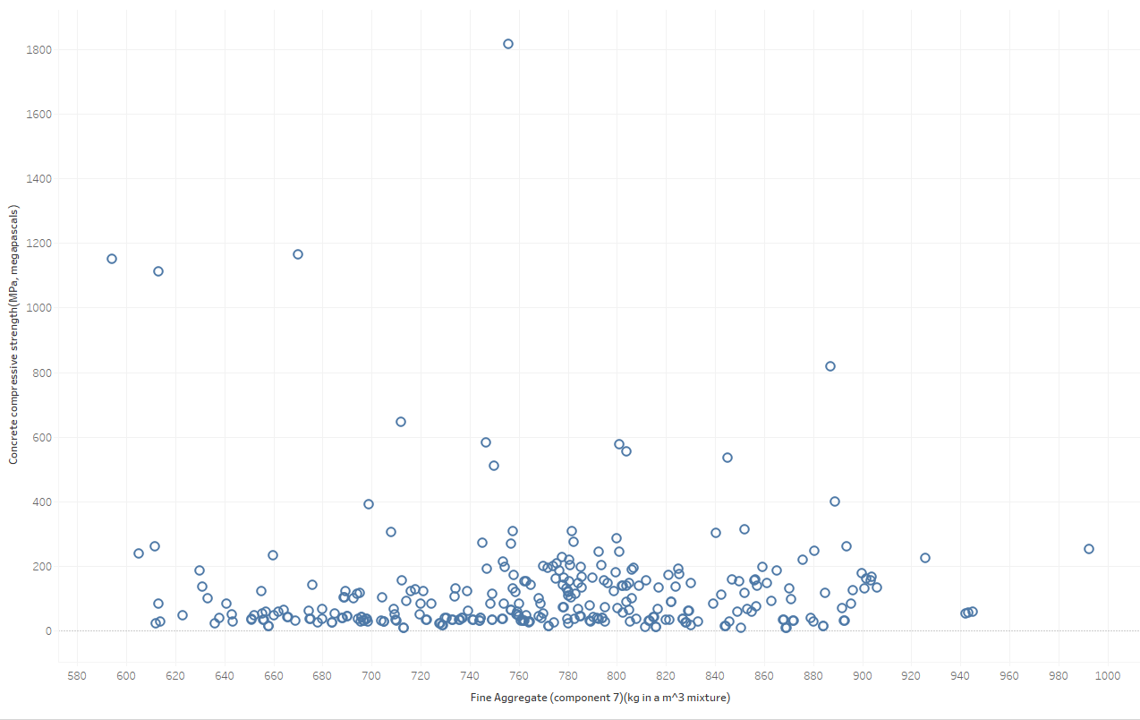
Notes:
Fine Aggregate: the highest compressive strength id about 1800 Mpa when the fine aggregate is about 758kg in a cubic meter mixture

Slide 15
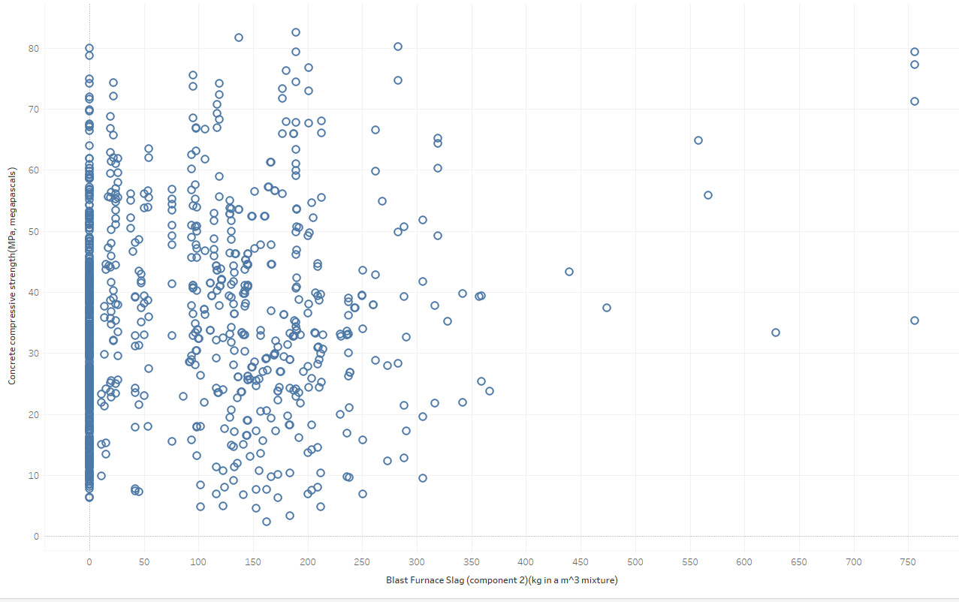
Notes:
Blast Furnace slag : The highest compressive strength is about 82MPa at a blast furnace component of about 190kg in a cubic meter mixture

Slide 16
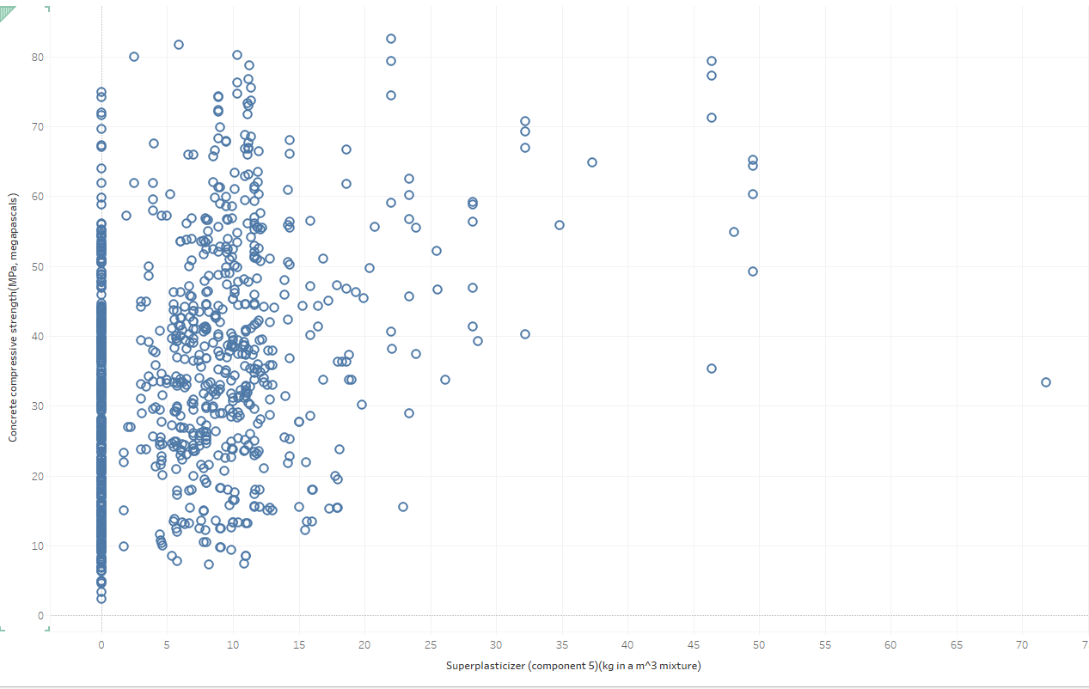
Notes:
Superplasticizer: The highest superplasticizer is at 85MPa at a superplasticizer component of 23kg in a cubic meter mixture

Slide 17
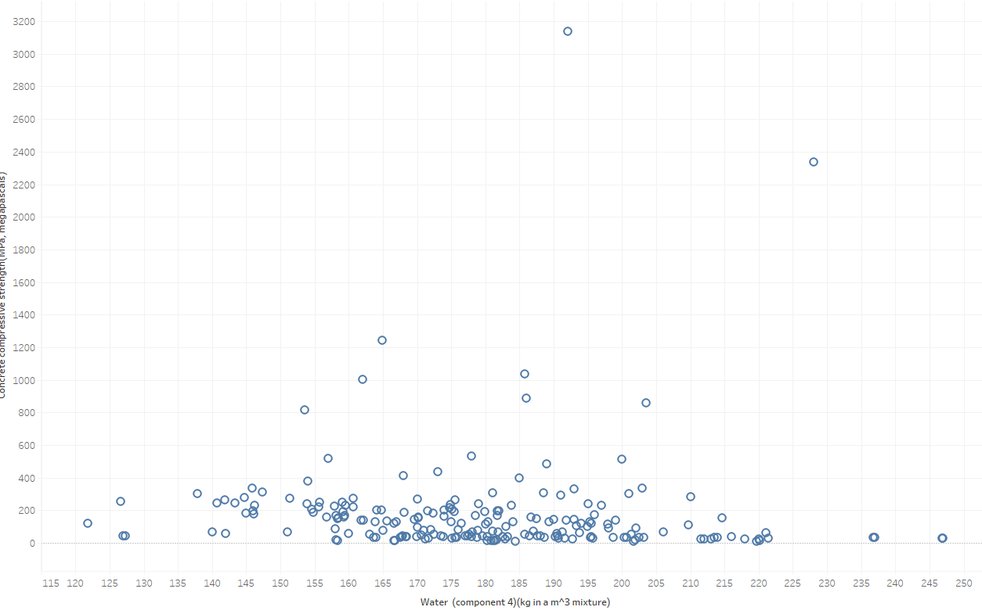
Notes:
Water component; The highest compressive strength , 3150MPa occurs at a water component of 192kg in a cubic meter mixture. This results show that the more water added to the concrete mixture, reduces the strength.

Slide 18
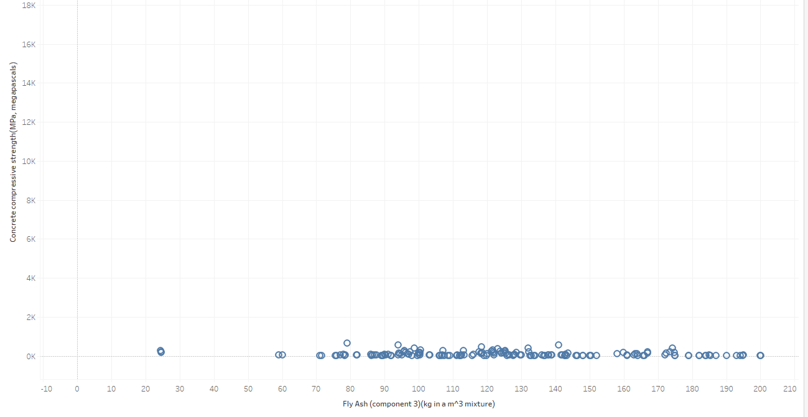
Notes:
Fly Ash: This is a constant , meaning Fly ash does not affect the compressive strength of concrete

Slide 19
Methodology
Visualization: Tableau and Power BI
Machine Learning: Developing the Predictive Model: Data Robot

Slide 20
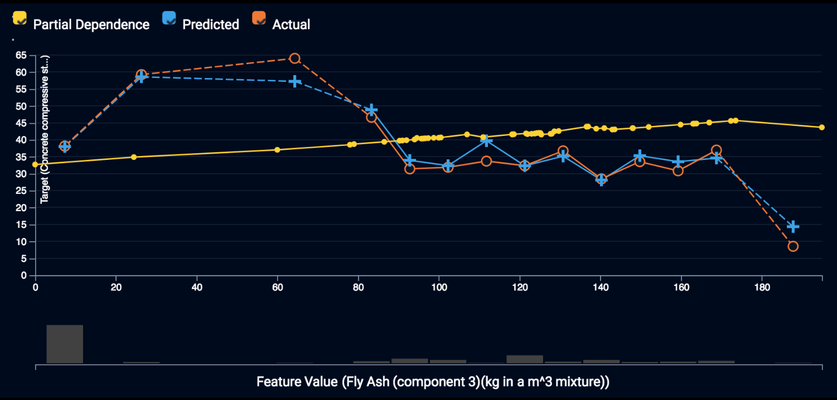
Predictive Model: Data Robot

Slide 21
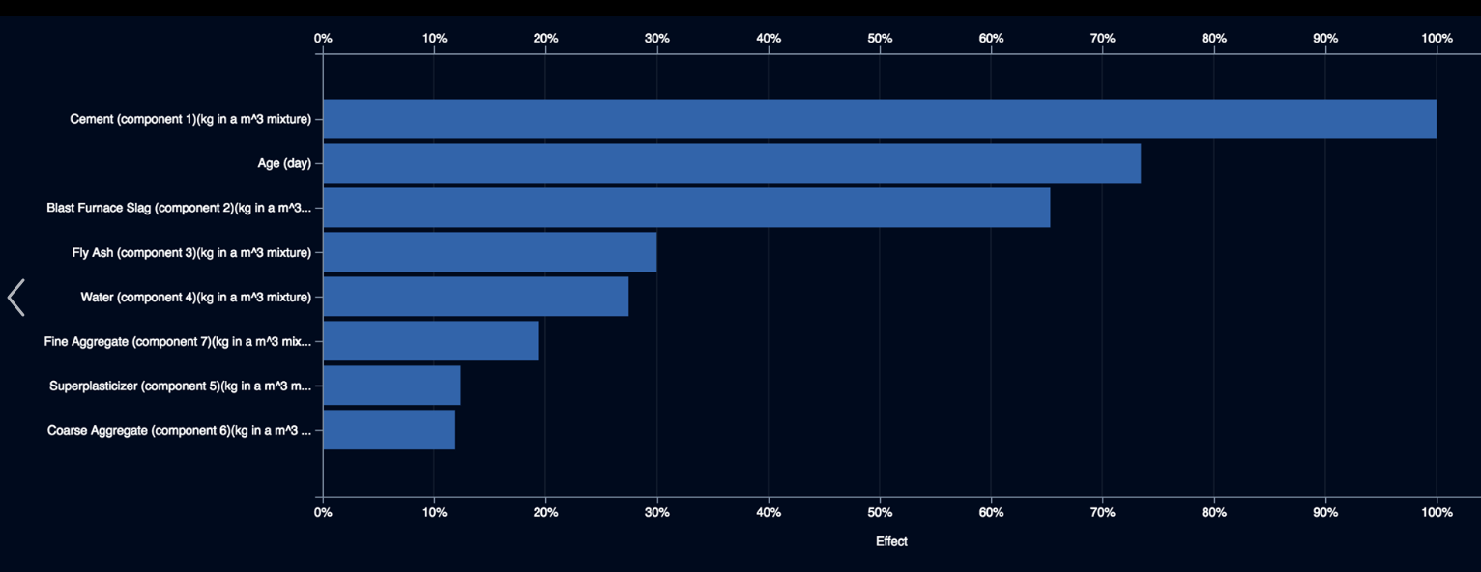

Slide 22
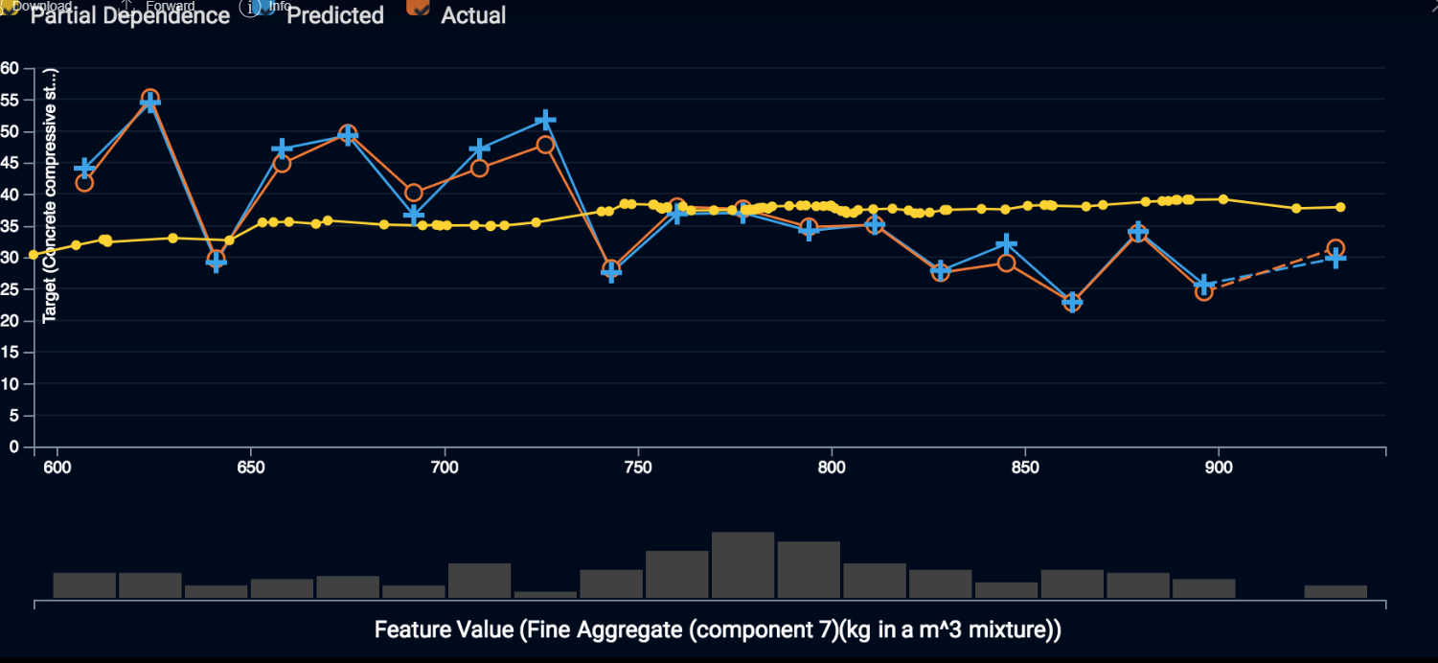

Slide 23
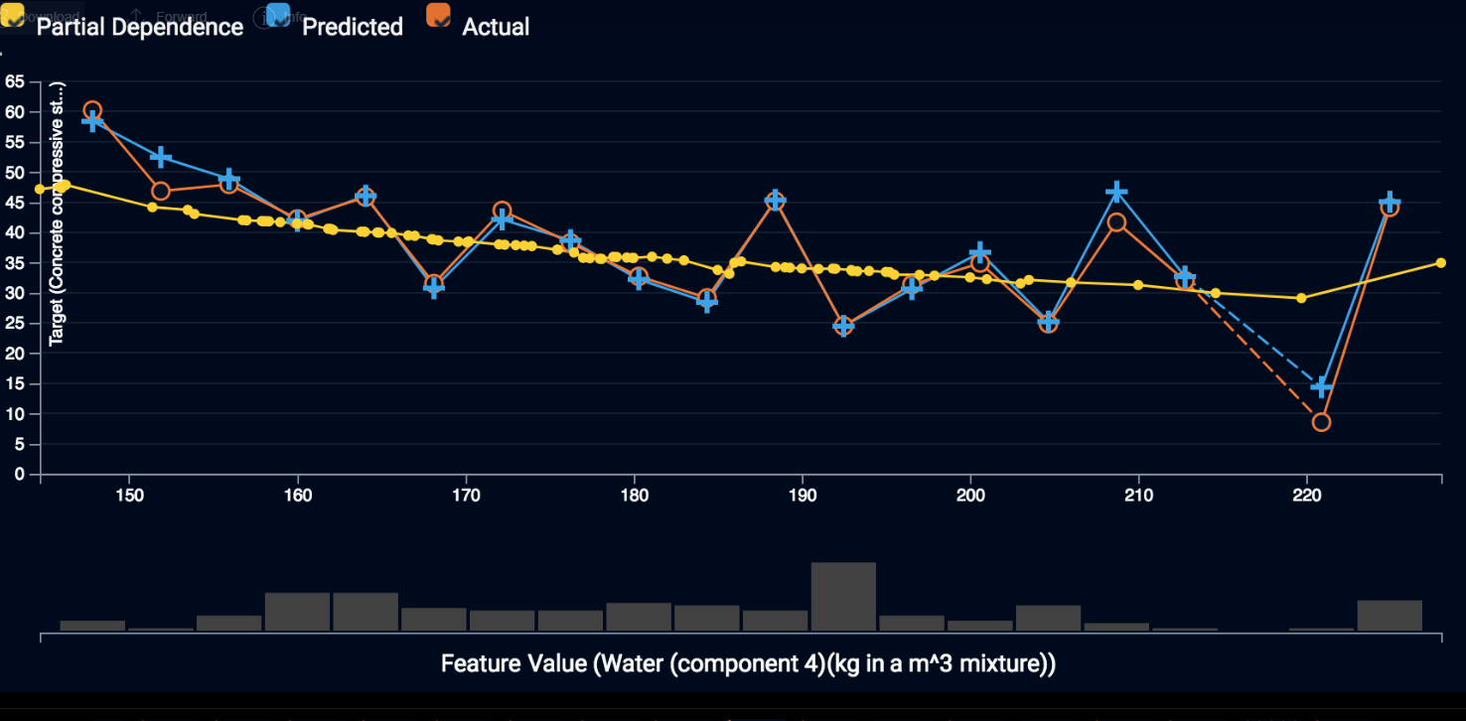

Slide 24
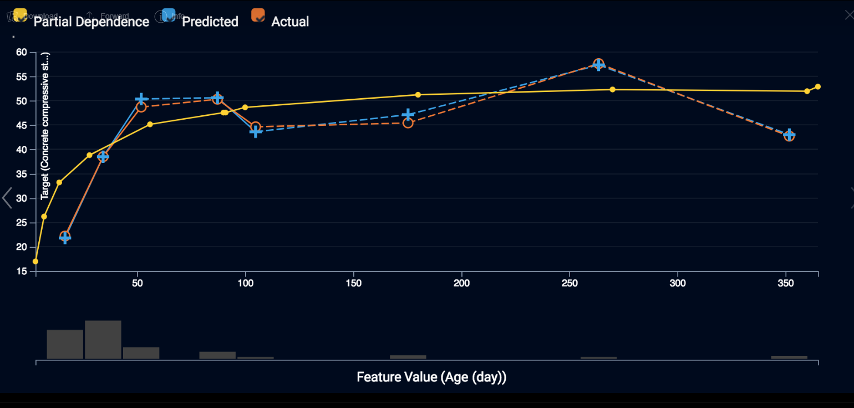

Slide 25
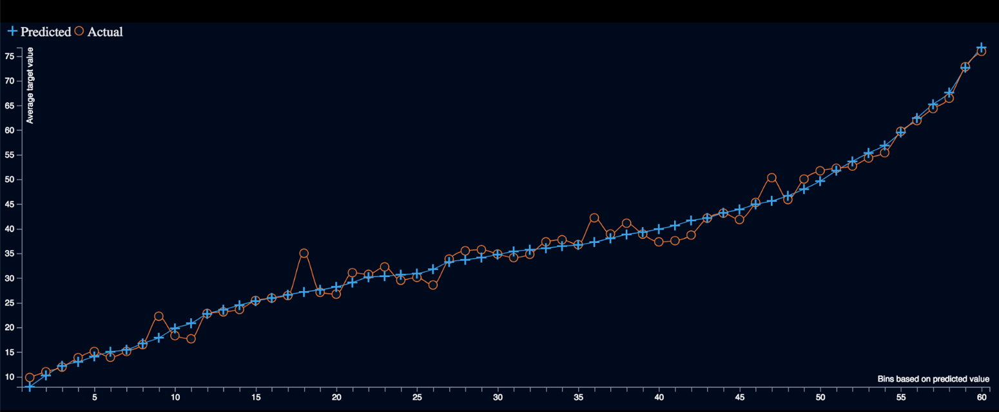

Slide 26
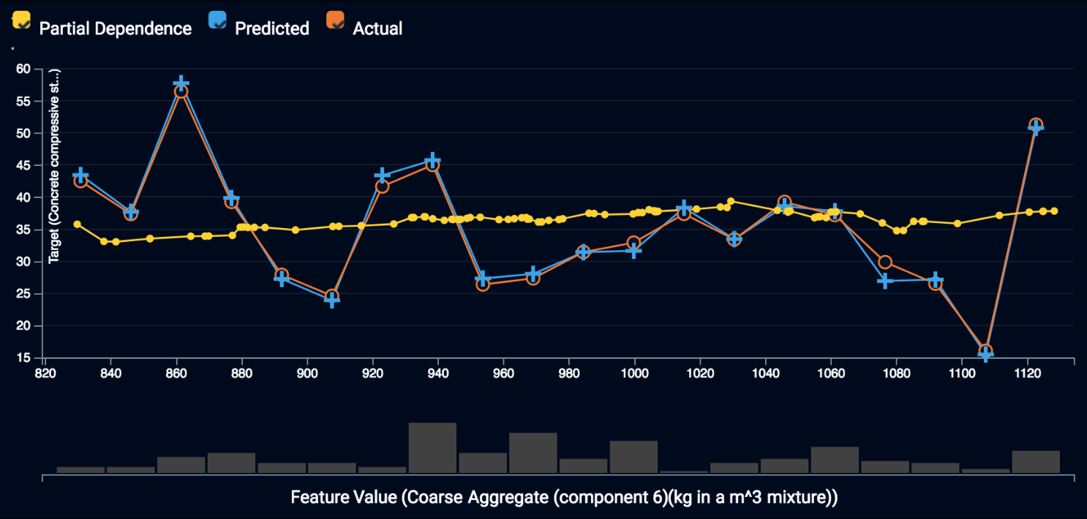

Slide 27
Recommendations

