Slide 1

DFC 20203 - Database Design
Chapter 3 :
Entity-Relationship (E-R) Model & Normalization
LECTURER : PN.MUNA ISHAK | SESSION 2 2022/23

Slide 2

Let’s Review Last Lesson
Log in Quizizz.com and join the quiz
https://quizizz.com/

Slide 3
3.2 Apply E-R Diagrams (ERD) in database development
3.2.1 Define entity, attribute and relationship
3.2.2 Interpret relationship cardinality
  a. One to one (1:1)
  b. One to many (1:M)
  c. Many to many (M:N)
3.2.3 Relate entities by applying the rules of cardinality
3.2.4 Identify the E-R diagram notations for:
  a. Entity
  b. Weak entity
  c. Attributes
  d. Key attribute
  e. Multivalued attribute
  f. Derived attribute
  g. Relationships
  h. Cardinality
3.2.5 Identify the steps in creating E-R diagram
3.2.6 Construct ER diagram components that represent entities and attributes according to diagramming conventions based on a given scenario or problem statement
3.2.7 Transform an E-R diagram into physical database design

Slide 4
Lesson Learning Outcome (LLO)
By the end of this lesson, student should able to:
3.2.1 Define entity, attribute and relationship
3.2.2 Interpret relationship cardinality
  a. One to one (1:1)
  b. One to many (1:M)
  c. Many to many (M:N)
3.2.3 Relate entities by applying the rules of cardinality
  a. Entity
  b. Weak entity
  c. Attributes

Slide 5
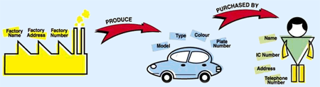
ER Model for purchasing a car
Perhubungan (Relationship)
FACTORY
CAR
CUSTOMER
Entity
The diagram above shows a car-purchasing model that involves the relationship between the factory, car and customer. Here, we can see clearly that factory produces car and a customer purchases the car.
Entity: FACTORY, CAR & CUSTOMER.
Relationship: Produce & Purchased by.

Slide 6
Entity Relationship Diagram (ER-D)
An entity-relationship (ER) diagram is a specialized graphic that illustrates the interrelationships between entities in a database.
ER diagram represent entity types and relationships among them.

Slide 7
Uses of ER-Diagram
ER diagrams are used to model and design relational databases, in terms of logic and business rules (in a logical data model) and in terms of the specific technology to be implemented (in a physical data model.)
ER diagrams are used to analyze existing databases to find and resolve problems in logic or deployment.
The diagrams are used to design or analyze relational databases used in business processes.

Slide 8
Entity Relationship Diagram (ERD)
ER diagrams often use symbols to represent three different types of information.
3 Elements of ERD :
    ENTITY
    ATTRIBUTE
    RELATIONSHIP
Boxes/ Rectangle are commonly used to represent entities.
Diamonds are normally used to represent relationships, and
Ovals are used to represent attributes.

Slide 9
Details for Entity Relationship Diagram Symbols. Professional ERD Drawing :
http://www.conceptdraw.com/How-To-Guide/erd-entity-relationship-diagram-symbols
http://www.conceptdraw.com/diagram/er-diagram-of-a-bank-business-scenario

Slide 10
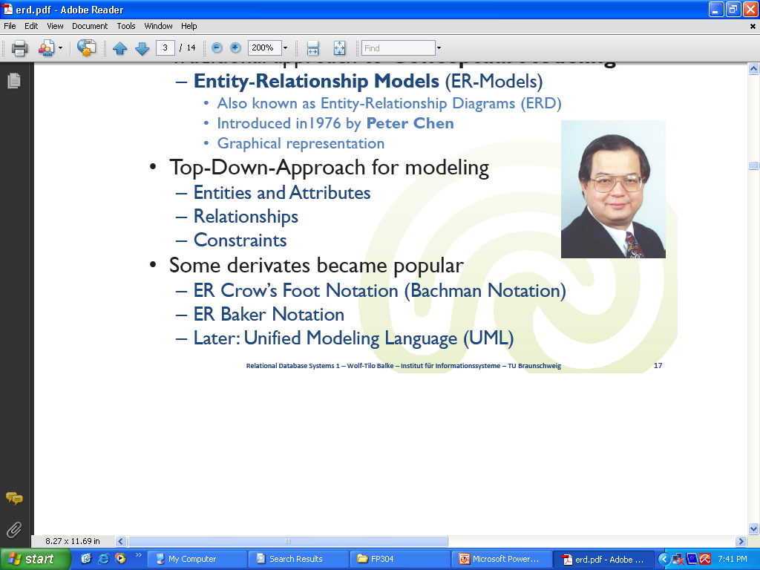
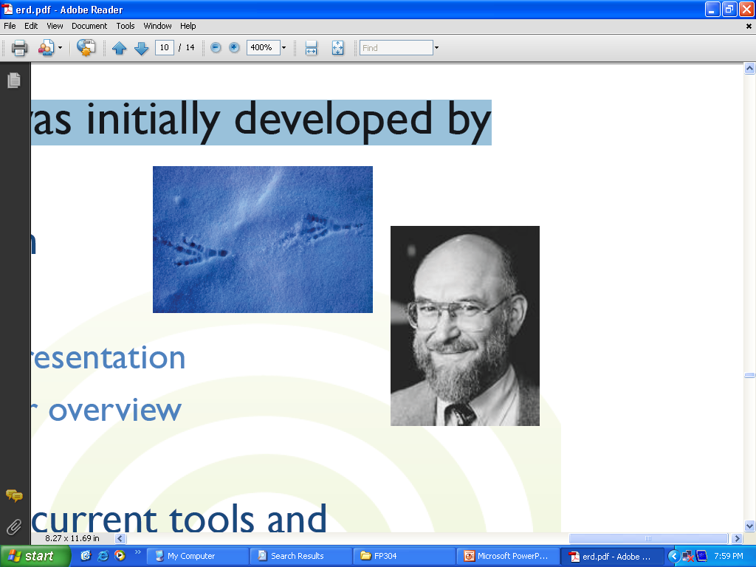
ER Notations
  Chen notation - by Peter Chen
  Crow’s Foot Notation - developed by Gordon Everest

Slide 11
Entity
An entity is an object that exists and which is distinguishable from other objects. An entity can be a person, a place, an object, an event, or a concept about which an organization wishes to maintain data.
In both the Chen and Crow’s Foot notations, an entity is represented by a rectangle containing the entity’s name.

Slide 12
Entity
  The entity name, a noun, is usually written in all capital letters.
The following are some examples of entities:
  Person: STUDENT, EMPLOYEE, CLIENT
  Object: COUCH, AIRPLANE, MACHINE
  Place: CITY, NATIONAL PARK, ROOM, WAREHOUSE
  Event: WAR, MARRIAGE, LEASE
  Concept: PROJECT, ACCOUNT, COURSE

Slide 13
Let’s discuss
Which of the following are likely to be entities?
1. Customer
2. Computer sales tax
3. Height
4. Product
5. Tomato

Slide 14
Answer 1
1. Customer – Yes.
2. Computer sales tax – does not have occurrences which are distinguishable by attributes. It is an imperative statement.
3. Height – does not have attributes. It takes numerical values, therefore, is an attribute.
4. Product – Yes.
5. Tomato – could be an entity if we are concerned with keep data about distinguishable tomatoes. But it is more likely to be an occurrence of another more general entity like FRUIT or PRODUCT

Slide 15
Attributes
Attributes are characteristics of entities.
Some attributes of common entity types include the following:
    STUDENT (Student ID, SSN, Name, Address, Phone, Email, DOB)
    ORDER (Order ID, Date of Order, Amount of Order)
    ACCOUNT (Account Number, Account Type, Date Opened, Balance)
    CITY (City Name, State, Population)

Slide 16
Attribute
In Chen model, attributes are represented by ovals and are connected to entity rectangle with a line
Each oval contains the name of attribute it represents
In Crow’s Foot model, attributes are written in attribute box below entity rectangle
Attributes
Entity
Attributes

Slide 17
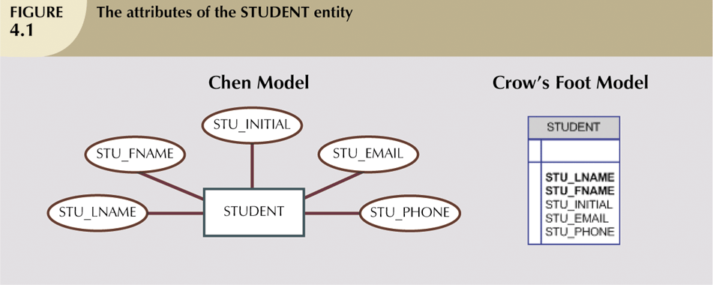
Example attribute

Slide 18
Let’s discuss
Remember !
Entities = Relation/Table name
We are a small fast food business. Our menu features food items that can be ordered by a customer. A customer places an order at the counter and indicates what food items he/she would like on that order.
Lately we’ve noticed that we have some regular customers, so we started asking them for information – such as name and address, so we can mail them coupons when we have specials.
  a. Using the restaurant entities ORDER, FOOD ITEM and CUSTOMER, identify the attributes for each entity.

Slide 19
Relationships
Its meaningful associations between or among entities.
They are usually verbs, e.g. assign, associate, or track.
A relationship provides useful information that could not be discerned with just the entity types.
In Chen model, relationship is represented by a single rhombus (diamond).
Relationship

Slide 20
Example Relationships
Relationship name: writes
Author
Book
An author writes one or more books
A book can be written by one or more authors.

Slide 21
Let’s discuss
Which of the following are likely to be relationships?
1. purchases
2. customer
3. belongs to
4. MatricNo

Slide 22
Answer 2
1. purchases – yes, describing association between a Customer and Product.
2. customer – no, suitable to be entity.
3. belongs to – yes, describing association between a Person and Item.
4. MatricNo – no, suitable to be attribute.

Slide 23
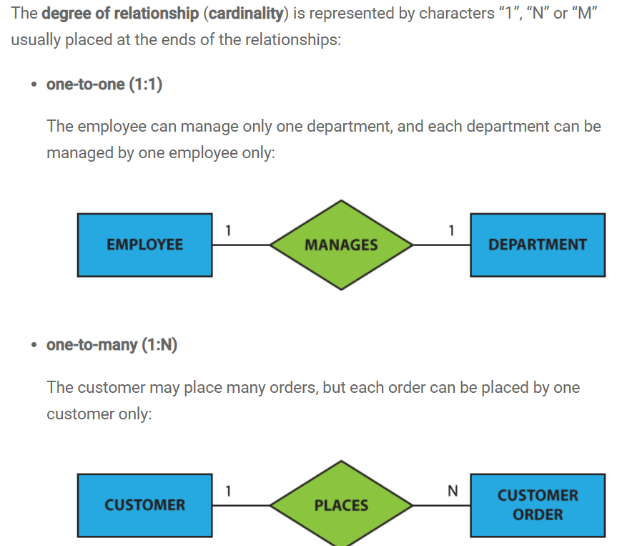
Cardinality

Slide 24
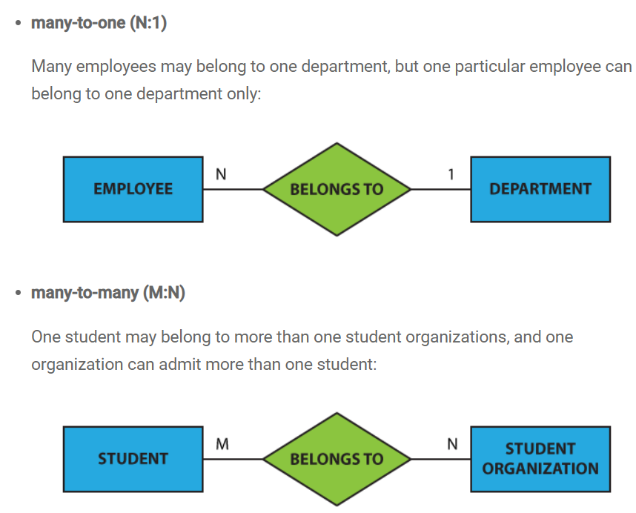
Cardinality

Slide 25
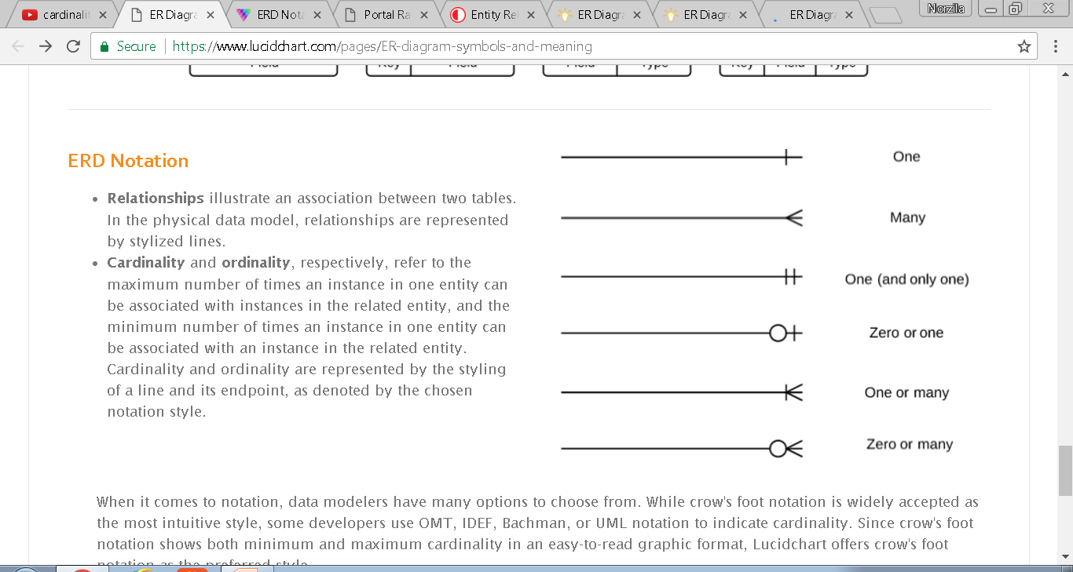
Cardinality Notation (crow’s foot notation)

Slide 26
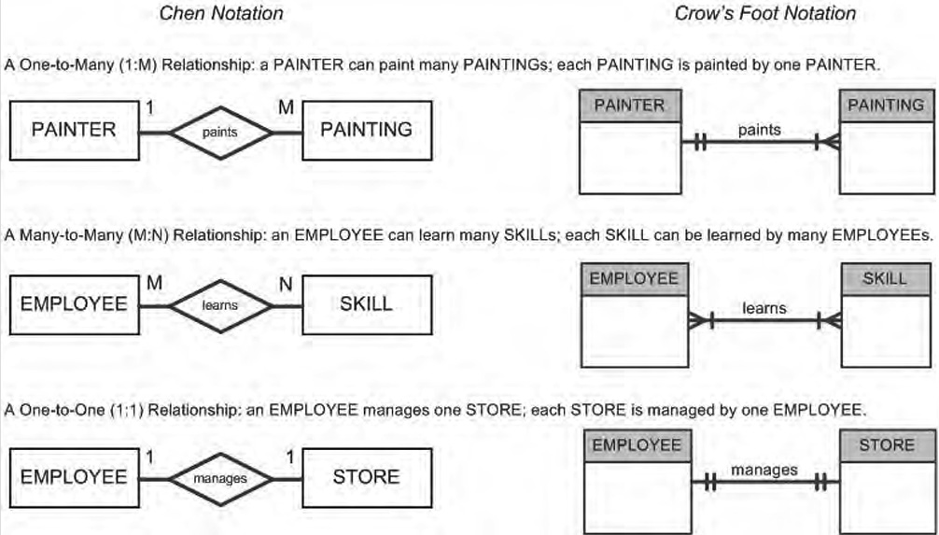
Example:

Slide 27
Optionality and Cardinality
Examples:
Each EMPLOYEE must hold one and only one JOB
Each JOB may be held by one or more EMPLOYEEs
Each PRODUCT must be classified by one and only one PRODUCT TYPE
Each PRODUCT TYPE may classify one or more PRODUCTs

Slide 28
What is Cardinality in a Relationship?
Cardinality. This specifies the number of each entity that is involved in the relationship. There are 3 types of cardinality for binary and unary relationships:
1. One to one (1:1). For example, 1 man is married to 1 woman.
2. One to many (1:M). For example, 1 manager manages many employees, each employee is managed by 1 manager.
3. Many to many (M:N). For example, Each students take many modules, each module is taken by many students.
How many is many? It doesn't matter! If it's 0, 10 or 100, the way you implement the relationship is the same.

Slide 29


Slide 30
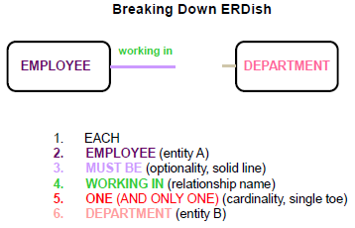
Since each relationship has two sides, first read relationship from left to right (or top to bottom, depending on the ERD layout).

Slide 31
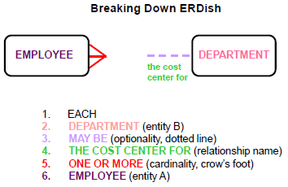

Slide 32
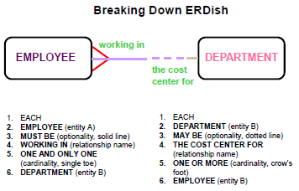

Slide 33

Test your knowledge
1. The goal of this practice is to read a relationship. Which text corresponds to the diagram?
a. Each EMPLOYEE may be assigned to one or more DEPARTMENTs.
Each DEPARTMENT must be responsible for one or more EMPLOYEEs.
b. Each EMPLOYEE must be assigned to one and only one DEPARTMENT.
Each DEPARTMENT must be responsible for one or more EMPLOYEEs.
c. Each EMPLOYEE must be assigned to exactly one DEPARTMENT.
Each DEPARTMENT may be responsible for exactly one EMPLOYEE.

Slide 34
Test your knowledge
1. The goal of this practice is to read a relationship. Which text corresponds to the diagram?
a. Each EMPLOYEE may be assigned to one or more DEPARTMENTs.
Each DEPARTMENT must be responsible for one or more EMPLOYEEs.
b. Each EMPLOYEE must be assigned to one and only one DEPARTMENT.
Each DEPARTMENT must be responsible for one or more EMPLOYEEs.
c. Each EMPLOYEE must be assigned to exactly one DEPARTMENT.
Each DEPARTMENT may be responsible for exactly one EMPLOYEE.

Slide 35
Conclusion
ER Model is the constructs and conventions used to create a model of the user data.
The results are documented in an entity relationship diagram.
Entity relationship diagram is a diagram that depicts entity relationship model entities, attributes and relations. It also displays connectivity and cardinality.

Slide 36
Lesson Learning Outcome (LLO)
3.2.4 Identify the E-R diagram notations for:
  a. Entity
  b. Weak entity
  c. Attributes
  d. Key attribute
  e. Multivalued attribute
  f. Derived attribute
  g. Relationships
  h. Cardinality

Slide 37
Entity
Entities are objects or concepts that represent important data. They are typically nouns, e.g. customer, supervisor, location, or promotion.
Corresponds to table and not to row in relational environment
In both Chen and Crow’s Foot models, entity is represented by rectangle containing entity’s name
Entity

Slide 38
Weak Entity
An entity that cannot be uniquely identified by its attributes alone.
The existence of a weak entity is dependent upon another entity called the owner entity.
The weak entity’s identifier is a combination of the identifier of the owner entity and the partial key of the weak entity.
Weak Entity

Slide 39
Key Attribute
An attribute that uniquely identifies a particular entity.
The name of a key attribute is underscored.
Only for primary key.
Attributes

Slide 40
Multivalued Attribute
An attribute that can have many values (there are many distinct values entered for it in the same column of the table).
Multivalued attribute is depicted by a dual oval.
Example: A staff may have 2 tel_no, which are home tel_no and mobile tel_no (hand phone).
Multivalued Attributes

Slide 41
Derived Attribute
An attribute whose value is calculated (derived) from other attributes.
The derived attribute may or may not be physically stored in the database.
In the Chen notation, this attribute is represented by dashed oval.
Example: Age can be known from Date_of_Birth.
Derived Attributes

Slide 42
Activity 1
Find the entity, attributes and relationship cardinality based on a given scenario below:-
An automobile insurance company needs to keep track of information about vehicle. The company has to store information of customer, car and accident. Customer information is LicenseNo, name and address. Customers can own one or more cars, where the car information is PlateNo, model and year. A car not involved or involved in many accidents. If the car is involved in an accident, the information that will be stored is Report_number, location and date.

Slide 43
Activity 1
Find the entity, attributes and relationship cardinality based on a given scenario below:-
An automobile insurance company needs to keep track of information about vehicle. The company has to store information of customer, car and accident. Customer information is LicenseNo, name and address. Customers can own one or more cars, where the car information is PlateNo, model and year. A car not involved or involved in many accidents. If the car is involved in an accident, the information that will be stored is Report_number, location and date.

Slide 44
Activity 2
We are a small fast food business. Our menu features food items that can be ordered by a customer. A customer places an order at the counter and indicates what food items he/she would like on that order. Lately we’ve noticed that we have some regular customers, so we started asking them for information – such as name and address, so we can mail them coupons when we have specials.
a. Using the restaurant entities ORDER, FOOD ITEM and CUSTOMER, identify the attributes for each entity.

Slide 45
Lesson Learning Outcome
3.2.5 Identify the steps in creating E-R diagram

Slide 46
Identify the steps in E-R modelling.
Create a detailed narrative of the organization’s description of operations.
Identify the business rules based on the description of operations.
Identify the main entities and relationships from the business rules.
Develop the initial ERD.
Identify the attributes and primary keys that adequately describe the entities.
Revise and review the ERD.
eBook - E N T I T Y R E L A T I O N S H I P ( E R ) M O D E L I N G pg.127

Slide 47
Steps to Develop ER Diagram:
Step 1 : Identify entity
Step 2 : Identify RELATIONSHIP
Step 3 : DRAW THE ERD

Slide 48
Example - Entities
A university consists of a number of departments. Each department offers several courses. A number of modules make up each course. Students enrol in a particular course and take modules towards the completion of that course. Each module is taught by a lecturer from the appropriate department, and each lecturer tutors a group of students.
Step 1 : Identify entity

Slide 49
Example - Relationships
A university consists of a number of departments. Each department offers several courses. A number of modules make up each course. Students enrol in a particular course and take modules towards the completion of that course. Each module is taught by a lecturer from the appropriate department, and each lecturer tutors a group of students.
Step 2 : Identify RELATIONSHIP

Slide 50
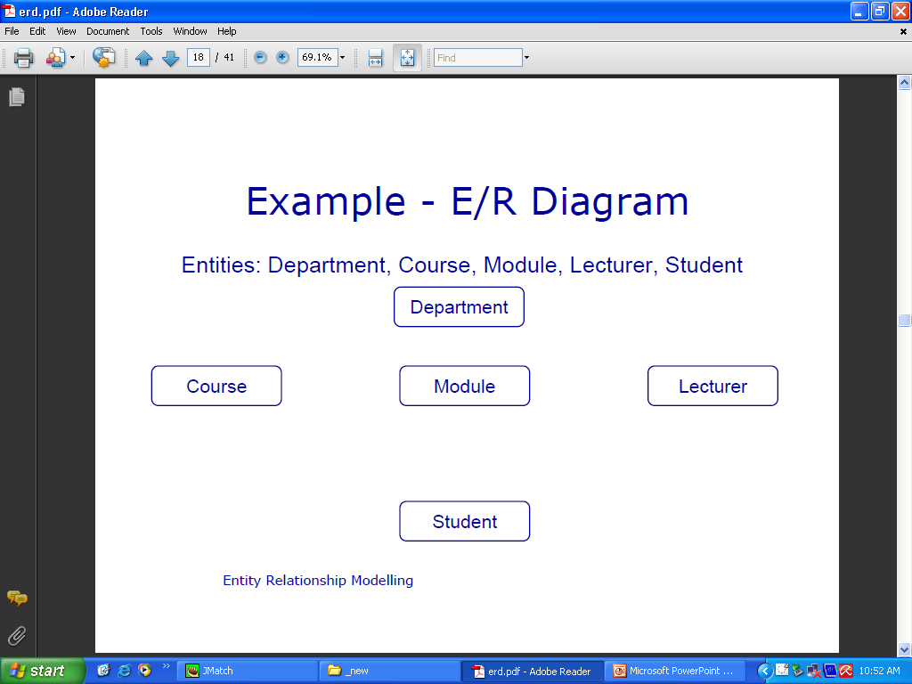
Example - ER Diagram
Entities: Department, Course, Module, Lecturer, Student
Step 3 : DRAW THE ERD

Slide 51
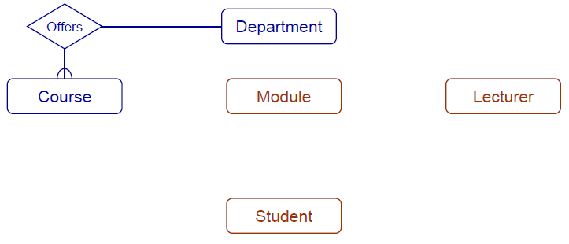
Relationship: Each department offers several courses

Slide 52
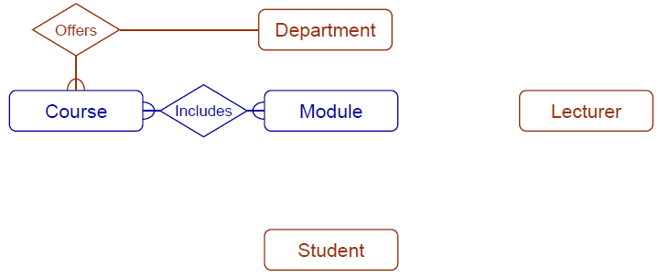
Relationship: A number of modules make up each courses

Slide 53
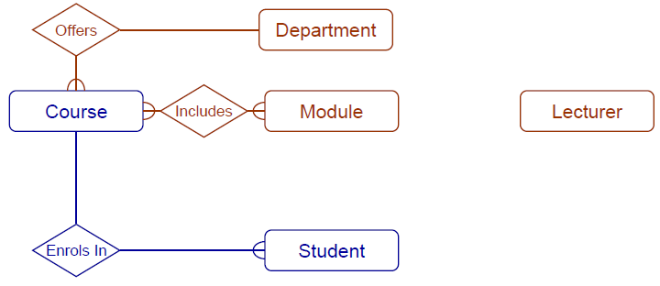
Relationship: Students enrol in a particular course
[*ignore the symbols used]

Slide 54
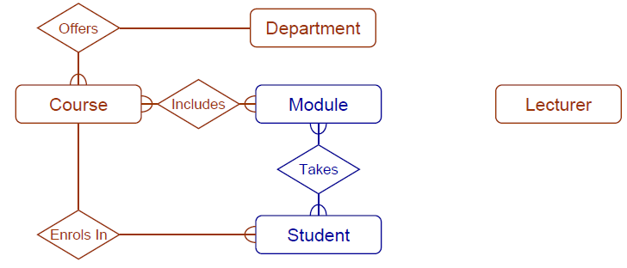
Students enrol in a particular course and take modules
[*ignore the symbols used]

Slide 55
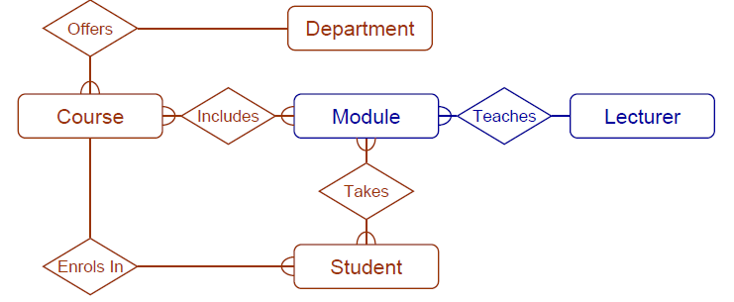
Each module is taught by a lecturer
[*ignore the symbols used]

Slide 56
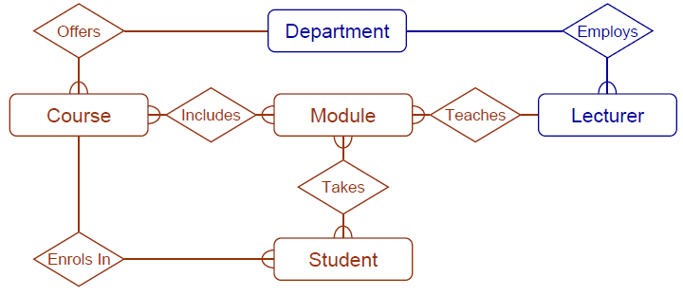
A lecturer from the appropriate department
[*ignore the symbols used]

Slide 57
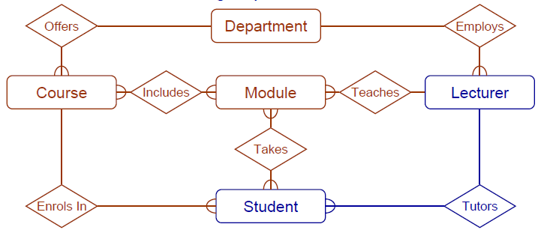
Each lecturer tutors a group of students
[*ignore the symbols used]

Slide 58
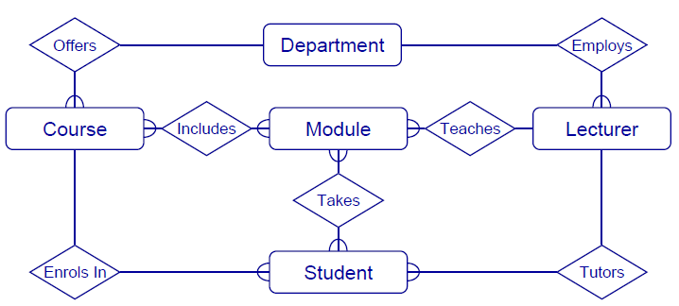
The result
[*ignore the symbols used]

