Slide 1

CHAPTER 3
BUSINESS & FINANCIAL PLAN

Slide 2
What is Business Plan??
A business plan is also known as a venture plan, entrepreneur’s plan, working paper, project paper, or prospectus.
It is a written document between 25 and 40 pages describing the overall plans of a business in detail, that it is what the entrepreneur plans to do and how he plans to do it.
Therefore, a business plan is the blueprint of the company which is presented in a standard business format that is logical and realistic.

Slide 3
Characteristics of a Business Plan using SMART Concept
Specific
  The business plan must clearly state the goals and strategies.
  Example: Instead of saying “increase sales,” specify “increase online sales of handmade bags by 20% in the next 12 months.”
Measurable
  Goals should be trackable with numbers or indicators.
  Example: “Gain 500 new customers within six months” allows progress to be monitored.

Slide 4
Attainable
  Objectives must be realistic based on available resources (time, money, manpower).
  Example: A small start-up should not aim to overtake a global company in one year.
Relevant
  Goals must align with the overall vision, mission, and industry trends.
  Example: A café should focus on improving menu variety or customer service, not on unrelated ventures like selling electronics.

Slide 5
Timely
  The plan should have a clear timeline or deadline.
  Example: “Launch the new product line within the next 9 months.”

Slide 6
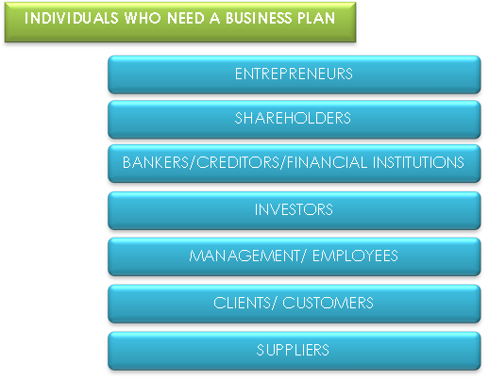
WHO NEED A BUSINESS PLAN?

Slide 7
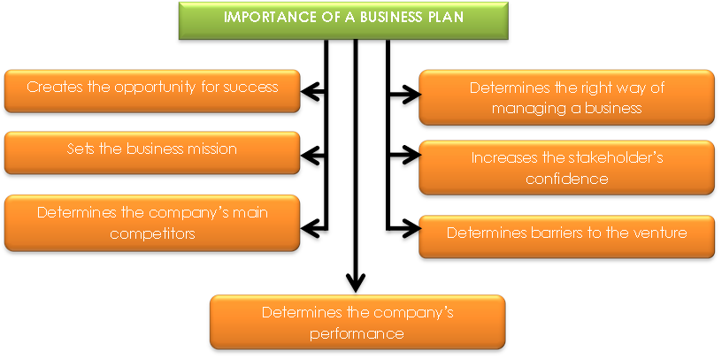
WHY A BUSINESS PLAN IMPORTANT?

Slide 8
THE IMPORTANCE OF BUSINESS PLAN
Creates the opportunity for success
  A comprehensive business plan helps to identify and define the performance level that is to be achieved in the business
  The plan will also determine the changes that need to be made to ensure the company’s success, for example, changes in the organizational structure, introduction of new technology and new manufacturing techniques

Slide 9
Sets the business mission
  A business plan can set a clear mission and vision for the business
  It enables an entrepreneur to make the right decision and actions in the future
  The mission and vision of the business will act as a guide to enable the entrepreneur to know the direction of his firm

Slide 10
Determine the company’s main competitors
  A business plan will enable an entrepreneur to determine his main competitors in terms of their strength, weakness and the right strategy to face them
  These aspects can be determined by conducting a competitor analysis to identify the competitor’s product line as well as their market segments

Slide 11
Determine the right way of managing the business
  A business plan gives room or space and opportunity for an entrepreneur and his employees to develop an effective strategy to run the business
  They can define who, when and how to apply their knowledge, skills and ability in carrying out the business

Slide 12
Increases the stakeholders’ confidence
  Each stakeholder who has an interest in the business will be eager to know the company’s strength, mainly in terms of the company’s viability in finance and resources

Slide 13
Determine barriers to the venture
  An entrepreneur will definitely face many barriers in operating his business
  If these barriers are not managed properly, it can result in failure or decrease the entrepreneur’s progress and growth
  Therefore, the entrepreneur should be aware of the barriers that may be faced by him before starting the venture and take the necessary action to overcome them
  Barriers may come from the internal or external environment

Slide 14
Determine the company’s performance
  A business plan that is managed properly can be used as an operating tool that will help an entrepreneur to work effectively towards success in business
  The plan allows him to set a realistic target to be achieved as a performance yardstick
  As such, the business plan will provide the basic of evaluating and controlling the company’s performance in the future, in terms of profits, costs and quality

Slide 15
  It can also be used to achieve performance target, analyze consumer behavior, study the competitor’s strength and investigate economic performance locally and internationally

