Slide 1
THE FUTURE OF WORK: DATA ANALYSIS OF GLASSDOOR JOBS PROJECT

Slide 2
TEAM ID : LTVIP2023TMID04038
Team Leader : Karri Yamuna Ramalakshmi Ramya
Team Member :Katta Chinna Venkata Balaji
Team Member : Kintali Leela Prasad
Team Member : Koka Naga Pavan
Team Member : Tirumalasetti Koti Surya Durga Ramakumar
Faculty Mentor Name:
Kotikalapudi Chandra Sekhar Sir

Slide 3
INTRODUCTION ABOUT THE PROJECT
Job analysis is a systematic procedure to analyse the requirements for the job role and job profile. Glassdoor is a website and online platform that provides information about jobs, salaries, and companies. Job analysis is a systematic approach to defining the job role, description, requirements, responsibilities, evaluation, etc. It helps in finding out the required level of education, skills, knowledge, training, etc for the job position. It also depicts the job worth i.e. measurable effectiveness of the job and contribution of job to the organization. Thus, it effectively contributes to setting up the compensation package for the job position.
Lack of analysis of Glassdoor jobs can result in limited understanding of job market trends, difficulty in finding relevant job opportunities, inability to attract and retain top talent, and lack of insight into company branding and reputation.The purpose of this project is to conduct an analysis of Glassdoor job postings to gain insights into current and emerging job market trends, identify in-demand skills and experience, and understand how employers can improve their employer branding and reputation to attract and retain top talent.

Slide 4
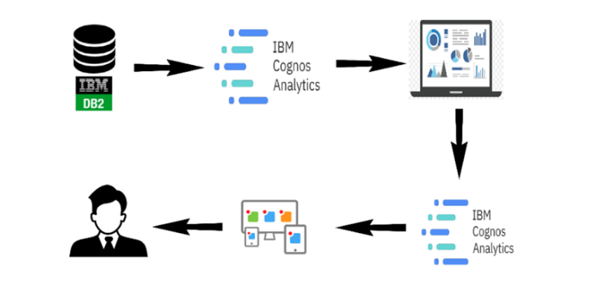
TECHNICAL ARCHITECTURE

Slide 5
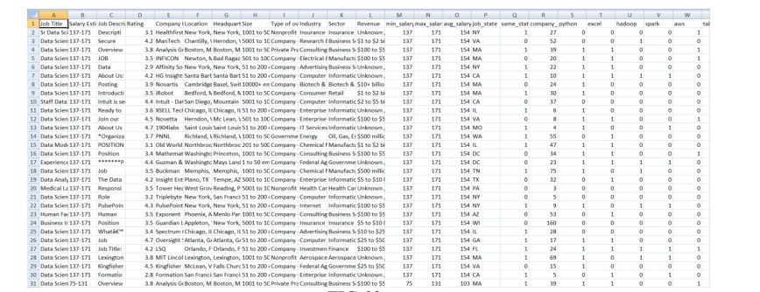
DATASET :

Slide 6
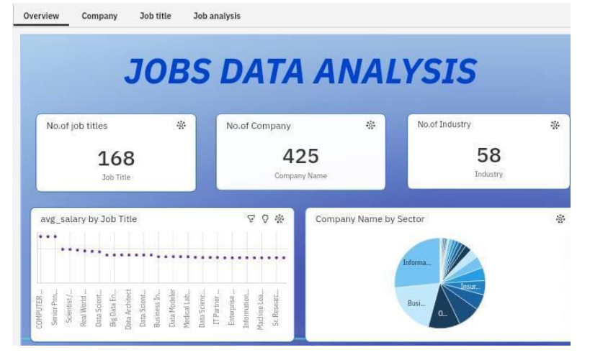
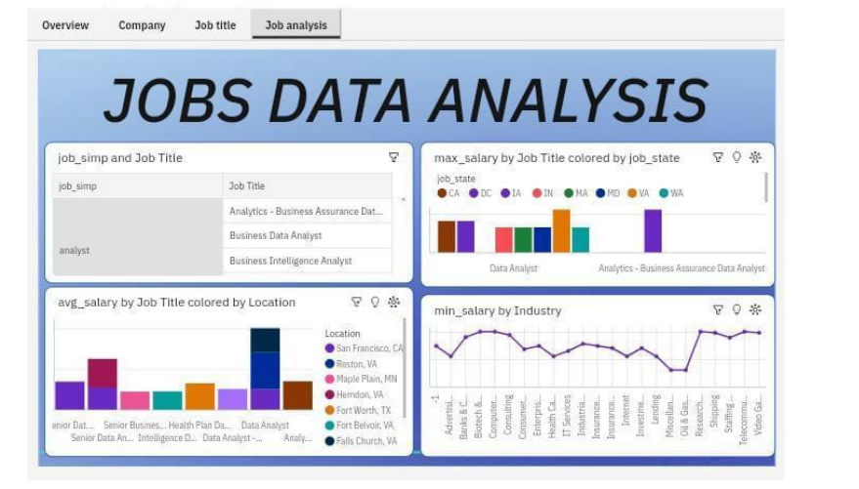
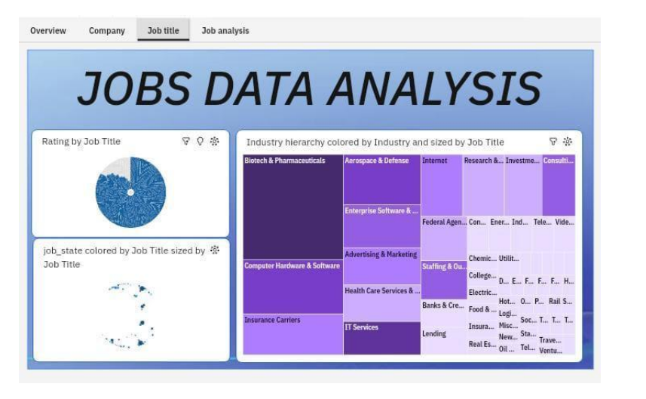
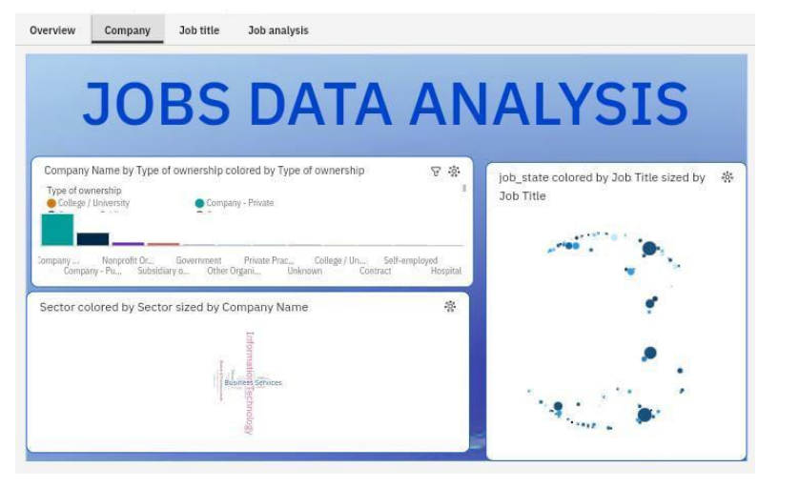
RESULTS:

Slide 7
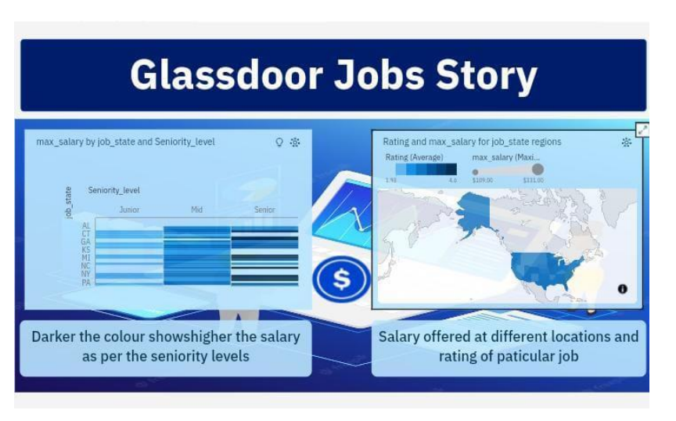
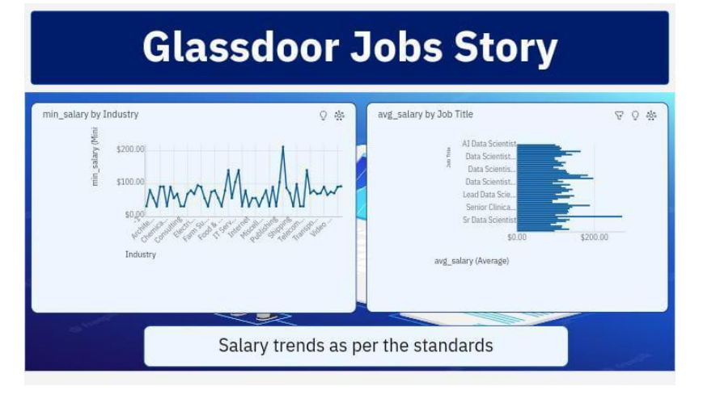
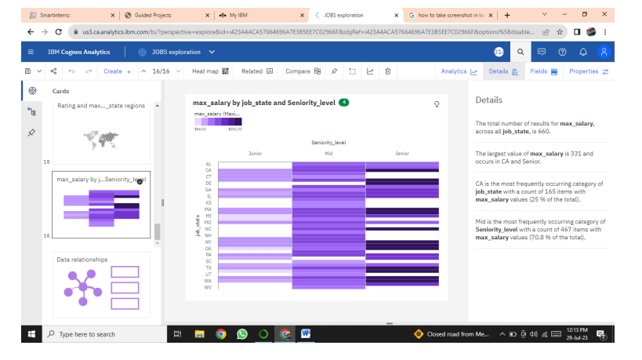
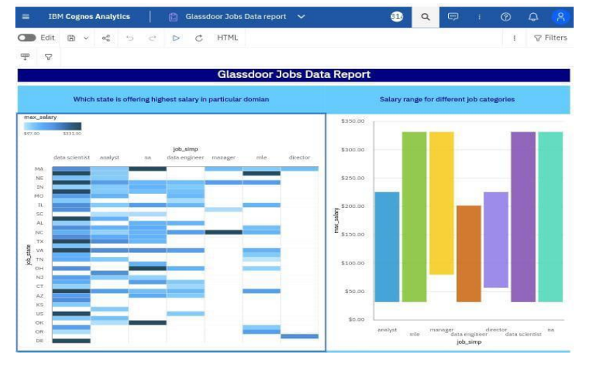

Slide 8
APPLICATIONS:
Generally, data analysis in the context of the future of work on Glassdoor could have several applications:
Trends in Job Market
Salary and Compensation Insights
Skill Mapping and Upskilling
Diversity and Inclusion
Employee Satisfaction Analysis
Remote Work Trends
Job Market Predictions

Slide 9
CONCLUSION:
In the future, the Glassdoor jobs project can be improved in several ways:
Use smart computer techniques to understand job descriptions and reviews better.
Look at more factors like salaries, benefits, and company culture for a complete view of the job market.
Compare different industries, regions, or job roles to find trends and strengths.
Show the data in easy-to-understand charts and maps.
Keep the information up-to-date by regularly getting new data from Glassdoor.
By doing these things, we can provide valuable insights for job seekers and companies, making the job market more transparent and efficient.
Overall, the future work for the data analysis of the Glassdoor jobs project holds immense potential in terms of uncovering valuable insights, providing actionable recommendations, and empowering job seekers and companies alike. By leveraging advanced analytical techniques and continuously improving the data analysis pipeline, the project can contribute to enhancing transparency and efficiency in the job market

Slide 10
FUTURE SCOPE:
The future scope of analyzing Glassdoor job data includes predictive analysis for forecasting job trends , leveraging insights for skill development and training , optimizing talent acquisition and recruitment strategies , facilitating workforce planning, adapting to remote and flexible work arrangements and supporting industry and economic research.

Slide 11
THANK YOU

