Slide 1

2018 FALL 데이터관리와 분석
CONCEPTUAL DB DESIGN
TEAM 08

Slide 2


01
02
03
04
CONTENTS
DEFINE PROBLEM
Analyzing Requirements
Perspective of Optimization
ER DIAGRAM
Affirmation
RELATIONAL DB SCHEMA
Naming Attributes for Each Relationship
Constraints
REVIEW
Additional details

Slide 3


001
DEFINE
PROBLEM

Slide 4



01 DEFINE PROBLEM
Analyzing Requirements

Slide 5


01 DEFINE PROBLEM
Perspective of Optimization

Slide 6
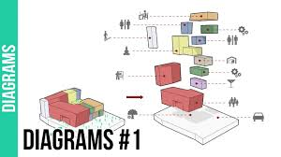
002
ER
DIAGRAM

Slide 7
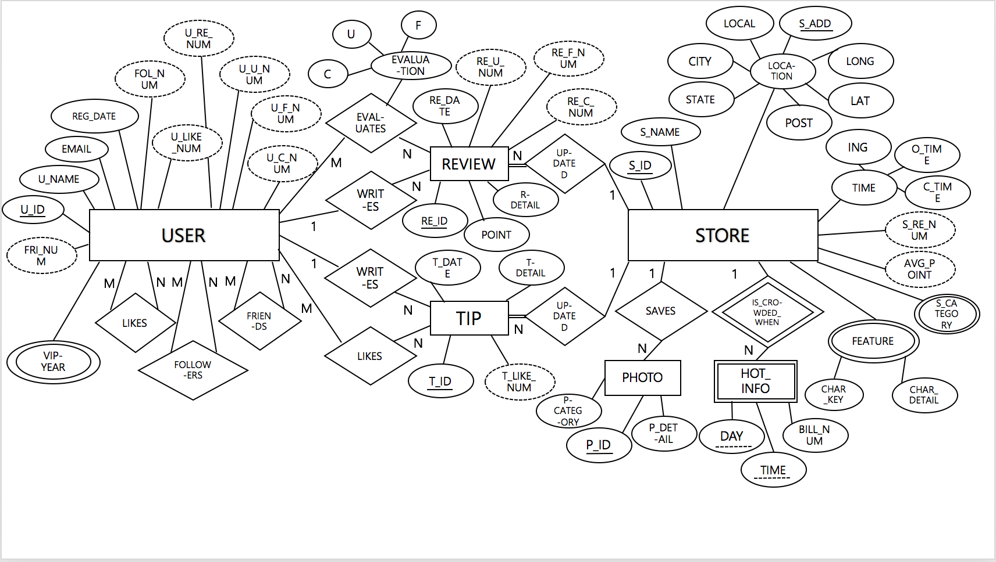

Slide 8
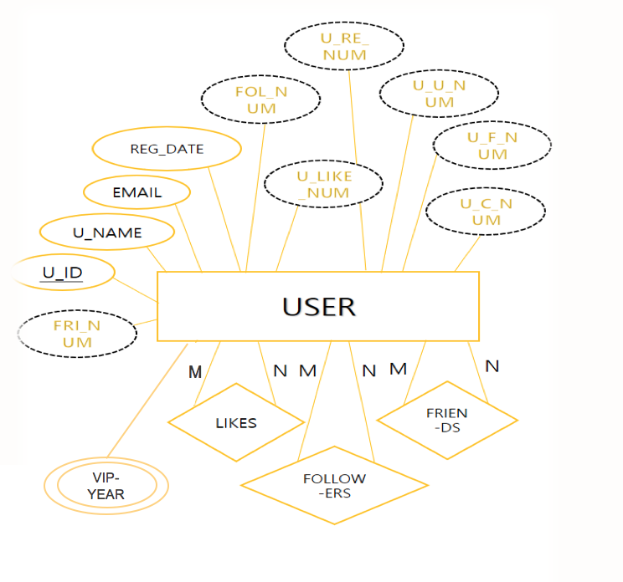
02 DB DIAGRAM
Case of User

Slide 9
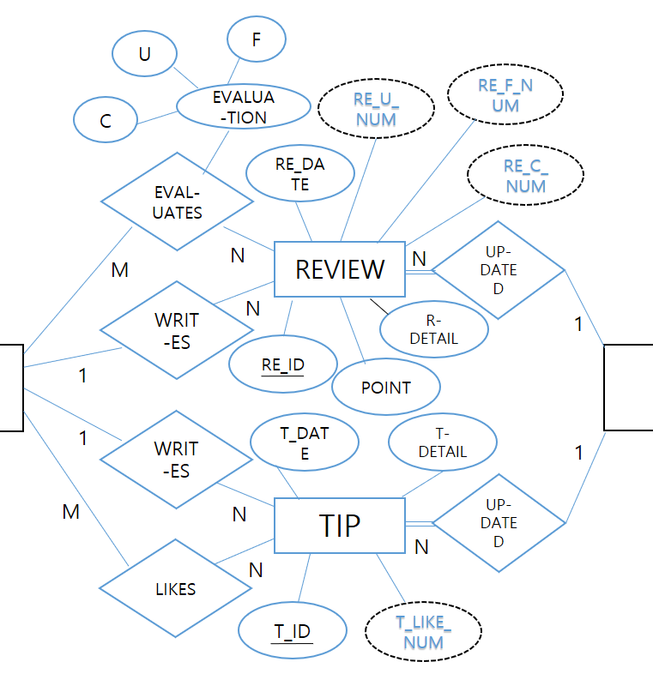
02 DB DIAGRAM
Case of Relation between User and Store
USER
STORE

Slide 10
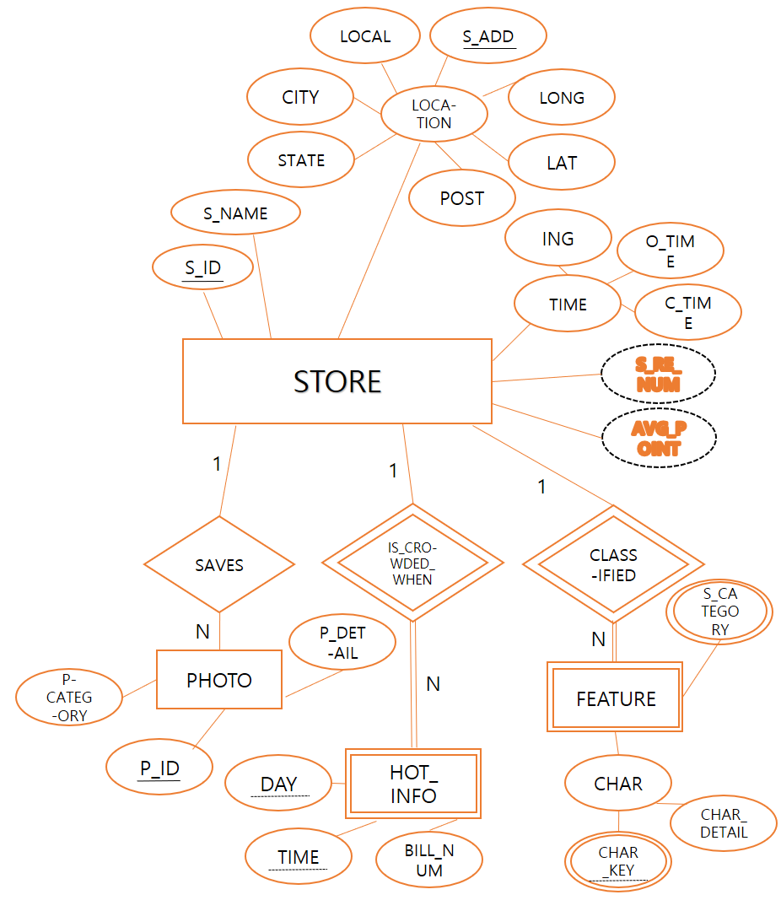
02 DB DIAGRAM
Case of Store
S_CATEGORY
FEATURE
CHAR_KEY
CHAR
_DETAIL

Slide 11

003
RELATIONAL
DB SCHEMA

Slide 12
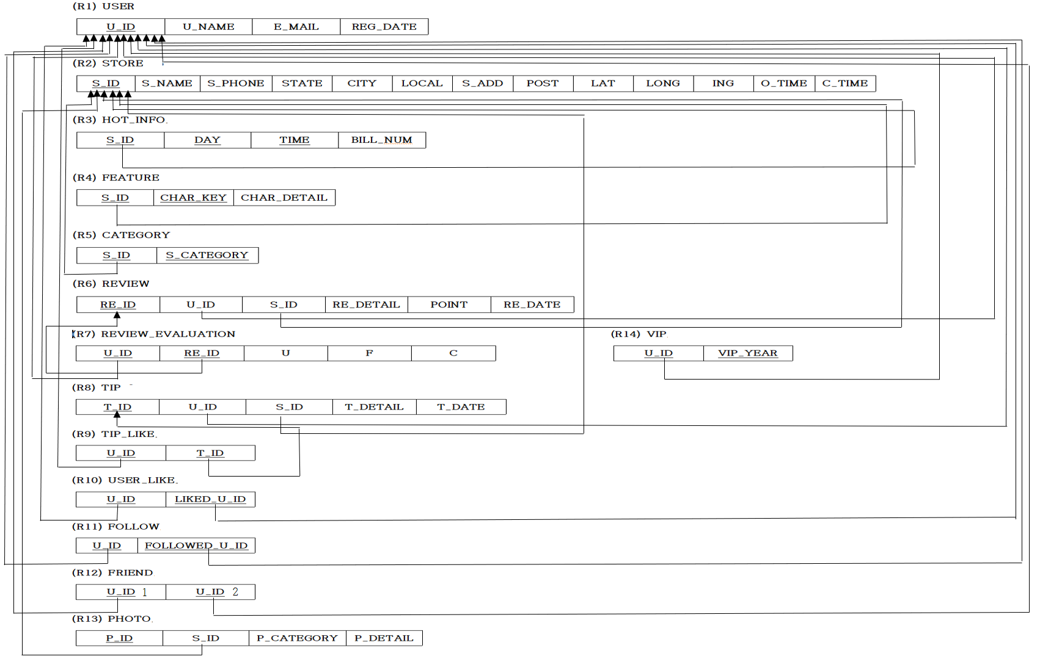
03 RELATIONAL DB SCHEMA
Attributes and its Relationship

Slide 13
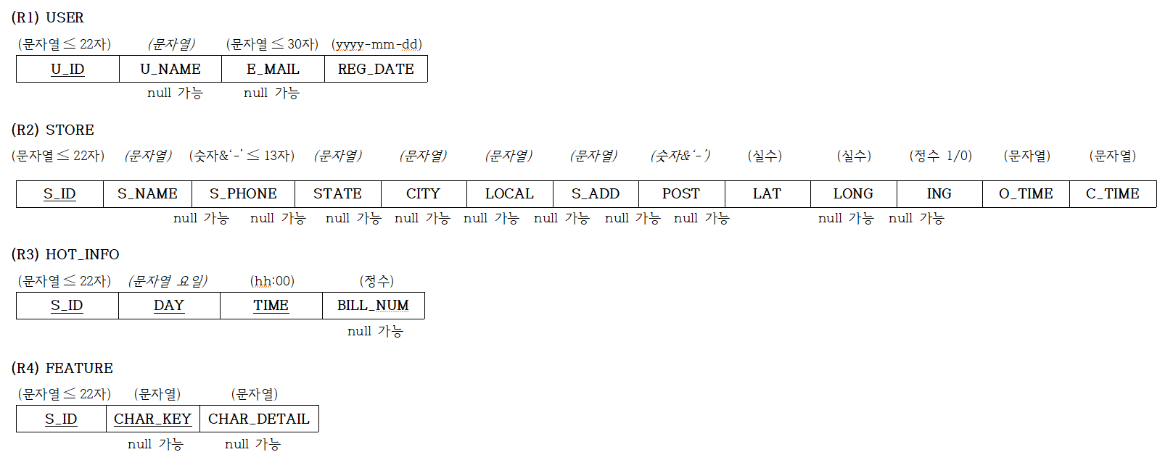
03 RELATIONAL DB SCHEMA
Relational Schema and Domain Constraints

Slide 14
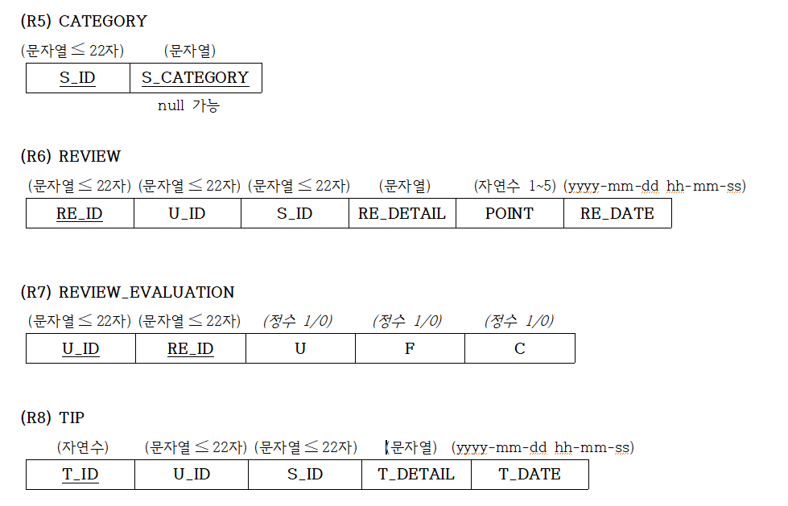
03 RELATIONAL DB SCHEMA
Relational Schema and Domain Constraints

Slide 15
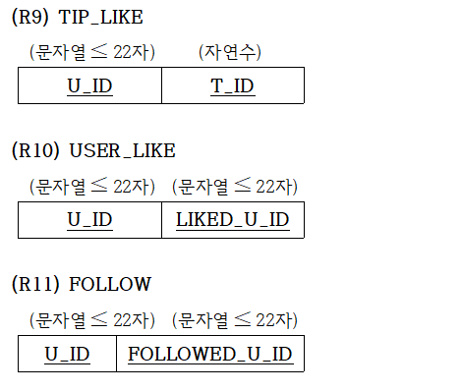
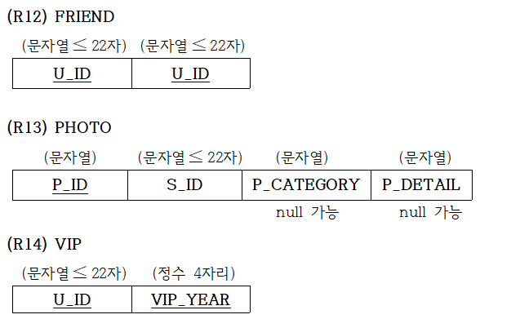
03 RELATIONAL DB SCHEMA
Relational Schema and Domain Constraints

Slide 16

004
REVIEW

Slide 17



04 REVIEW
Details
DERIVED
ATTRIBUTES
APPLICATION
TO REALITY
MULTIVALUED

Slide 18



04 REVIEW
Details
REDUCING
REDUNDANCY
CONSIDER
VARIATIONS
EFFICIENCY

Slide 19
THANK YOU

